Slide 1
Boruta Algorithm |
Feature selection

Slide 2
Agenda
What is feature selection | Why is it required
Boruta Algorithm | How does it work
Other Algorithms for feature selection
Pros and Cons of Boruta Algorithm

Slide 3

Feature selection
Feature selection is required as we have access to too many predictors for a predictive model now a days.
But not every variable is important for prediction.
Hence it is essential to identify important variables and remove redundant variables.
Before building a predictive model, it is generally not known the exact list of important variable which returns accurate and robust model.

Slide 4
Boruta Algorithm
Step 1: Create shadow features or random attributes for each actual feature
Step 2: Fit a random forest to the original and shadow features
Step 3: Calculate the importance for all the features (actual and shadow)
Step 4: A feature is importance in a single run if its importance is higher than maximum importance of all shadow features (MIRA)
Step 5: Eliminate all features whose importance is low enough
Step 6: Repeat all steps if features are tagged tentative

Slide 5
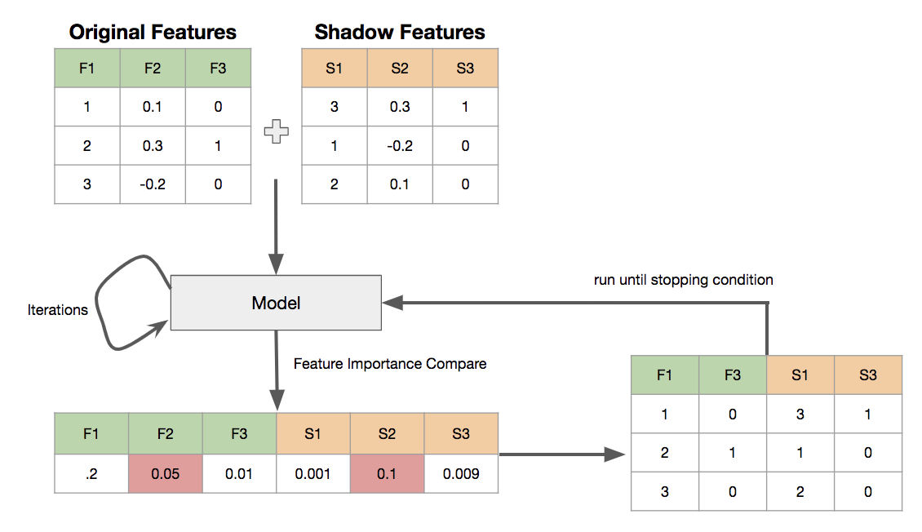
Boruta Algorithm contd..

Slide 6
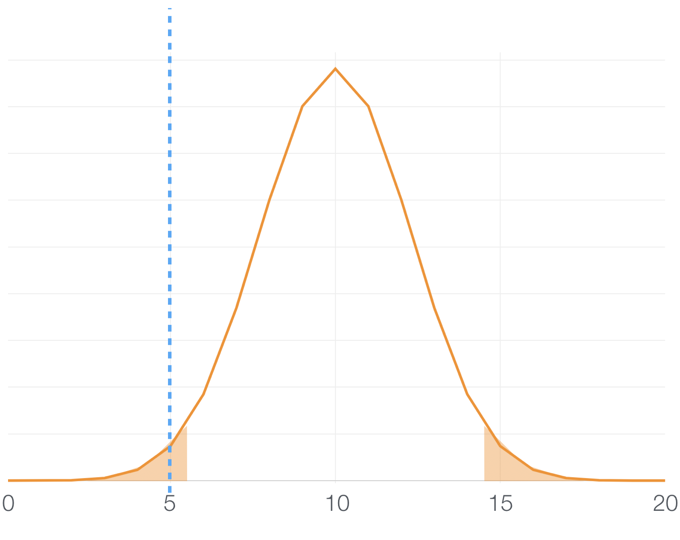
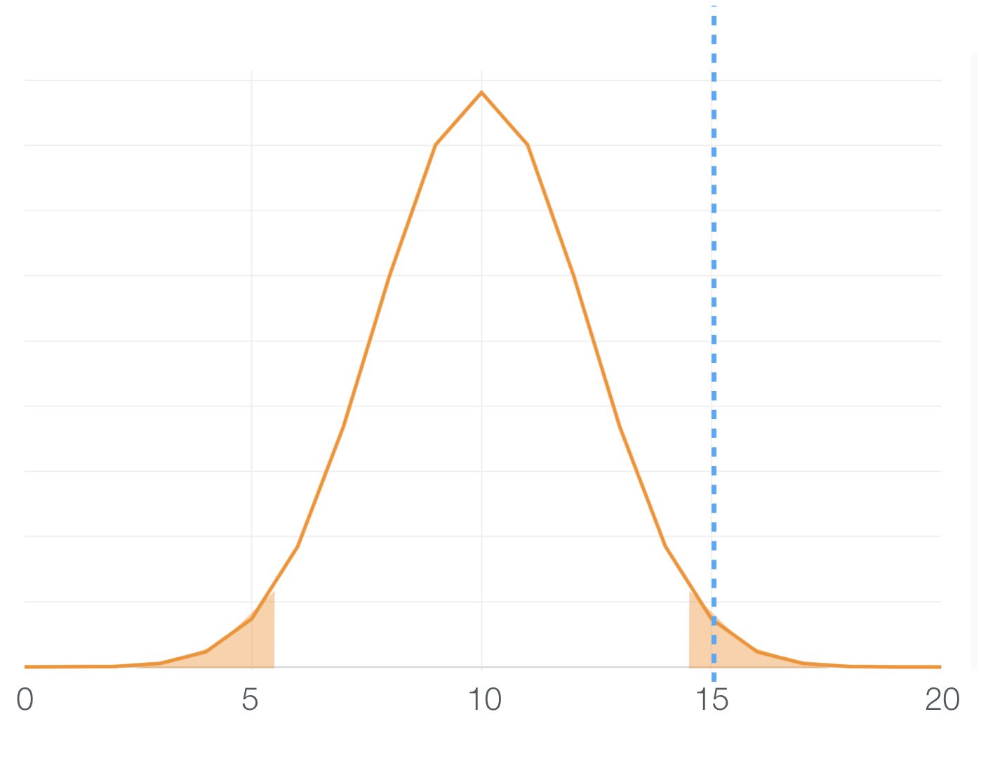
Boruta Algorithm contd..
Useful Variables
Useless Variables
Null Hypothesis : There is no difference between shadow variable and actual variable

Slide 7
Other algorithms for feature selection
Variable Importance from Machine Learning Algorithms
Lasso Regression (elastic net)
Step wise Forward and Backward Selection
Relative Importance from Linear Regression
Recursive Feature Elimination (RFE)
Genetic Algorithm

Slide 8
Pros – Cons
PROS:
It works well for both classification and regression problem
It takes into account multi-variable relationships
It is an improvement on random forest variable importance measure which is a very popular method for variable selection
It follows an all-relevant variable selection method in which it considers all features which are relevant to the outcome variable
CONS:
Very high computational time
If a variable is declared tentative there is no way on classifying it as important or un-important
It is important to handle collinearity after getting important variables from boruta.

Slide 9
Thank You!

