Slide 1
Linear Regression |
Part 2

Slide 2
Agenda
Linear regression Assumptions
Popular regularization techniques for linear Regression
Ridge
Lasso
Elastic Net

Slide 3
Assumptions of Linear Regression
There are four assumptions associated with a linear regression model:
Linear and Additive: The relationship between X( independent ) and the mean of Y( dependent variable) is linear. An additive relationship suggests that the effect of X on Y is independent of other variables
Homoscedasticity: The variance of residual is the same for any value of X
Autocorrelation: There should be no correlation between the residual (error) terms. Absence of this phenomenon is known as Autocorrelation
Multicollinearity: The independent variables should not be correlated

Slide 4
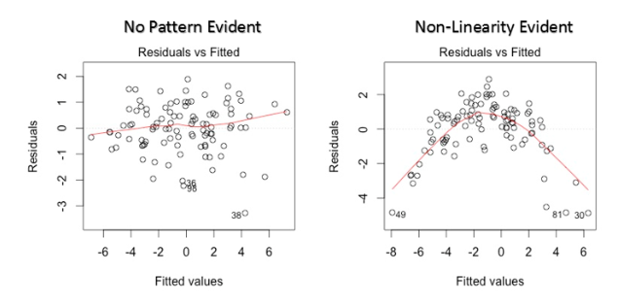
Assumptions of Linear Regression – How to check
Linear and Additive: Look for residual vs. fitted value plot
Solution: To overcome the issue of non-linearity, you can do a non linear transformation of predictors such as log (X), √X or X² transform the dependent variable

Slide 5
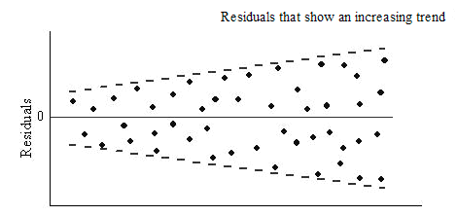
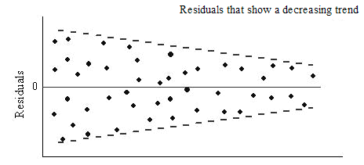

Assumptions of Linear Regression – How to check
Homoscedasticity : The residual vs. fitted values plot, if heteroskedasticity exists, would exhibit a funnel shape pattern. We can also use Breusch-Pagan / Cook – Weisberg test or White general test to detect this phenomenon
The calculated p-value is 0.0065 which implies rejection of the null hypothesis of homoskedasticity
Solution: To overcome this, one way is to transform the response variable such as log(Y) or √Y or weighted least square method

Slide 6
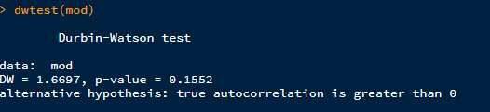
Assumptions of Linear Regression – How to check
Autocorrelation : We can use Durbin – Watson (DW) statistic. It must lie between 0 and 4. If DW = 2, implies no autocorrelation, 0 < DW < 2 implies positive autocorrelation while 2 < DW < 4 indicates negative autocorrelation. We can see residual vs. time plot and look for the seasonal or correlated pattern in residual values
The calculated DW value is not close to 2, also the p value is much grater than 0.05, hence we can conclude that autocorrelation exists and is a positive autocorrelation
Solution: Change the model specification to obtain non-auto correlated errors. For example, run a regression with ARMA errors (easy to implement by arima or auto.arima functions in R including the regressors via the parameter xreg) or include lags of dependent variable as regressors

Slide 7
Assumptions of Linear Regression – How to check
Multicollinearity : We can use scatter plot to visualize correlation effect among variables. We can also use VIF factor. VIF value <= 4 suggests no Multicollinearity whereas a value of >= 10 implies serious Multicollinearity.
VIF = 1 / (1 - R^2)
It is a measure of colinearity among predictor variables within a multiple regression. It is calculated by taking the the ratio of the variance of all a given model's betas divide by the variane of a single beta if it were fit alone.
Solution: We can remove the variables with high VIF values or create interaction variables and use those instead of the actual variables

Slide 8
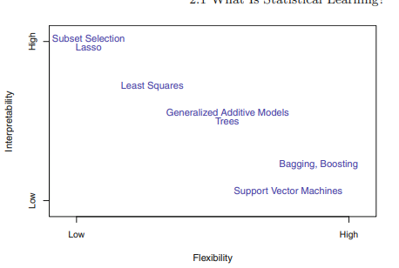
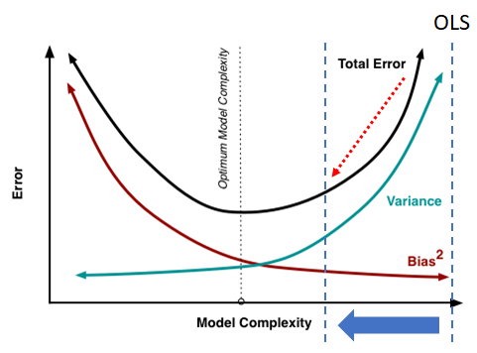
Why is there a need for Ridge/Lasso ?
To increase interpretability
To reduce model complexity

Slide 9

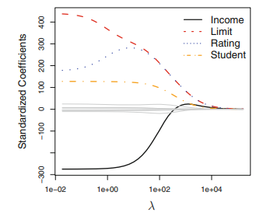
Ridge Regression
Equation
λ is a tuning parameter
λ ∑j β2 is called the shrinkage penalty.
When λ = 0, the penalty term has no effect, and ridge regression will produce the least squares estimates. However, as λ → ∞, the impact of the shrinkage penalty grows, and the ridge regression coefficient estimates will approach zero.
Selecting a good value for λ is critical; where we use cross-validation
Disadvantage : It shrinks the unimportant betas but at the end will select all feature variables

Slide 10

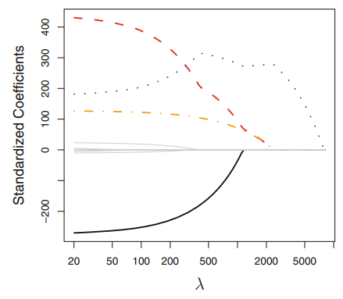

Lasso Regression
Equation
λ is a tuning parameter
λ ∑j β is called the lasso penalty.
To overcome the disadvantage of Ridge regression, the lasso uses an l1 penalty instead of an l2 penalty
Depending on the value of λ, the lasso can produce a model involving any number of variables. In contrast, ridge regression will always include all of the variables in the model, although the magnitude of the coefficient estimates will depend on λ.
Disadvantage : It does not handle highly correlated variables very well, the coefficients can be erratic

Slide 11
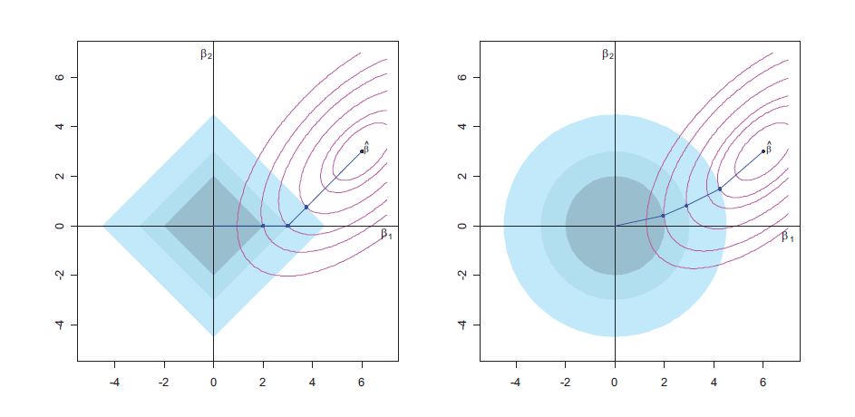
Geometric Interpretation of Ridge and Lasso Regression
Lasso – L1 Norm
Ridge – L2 Norm

Slide 12

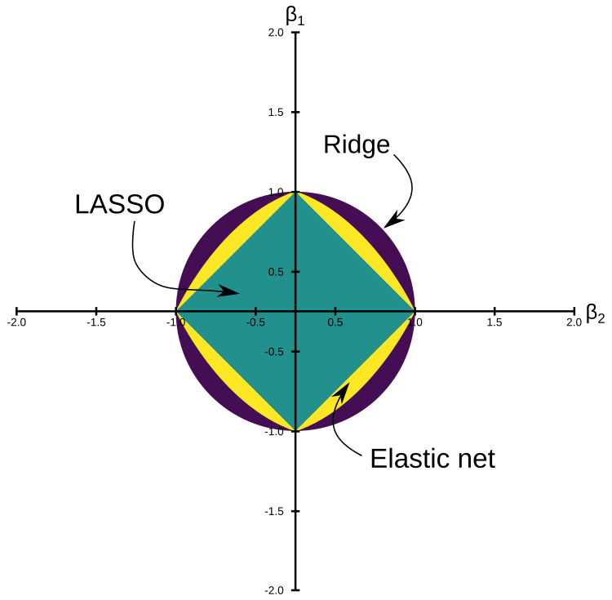
Elastic Net Regression – Combination of Ridge and Lasso
Equation (Ridge + Lasso )
Here α is the mixing parameter between ridge (α = 0) and lasso (α = 1).
To overcome the disadvantage of both Ridge and Lasso regression, elastic net is used.
Elastic Net reduces the impact of different features while not eliminating all of the features.
We can tune the value of alpha between 0 and 1 to optimize the elastic net equation

Slide 13
Reading material

Slide 14
Thank You!

