Slide 1

Capstone Project nopCommerce Test Automation
By Shivam Shivhare
Using Selenium, TestNG & Java

Slide 2
Introduction
This project automates functional testing of the nop-Commerce website.
Covered modules include Registration, Login, Submodules navigation, Electronics section, Shopping Cart, and Checkout.
Implemented using Selenium WebDriver, TestNG, Java, and Excel integration.
Ensures accuracy, reduces manual effort, and validates end-to-end user workflows.

Slide 3
Tools & Technologies
Programming Language: Java
Testing Framework: TestNG
Automation Tool: Selenium WebDriver
Data Management: Excel Integration (Apache POI)
Reporting: TestNG Reports & Custom Listener
IDE: Eclipse
Build Tool: Maven

Slide 4
Test Scenarios
1. User Registration
2. Login with valid, invalid, and empty credentials
3. Verify nop-Commerce submodules
4. Verify Electronics and its submodules
5. Cell Phone selection and validation
6. Add to Cart functionality
7. Shopping Cart verification
8. Checkout process with billing address validation

Slide 5
Test Flow
Launch browser and navigate to nopCommerce
Register a new user
Perform Login validation
Navigate and verify submodules
Add items from Electronics -> Cell Phones
Add selected phone to Shopping Cart
Verify Shopping Cart contents
Proceed through Checkout process

Slide 6
Excel Integration
Test data such as Registration details, Login credentials, and Checkout information are stored in Excel sheets.
Apache POI library is used for reading and writing Excel files.
Ensures data-driven testing with reusable test cases.
Reduces hardcoding and improves flexibility.

Slide 7
Reporting
TestNG default reports are generated after execution.
Custom Listener (ITestListener) implemented for enhanced logging.
Screenshots captured for failed test cases.
Final report provides step-wise execution results.
Also Used Extent-Report for well structured report.

Slide 8
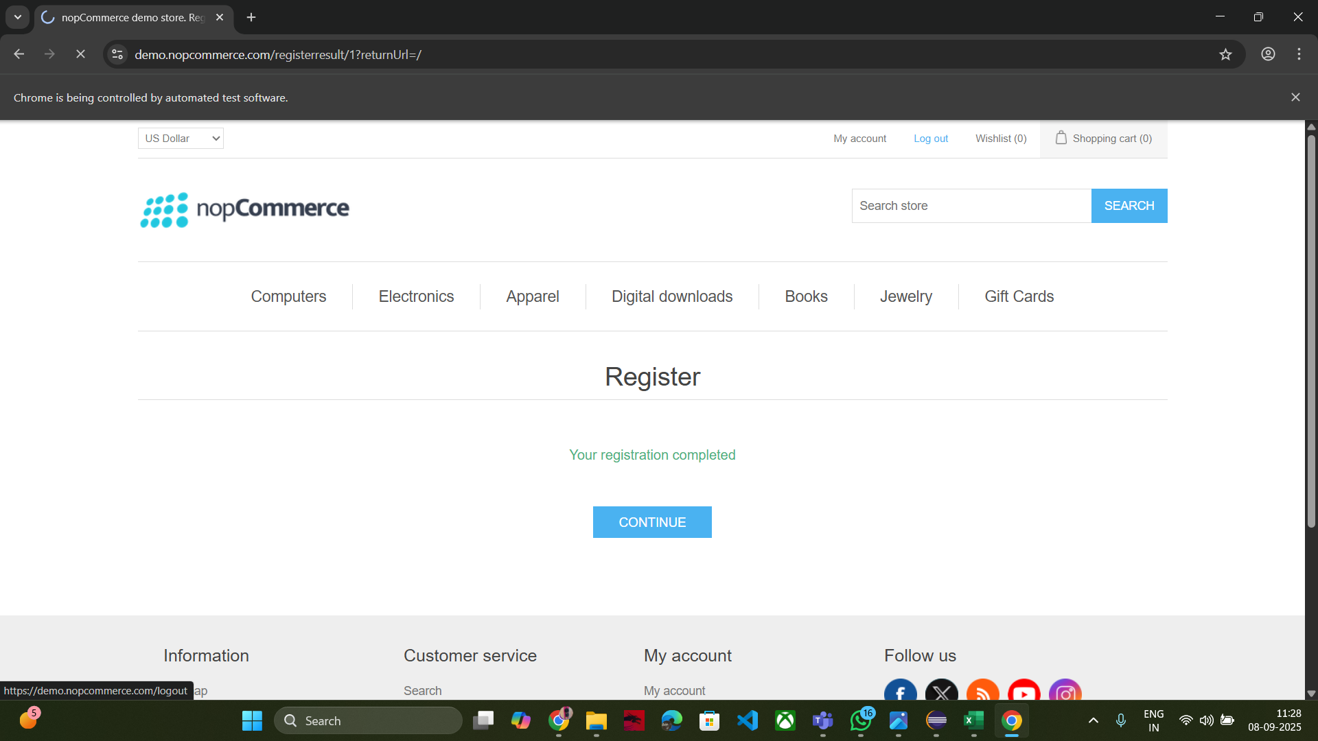
Screenshots
Screenshot of Registration Test

Slide 9
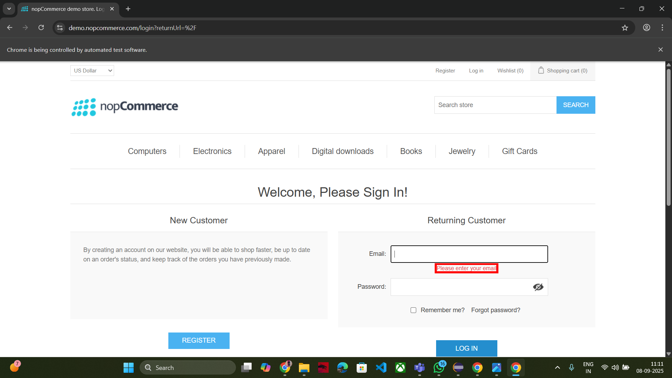
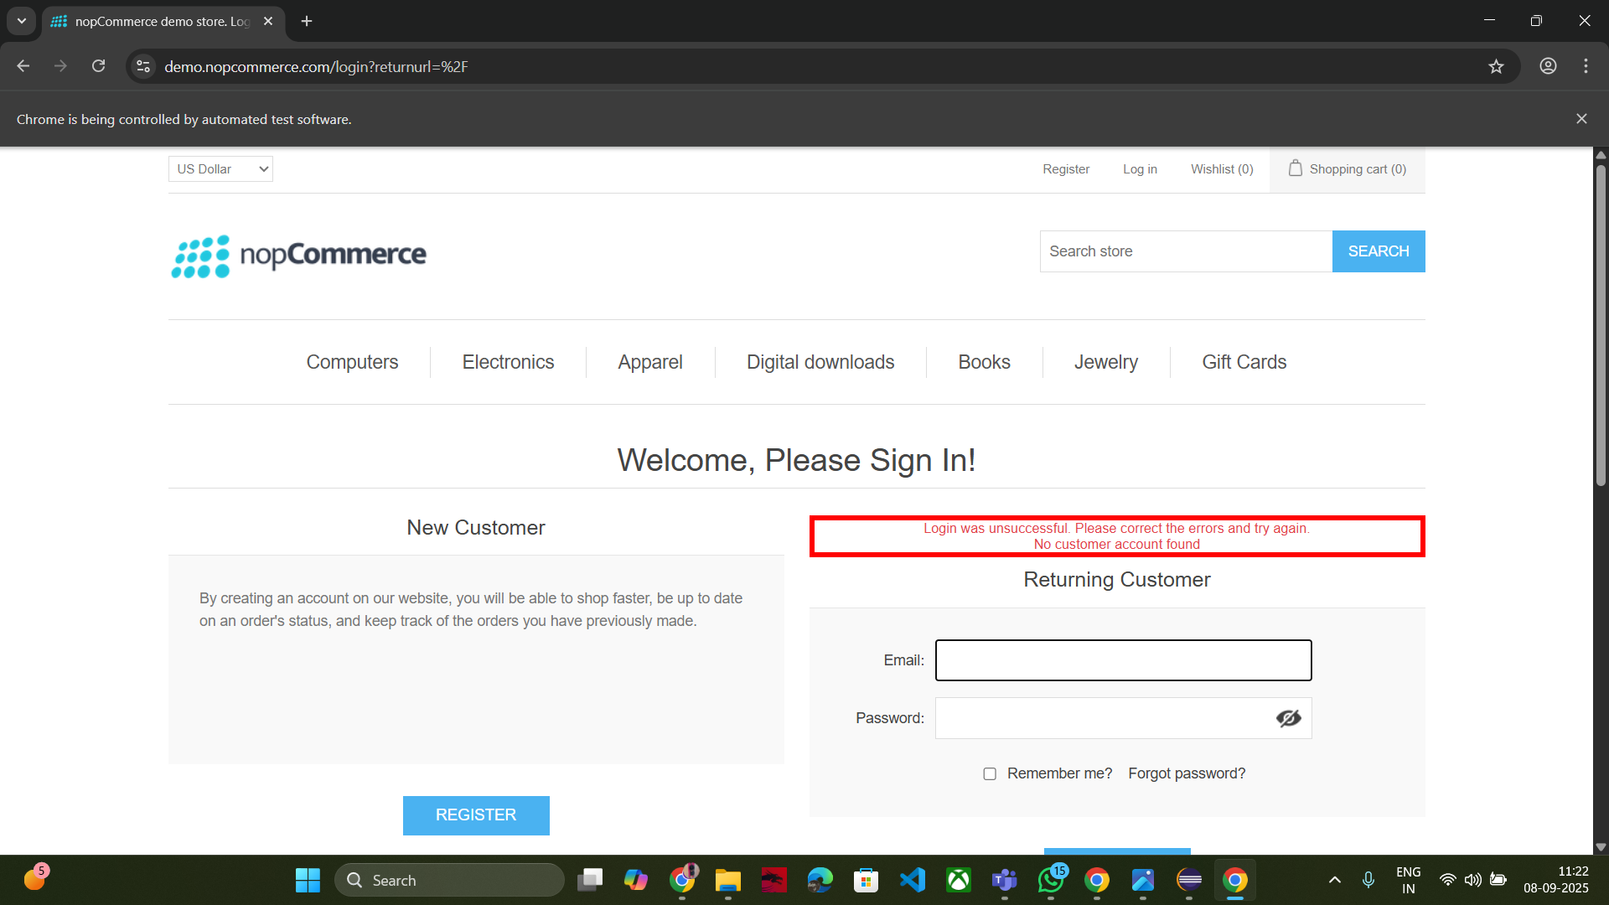
Screenshot of Login Test

Slide 10
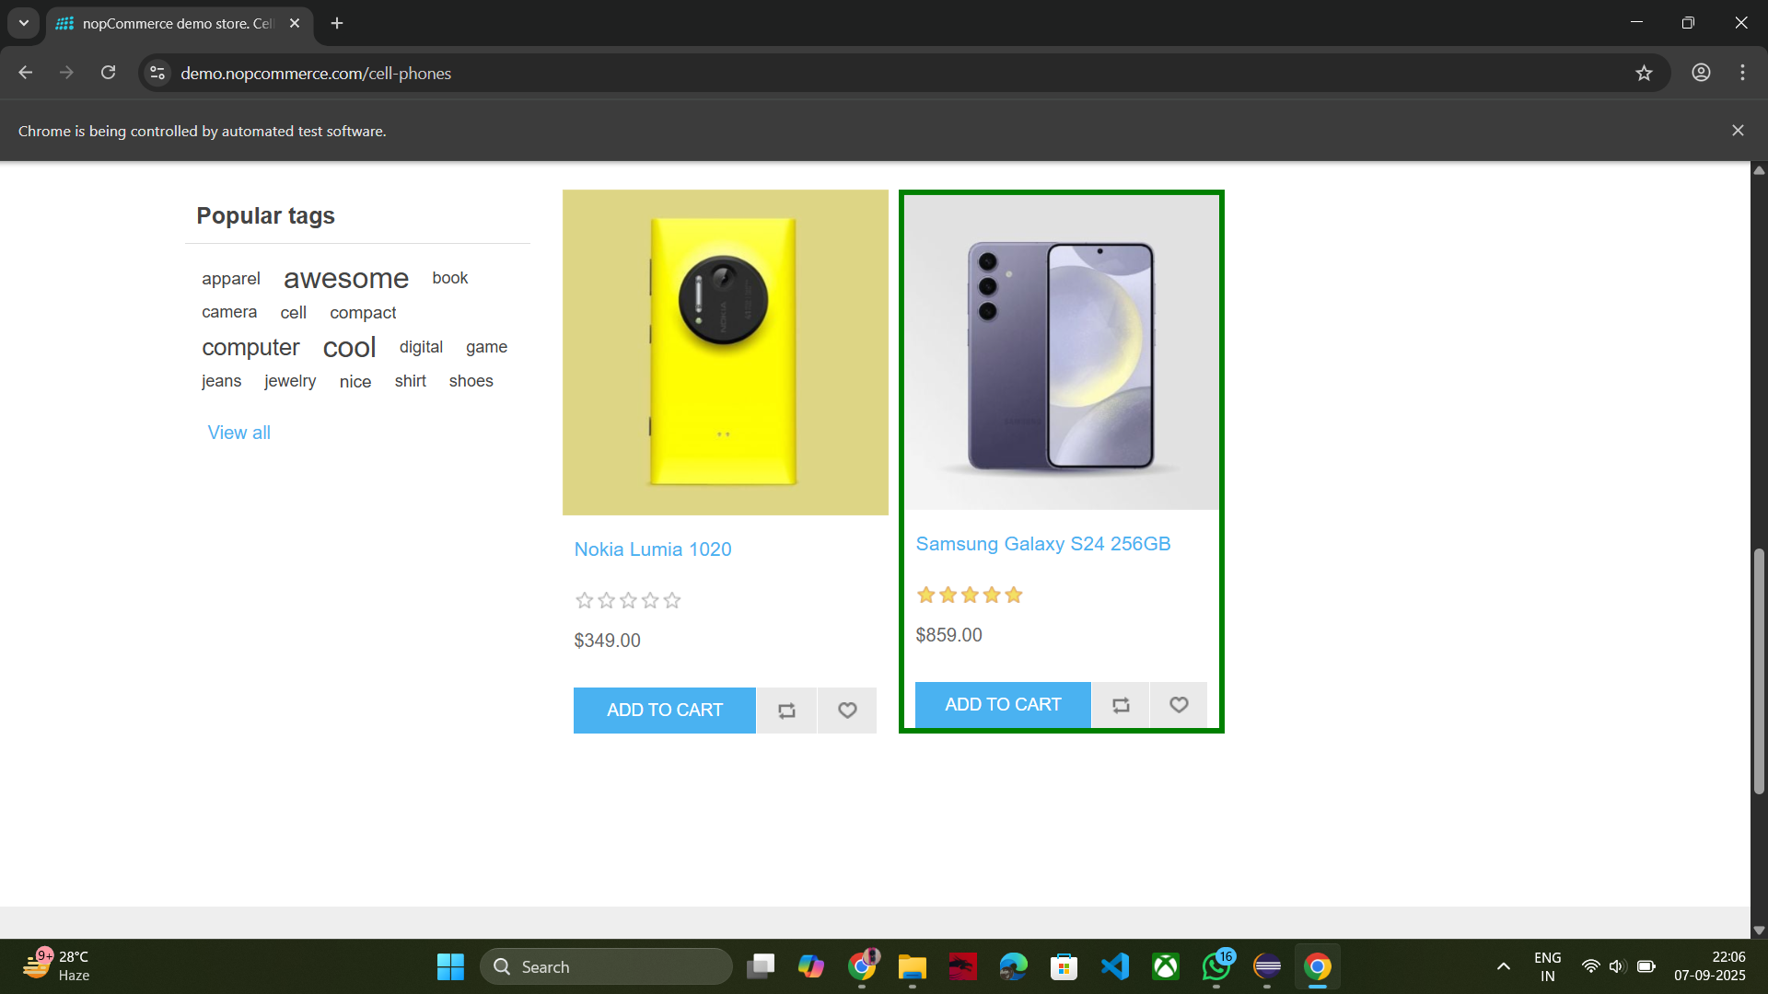
Screenshot of Selecting Required Product

Slide 11
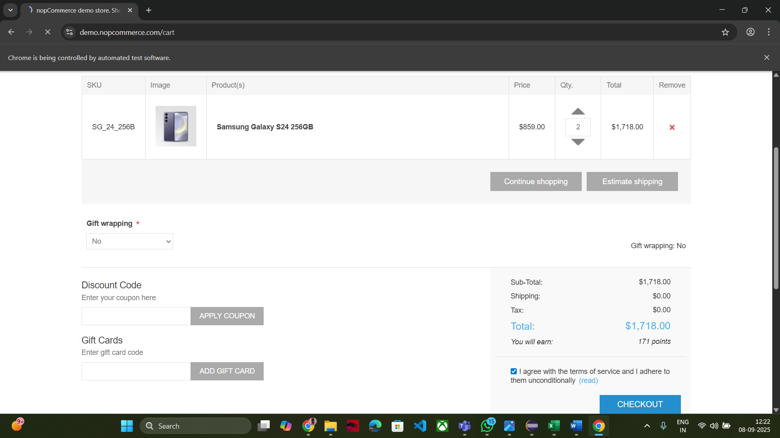
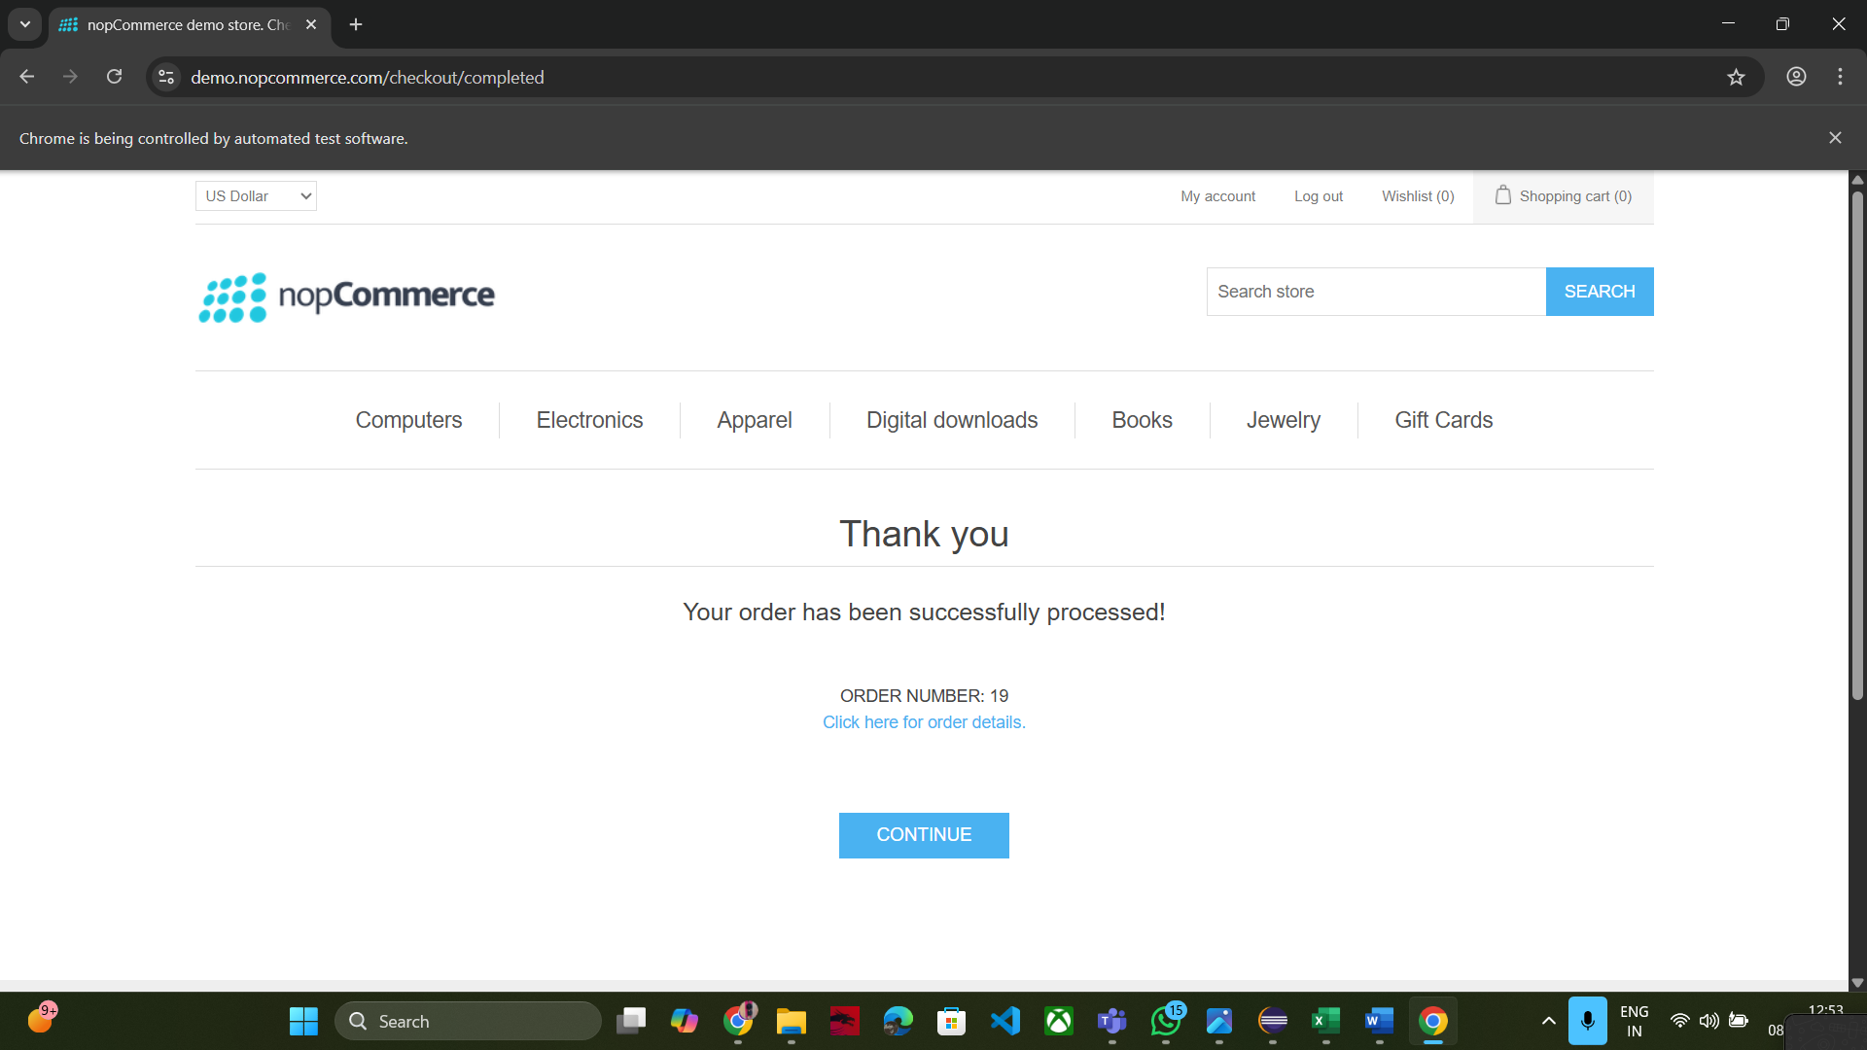
Screenshot of Checkout Process

Slide 12
Conclusion
Automated testing of key functionalities in nopCommerce website.
Increased test coverage and reliability.
Reduced manual testing effort.
Framework can be extended for more modules in future.
Demonstrates integration of Selenium, TestNG, and Excel in a real-world scenario.

