Slide 1
Power Consumption Dataset
Time-Series Modeling (AR, MA, ARIMA)
Shivi Anand, Edvina Buyuksoy
DSO 424: Business Forecasting

Slide 2
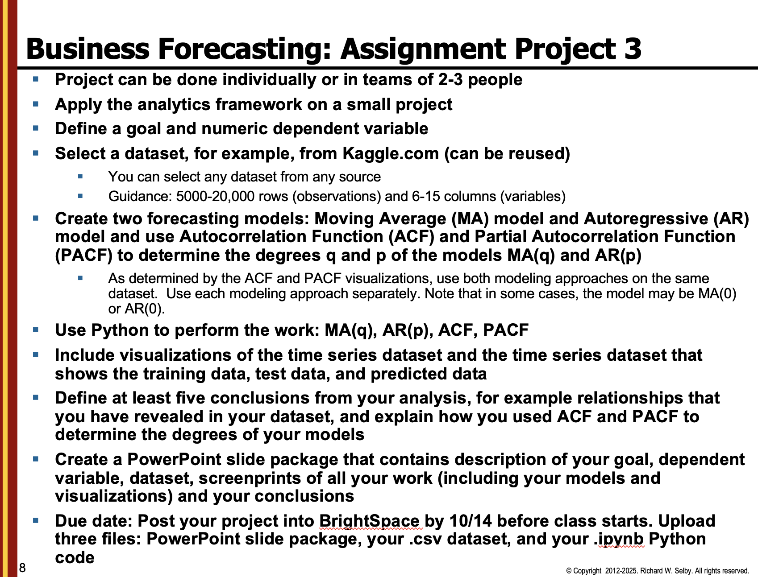
Notes:
Analytics framework = Goal definition, Data collection, Data analysis and modeling, Interpretation, action, and feedback

Slide 3

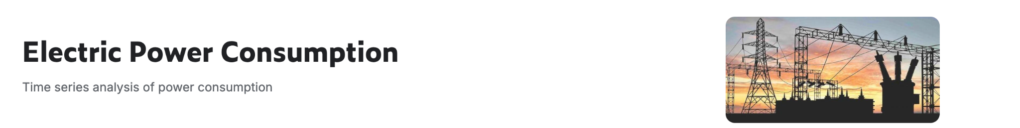
Goal Definition
Goal: Analyze and forecast daily electricity consumption patterns in the city of Tetouan, Morocco, using historical power usage and weather data. The objective is to build time series forecasting models, Autoregressive (AR), Moving Average (MA), and ARIMA, to predict future power demand and evaluate which model provides the most accurate forecast
Dependent variable: PowerConsumption_Zone2
Notes:
Create two forecasting models: Moving Average (MA) model and Autoregressive (AR) model and use Autocorrelation Function (ACF) and Partial Autocorrelation Function (PACF) to determine the degrees q and p of the models MA(q) and AR(p). As determined by the ACF and PACF visualizations, use both modeling approaches on the same dataset. Use each modeling approach separately. Note that in some cases, the model may be MA(0) or AR(0

Slide 4
Energy Consumption Dataset
52,416 observations
Recorded at 10-minute intervals for one year
Every observation has 9 feature columns as described below
Data Dictionary:
Date Time: Time window of ten minutes
Temperature: Weather Temperature
Humidity: Weather Humidity
Wind Speed: Wind Speed
General Diffuse Flows: describes low-temperature (< 0.2° to ~ 100°C) fluids that slowly discharge through sulfide mounds, fractured lava flows, and assemblages of bacterial mats and macrofauna
Diffuse Flows
Zone 1 Power Consumption
Zone 2 Power Consumption
Zone 3 Power Consumption
Notes:
Insert ss

Slide 5
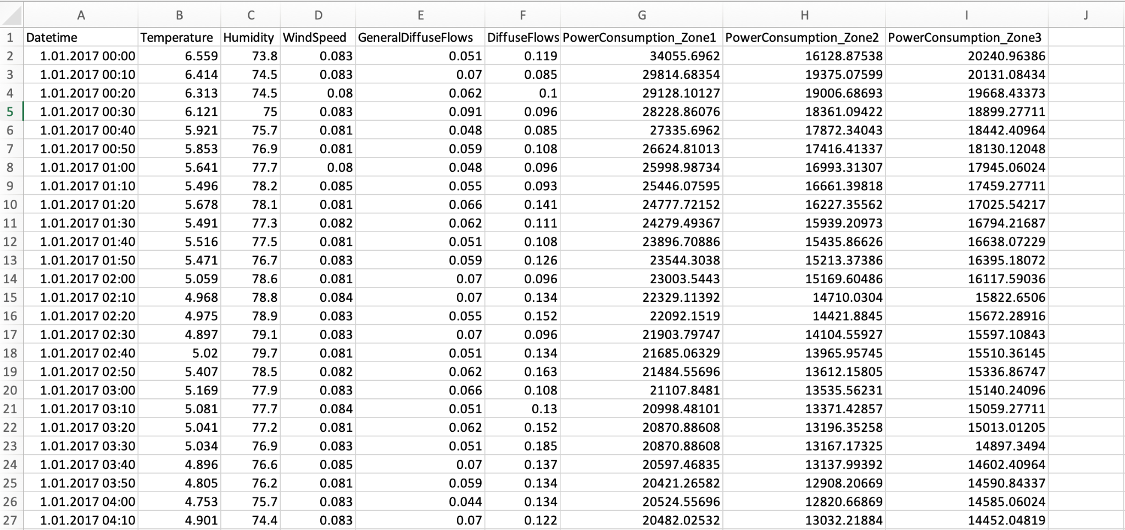
Dataset Snapshot

Slide 6
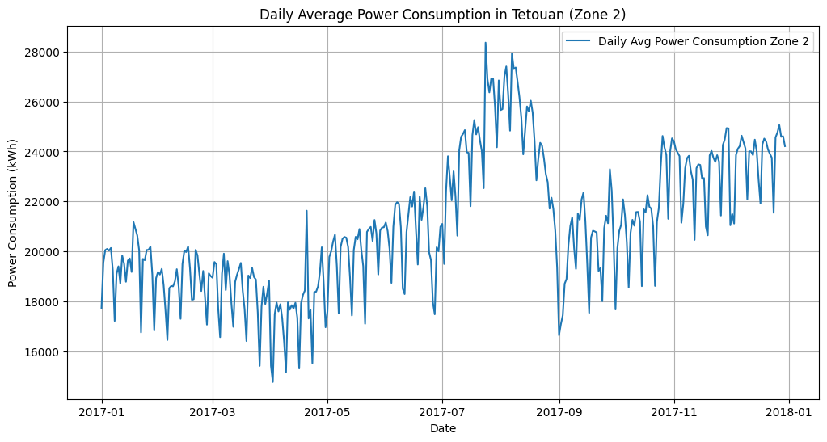
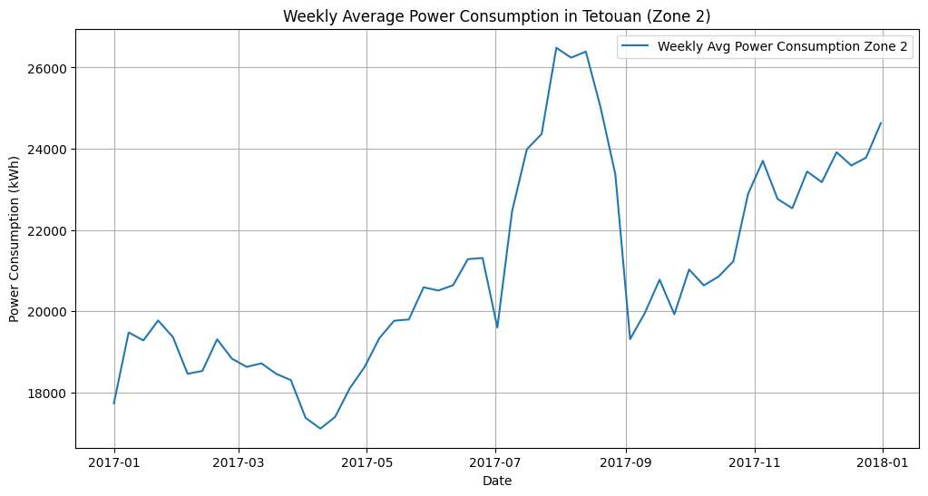
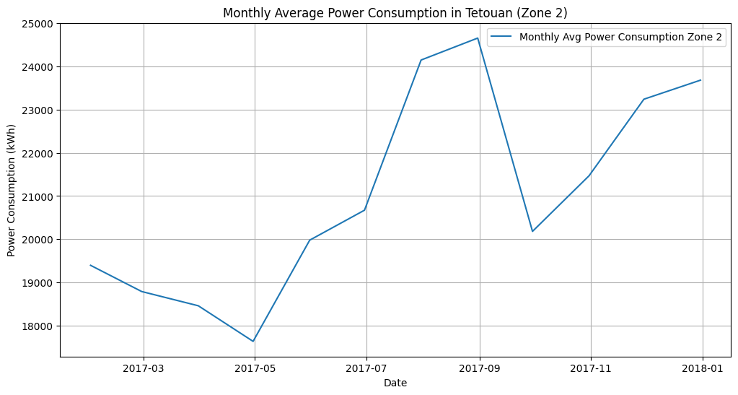
Tested Daily, Weekly, and Monthly Time Series
Tested the dataset at three different time frequencies to select the best level for forecasting
Daily series had clear autocorrelation, but weekly and monthly series showed none, with all lags falling within the confidence intervals
Loss of autocorrelation in these time series is likely a result of aggregating averages
In terms of stationarity, the daily and weekly series achieved stationarity after one differencing, whereas monthly required two levels of differencing
So, we proceeded with daily time series for the models

Slide 7
Preparing the Dataset
To build a clean, stationary daily series for forecasting:
Converted Date Time to a datetime object and set it as the index
Resampled 10-minute readings into daily averages
Ran our first ADF test on the daily series, and found our data was non-stationary
Applied first differencing (d = 1) to smooth the data and remove potential trends
Reran the ADF test, which returned “Stationary”, which indicated our data was now suitable for AR/MA/ARIMA modeling

Slide 8
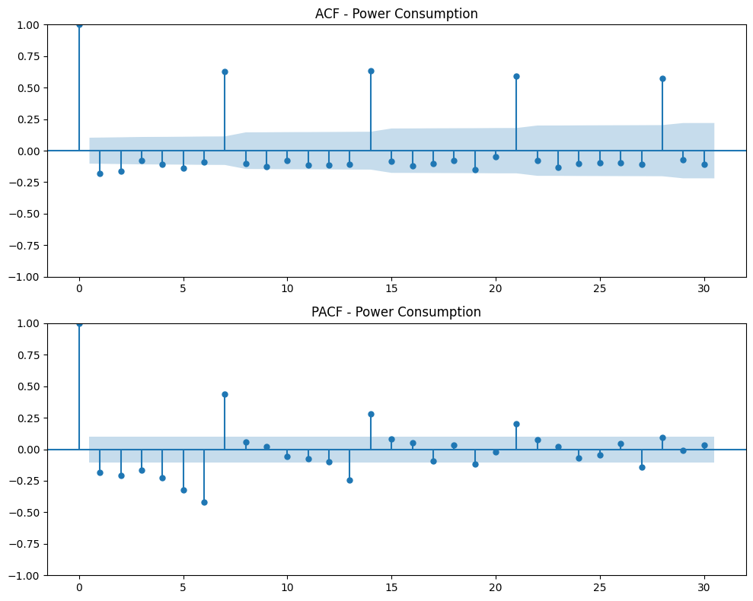
ACF and PACF Models
Interpretation of Plots:
The ACF plot shows spikes at lag 7, 14, and 21, indicating a repeating pattern every 7 time periods (likely a weekly seasonal cycle)
The PACF plot also shows a spike at lag 7 before values taper off, further implying that the autoregressive relationship repeats weekly
Therefore, we chose to use a lag of 7 for both our MA and AR model to capture this weekly dependence
Model:
The model uses p = 7 and q = 7, capturing both autoregressive and moving-average dependencies over a weekly cycle
Notes:
What the p and q are, interpretation of it + image

Slide 9
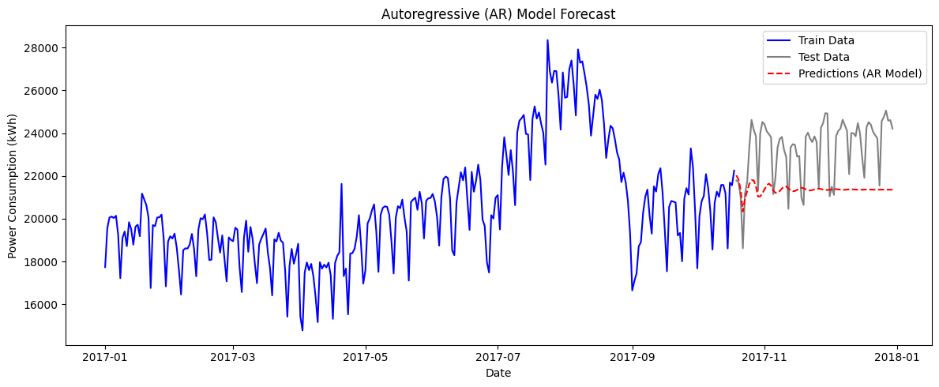
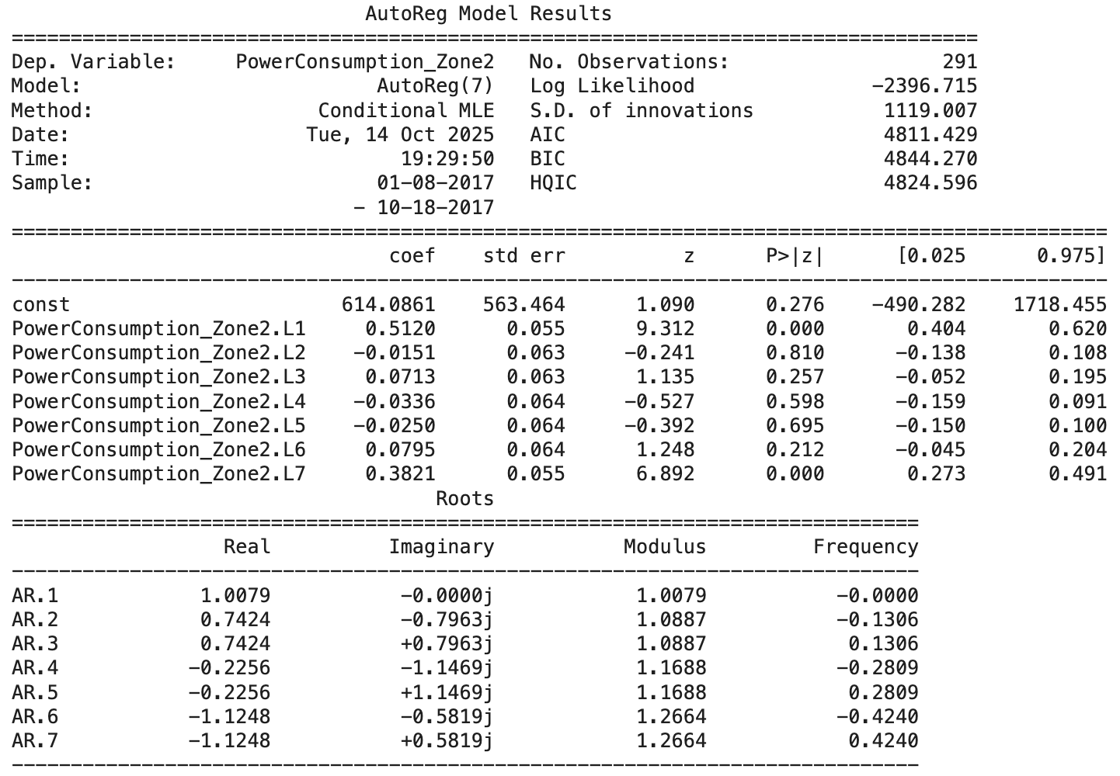
Autoregressive (AR) Model
We fitted an AR(7) model to Zone 2 power consumption
Model captured overall patterns in the training data, but forecasted a flatten out for the test period, which suggests a limited ability to follow the daily fluctuations
Seasonal or external drivers are likely not captured by lag terms alone
Looking at coefficients, Lag 1 showed that yesterday’s power usage had a strong influence on today’s
Looking at p-values, Lags 1 and 7 were statistically significant (p < 0.05)
Notes:
First graph

Slide 10

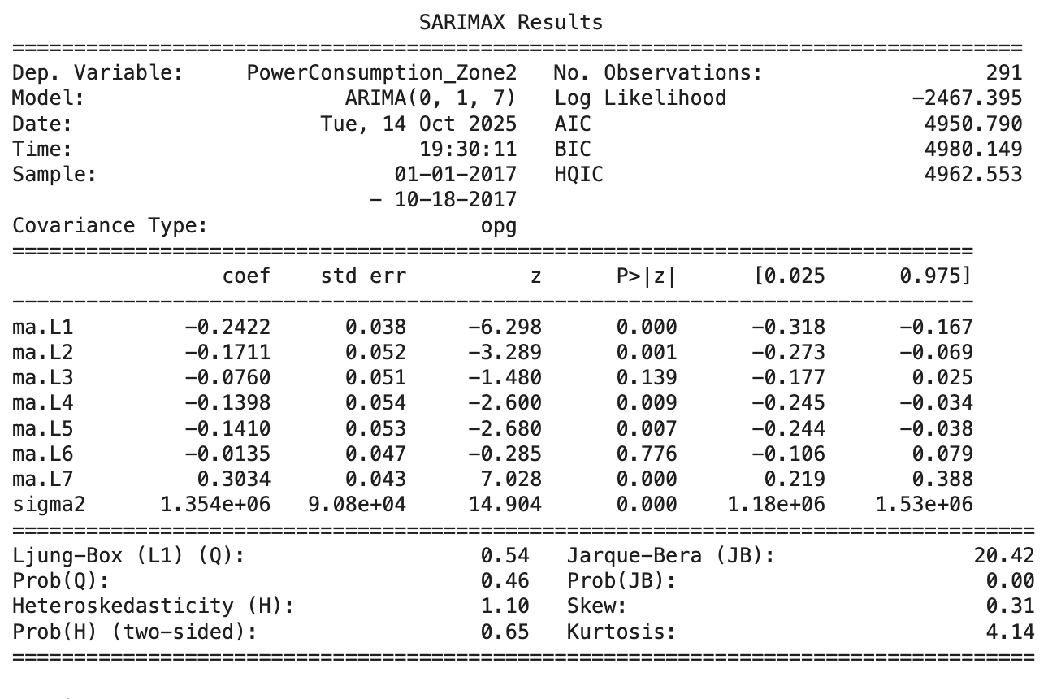
Moving Average (MA) Model
We fitted an MA(7) model to Zone 2 power consumption
The model captures short-term fluctuations but flattens predictions over time
Most coefficients (lags 1, 2, 4, 5) are negative and statistically significant (p < 0.05), which suggests short-term fluctuations in consumption are followed by corrections in the opposite direction
High consumption one day is balanced by lower consumption. We found this to be reasonable as energy usage naturally fluctuates day to day — people don’t consume the same amount of electricity daily
Lag 7 has a positive and significant coefficient, indicating a weekly cycle, where consumption patterns repeat roughly every seven days
Notes:
First graph

Slide 11
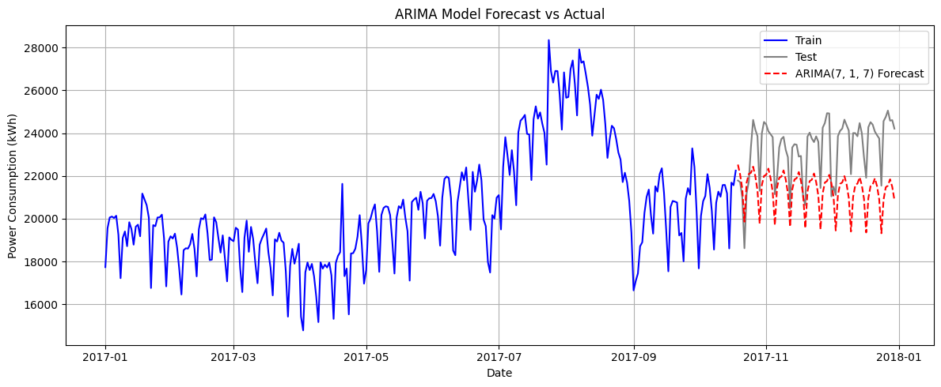
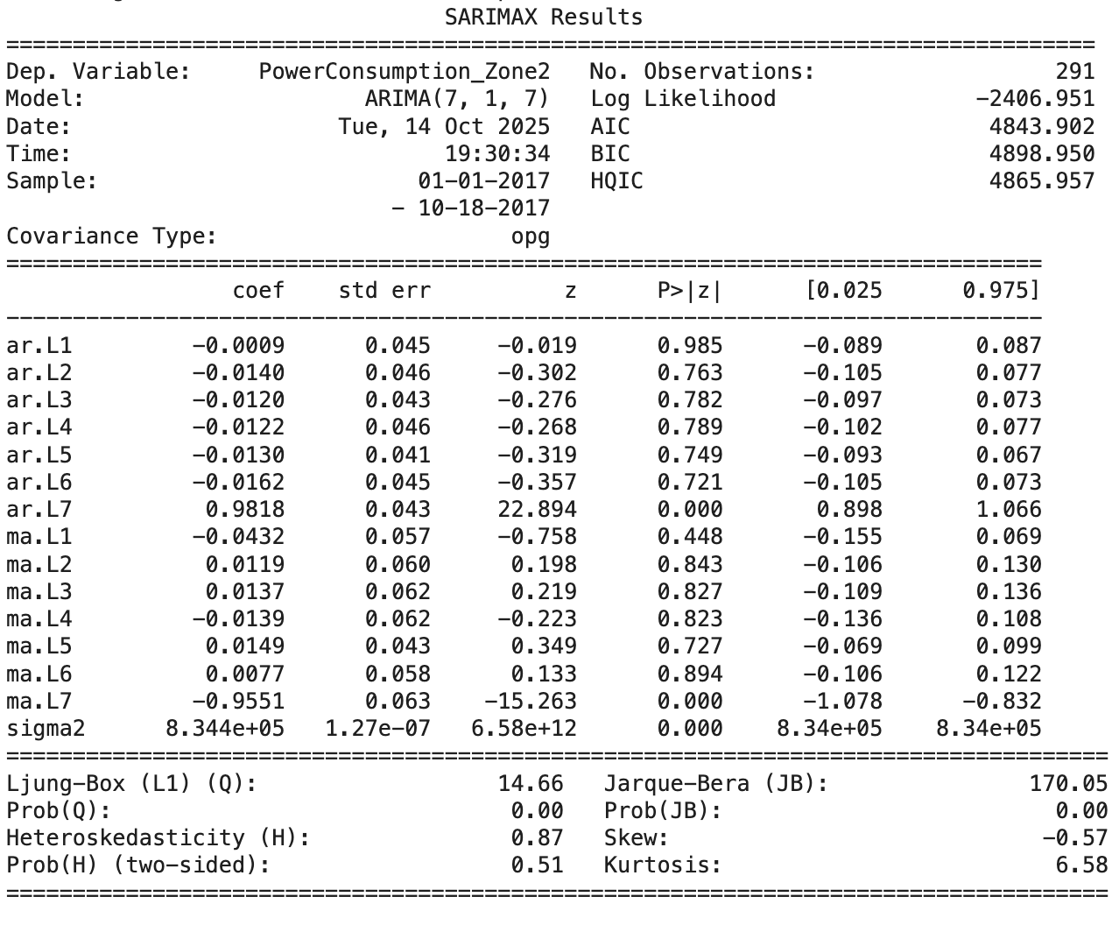
Autoregressive Integrated Moving Average (ARIMA)
The ARIMA model forecasts follow the overall weekly rhythm but remains smoother than actual consumption
It captures cyclical trends but underestimates fluctuations, which is normal when data has high daily variability
Consistent with the AR and MA models discussed previously, AR(7) and MA(7) terms are statistically significant (p<0.05)
Notes:
First graph

Slide 12
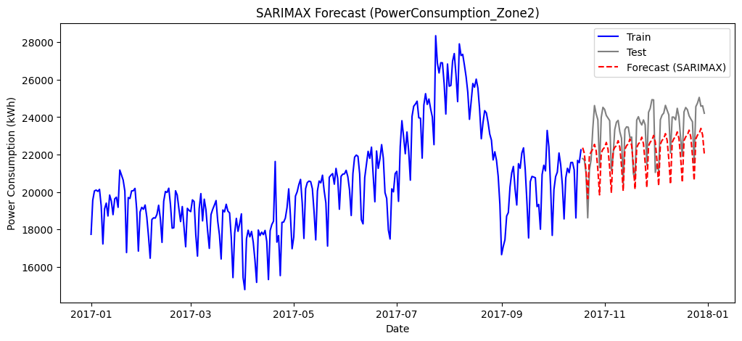
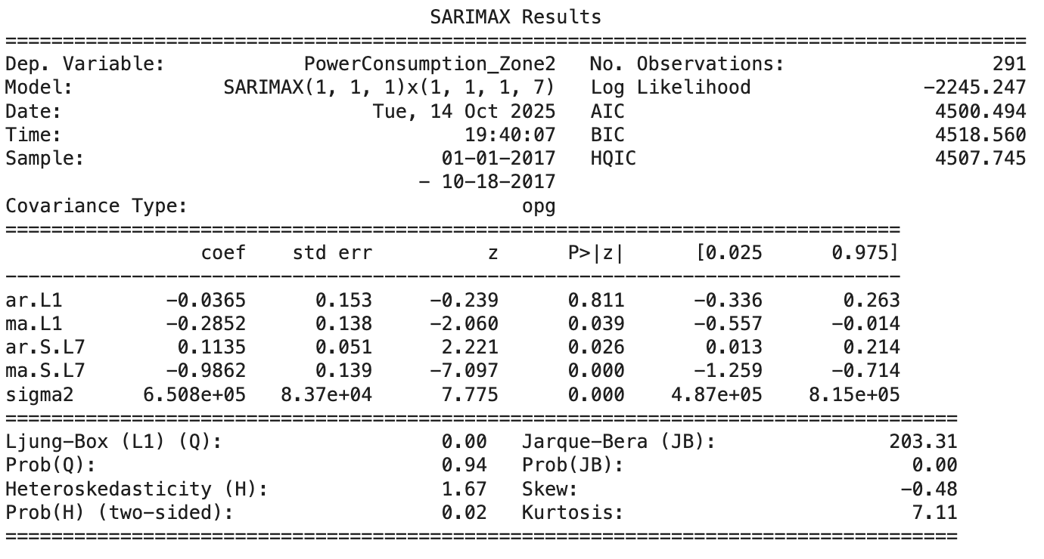
Seasonal Autoregressive Integrated Moving Average (SARIMAX)
Weekly Seasonality: Both Seasonal AR(7) (p = 0.026) and MA(7) (p = 0) are significant, confirming a pattern where power consumption roughly repeats each week and adjusts smoothly based on the previous week’s residuals
SARIMAX forecast tracks the gray test data far better than the others. It captures the weekly seasonality and minimizes error, making it the most reliable forecasting method of the four we explored. The forecast line is smoother than real data but still maintains realistic ups and downs
Notes:
First graph
SARIMAX delivers the best performance among all models by combining differencing, autoregression, moving average, and explicit weekly seasonality

Slide 13
Forecast Accuracy Across Models
According to the Root Mean Square Errors, the SARIMAX performed the best compared to the AR, MA, and ARIMA models. ARIMA captured some seasonality, but SARIMAX significantly reduced the error of the prediction
The data has a clear, periodic autocorrelation in 7 day periods → weekly seasonality. This is verified by other sources that show increases in energy consumption on weekdays and decreases on weekends
The autocorrelation largely disappeared when the data was aggregated to weekly or monthly levels, so we may say that the observed dependencies are short-term/intra week changes
Model | RMSE
AR | 2320.37
MA | 2018.41
ARIMA | 2230.99
SARIMAX | 1418.17
Notes:
Insert ss

Slide 14
What we Learned and Why it Matters
Models:
Daily patterns drive energy consumption: Power usage follows clear weekly cycles with weekday peaks and weekend drops; short-term shocks smooth out shortly after they occur
SARIMAX performs best: It captures both short-term and weekly seasonality, giving the most accurate forecasts
Applying this insight to business context:
Utilities: Knowing weekly seasonality helps forecast weekday peaks and weekend drops, enabling more efficient power generation and load balancing
Industries: Understanding weekly demand cycles allows companies to schedule high-energy operations during low-demand periods and cut energy costs
Buildings: Recognizing weekday and weekend consumption patterns supports HVAC and lighting controls for more sustainable energy use
Notes:
Insert ss

