Slide 1
Power Consumption Dataset
Time-Series Modeling (Auto-ARIMA)
Shivi Anand, Edvina Buyuksoy
DSO 424: Business Forecasting

Slide 2
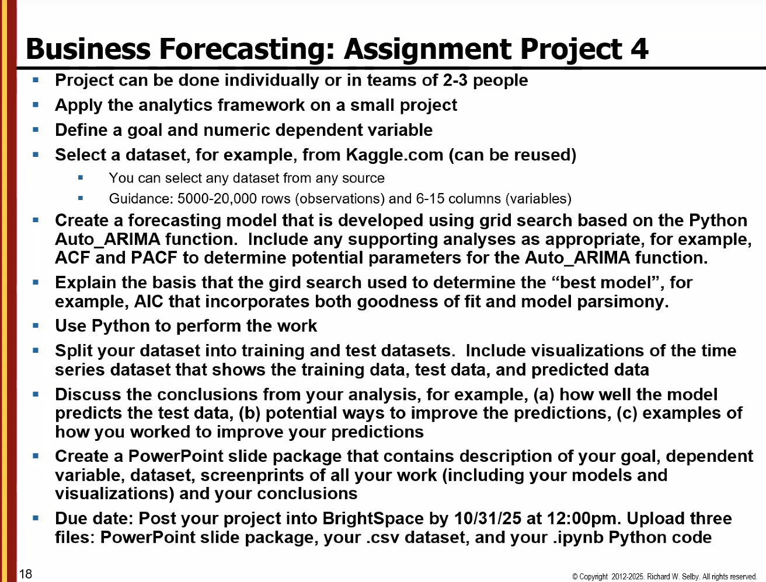
Notes:
Analytics framework = Goal definition, Data collection, Data analysis and modeling, Interpretation, action, and feedback

Slide 3

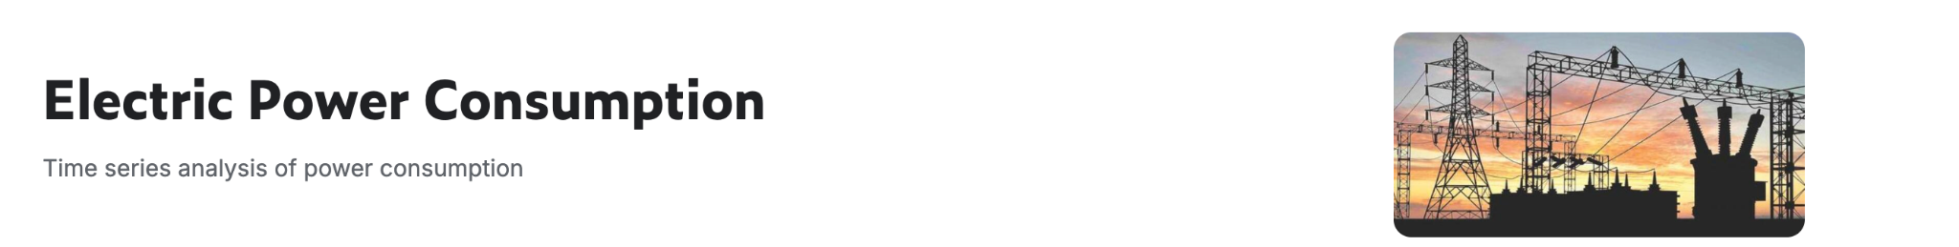
Goal Definition
Goal: Analyze and forecast daily electricity consumption patterns in the city of Tetouan, Morocco, using historical power usage and weather data. The objective is to evaluate Auto-ARIMA forecasting accuracy and identify ways to improve model performance
Dependent variable: PowerConsumption_Zone2
Notes:
Create two forecasting models: Moving Average (MA) model and Autoregressive (AR) model and use Autocorrelation Function (ACF) and Partial Autocorrelation Function (PACF) to determine the degrees q and p of the models MA(q) and AR(p). As determined by the ACF and PACF visualizations, use both modeling approaches on the same dataset. Use each modeling approach separately. Note that in some cases, the model may be MA(0) or AR(0

Slide 4
Energy Consumption Dataset
52,416 observations
Recorded at 10-minute intervals for one year
Every observation has 9 feature columns as described below
Data Dictionary:
Date Time: Time window of ten minutes
Temperature: Weather Temperature
Humidity: Weather Humidity
Wind Speed: Wind Speed
General Diffuse Flows: describes low-temperature (< 0.2° to ~ 100°C) fluids that slowly discharge through sulfide mounds, fractured lava flows, and assemblages of bacterial mats and macrofauna
Diffuse Flows
Zone 1 Power Consumption
Zone 2 Power Consumption
Zone 3 Power Consumption
Notes:
Insert ss

Slide 5
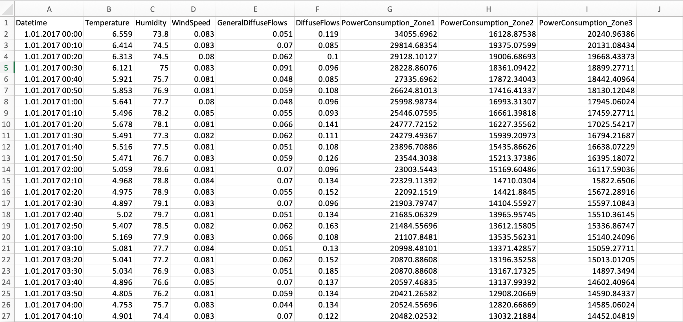
Dataset Snapshot

Slide 6
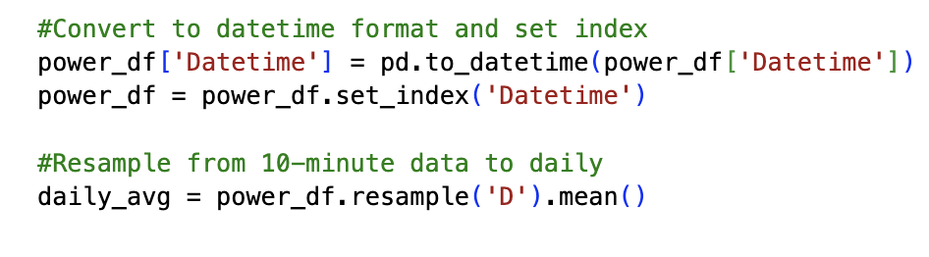
Preparing the Dataset
To build a clean, stationary daily series for forecasting:
Converted Date Time to a datetime object and set it as the index
Resampled 10-minute readings into daily averages
No differencing performed because that step is built in to the auto arima function.

Slide 7
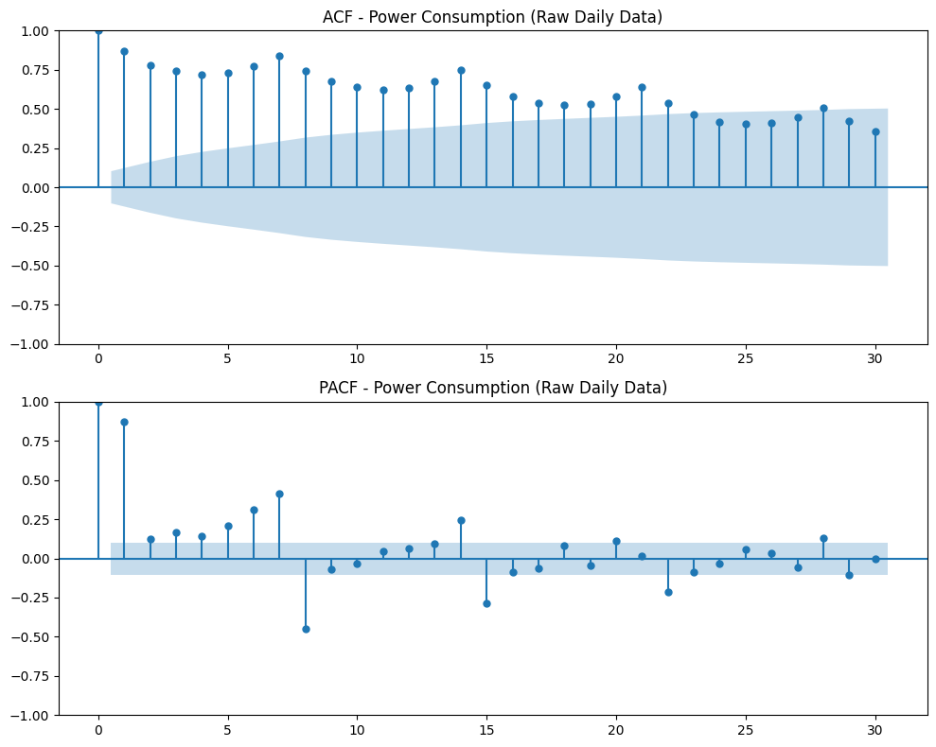
Exploratory ACF and PACF on Raw Data
ACF spikes at lags 7, 14 → strong repeating weekly pattern
PACF spikes at short lags → short-term autocorrelation
These plots guided the Auto-ARIMA seasonal setup (m = 7)
Because the data is not stationary, the autocorrelations remain strong over many lags, confirming the need for differencing, which Auto-ARIMA will automatically handle.
Notes:
What the p and q are, interpretation of it + image

Slide 8
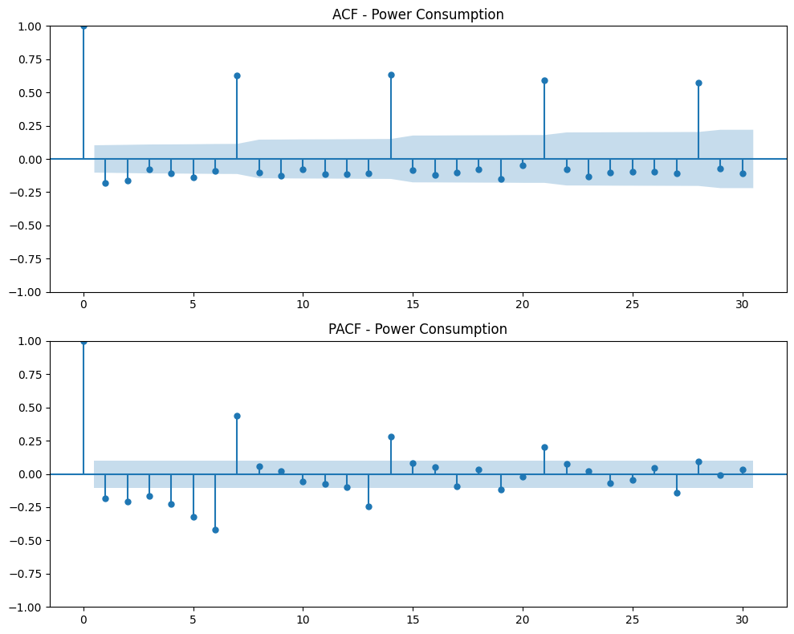
ACF and PACF Models
ACF and PACF after applying first differencing (d=1).
The series is now stationary, with autocorrelations fading quickly, indicating a stable mean
Auto-ARIMA detects and applies this differencing step
A noticeable spike at lag 7 remains, confirming a weekly seasonal pattern captured through the seasonal parameter(m=7)

Slide 9
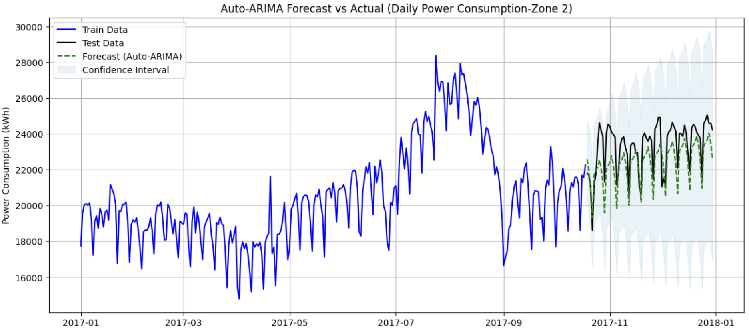
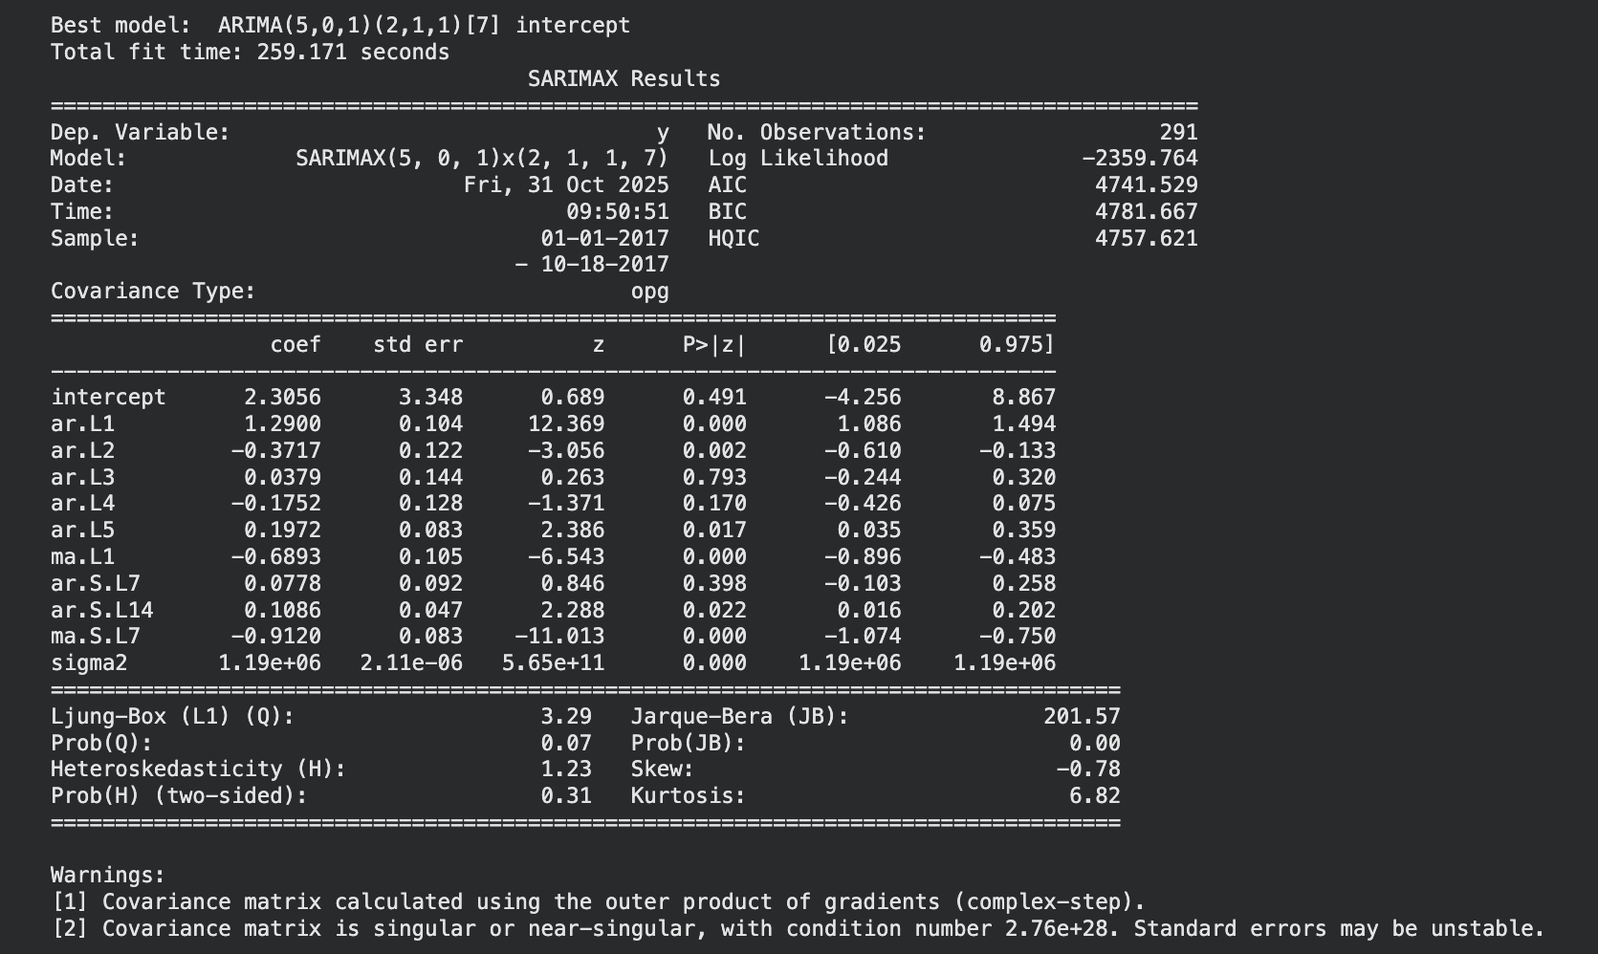
Auto ARIMA Model
The Auto-ARIMA grid search tested multiple (p,d,q)(P,D,Q,7) configurations and selected the model with the lowest AIC, ensuring both a good fit and model simplicity. The AIC balances model accuracy with parsimony
The best model found was ARIMA(5, 0, 1)(2, 1, 1, 7), which means this was the model with the strongest fit without overfitting. It captures both short-term AR and MA dynamics and weekly seasonality (m = 7). Selected through AIC minimization (AIC = 4741.5)
Notes:
First graph

Slide 10
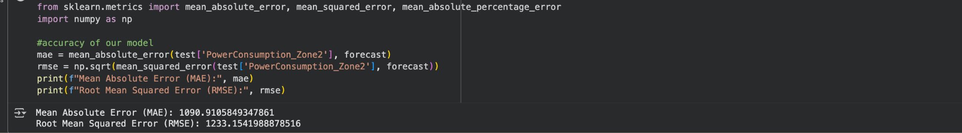
Baseline Model Forecast Accuracy
MAE: 1,090.91
RMSE: 1,233.15
The baseline Auto-ARIMA model performed reasonably well
To improve accuracy we could:
Broaden the grid search parameter ranges (p, d, q, P, D, Q) to explore different model structures
Introduce data transformations or exogenous predictors to test for external influences
Notes:
Insert ss

Slide 11
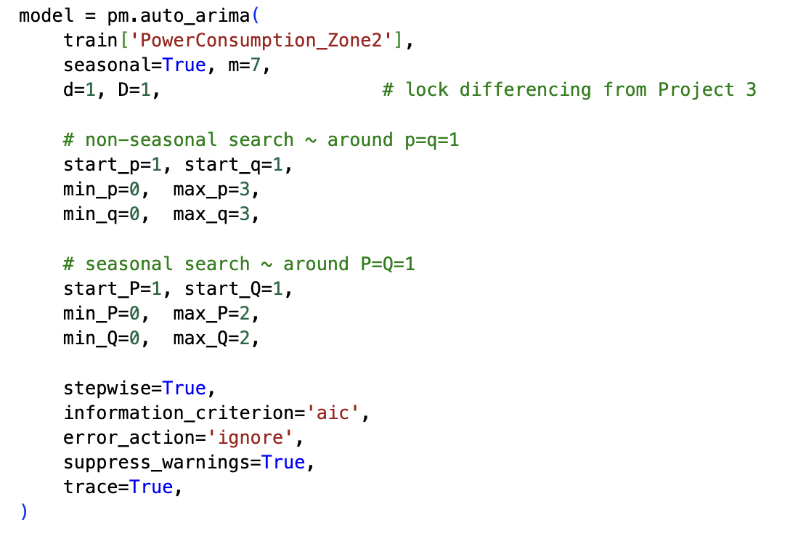
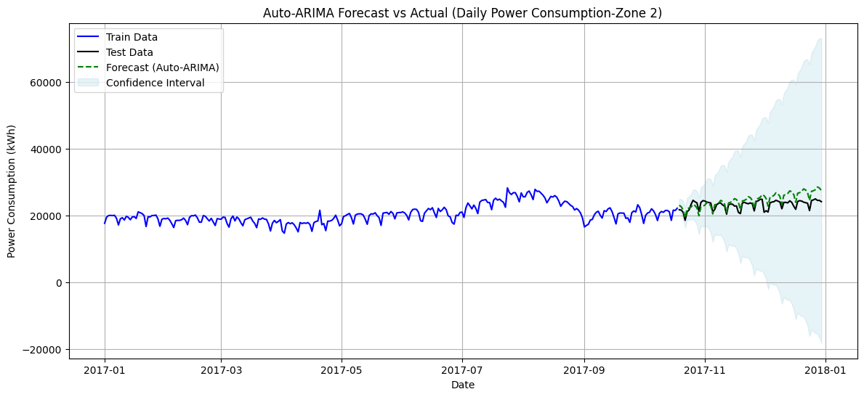
Improving predictions:
Version 2: Broader more Seasonal Grid (p/q)
ARIMA(0,1,1)(2,1,0)[7]
Notes:
Insert ss

Slide 12
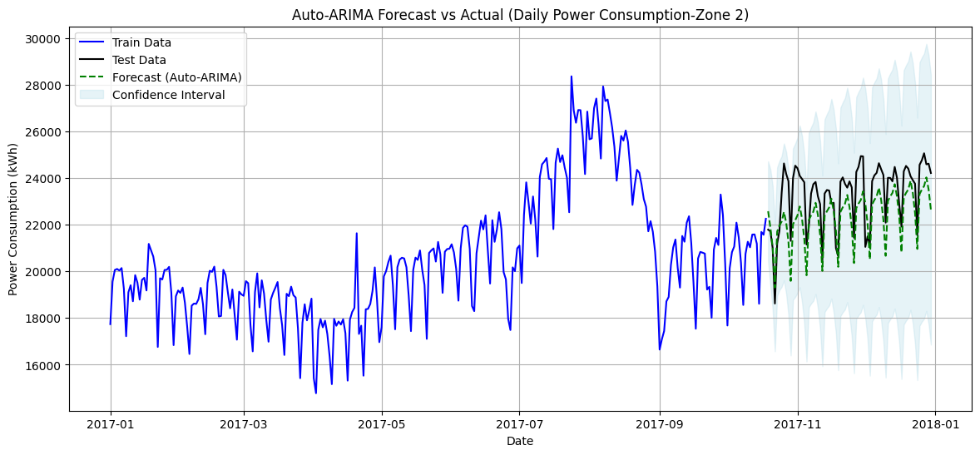
Improving predictions:
Version 3: Adding Exogenous Variables
Order: (5, 0, 1)
Seasonal order: (2, 1, 1, 7)
Notes:
Insert ss

Slide 13
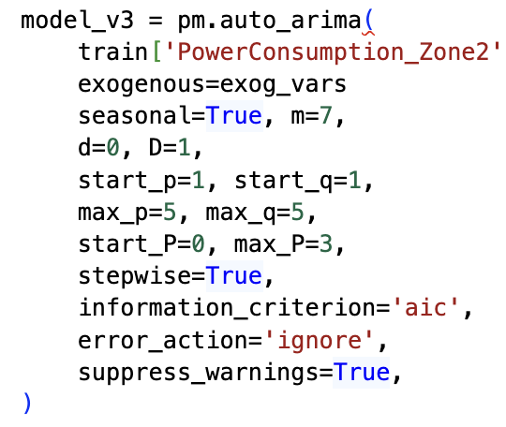
Version 3 Analysis
For model 3, we observed that the added exogenous variable parameter resulted in the same order as the baseline model/ This suggests that external predictors didn’t provide additional explanatory power beyond what we already capture in the time series.
It did however reduce the AIC which helped simplify the model and reduce the overfitting.

Slide 14
Comparison Table
Note that all versions were seasonal with m=7
Model | Change we made | AIC | RMSE | MAE
Baseline Model | p range 1-5 q range 1-5 P range 0-5 d = none, D =1 | 4741.53 | 1233.15 | 1090.91
Version 2: | p range 0-3 q range 0-3 P range 0-2 Q range 0-2 | 4709.17 | 2063.00 | 1737.37
Version 3: | ARIMA(5, 0, 1)(2, 1, 1, 7) With exogenous variables Temperature and Humidity | 4709.17 | 1233.15 | 1090.91
Notes:
Insert ss

Slide 15
Conclusions and Interpretations
To improve model accuracy, three approaches were tested:
Version 1 - Baseline Auto-ARIMA:
This model used parameter ranges centered around the optimal values identified in Project 3. It achieved strong accuracy, reflected in low RMSE and MAE, but had a higher AIC, suggesting a complex structure relative to the other models.
Version 2 - Seasonal Auto-ARIMA (SARIMA-based):
Introducing weekly seasonality produced a more generalized and smoother fit. While the RMSE increased compared to the baseline, the model achieved a lower AIC, indicating improved simplicity and broader applicability across datasets, and this demonstrated the trade-off between parsimony and model fit.
Version 3 - Auto-ARIMA with Exogenous Variables:
Temperature and humidity were added as external regressors, capturing real-world drivers of energy demand. Exogenous variables, unlike lag-based predictors, represent external influences that affect power consumption patterns. This version reduced RMSE by approximately 1,000 points and further lowered AIC, combining the high accuracy of Version 1 with the efficiency of Version 2.
In conclusion, Version 3 emerged as the most balanced and interpretable model with the best accuracy parsimony fit. Iterative modeling helped us see how tuning parameters, running diagnostics can improve reliability, planning and decision making. These models are helpful on the larger scale to make sure energy consumption and resource allocation are optimized and may have business applications in utilities, manufacturing businesses and commercial and residential buildings.

