Slide 1
Predicting Sunspots Time Series using Machine Learning Methods
Undergraduate project
Shivi Gupta (180730)
Supervisor: Prof. Mahendra Kumar Verma
Co-supervisor: Prof. Vipul Arora

Slide 2
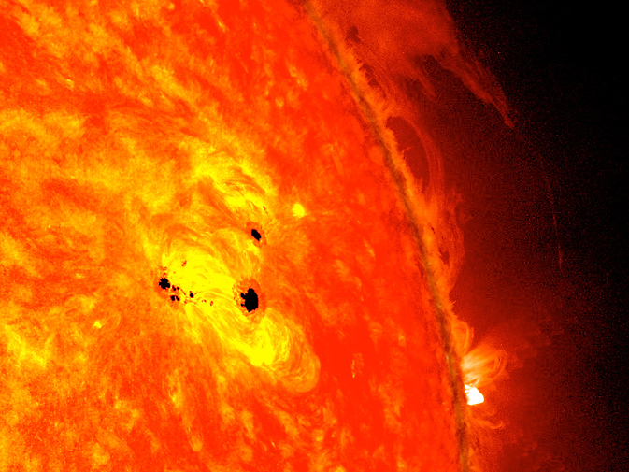
Introduction
Sunspots are regions of large magnetic flux on Sun’s surface
They affect space navigation, radio communication and electrical lines
High activity can cause disruption in radio transmission and power grids
Predictions help in understanding Sun’s behaviour and predicting solar flares
Image credit: NASA/SDO/AIA/HMI/Goddard Space Flight Center

Slide 3
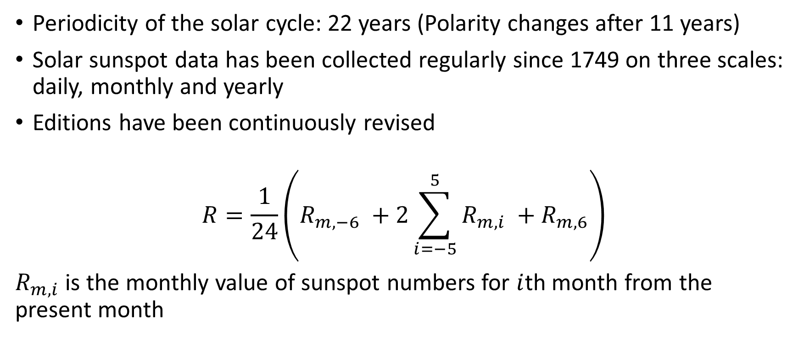
Sun spot number (SSN)
Periodicity of the solar cycle: 22 years (Polarity changes after 11 years)
Solar sunspot data has been collected regularly since 1749 on three scales: daily, monthly and yearly
Editions have been continuously revised
$$R=\frac{1}{24}\left(R_{m,−6} +2\sum_{i=−5}^{5}{R_{m,i}} +R_{m,6}\right)$$
$R_{m,i}$ is the monthly value of sunspot numbers for $i$th month from the present month

Slide 4
Dataset
SILSO sunspot dataset
Collected from 1749 to 2021
We use the monthly sunspot numbers dataset
3265 datapoints in total
2500 : 765 train – validation split

Slide 5
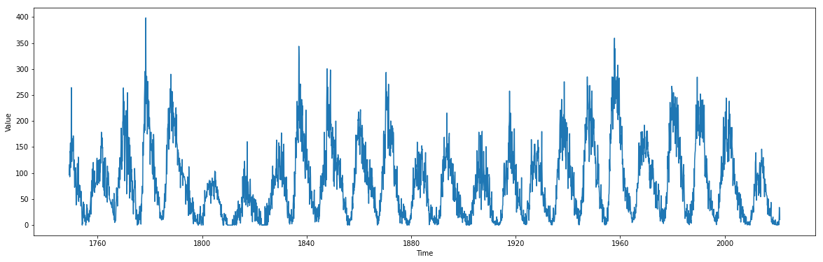
Dataset

Slide 6
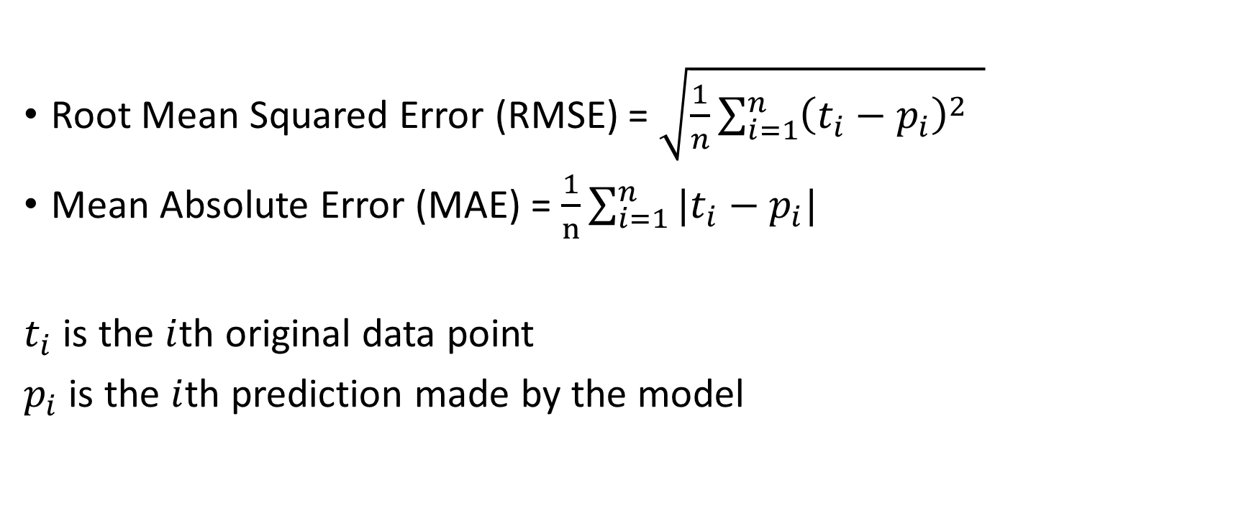
Comparison metrics
Root Mean Squared Error (RMSE) = $\sqrt{\frac{1}{n}\sum_{i=1}^{n}{{\left(t_{i}−p_{i}\right)}^{2}} }$
Mean Absolute Error (MAE) = $\frac{1}{n}\sum_{i=1}^{n}{|t_{i}−p_{i}|}$
$t_{i}$ is the $i$th original data point
$p_{i}$ is the $i$th prediction made by the model

Slide 7
Previous works
Solar dynamo models usually work well
Many deep learning methods have also been carried out
Wei Cheng, Yan Wang, Zheng Peng, Xiaodong Ren, Yubei Shuai, Shengyin Zang, Hao Liu, Hao Cheng, Jiagui Wu High-efficiency chaotic time series prediction based on time convolution neural network (2021)
TCN-CBAM (Temporal Convolutional Network – Convolutional Block Attention Module) model
Pala, Z., Atici, R. Forecasting Sunspot Time Series Using Deep Learning Methods. Sol Phys 294, 50 (2019)
NNAR (Neural Network Autoregression) and LSTM models

Slide 8
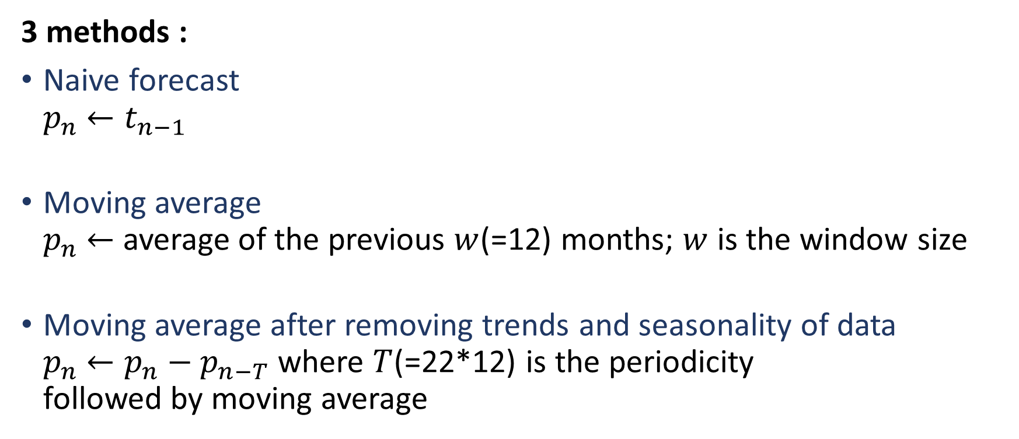
Preliminary Analysis
3 methods :
Naive forecast $p_{n}$ $←t_{n−1}$
Moving average $p_{n}$ $←$ average of the previous $w$(=12) months; $w$ is the window size
Moving average after removing trends and seasonality of data $p_{n}$ $←p_{n}−p_{n−T}$where $T$(=22*12) is the periodicity followed by moving average

Slide 9
Preliminary Analysis: results
Method | RMSE | MAE
1. Naïve Forecast | 25.8 | 18.4
2. Moving average | 31.2 | 23.0
3. Moving average after removing trends and seasonality | 35.0 | 33.7

Slide 10
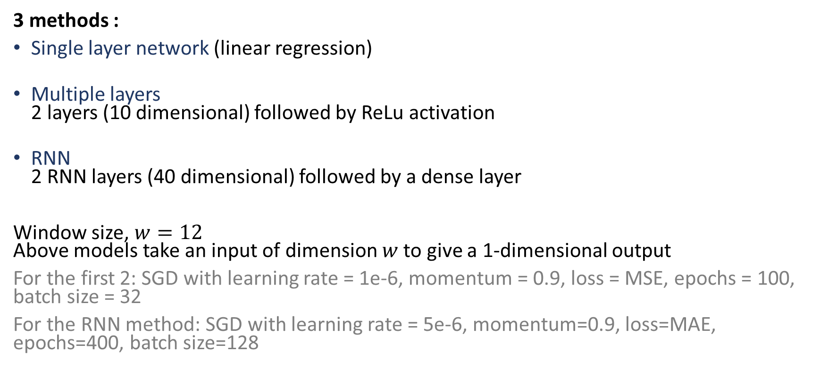
Deep Neural Network based Models
3 methods :
Single layer network (linear regression)
Multiple layers 2 layers (10 dimensional) followed by ReLu activation
RNN 2 RNN layers (40 dimensional) followed by a dense layer
Window size, $w=12$ Above models take an input of dimension $w$ to give a 1-dimensional output
For the first 2: SGD with learning rate = 1e-6, momentum = 0.9, loss = MSE, epochs = 100, batch size = 32
For the RNN method: SGD with learning rate = 5e-6, momentum=0.9, loss=MAE, epochs=400, batch size=128

Slide 11
Deep Neural Network based Models: results
Method | RMSE | MAE
Single layer network (Linear regression) | 26.0 | 18.9
Multi-layer neural network | 25.3 | 18.4
Recurrent neural network layers | 25.1 | 17.9

Slide 12
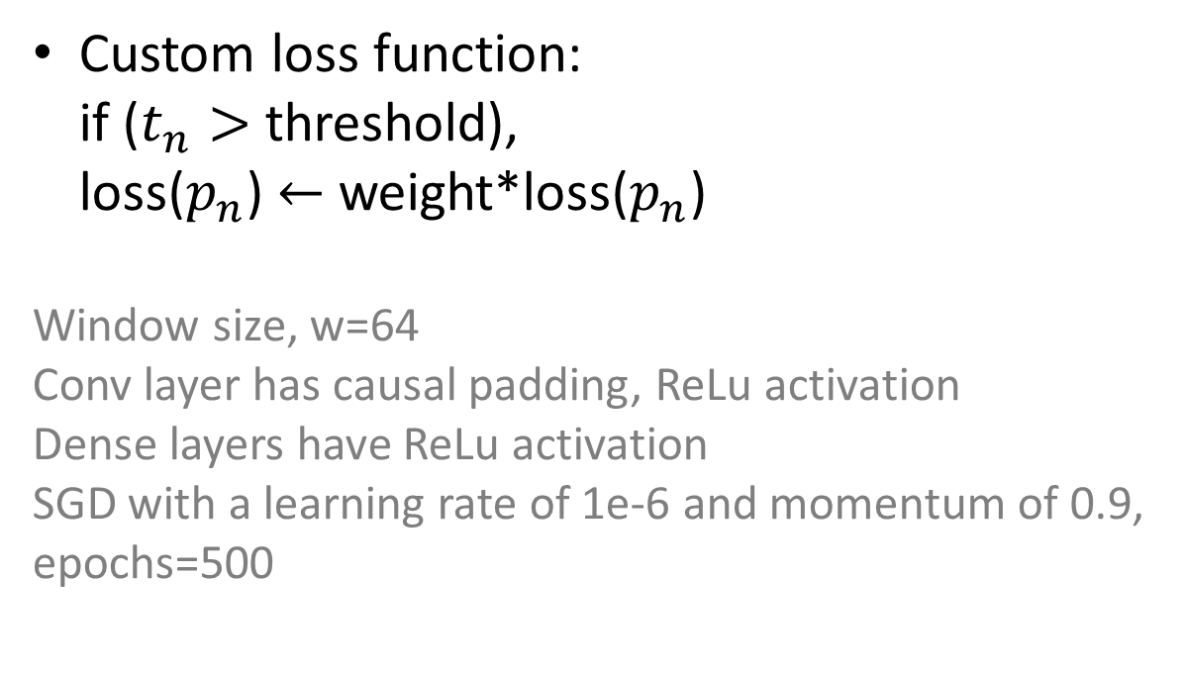
Best performing model: CNN, LSTM with a custom loss function
Input of dimension w
Custom loss function: if ($t_{n}>$threshold), loss($p_{n}$) $←$weight*loss($p_{n}$)
Window size, w=64 Conv layer has causal padding, ReLu activation
Dense layers have ReLu activation
SGD with a learning rate of 1e-6 and momentum of 0.9, epochs=500
1D convolution layer
(filters=60, kernel size=5)
LSTM layer (n=60)
LSTM layer (n=60)
Dense layer (n=30)
Dense layer (n-10)
Dense layer (n=1)
Output of dimension 1

Slide 13
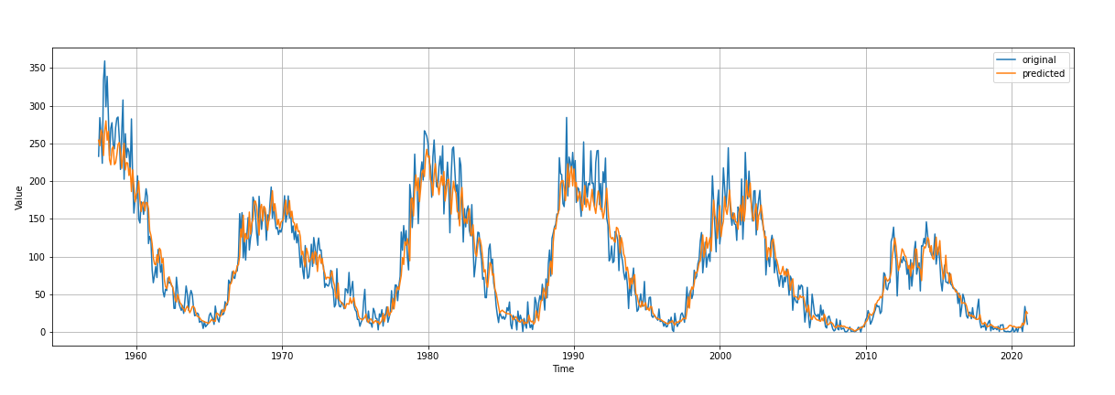
Model predictions
RMSE | MAE
22.8 | 16.1

Slide 14
Customizing
Varying the window size
Weights for weighted loss function
Loss weight | MAE
1 | 17.0
1.5 | 16.6
2 | 16.8
5 | 18.0
Window size | MAE
16 | 17.3
32 | 16.6
64 | 16.2
128 | 17.0
256 | 16.9

Slide 15
Future Work
Multi step prediction to predict the next solar cycle (Feeding the output of the model back into the input)
Continuous weights for the loss function instead of discrete
Comparison with current state of the art methods

Slide 16
References
Wei Cheng, Yan Wang, Zheng Peng, Xiaodong Ren, Yubei Shuai, Shengyin Zang, Hao Liu, Hao Cheng, Jiagui Wu High-efficiency chaotic time series prediction based on time convolution neural network (2021)
Qi-Jie Wang et al 2021 Res. Astron. Astrophys. 21 012 Solar cycle prediction using a long short-term memory deep learning model (2021)
Pala, Z., Atici, R. Forecasting Sunspot Time Series Using Deep Learning Methods. Sol Phys 294, 50 (2019)
Petrovay, K. Solar cycle prediction. Living Rev Sol Phys 17, 2 (2020)

Slide 17
Thank you

