Slide 1
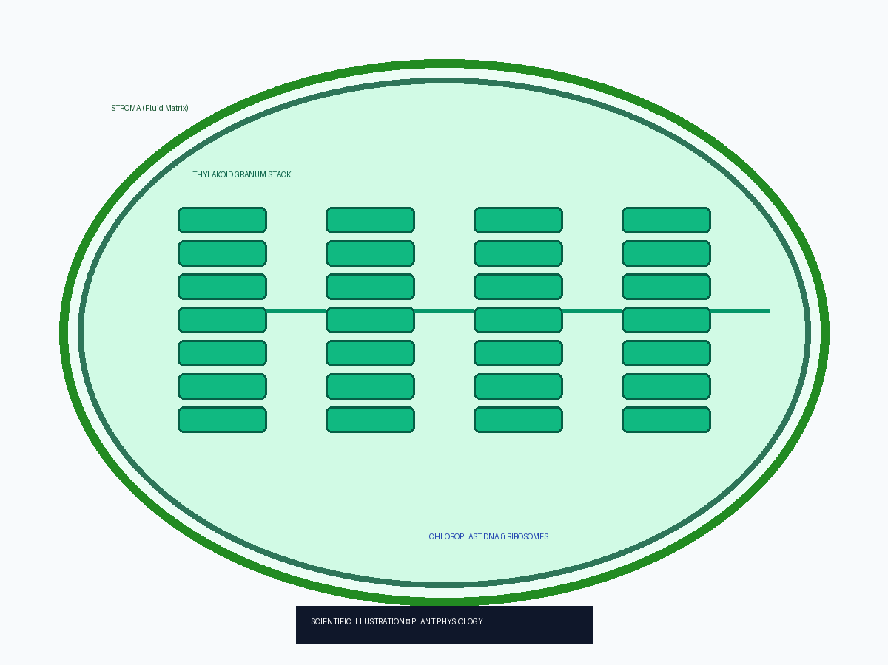
Chloroplast Ultra-Structure & Energy Transduction
Thylakoid membranes contain Photosystems I and II driving light reactions.
Stroma fluid contains RuBisCO enzymes for Calvin Cycle dark reactions.
Semi-autonomous organelle possessing circular DNA and 70S ribosomes.

