Slide 1
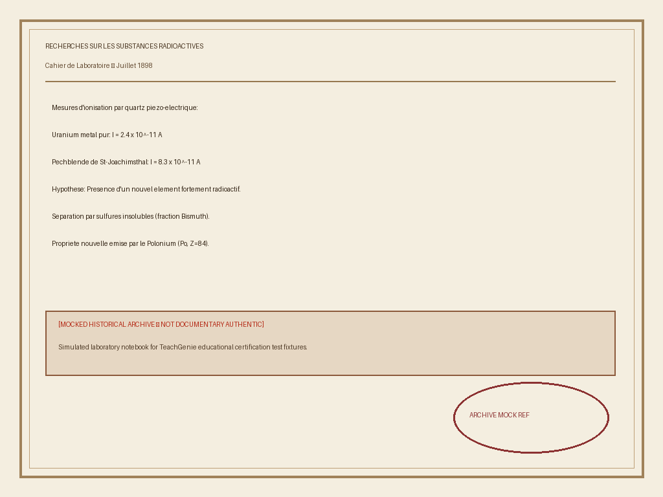
Marie Curie's 1898 Laboratory Notebooks [MOCKED ARCHIVE]
Simulated archival reference demonstrating historical image ingestion.
Piezoelectric quartz electrometer enabled quantitative radiation measurement.
Isolated fractional polonium and radium pitchblende ores.
Photo: TeachGenie Archival Reference Collection (Mocked Laboratory Record)

