Slide 1


Team Details and Problem Statement
Ministry/Organisation Name: Ministry of Ayush PS Number:- SIH1342 Team Name:- Maverick 2.0
Team Leader Name:- Shivika Tyagi Institute Code:- C-46109 Institute Name:- AJAY KUMAR GARG ENGINEERING COLLEGE
Problem Statement Title:- Development of a prototype instrument (sensor based) for assessment and quantification of rasas (taste) in
Crude herbs
Idea/Aim
Standardized Quality Analysis: To create a device that would provide a standardized method for analysis of the taste profile of herbs and dietary items, ensuring consistent quality and effectiveness in Ayurvedic treatments.
Medicine Formulation: Ayurvedic practitioners could use the device to precisely formulate herbal medicines, ensuring the correct balance of tastes for specific health conditions.
Improved Herbal Product Quality: By using this tool, producers can keep their herbal goods original and high-quality while minimising variation in flavour profiles.
Research and Development: The Tongucometer can aid in research on Ayurvedic herbs, helping to identify their therapeutic potential based on taste characteristics.
Optimized Dosage: By assisting in determining the proper dosage of herbs and food items, the gadget helps lower the possibility of overdosing or underdosing.
Health Management: Ayurvedic practitioners and individuals can better manage health conditions by selecting foods and herbs with the right taste attributes to balance their doses (Vata, Pitta, Kapha).
User-Friendly Design: Making sure the Tongucometer is portable, easy to use, and suitable for both traditional Ayurvedic practitioners and modern healthcare professionals.

Slide 2




Solution
at glance - Developing a website that will present basic information regarding the effect of taste on the properties of herb as well will fetch the calculated readings by sensors and will display the percentage of different tastes(rasa) and the discovered herbs closely aligning to its properties.
Website
Frontend
Backend
Machine Learning
App
Login /Sign up Portal for user registration.
Basic information about different taste(rasa) present in herb and there effect in ayurveda.
A section to display the results of finds in amount of different taste flavours present.
Displaying ayurvedic properties of the herb to be identified based on the herbs having similar taste.
User authentication: implement secure login/signup with token-based authentication.
Fetching API from microcontroller to get readings from sensors.
Providing the processed data to machine learning model.
The analyzed data from ML model is displayed on frontend through backend.
Using data data-set to determine various factors like - adulteration in food product, and diet plan.
Adulteration - checking if the composition of product based on ts taste is same as that of original product.
Diet Plan - Providing a brief if that product can be included in diet of a person based on their age.
Basic Information about different taste present in herb and their medical effect.
Login and Signup to ensure a safe access.
Displaying results in form of reading of different taste we are conducting.
Providing choices to user as per their need.
Integration several APIs to fetch the results from Ml models and Arduino microcontroller.
Sensors
pH sensor - we are using pH level of a substance to determine if that herb in sour (0 to 6.9) or bitter (7.1 to 14)
VOC gas sensor - VOC gas sensor is used to measure pungentness in a herb as the pungent gas have a threshold of 300 and VOC gas sensors is used to determine that taste.
Glucose sensor - Any sweet substance has two 2 anomers and both try to balance each other out which is ho w through the angle they are reflecting(here 52 degrees) we are check for the amount of light reflected to check for presence of glucose.

Slide 3
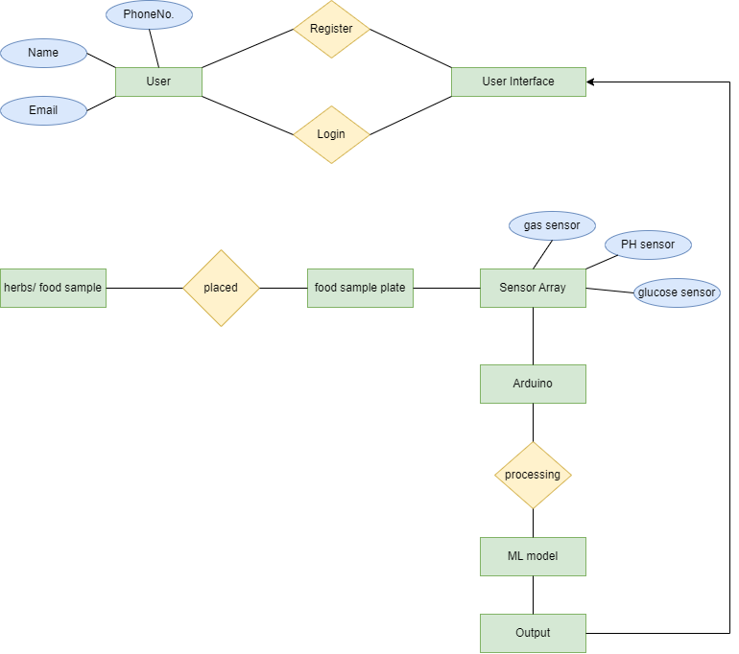









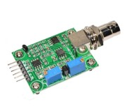
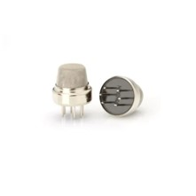
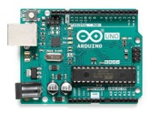
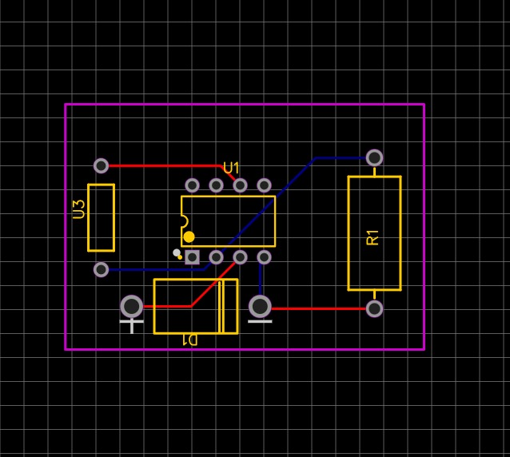
Flow of model
Tech Stack
Frontend
Backend
Sensors
pH sensor
VOS gas sensor
Arduino UNO
Glucose Sensor circuit

Slide 4
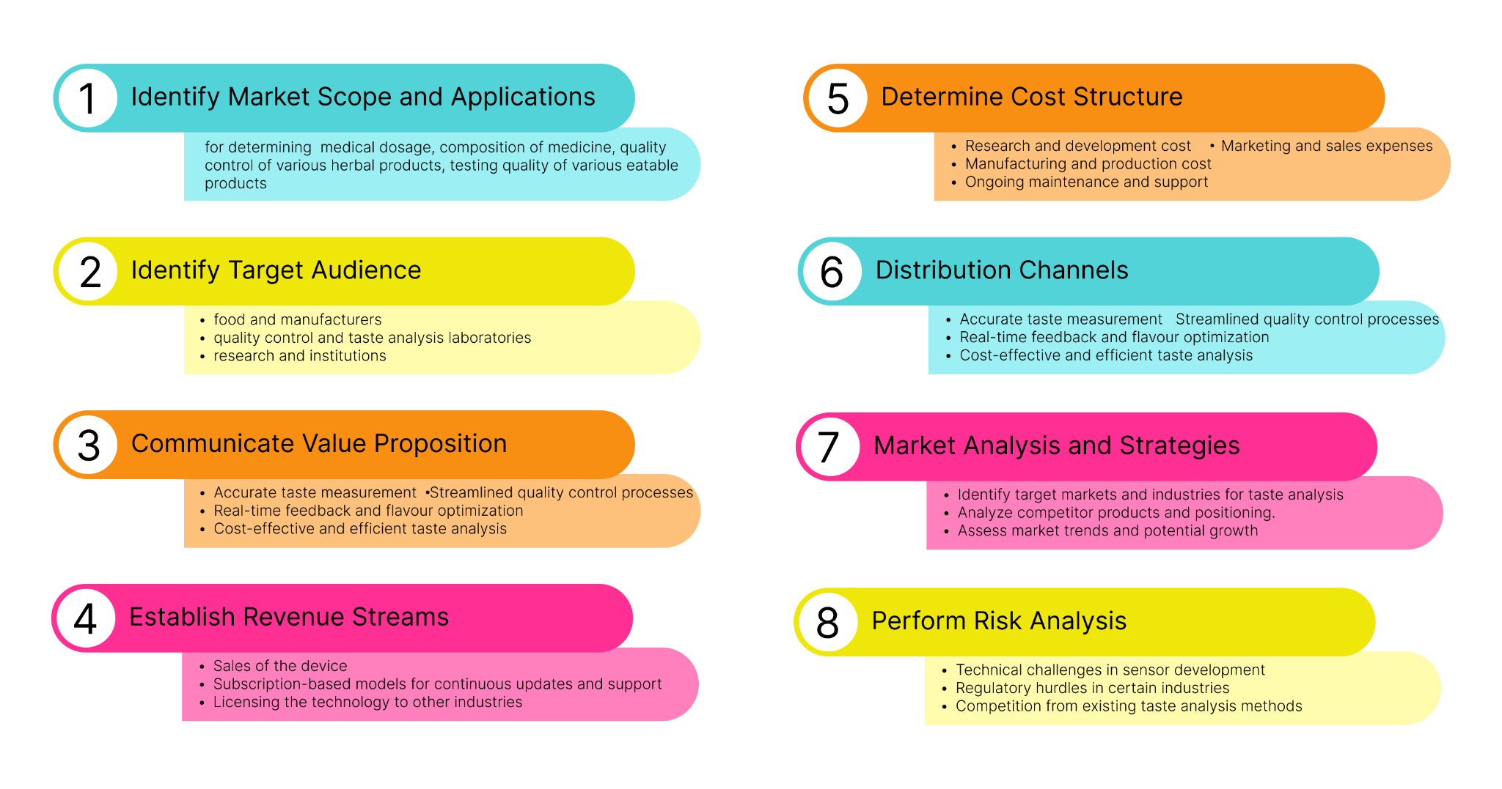
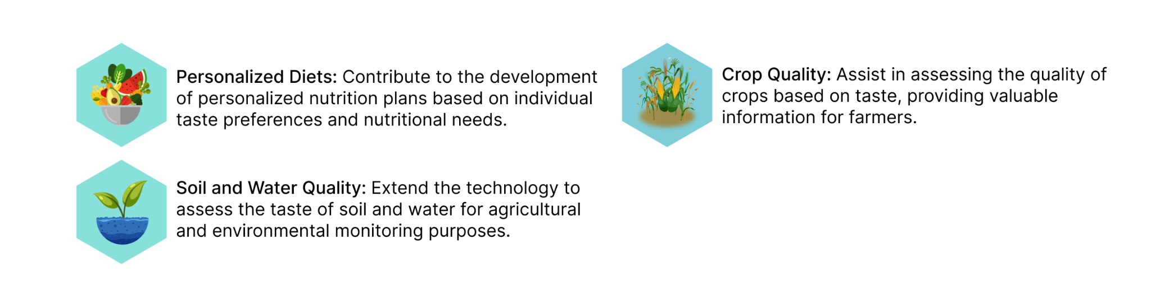
Business Model
Usage
Identification of unknown herbs to check if they are harmful or not.
Medication dosage and composition of medicine.
Checking adulteration of product by comparing to standard product.
Planing diet chart according to different body types(pitta vata kapha).
Future Scope

