Slide 1
AITSP AI Powered Tech Support Platform
VIT_ Vellore_Devtos
Arinjay Bisht
Shivam Kumar Pandey
Sourav Dey
Qualitative And Quantitative Impact

Slide 2

CALL CENTRES OF INDIA
An Excuse for Employment

Slide 3

PROBLEM
There are problems for both employer and employee:
Employee is under constant stress from deadlines.
Employer has to provide for transport and security of female employees who are supposed to work night shifts.
Almost all the time, the help center call operators are only noting down your issues and creating a ticket for the technical team.

Slide 4
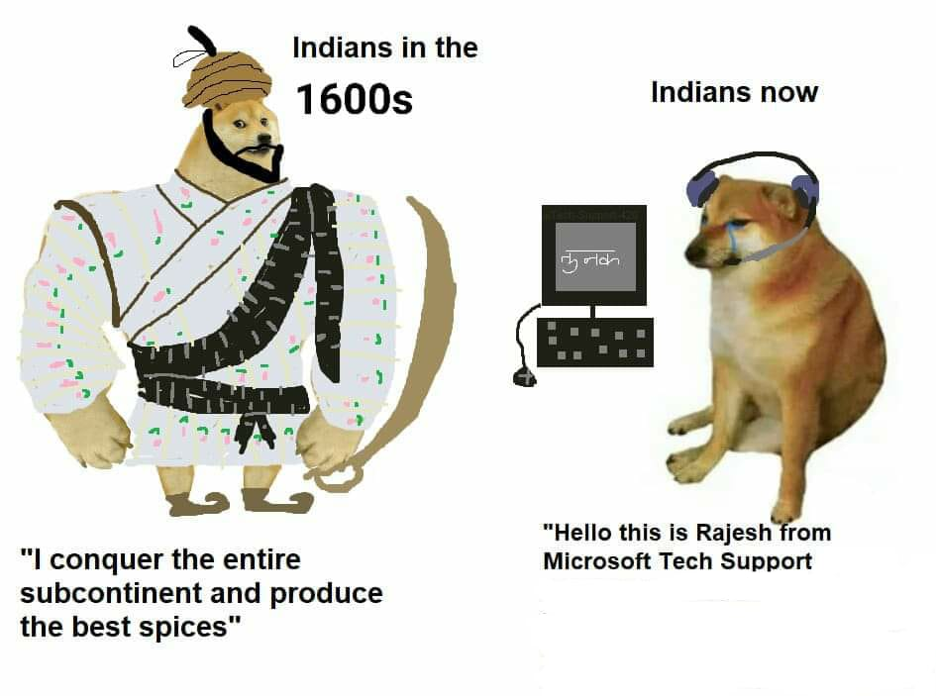
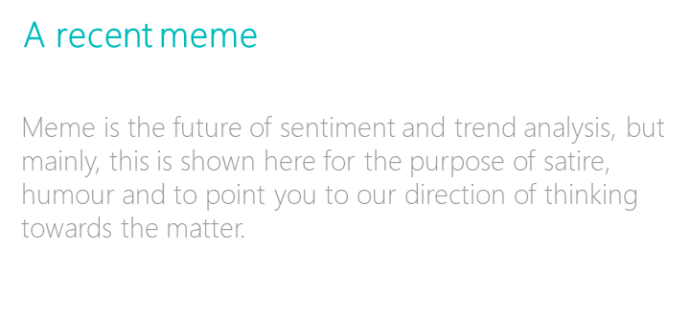
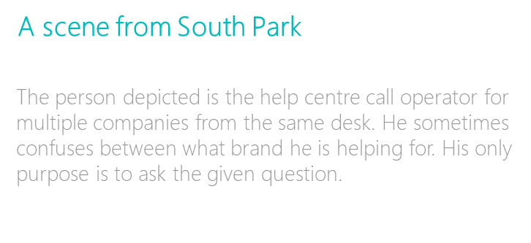

Slide 5

Qualitative Improvement
Life of a call center employee
Cruel deadlines
Poor wages
High Stress due to customer’s profanity
Unnatural working hours

Slide 6

Qualitative Improvement
Customer Satisfaction
Customer is heard without interruption or delays. Help is available all the time, and they feel like their problem will be resolved soon.
The money thus saved can be used to hire more technical staff or invested in other places to increase and improve your business.

Slide 7

Quantitative Improvement
Customer Support
It’s estimated that by 2020, 85% of customer service interactions will be automated. – Ameyo
Over 60% of US consumers prefer an automated self-service, such as a website or mobile app, for simple customer service tasks. – AE
You’ll never have a product or price advantage again. They can be easily duplicated, but a strong customer service culture can’t be copied.” — Jerry Fritz, Author of Breakthrough Customer Service.

Slide 8
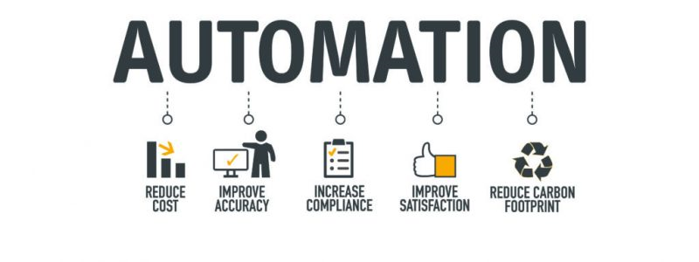
Quantitative Improvement
Customer Support
Cost benefits of an AI based system greatly outdo that of multiple employees.
The cost of the automated system including annual maintenance is less than the monthly salary of a single employee( ~Rs.10,000)

Slide 9

Alternate Usage
Distress Platform
Since a pipeline like this can be easily setup and quickly deployed, it is the perfect solution for emergency situations like floods, crimes against women, road accidents etc.
In a disaster relief situation, no amount of resources are enough to help people. Our platform will help people get help quickly and smoothly.

Slide 10
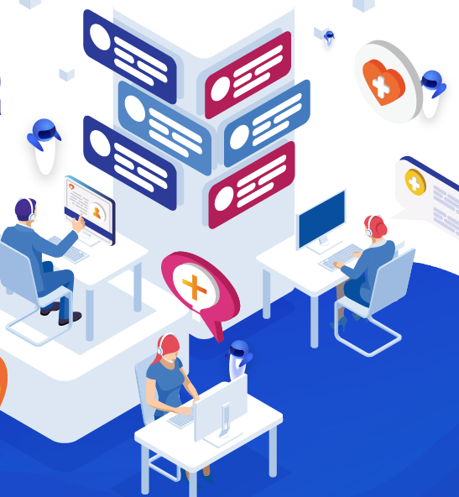
SOLUTION
Reliable Customer Support 24/7
Customer calls and tells the problem any time.
Tech support reviews it and provides solution, site visit if needed.
No downtime, no expenses on employees.
In the current COVID premise, where customer’s problem resolution has become inadequate due to lack of preparation by the various brands, this is the most ideal solution.

Slide 11
THANK YOU!

