Slide 1
MACHINE LEARNING PROJECT
Mobile Price Prediction
Presented by: Shivani Sharma
Project Presentation | Data Exploration • Model Training • Evaluation
01

Slide 2
Introduction & Objective
In this project, we analyses these mobile features and develop a Machine Learning model that can estimate the price of a mobile phone.
Introduction
The main objective of this project is to predict the price of a mobile phone based on its specifications using Machine Learning techniques.
Project Objective
3

Slide 3
Dataset Description
Target Variable
Numerical Features
Categorical Features
Price
The value the model learns to predict.
RAM, Memory, Battery_, camera specifications and Mobile Height.
Model, Colors and Processor_ (depending on the actual file).
Values after running df. shape and df. columns:
Number of Rows
Number of Columns
Data Source
Dataset rows: 12
Dataset columns: 541
File name / source: Mobile price Prediction
4

Slide 4
Exploratory Data Analysis (EDA)
Price Histogram
Price Boxplot
Battery Capacity vs Price
Shows the frequency distribution of mobile prices and whether prices cluster in particular ranges.
Highlights potential outliers; each unusual point should be checked before any removal.
It shows how prices vary across different battery capacities. However, battery capacity alone may not.
Categorical Comparison
Correlation Heatmap
Average price by Colour or another category, only if the column exists and group sizes are meaningful.
Summarizes linear relationships among numeric columns. It does not show causal effects.
6

Slide 5
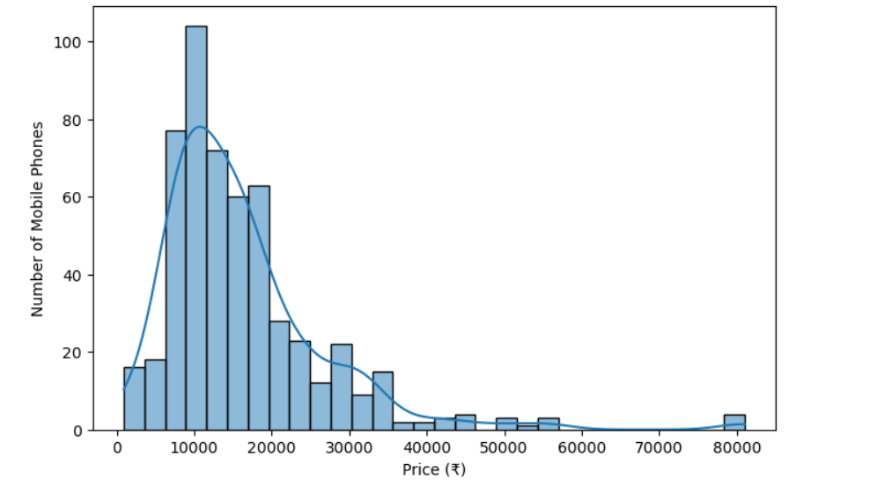
Price Histogram
We can observe that most smartphones are priced between ₹5,000 and ₹20,000. The highest concentration is around ₹10,000. As the price increases, the number of smartphones decreases. We can also observe a few premium smartphones with prices reaching approximately ₹80,000. Therefore, the price distribution is positively skewed, which means most mobile phones belong to the budget and mid-range segments.

Slide 6
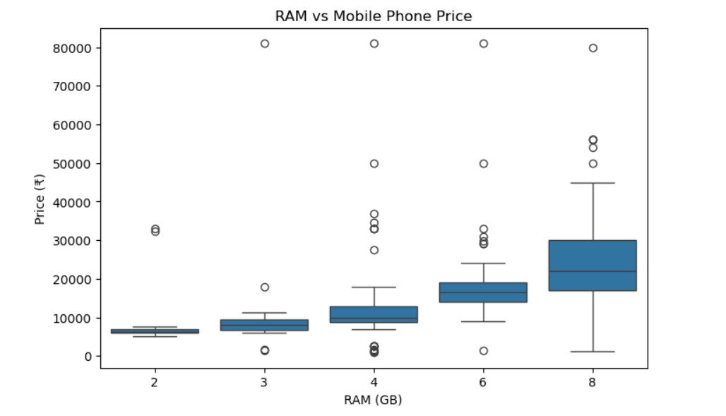
Price Boxplot
We can observe that as RAM increases, the median mobile price also increases. Smartphones with 2 GB RAM are generally cheaper, whereas smartphones with 8 GB RAM are more expensive. We can also see some outliers, which may represent premium smartphones. Therefore, RAM plays an important role in mobile phone price prediction.

Slide 7
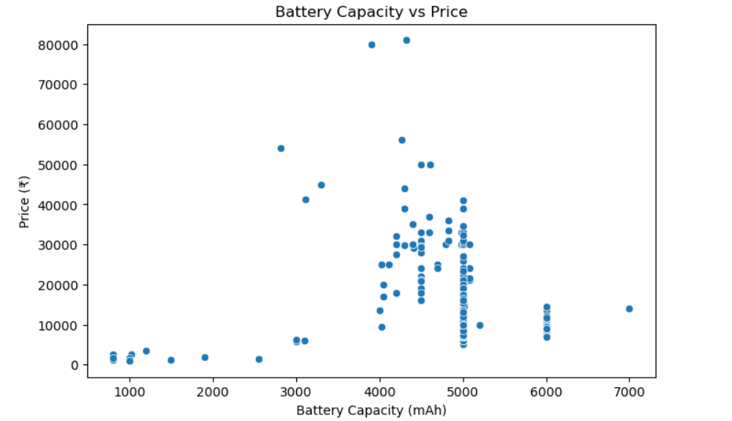
Battery Capacity vs Price
We can observe that most smartphones have battery capacities between 4,000 and 5,000 mAh. However, their prices vary significantly, even when battery capacity is similar. This indicates that battery capacity alone does not determine the price. Other features, such as RAM, processor, camera and storage, also influence mobile phone prices.

Slide 8
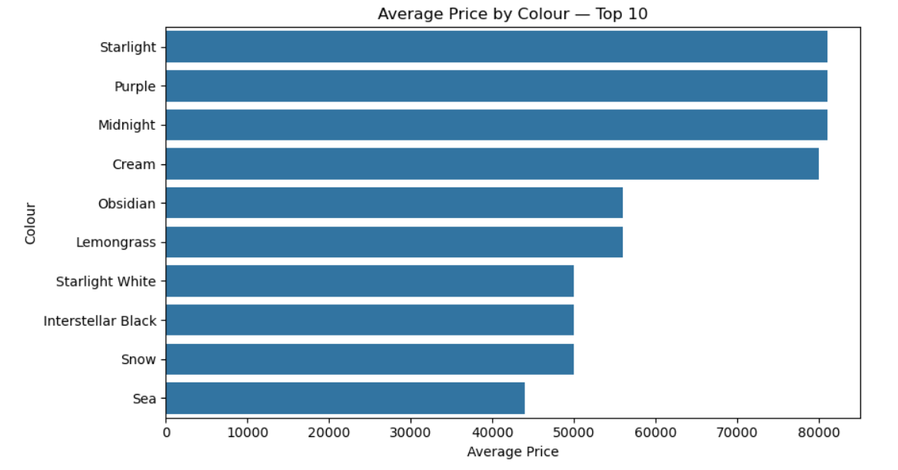
Categorical Comparison
We can observe that Starlight, Purple and Midnight have the highest average prices, approximately ₹80,000, whereas Sea has the lowest average price of approximately ₹40,000. This analysis shows variations in average prices across different colours. However, these differences may be influenced by smartphone models and specifications rather than colour itself.

Slide 9
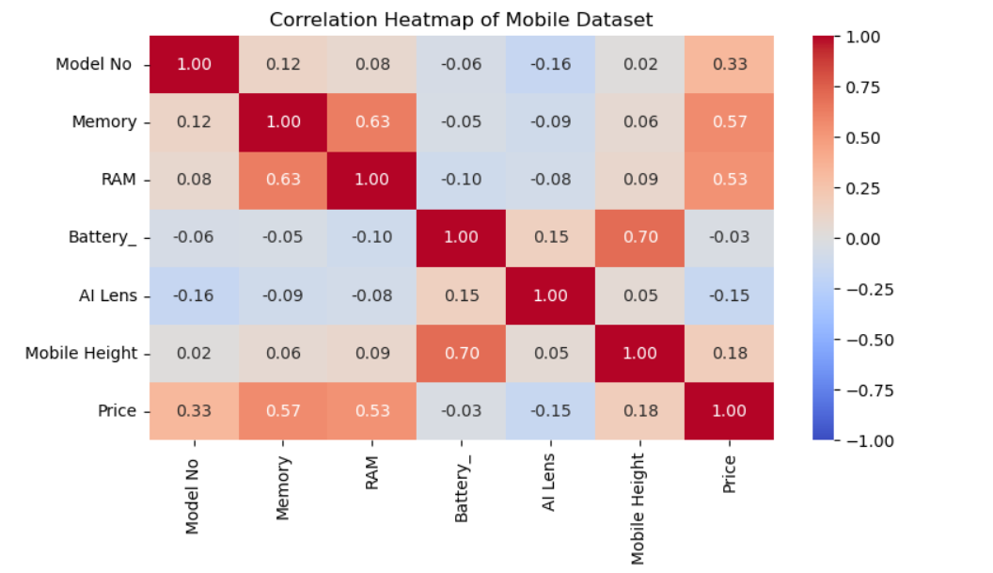
Correlation Heatmap
We can observe that Memory has a positive correlation of 0.57 with Price, while RAM has a correlation of 0.53. This indicates that these two features have relatively stronger relationships with mobile phone prices. Battery capacity has almost no linear correlation with price. We also observe a strong correlation of 0.70 between Battery and Mobile Height.

Slide 10
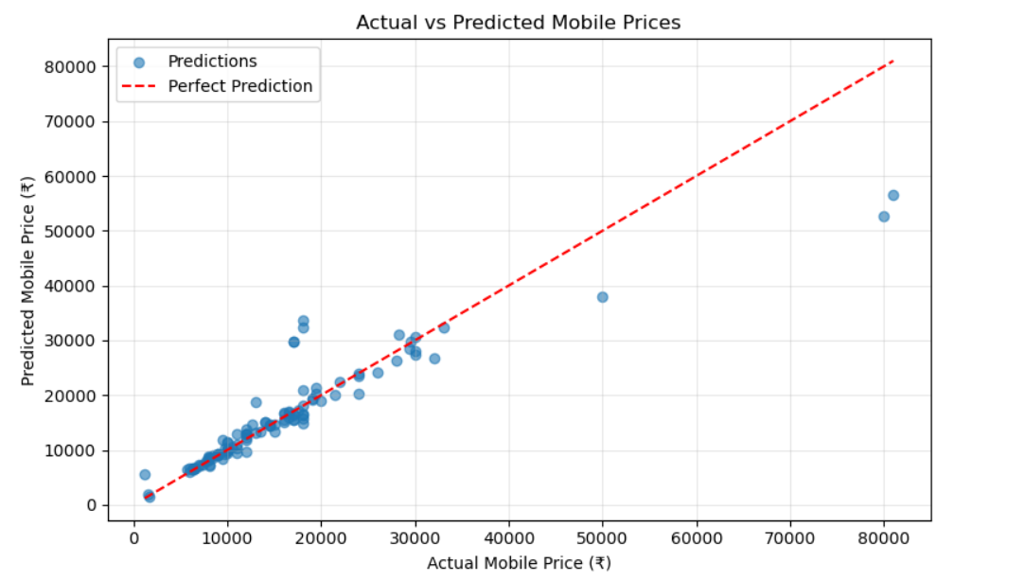
Actual vs Predicted Price
The blue dots represent predicted prices, while the red dashed line represents perfect predictions. We can observe that most points are close to the red line, especially for budget and mid-range smartphones. However, some premium smartphones are underestimated by the model. This indicates that our model performs reasonably well but still has scope for improvement, particularly for high-priced smartphones.
11

Slide 11
Model Evaluation Results
Our mobile price prediction model was evaluated using three performance metrics: MAE, RMSE and R² Score. The MAE is ₹1,959.25, which represents the average absolute prediction error. The RMSE is ₹4,767.83, showing that some predictions have larger errors. Finally, our model achieved an R² score of 83.51%, which indicates good predictive performance. Overall, the Random Forest Regression model provides reasonably good results for predicting mobile phone prices.
MAE
RMSE
R² Score
₹ _₹1,959.25
Average absolute prediction error.
₹ _₹4,767.83
Penalizes larger errors more strongly.
_0.8351
(%): 83.51%
Closer to 1 is generally better.
9

Slide 12
Conclusion & Business Recommendations
The project demonstrates that Machine Learning can be effectively used to predict mobile phone prices based on their specifications. The Random Forest Regression model achieved an R² score of 83.51%, indicating good predictive performance. The analysis highlights the importance of features such as RAM and memory in understanding mobile phone pricing. However, further improvements are needed to enhance prediction performance for premium smartphones. Overall, this project provides a useful approach for data-driven mobile phone price estimation and business decision-making.
Business Recommendations
Based on the findings, the following business recommendations can help mobile phone manufacturers, retailers and marketing teams.
Pricing Strategy
Product Development
Market Segmentation
Inventory Management
Premium Smartphone Pricing
12

Slide 13
Mobile Phone Price Prediction Using Machine Learning
Our project successfully demonstrates the application of Machine Learning for mobile phone price prediction. We performed data cleaning, exploratory data analysis, correlation analysis and developed a Random Forest Regression model. The model achieved an R² score of 83.51%, with an MAE of ₹1,959.25. Our analysis shows that RAM and memory are important features associated with mobile phone prices. Based on these findings, businesses can improve pricing strategies, product development, market segmentation and inventory planning. In the future, we aim to improve model performance and develop a user-friendly application for mobile phone price prediction
Thank You

