Slide 1
FastestCoder Hackathon
Sivaprakash

Slide 2
Personal Finance Tracker – javascript (high-level architecture)
Main Page
User
APP.JS
EXPENSEFORM
EXPENSELIST

Slide 3
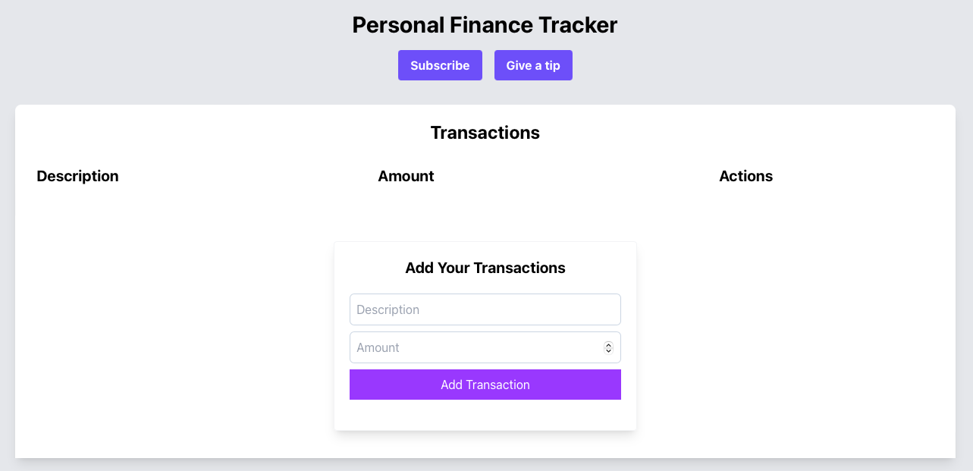
Wireframe – prototype (initial screen)

Slide 4
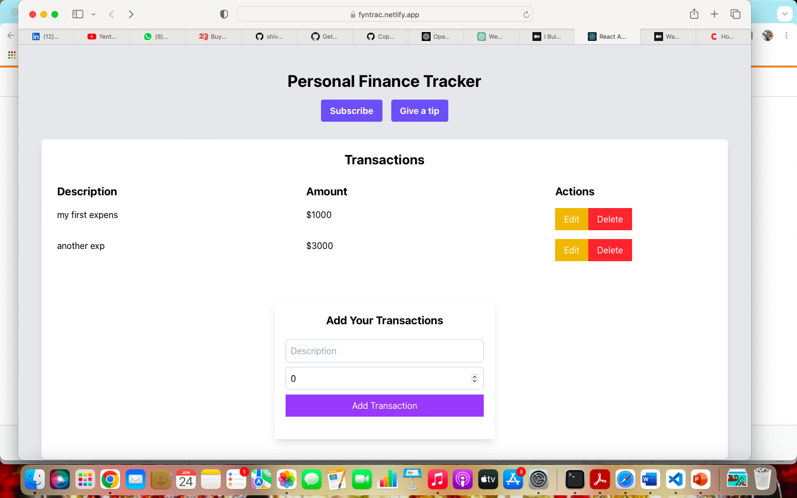
Wireframe - prototype

Slide 5
Submission
Please accept the GitHub Co-Pilot invite – DONE
Do you have README file – YES
Screen Shot of the Product – Attached in the Presentation
Architecture Diagram – Included
Which GitHub use case did you use and how did this help my submission
Code Generation
Language and API Assistance
Documentation Reference
Refactoring and Code Quality
Learning and Exploration
By leveraging the capabilities of GitHub Copilot effectively, I could expedite and explore my coding tasks, improve code quality, and explore new coding concepts, ultimately enhancing my hackathon submission

Slide 6


Slide 7
Story line
complete code for a personal finance tracker website that helps users keep track of their income and expenses in React
basic structure of a personal finance tracker website that allows users to add and delete transactions.
functioning of the Delete and Add Transaction buttons is perfect.
every transaction has an edit button from which I can update each transaction
However,,when a user refreshes the page or returns back, the data is not persistent.

