Slide 1

AI-Powered Ayurvedic Prakriti-Satmya Intelligence
Notes:
1

Slide 2
The Challenge: Need of Ayurvedic Diet and Nutrition Innovations
70% of urban Indians suffer from Vikriti (Dosha imbalance), leading to prevalent issues like digestive disorders, lifestyle diseases (diabetes, hypertension), and mental health challenges from aggravated Vata and Pitta.
Problem Statement
What AYUSHYA brings in
Many seek holistic well-being, but applying Ayurvedic principles in daily life can be complex.
Simplified approach of offering personalised guidance based on individual constitution and real-world factors.
Notes:
2

Slide 3
Novelty
Generic Diet Apps
AYUSHYA
Personalization
Learning
Age/calories only
No learning capability
Personalization
Learning
Seasonal Adjustment
Geography
Dosha + Satmya + Ritu + Desha + Kala
Learns your Satmya from feedback
Fixed recommendations
Global generic approach
Timing
Expert Validation
Random meal suggestions
Nutritionists only
Seasonal Adjustment
Geography
Real-time Ritu lookup + auto-adjust
Desha-specific (Bengaluru ≠ Rajasthan)
Timing
Expert Validation
Kala-optimized (lunch ≠ dinner)
Ayurveda MD validated approach
Notes:
3

Slide 4
Innovative Holistic Wellness Engine
Ayushya integrates several key functionalities to provide a comprehensive, user-centric experience.
Personalised Input
AI-Powered Recommendations
Questionnaires and daily logging (Satmya) for accurate individual profiles.
Weekly, region-wise, and Dosha-specific recommendations including grocery lists and recipes.
Food Pairing & Digestibility
Dynamic AQI - Ritu Pairing
Guidance on compatible food combinations for optimal digestion.
Pair AQI spikes with Ritu Adjustments, bringing Ayurveda with urban environmental health.
Satmya Feedback
Centralized Family Diet Tracking
Continuously Adapts recommandations based on user feedbacks (good , neutral,bad )
Share Dosha Profiles and & weekly reccommandations within family groups
Notes:
simplified -> aqi ritu

Slide 5
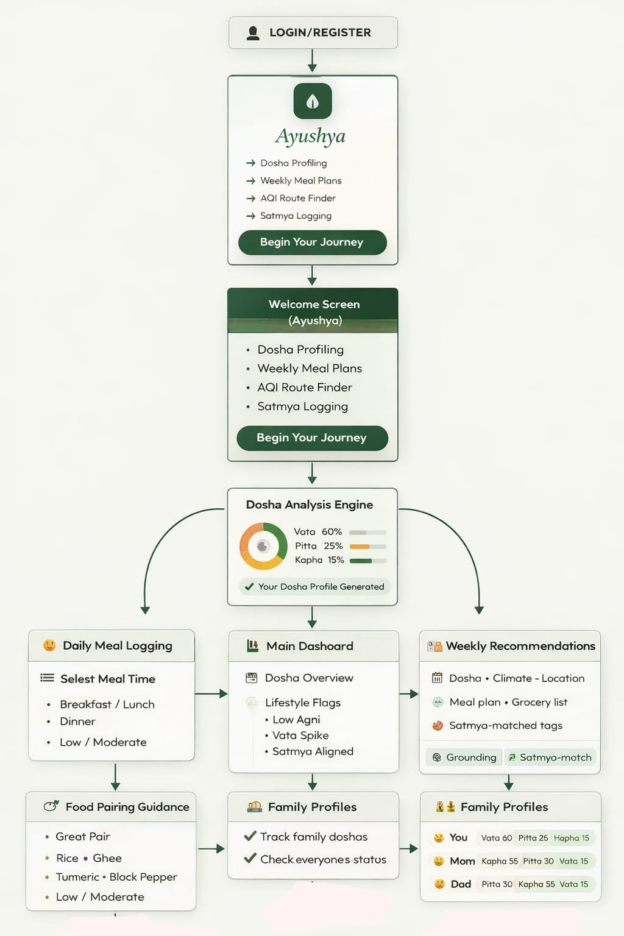
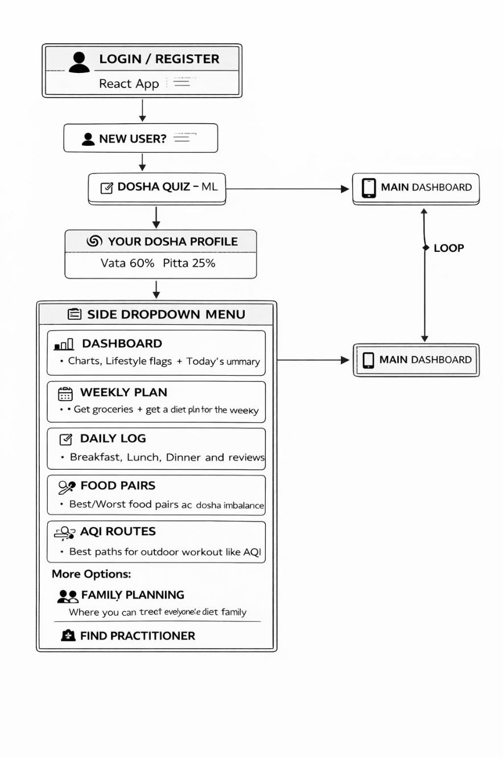
Life Cycle of the Project : End to End Flow
.
Notes:
7

Slide 6
Feasibility: Technical & Ayurvedic Rigor
Ayushya is built on a robust technical stack and adheres strictly to foundational Ayurvedic principles, ensuring both reliability and authentic application.
Technical Foundation
Ayurvedic Model Rigor
Frontend: React, Vite, Tailwind CSS for a modern, responsive user experience.
Backend: FastAPI for high-performance, asynchronous data processing.
ML: Leverages ready-to-use Kaggle datasets for efficient model development.
Database: MongoDB
Deployment: Docker containerization
Validated Framework: Adheres to Charak Samhita principles for Dosha, Satmya, Ritu/Desha/Kala.
Rule-based Diet Mapping: Precise algorithms for personalised food recommendations.
Risk Flags: Daily feedback loop monitors Agni/digestion, enabling proactive adjustments and user insights.
Notes:
8

Slide 7

Ayushya's Evolution: Future Scope And Challenges
Symptom Detection & Risk Alerts
Wearable Integration
Adaptive Planning & Adherence
Real-time biometric data from wearables (sleep, activity, heart rate) will dynamically refine Dosha assessments. This passive monitoring enables hyper-personalised recommendations, proactively addressing imbalances.
The app analyzes recorded daily logs to identify emerging symptoms and imbalances. When patterns indicate potential health risks, automated alerts notify users with preventive recommendations, enabling early intervention before conditions escalate.
Life is unpredictable. Our "makeup" feature intelligently adjusts your Ayurvedic plan if you miss a day. This ensures flexibility, supports sustained adherence, and keeps your wellness journey realistic.
Allergies & Intolerances
Users can input specific dietary restrictions ensuring recommandations are always safe and suitable.
Notes:
9

Slide 8




Social & Clinical Impact at Scale
AYUSH Ministry Alignment
Democratizing Ayurveda
Government promotes Ayurveda + technology integration. Ayushya: "Make Ayurveda Modern" initiative. Potential government integration + funding.
Most Indians can't afford Vaidya consultations . Ayushya offers Vaidya wisdom to a larger audience.
Sustainable Business Model
Clinic Finder Partnership
Freemium basic Dosha profiling free. Paid personalized recs + AI chatbot + clinic finder . B2B health insurance, corporate wellness partnerships.
Connects users to verified Ayurveda practitioners. Practitioners get patient data (with consent) for better care. Addresses clinic authenticity challenge.
Notes:
7

