Slide 1

Building Real Estate Data Pipelines for Assette
BA888 MSBA Capstone
Shiv Nag, Courtney Vincent, Zicheng Wang

Slide 2
Problem Statement
Need: Assette’s goal is to expand their Snowflake database to house Real Estate data
Challenge: Defining & sourcing the data needed for Real Estate funds
Goal: Fulfill this need with production-ready code with realistic Real Estate data

Slide 3
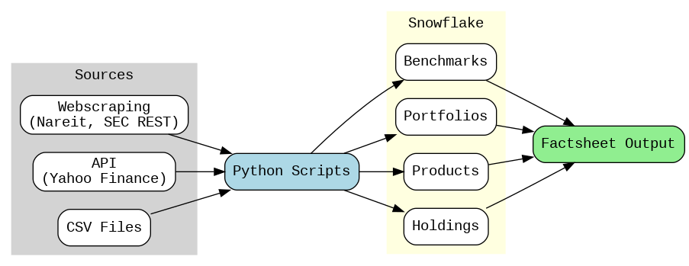






Goals & Objectives

Slide 4




Results
Foundation: built the base for a fully automated Real Estate pipeline
Real Estate Focus: Tailored data and analytics specifically for Real Estate performance tracking
Scalability: Created a repeatable process for onboarding new securities at scale
Integration: Linked Snowflake tables through automated primary key relationships
Notes:
First, we built the foundation for a fully automated real estate pipeline, allowing data to flow from multiple sources into Snowflake.
Second, we tailored it specifically for REIT performance tracking, ensuring the data and analytics met industry needs.
Third, we made it scalable — new securities can be onboarded quickly and consistently.
And finally, we integrated Snowflake tables through automated primary key relationships, keeping all datasets in sync.

Slide 5
Challenges
Data availability and format are critical for a functional pipeline
Balancing real and synthetic data in portfolios
Use Generative AI with caution & be efficient when using it
Notes:
Data availability and format are critical for a functional pipeline. For example, some real estate tickers had only been traded for a month or were no longer on the market, so the Yahoo Finance API couldn’t pull complete data, so we needed accurate validation code.
matching synthetic portfolios to real tickers while keeping performance metrics realistic meant constant checks for consistency, scale, and plausibility.
Generative AI can speed up work, like drafting data dictionaries or creating test data, but we can’t rely on it blindly, it can introduce wrong assumptions into a financial dataset. The key is to use AI where it adds value and always carefully review.

Slide 6
Future work
Expand Data Broaden coverage to include more diverse Real Estate securities
Classify Holdings Auto-assign by sub-class (REIT, Core, Opportunistic)
Automate Updates Schedule refreshes (Airflow, dbt, Snowflake Tasks)
Validate & Audit Enhance accuracy with exception handling & anomaly detection
Externalize Rules Store logic in YAML/JSON for quick updates
Benchmark Integration Link portfolios to performance benchmarks
Notes:
Our recommendations focus on integrating this Real Estate pipeline into Assette’s reporting ecosystem and broadening coverage to include more diverse Real Estate securities.
We suggest adding holdings-based classification to automatically assign sub-classes like REIT, Core, and Opportunistic, with dynamic portfolio metadata updates.
Automated data refreshes using APIs and Snowflake Tasks will ensure scheduled, consistent updates, while enhanced validation and audit processes will improve data accuracy. Parameterizing business rules in YAML/JSON or database tables will allow quick updates without code changes.
Finally, linking portfolios to benchmark performance will enable ongoing, automated comparative analytics, supported by strong governance to keep classifications, benchmarks, and metadata accurate as strategies evolve.

Slide 7
Questions?

Slide 8
Appendix
Link to GitHub Repository:
https://github.com/shivnag5/BA888-Capstone-Real-Estate

Slide 9


Building Real Estate Data Pipelines for Assette
MSBA Capstone 2025 – Shiv Nag, Courtney Vincent, Zicheng Wang
Problem Statement
Data Flow & Architecture
Challenges
Need: Assette’s goal is to expand their Snowflake database to house real estate data.
Challenge: Defining and sourcing complete, accurate data for real estate funds.
Goal: Deliver production-ready code with realistic real estate data.
Data availability & format: Some tickers had short histories or were delisted, requiring stronger validation.
Balancing real & synthetic data : Needed constant checks for realistic performance metrics.
Using Generative AI wisely: Helpful for speed, but all outputs were reviewed for accuracy.
Inputs
Transformation
Upload
Output
Data Overview
Portfolio
Product Master – Source: Synthetic
Portfolio General Information – Source: Nareit, REIT Notes, Synthetic
Benchmark
Benchmark General Information – Source: Yahoo Finance API
Benchmark Characteristics – Source: Yahoo Finance API
Security
Security Master – Source: Yahoo Finance CSV
Holdings Details – Source: Yahoo Finance API, Synthetic
Performance
Benchmark Performance – Source: Yahoo Finance API
Portfolio Performance – Source: Yahoo Finance API
Portfolio Benchmark Association – Source: Benchmark General Information, Portfolio Performance
Sample Output & Initial Results
Next Steps & References
9 Snowflake tables populated with real + synthetic REIT data
Modular Python scripts aligned with Snowflake schemas for easy updates
Standardized performance metrics across all portfolios & benchmarks
Scalable ingestion pipeline ready for new securities and asset classes
Data validation through cross-checks of real vs. synthetic outputs
Externalize Rules Store logic in YAML/JSON for quick updates
Classify Holdings Auto-assign by subclass (REIT, Core, Opportunistic)
Automate Updates Schedule refreshes (Airflow, dbt, Snowflake Tasks)
Validate & Audit Enhance accuracy with exception handling & anomaly detection
Expand Data Broaden coverage to include more diverse Real Estate securities
Benchmark Integration Link portfolios to performance benchmarks

