Slide 1



Sustainable Supply Chain Performance Dashboard in Power BI
Student Name: Shivom Joyatu Bhattacharjee
Student ID: STU673cc3f5d0a411732035573
College Name: Pillai College of Engineering, New Panvel

Slide 2

Learning Objectives
Understand key supply chain performance metrics
Master the use of Power BI for interactive data visualization
Apply data-driven decision-making strategies in supply chain management
Clean, transform, and prepare supply chain data for analysis
Analyze sustainability factors in supply chain operations
Identify trends and patterns using visual analytics
Evaluate supplier performance and transportation efficiency
Optimize inventory levels and product availability
Interpret lead times, shipping costs, and production volumes
Develop insights to enhance sustainable supply chain practices
GOAL
Source :
www.freepik.com/

Slide 3
Tools and Technology used
Microsoft Excel for data extraction, cleaning, and transformation
Power Query for data transformation and loading
Power BI for data visualization and dashboard creation
Microsoft PowerPoint for presenting insights and findings

Slide 4
Methodology
Data Collection: Gathered supply chain data, including product details, stock levels, lead times, and shipping information.
Data Cleaning and Preparation: Used Microsoft Excel to remove duplicates, handle missing values, and format data for analysis.
Data Transformation: Applied Power Query to reshape data, merge tables, and create calculated columns.
Data Visualization: Built interactive dashboards in Power BI to track key metrics like stock levels, shipping costs, and supplier performance.
Analysis and Insights: Analyzed trends in product availability, lead times, and transportation efficiency to identify areas for improvement.
Sustainability Evaluation: Assessed supply chain practices to highlight opportunities for reducing environmental impact.
Presentation: Compiled findings into a PowerPoint presentation, showcasing data-driven insights.

Slide 5
Problem Statement:
In today’s fast-paced business environment, managing a sustainable supply chain is a complex challenge. Companies often struggle with:
Inefficient Inventory Management: Difficulty in tracking stock levels, leading to overstocking or stockouts.
Unpredictable Lead Times: Variations in supplier and manufacturing lead times affecting order fulfillment.
High Transportation Costs: Lack of visibility into shipping routes and carriers, driving up logistics expenses.
Data Silos: Disconnected data sources making it hard to get a unified view of supply chain performance.
Sustainability Concerns: Limited insights into the environmental impact of supply chain operations.
The absence of a comprehensive, data-driven approach hinders decision-making, resulting in operational inefficiencies and missed opportunities for sustainable practices.
This project aims to address these challenges by building a Sustainable Supply Chain Performance Dashboard to provide real-time insights, improve efficiency, and support informed decision-making.

Slide 6
Solution:
Develop a Sustainable Supply Chain Performance Dashboard using Power BI
Track key metrics like stock levels, lead times, shipping costs, and supplier performance
Integrate data from multiple sources using Excel and Power Query
Visualize trends with interactive charts and graphs for better decision-making
Identify areas to reduce transportation costs and optimize inventory
Highlight sustainability insights by monitoring environmental impacts of supply chain activities
Provide a unified view of supply chain performance for real-time analysis

Slide 7
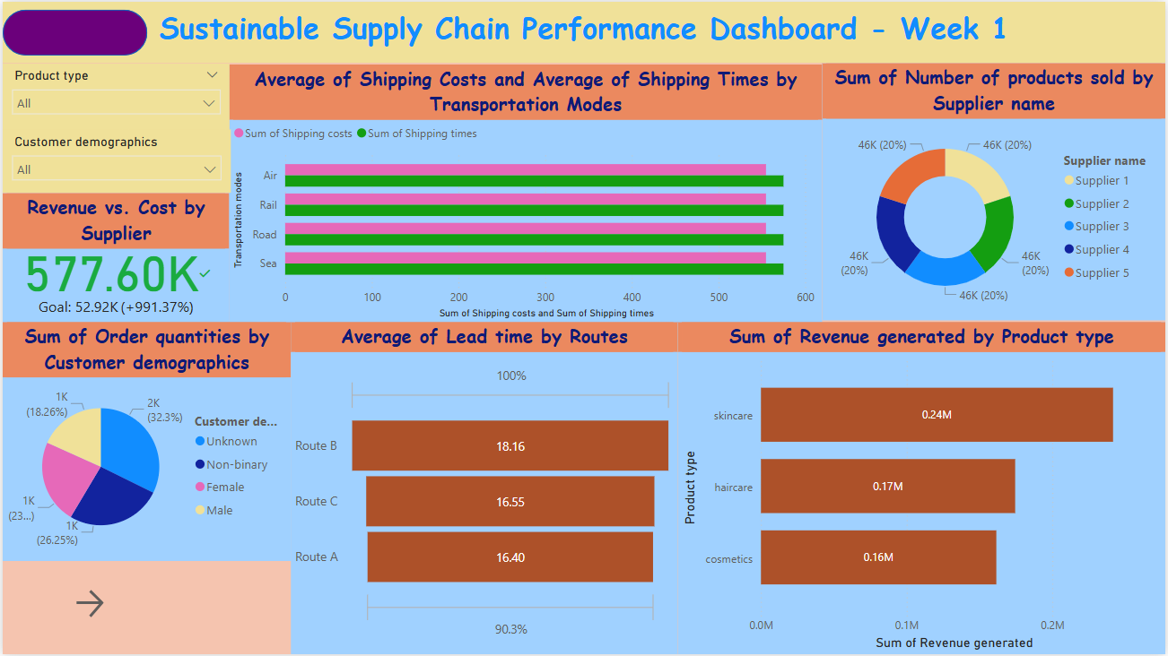
Screenshot of Output:

Slide 8
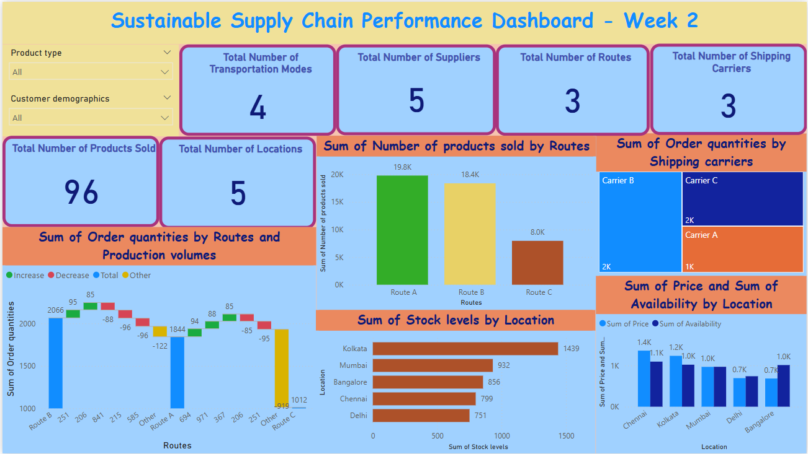
Screenshot of Output:

Slide 9
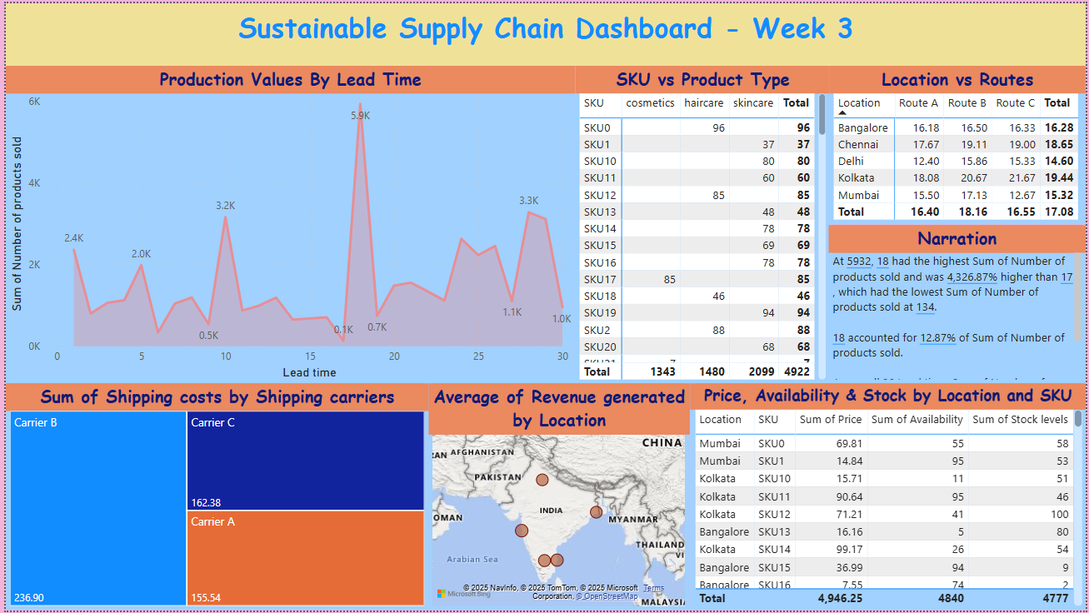
Screenshot of Output:

Slide 10
Conclusion:
The Sustainable Supply Chain Performance Dashboard provides real-time insights into key metrics.
Enhanced inventory management by identifying stock trends and avoiding stockouts or overstocking.
Improved lead time analysis to support better supplier and manufacturing planning.
Optimized transportation costs by visualizing routes, carriers, and shipping times.
Promoted data-driven decision-making through interactive visualizations in Power BI.
Highlighted sustainability opportunities by tracking the environmental impact of supply chain operations.
Empowered stakeholders with a unified view of supply chain performance, fostering continuous improvement.

Slide 11
Thank You

