Slide 1
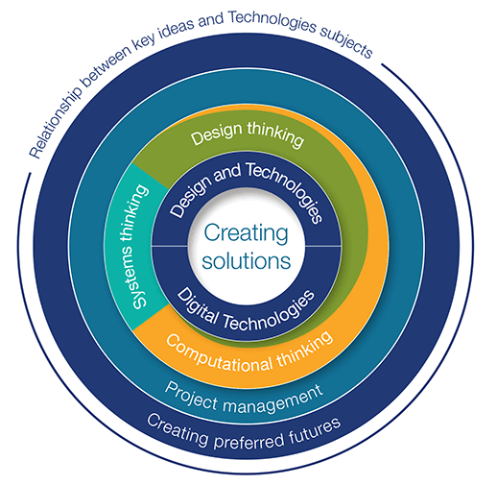
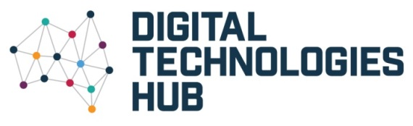

Technologies curriculum
Curriculum has been developed:
from Foundation to Year 8 in two subjects: Design and Technologies and Digital Technologies
from Years 9 to 10 in two optional subjects: Design and Technologies and Digital Technologies
2016 Education Services Australia Ltd, unless otherwise indicated.
Creative Commons BY 4.0 licence, unless otherwise indicated.
Australian Curriculum material is © ACARA 2010 to present, and is licensed under Creative Commons BY 4.0.
Notes:
The Australian Curriculum: Technologies has been developed:
from Foundation to Year 8 in two subjects: Design and Technologies and Digital Technologies
from Years 9 to 10 in two optional subjects: Design and Technologies and Digital Technologies

Slide 2
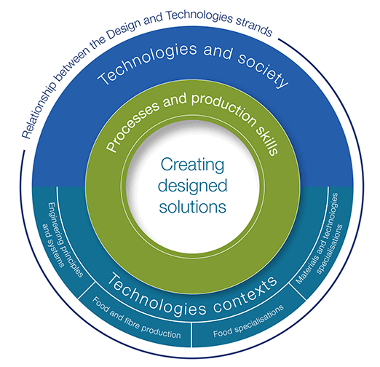
Design and Technologies
Comprises two related strands:
Design and Technologies knowledge and understanding – the use, development and impact of technologies and design ideas across a range of technologies contexts: engineering principles and systems; food and fibre production; food specialisations; materials and technologies specialisations
Design and Technologies processes and production skills – the skills needed to design and produce designed solutions.
Notes:
The Australian Curriculum: Design and Technologies comprises two related strands:
Design and Technologies knowledge and understanding – the use, development and impact of technologies and design ideas across a range of technologies contexts: engineering principles and systems; food and fibre production; food specialisations; materials and technologies specialisations
Design and Technologies processes and production skills – the skills needed to design and produce designed solutions.

Slide 3
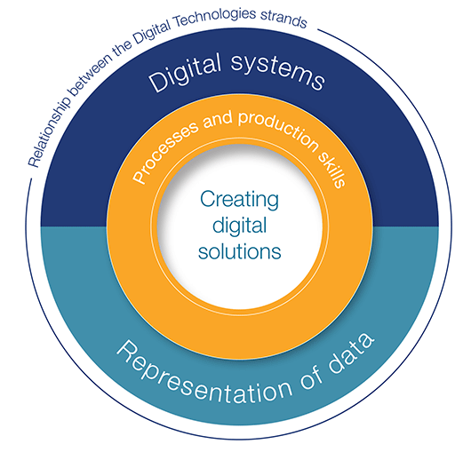
Digital Technologies structure
Comprises two related strands:
Digital Technologies knowledge and understanding – the information system components of data, and digital systems (hardware, software and networks)
Digital Technologies processes and production skills – using digital systems to create ideas and information, and to define, design and implement digital solutions, and evaluate these solutions and existing information systems against specified criteria.
Notes:
The Australian Curriculum: Digital Technologies comprises two related strands:
Digital Technologies knowledge and understanding – the information system components of data, and digital systems (hardware, software and networks)
Digital Technologies processes and production skills – using digital systems to create ideas and information, and to define, design and implement digital solutions, and evaluate these solutions and existing information systems against specified criteria.

Slide 4
ICT in the Australian Curriculum
ICT is addressed in the Australian Curriculum in two ways:
ICT Capability
Digital Technologies.
The capability assists students to become effective users of ICT.
The Digital Technologies curriculum assists students to become confident creators of digital solutions.
Notes:
ICT is addressed in the Australian Curriculum in two ways:
as the General Capability: ICT capability
and as a subject: Digital Technologies.
Aspects of ICT are also addressed in Media Arts.
The capability assists students to become effective users of ICT.
The Digital Technologies curriculum assists students to become confident creators of digital solutions.

Slide 5
Mitchel Resnick ...
“... most young people learn only to USE digital media, not to CREATE with digital media. It is as if they can ‘read’ but not ‘write’. They are not truly fluent with digital media. They browse websites but can't create their own. They play games, but can't create their own. They interact with simulations, but can't create their own.”
Notes:
Mitchel Resnick, Massechussets Institute of Technology (MIT) Media Lab, developed the Scratch programming language and online community and programmable bricks used in LEGO Mindstorms. Young people (ages 8 and up) have shared more than 4.5 million projects on the Scratch website.
This quote is very useful in allowing people to see the difference between the ICT Capability and Digital Technologies.

Slide 6
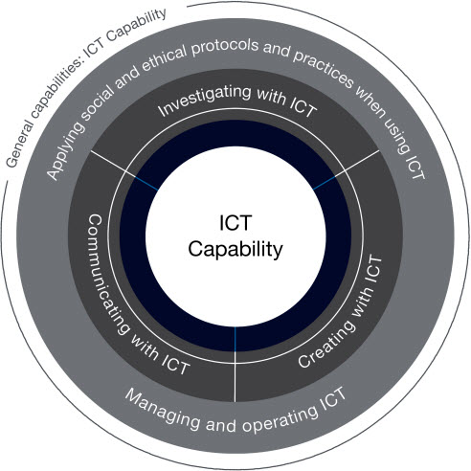
ICT Capability
Notes:
In the Australian Curriculum, students develop Information and Communication Technology (ICT) Capability as they learn to use ICT effectively and appropriately to access, create and communicate information and ideas, solve problems and work collaboratively in all learning areas at school and in their lives beyond school. ICT Capability involves students learning to make the most of the digital technologies available to them, adapting to new ways of doing things as technologies evolve and limiting the risks to themselves and others in a digital environment.
The key ideas for ICT Capability are organised into five interrelated elements in the learning continuum, as shown in the diagram. These are the organising elements of the ICT Capability.

Slide 7
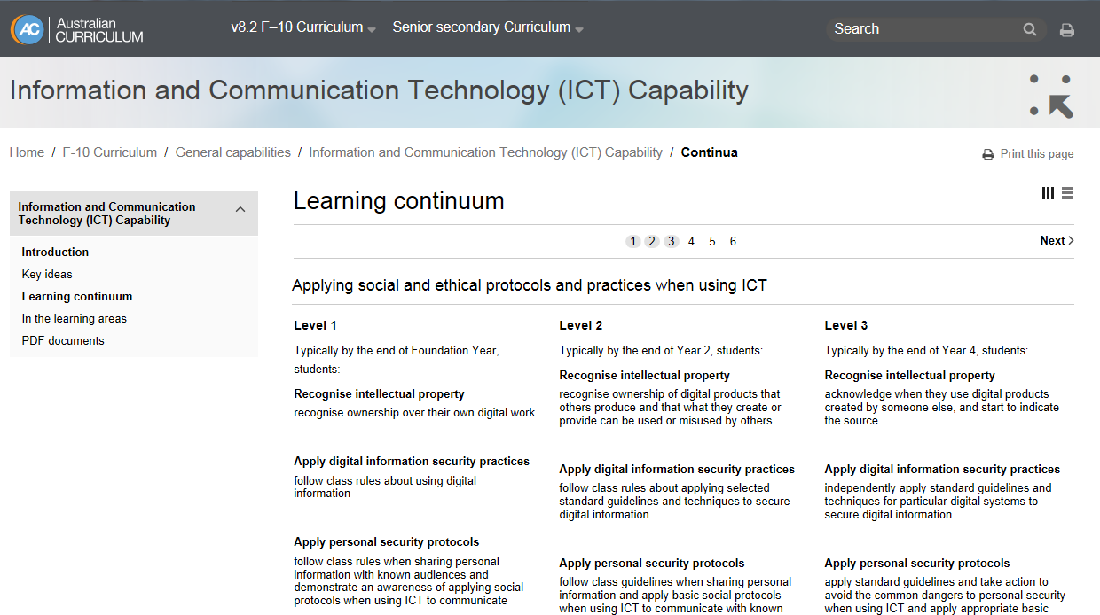
ICT Capability continuum
Notes:
The learning continuum for ICT Capability is provided at six levels across the five elements. Each element comprises sub-elements.

Slide 8
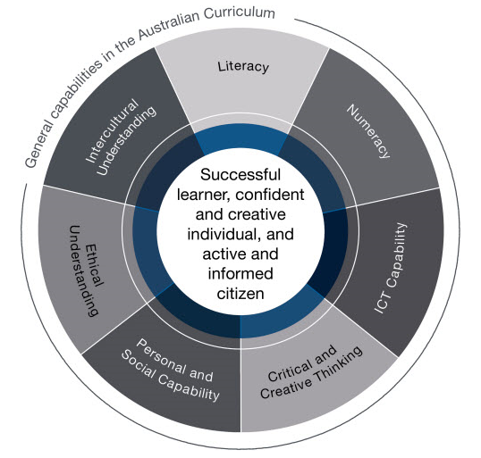
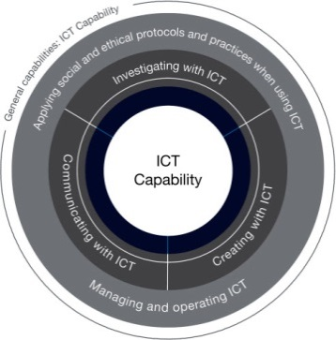
Relationship between Technologies and the ICT Capability
Notes:
ICT capability supports and enhances student learning across all areas of the curriculum. Students develop and apply ICT knowledge, skills and appropriate social and ethical protocols and practices to investigate, create and communicate, as well as developing their ability to manage and operate ICT to meet their learning needs. All learning areas provide the content and contexts within which students develop and apply the knowledge, skills, behaviours and dispositions that comprise ICT capability. However, it is more explicit and foregrounded in the Australian Curriculum: Digital Technologies.
In the Australian Curriculum: Digital Technologies, students develop an understanding of the characteristics of data, digital systems, audiences, procedures and computational thinking. They apply this when they investigate, communicate and create digital solutions. Students learn to formulate problems, logically organise and analyse data and represent them in abstract forms. They automate solutions through algorithmic logic. Students decide the best combinations of data, procedures and human and physical resources to generate efficient and effective digital solutions. They create digital solutions that consider economic, environmental and social factors.
In the Australian Curriculum: Design and Technologies, key ICT concepts and skills are strengthened, complemented and extended. Students become familiar with and gain skills using a range of software applications and digital hardware that enable them to realise their design ideas. Students use ICT when they investigate and analyse information and evaluate design ideas and communicate and collaborate online. They develop design ideas; generate plans and diagrams to communicate their designs and produce solutions using digital technologies, for example, creating simulations, drawings and models and manufacturing solutions (from basic drawing programs to computer-aided design/manufacture and rapid prototyping).

Slide 9
Key ideas
Creating preferred futures
Project management
Types of thinking:
design thinking
computational thinking
systems thinking
Notes:
Key ideas are embedded in the curriculum. They contribute to students’ knowledge, understanding and skills for the information age.
Creating preferred futures
Project management
Types of thinking:
design thinking
computational thinking
systems thinking

