Slide 1
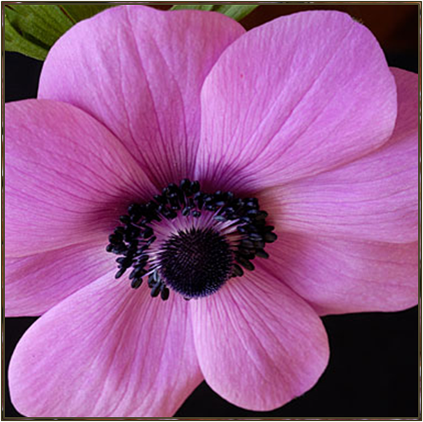
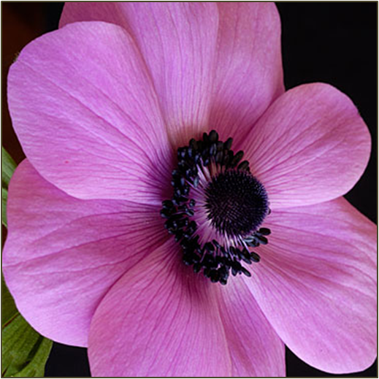

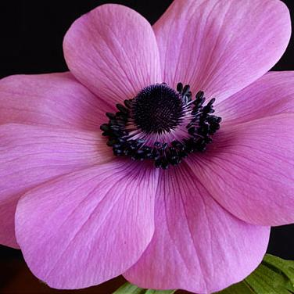

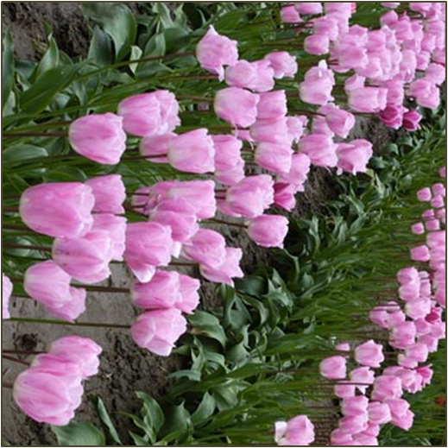
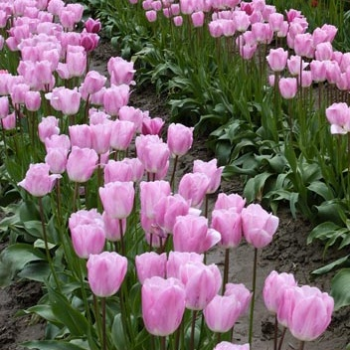


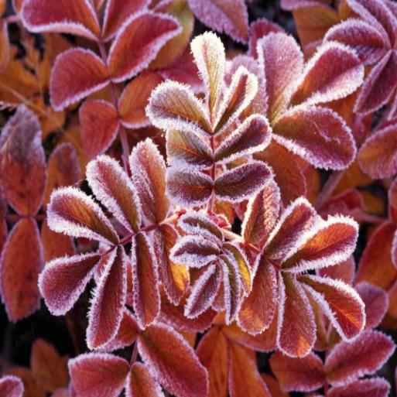





Notes:
Animated 3-D cube with changing pictures
(Basic)
Tip: This example uses six pictures grouped in four sets of three, so that during the animation, various pictures appear on the cube.
To reproduce the effects on this slide, do the following:
On the Home tab, in the Slides group, click Layout, and then click Blank.
On the Insert tab, in the Illustrations group, click Picture. In the Insert Picture dialog box, select a picture, and then click Insert.
Select the picture. Under Picture Tools, on the Format tab, in the Size group, click the Size and Position dialog box launcher. In the Format Picture dialog box, resize or crop the image so that the height is set to 3.42” and the width is set to 3.42”.
To crop the picture, click Crop in the left pane, and in the Crop pane, under Crop position, enter values into the Height, Width, Left, and Top boxes.
To resize the picture, click Size in the left pane, and in the right pane, under Size and rotate, enter values into the Height and Width boxes.
Under Picture Tools , on the Format tab, in the Picture Styles group, in the bottom right corner click the Format Shape dialog box launcher. In the Format Picture dialog box, in the left pane, click 3-D Format, and then in the 3-D Format pane, under Bevel, in the Top section, do the following:
Click the button next to Top and then select Convex (second row, third from the left)
In the Width box, enter 6 pt.
In the Height box, enter 6 pt.
Also in the Format Shape dialog box, in the left pane, click Line Color, and then in the Line Color pane, do the following:
Click Solid line.
Click the button next to Color, and then click More Colors. In the Colors dialog box, on the Custom tab, enter Red: 8, Green: 18, Blue: 31.
Also in the Format Shape dialog box, in the left pane, click Line Style, and then in the Line Style pane, in Width box, enter 0.75 pt.
To reproduce two additional pictures and the cube, do the following:
Select the picture on the slide. On the Home tab, in the Clipboard group, click the arrow next to Copy, and then click Duplicate. Repeat this step again for a total of three pictures. Position the pictures on the slide so that each one is visible.
Select one of the duplicate pictures. Under Picture Tools, on the Format tab, in the Adjust group, click Change Picture. In the Insert Picture dialog box, select a picture, and then click Insert.
Select the picture. Under Picture Tools, on the Format tab, in the Size group, click the Size and Position dialog box launcher. In the Format Picture dialog box, resize or crop the image so that the height is set to 3.42” and the width is set to 3.42”.
To crop the picture, click Crop in the left pane, and in the Crop pane, under Crop position, enter values into the Height, Width, Left, and Top boxes.
To resize the picture, click Size in the left pane, and in the right pane, under Size and rotate, enter values into the Height and Width boxes.
Repeat steps 1 -3 to reproduce another picture.
Select the picture that will appear on the top of the cube. Under Picture Tools, on the Format tab, in the Picture Styles group, click Picture Effects, point to 3-D Rotation, and then under Parallel, click Off Axis 1 Top (second row, third option from the left).
Select the picture that will appear on the left side of the cube. Under Picture Tools, on the Format tab, in the Picture Styles group, click Picture Effects, point to 3-D Rotation, and then under Parallel, click Off Axis 1 Left (second row, first option from the left).
Select the picture that will appear on the right side of the cube. Under Picture Tools, on the Format tab, in the Picture Styles group, click Picture Effects, point to 3-D Rotation, and then under Parallel, click Off Axis 1 Right (second row, second option from the left).
Drag the pictures on the slide to create a cube. The edges of each picture may not line up exactly. To align the pictures as closely as possible, on the View tab, click Zoom. In the Zoom dialog box, click 400%, and then drag the pictures on the slide.
Tip: To help more precisely place the pictures, select the picture that you want to move, then hold down the CTRL key and use the keyboard direction arrow keys.
Press and hold SHIFT and select all three pictures on the slide. On the Home tab, in the Drawing group, click Arrange, and then click Group.
On the Home tab, in the Editing group, click Select, and then click Selection Pane. Edit the name of the group in the Selection and Visibility pane, by double-clicking the group and then entering Cube Group.
To reproduce the shadow effects on this slide, do the following:
On the Home tab, in the Drawing group, click Shapes, and then under Rectangles click Rectangle (first option from the left). On the slide, drag to draw a rectangle.
Select the rectangle. Under Drawing Tools, on the Format tab, in the Size group, do the following:
In the Shape Height box, enter 3.42”.
In the Shape Width box, enter 3.42”.
On the Home tab, in the Drawing group, click the arrow next to Shape Fill, and then under Theme Colors click White, Text 1 (first row, second option from the left).
On the Home tab, in the Drawing group, click the arrow next to Shape Outline, and then click No Outline.
On the Home tab, in the bottom right corner of the Drawing group, click the Format Shape dialog box launcher. In the Format Shape dialog box, click 3-D Rotation in the left pane. In the 3-D Rotation pane, click the button next to Presets, and then under Parallel click Off Axis 1 Top (second row, third option from the left).
Also in the Format Shape dialog box, click Shadow in the left pane, and then do the following in the Shadow pane:
Click the button next to Presets, and then under Perspective click Below (first row, third option from the left).
In the Transparency box, enter 72%.
In the Size box, enter 110%.
In the Blur box, enter 41 pt.
In the Angle box, enter 115°.
In the Distance box, enter 111 pt.
On the Home tab, in the Drawing group, click Arrange, and then click Send to Back.
Drag the rectangle under the cube so that it looks like the cube is floating.
On the Home tab, in the Editing group, click Select, and then click Selection Pane. In the Selection and Visibility pane, press and hold CTRL and select both Cube Group and the rectangle. On the Home tab, in the Drawing group, click Arrange, and then do the following:
Click Group.
Point to Align, and then click Align to Slide.
Point to Align, and then click Align Center.
Point to Align, and then click Align Middle.
To reproduce the animation effects on this slide, do the following:
Select the cube. On the Home tab, in the Drawing group, Clipboard group, click the arrow next to Copy, and then click Duplicate.
Click one of the pictures in the new group of pictures and under Picture Tools, on the Format tab, in the group, click Change Picture. In the Insert Picture dialog box, select another picture and click Insert. If necessary resize the picture – under Picture Tools, on the Format tab, in the Size group, click the Size and Position dialog box launcher. In the Format Picture dialog box, resize or crop the image so that the height is set to 3.42” and the width is set to 3.42”.
To crop the picture, click Crop in the left pane, and in the Crop pane, under Crop position, enter values into the Height, Width, Left, and Top boxes.
To resize the picture, click Size in the left pane, and in the right pane, under Size and rotate, enter values into the Height and Width boxes.
Right-click another picture in the new group of pictures and repeat step 2.
Note: If necessary, reposition the new pictures so they form a cube.
Select the second cube. On the Animations tab, in the Animations group gallery of animation effects, under Entrance, click Fade.
In the Animation Pane, click the arrow next to the animation, and then click Timing. In the Fade dialog box, on the Timing tab, in the Delay box, enter 0.5 seconds, and then click OK.
Select both cubes. On the Home tab, in the Drawing group, click the arrow below Arrange, and under Position Objects, point to Align, and do the following:
Select Align Center.
Select Align Middle.
Repeat steps 1 through 6 two more times to reproduce the third and fourth cube, which improves the animation effect.
To reproduce the background effects on this slide, do the following:
On the Design tab, in the Background group, click Background Styles, and then select Style 8 (second row, fourth from the left).
Note: If this action is taken in a PowerPoint presentation containing more than one slide, the background style will be applied to all of the slides.

