Slide 1

Deep Learning Final Project
Group 4
Harpreet Kaur
Priyanka Awasthi
Shivraj Suryakant Dhumal
Vignesh Ram Sundararaman

Slide 2
Objective
Our objective is to use TensorFlow to explore Convolutional Neural Network and to optimize a network for a complex visual classification task.
Introduction
We require a model with a big learning capacity to learn about thousands of objects from millions of photos. Our model should also have a ton of previous knowledge to make up for all the data we don't have because the object recognition task is so complex that it cannot even be specified by a dataset as large as ImageNet. Convolutional neural networks (CNN) constitute one such class of models [16, 11, 13, 18, 15, 22, 26]. By changing their depth and width, they may adjust their capacity. They also make robust and generally accurate assumptions about the nature of images (namely, stationarity of statistics and locality of pixel dependencies). Thus, CNNs have improved performance compared to traditional feedforward neural networks with similar-sized layers.

Slide 3
Convolutional Neural Network
Convolutional Neural Network or ConvNets is a special type of neural network that is used to analyze and process images. It derives its name from the ‘Convolutional’ layer that it employs as a filter. This filter the images fed to it of specific features that is then activated. A feature map is therefore generated by passing the images through these filters to detect features, it’s position in the image and its strength that is relevant to the class.
We are given a dataset called the CIFAR-10 consisting of tiny (32 x 32) color images in 10 classes, it includes 50,000 training and 10,000 test images. Using this dataset, we used Python to experiment with the images like opening and viewing the images, resizing, and rearranging the images. Using TensorFlow, we built a convolutional neural network on at least three different image variants.

Slide 4
Task and Algorithm
Convolutional neural network is interesting because it automatically generates feature map for the images through the filters (the Convolutional Layer). This makes it very efficient and accurate for image recognition which eventually has a plethora of applications. Some of the top applications of it are image classification, recommendation systems, image and video recognition to name a few.
With the CIFAR-10 dataset, we have access to over 50,000 labelled images. Tensorflow to read images from the subdirectories and auto label the images based on the subdirectory names.
The Tensorflow library makes it quite straightforward to use convolutional neural network for our application. Specifically, we used pickle to load the data, we used keras.layers to build various layers on our ConvNet (a brief for convolutional neural network). Each of these files is a Python "pickled" object produced with Pickle. The system first uses various layers of ‘relu’ activation layers and a ‘softmax’. Using ‘relu’ in the activation layer helps us ensure that we don’t suffer from the vanishing gradient problem. Qualitatively, what it’s doing is controlling input neuron values and only allowing ‘pertinent’ information to be retained and propagated forward to the next layers.

Slide 5
Methodology
We first tried to understand how our ConvNet application is attempting to predict the class of the images, we analyzed what features ConvNet is paying attention to by analyzing what features get highlighted when passed through convolutional layers. We do this by building a model that will take an image as input and output the intermediate representation for all layers. We achieved this with the help of image class from the keras.preprocessing sub module of the tensorflow library.
We can visually look at how accurate the model is, history class and plotting it using the matplotlib. The graph shows us the accuracy on our training and validation data set. It is important to see that the accuracy on the validation set is as close to the training set as possible so that the model is generalized and not under-fitted or over-fitted.

Slide 6
The Architecture of our Project
This section describes the overall architecture of CNN, the net contains five layers for model 1, six layers for model 2 and six layers for model 3; the first five are convolutional and the remaining three are fully connected. We used input_shape of [32, 32, 3] because CIFAR-10 data has 32*32 pixels, so it’s 32 for each channel of RGB. The output of the last fully connected layer is fed to a ‘softmax’ which produces a distribution over the different class labels.
Dropout
A very effective method to lower test errors is to combine the predictions of several independent models, but it appears to be too expensive for large neural networks, which already require several days to train. However, there is a very effective form of model combination that only incurs a factor of two in training expenses. The neurons that are in this fashion "dropped out" do not contribute to the forward pass or backpropagation.
The dropout rate in our model1 is 10% as we used dropout (0.1) for model 1. However, we changed our dropout rate to 50% from 10% in other models as all the guidance we got from research articles suggested a dropout rate of approximately 50% is good for a model.

Slide 7
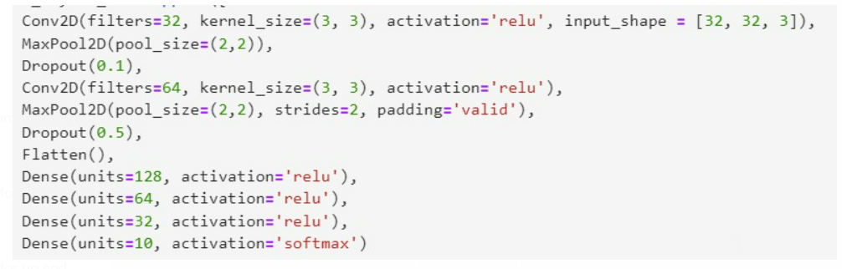
Model 7
Out of all seven models we ran, model 7 depicts the best performance
Creating the convolutional base for Model – 7 and addition of Dense layers

Slide 8
Model 7 - Continued
Compile the model
Training the model

Slide 9
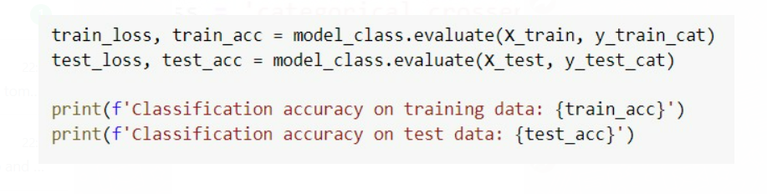
Model 7 - Continued
Evaluate the model

Slide 10
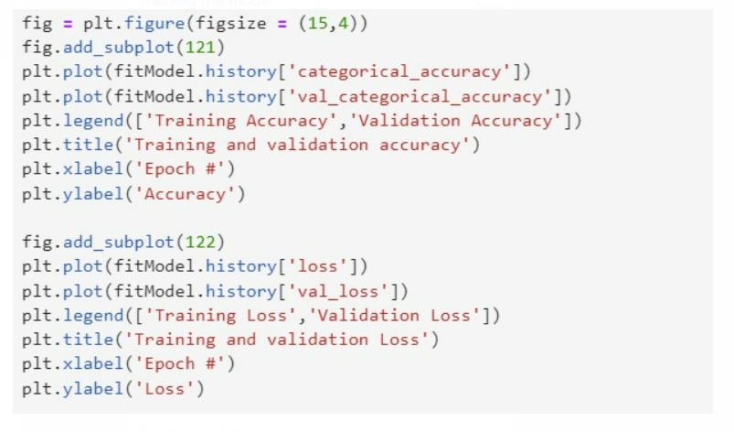
Model 7 - Continued
Plot of accuracy and loss

Slide 11
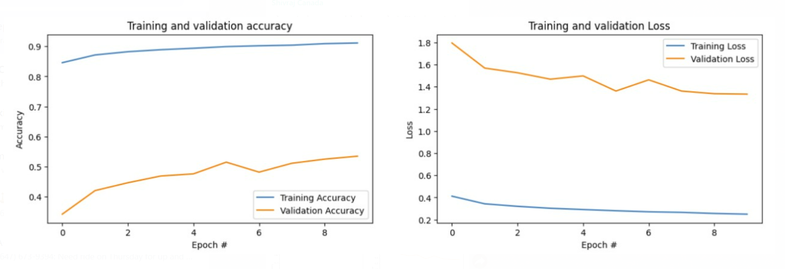
Model 7 - Continued
Model Plot

Slide 12

Results
Our findings demonstrate that a large, deep convolutional neural network is capable of breaking records on a very difficult dataset when utilizing only supervised learning. It is noteworthy that removing just one convolutional layer causes our network's performance to suffer. Initially, we noticed that the performance increased with each model, for instance, model 1 has the validation accuracy of only 50% however, this accuracy increased with each model. The best model is MODEL7 with validation accuracy of 53%, drop rate of 10% -50%, learning rate was default value of 0.001.

