Slide 1
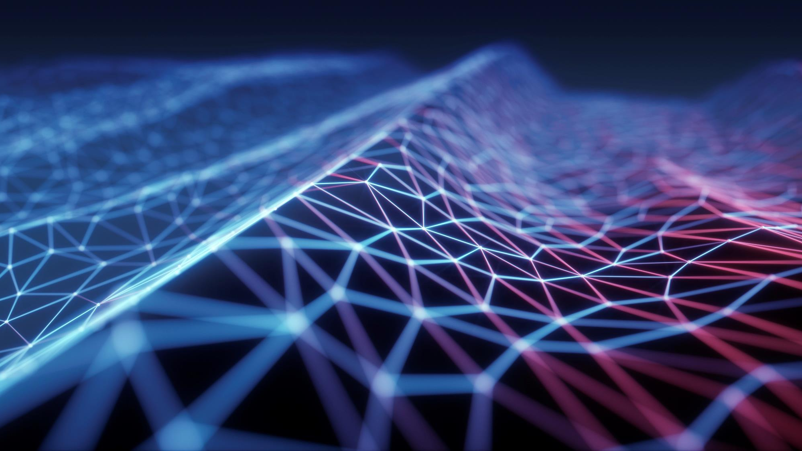
Computer vision project
Neural image style transfer using cnn (convolutional neural network)
Video Presentation: https://youtu.be/WFm4TGNcwps

Slide 2
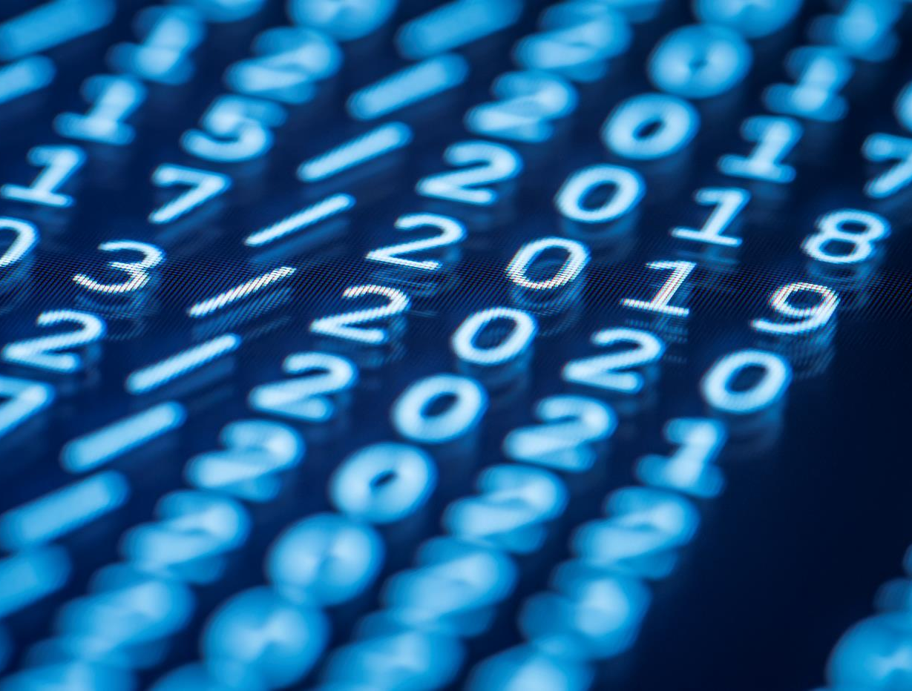
Mentor
Professor Babatunde Giwa
Group Members
Javid SADR
NONSO Ukwuma
YUKTI kakkar
Shivraj dhumal

Slide 3
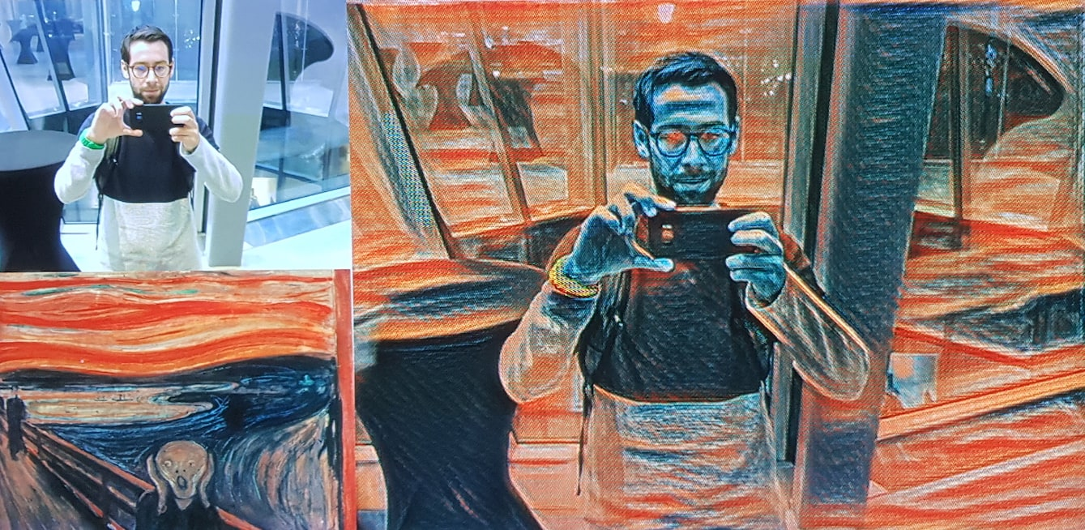
introduction
Neural Image Style Transfer is a way to transfer style (texture, color, etc) from one image called as Style Image on to the primary image called as content image using Convolutional Neural Network algorithm in machine learning.
It makes use of transfer learning approach wherein the most relevant parts or layers of a pre-trained sophisticated machine learning model are used.
VGG-19, a convolutional neural network that is 19 layers deep is used.

Slide 4
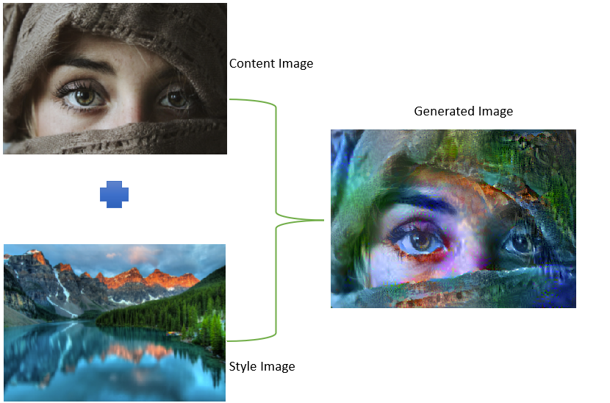
PREVIEW
Use a primary content image and apply styling or effect from another image (style image) to get the resulting output image (generated image) using the concept of style transfer using Convolutional Neural Network.

Slide 5
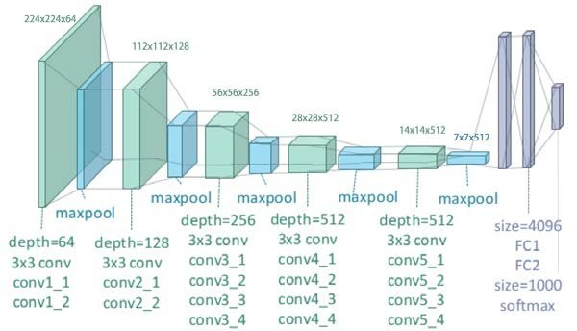
What is VGG-19?
VGG-19 is a convolutional neural network consisting of 19 layers (16 convolutional layers and 3 fully connected layers, 5 MaxPooling layers and 1 SoftMax layer.
Trained on the ImageNet database with about a million images of 1000 categories.
VGG-19 can recognize low-level features using earlier layers and high-level features using deep layers.

Slide 6
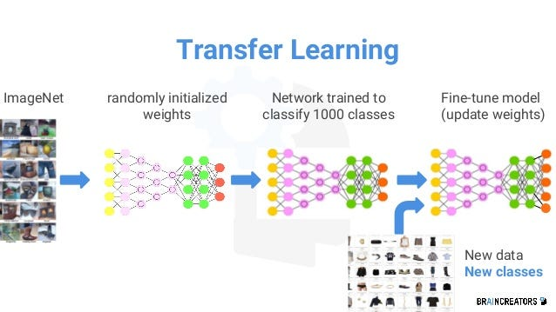
What is Transfer learning?
Training machine learning models requires a lot of data, which is not always available. This is where transfer learning comes into play as it leverages previously trained models.
Transfer learning is a popular approach in machine learning where a pre-trained model developed for a task is reused as the starting point for a model on a second task.
VGG-19 is one such model which is trained on high end GPUs for weeks which demands using high end resources and time.

Slide 7
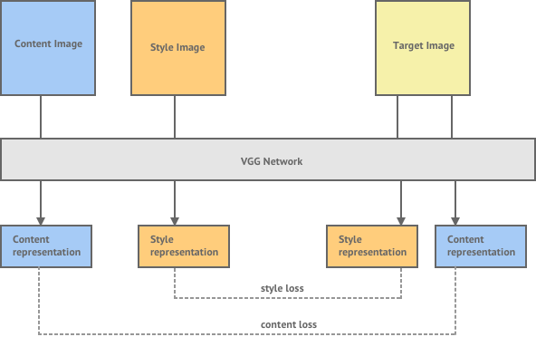
Steps Involved in neural style transfer
Compute the features for each of the images (content, style and generated image)
Compute content loss and style loss
Compute total combined loss
Backpropagate the gradient to update the generated image weight pixels.

Slide 8
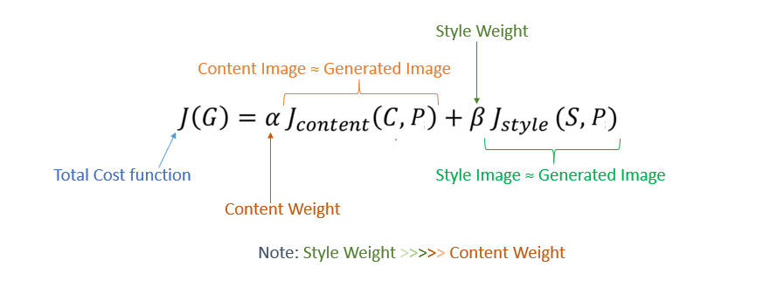
The cost function
In style transfer, the weights and biases of the neural net are kept constant while the target image is updated by changing the pixel values.
This process takes place until the cost function has the minimum loss.

Slide 9
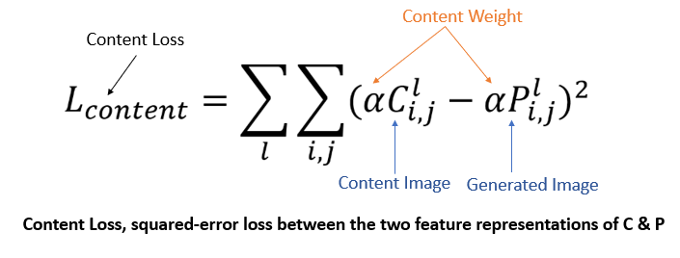
CALCULATING CONTENT LOSS
Content loss is the loss of content between the generated image and the input image.
The details from content image are copied to the generated image using MSE (mean squared error).

Slide 10
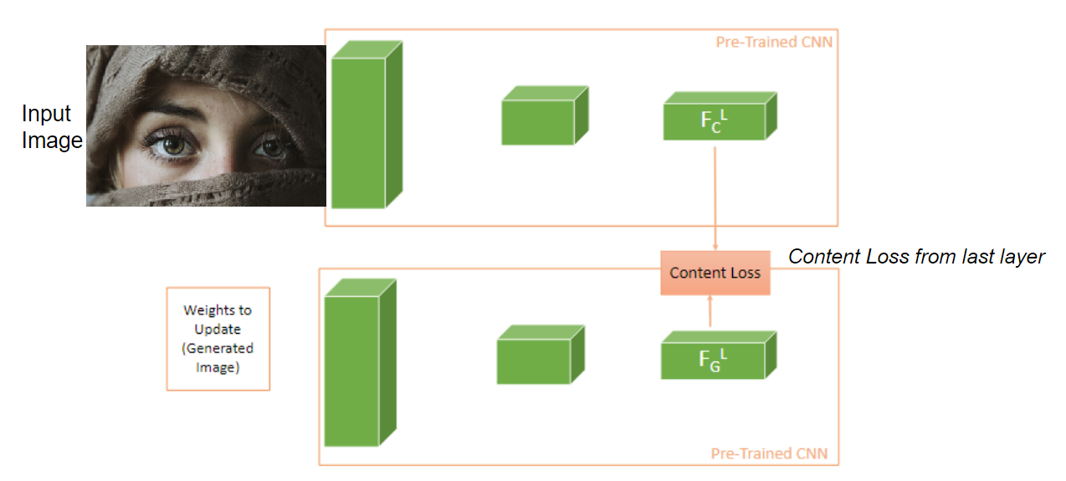
CALCULATING CONTENT LOSS
Last feature maps of the content image are used from the neural network because it consists of learned features like objects of parts of objects.

Slide 11
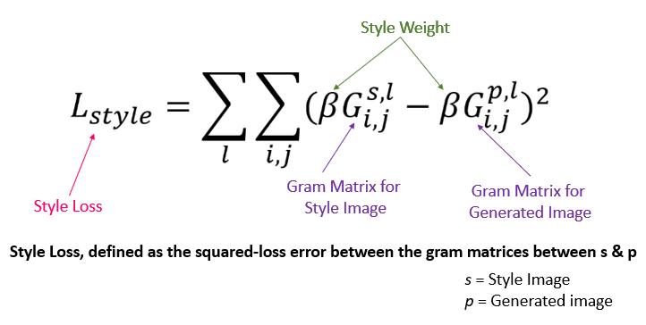
CALCULATING STYLE LOSS
Using style loss, we can check how much style related details of the style image are in the generated image.
To achieve that, the similar correlation of the activations between the style image and the generated image are measured by correlation matrix called as gram matrix.

Slide 12
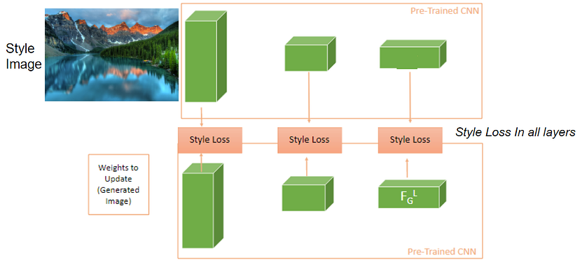
CALCULATING STYLE LOSS
Unlike in content loss, in style loss we use all the layers in the CNN.
We need to transfer every detail of the style image to the generated image and need to compute style loss from each layer of the encoder (Pre-trained CNN Model) where different details are found.

Slide 13
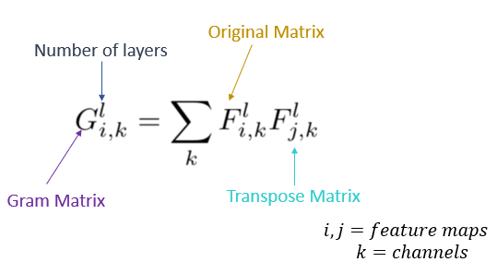
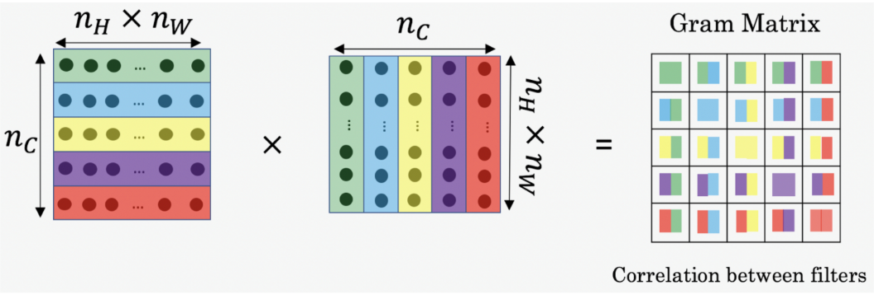
Why use gram matrix?
Gram matrix only takes into account whether the style related features are present in the image weights, textures and shapes.
The gram matrix is a dot product of feature maps of a layer that summarizes the activations that co-occur.

Slide 14
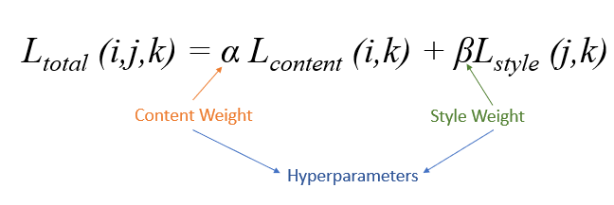
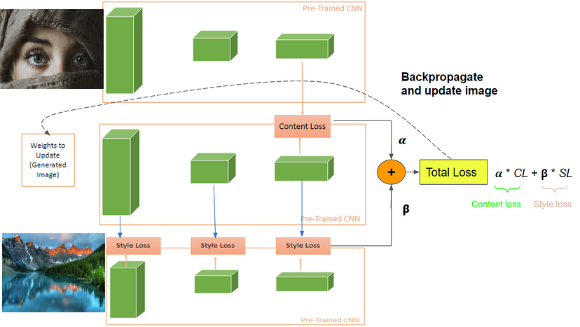
Calculating total loss
The total loss is calculated as weighted loss of content and style losses.
The α and β are used to control how much amount of content and style are to be represented in the generated image.
The main goal of total loss calculation is to minimize the total loss.

Slide 15
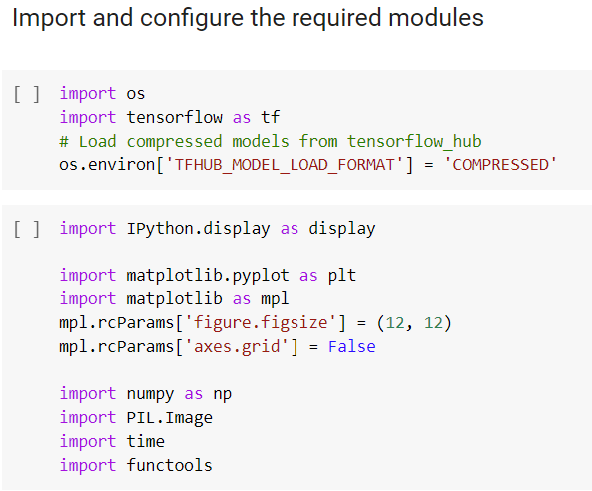
Code Overview
We are using mainly tensorflow libraries or modules, matplotlib to visualize the images and other libraries like Pillow.Image

Slide 16
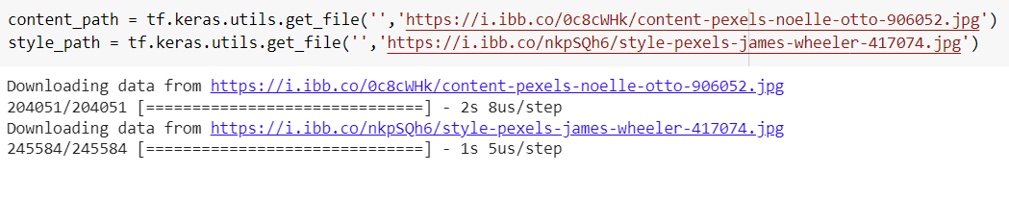
Code Overview
Download the content and style images

Slide 17
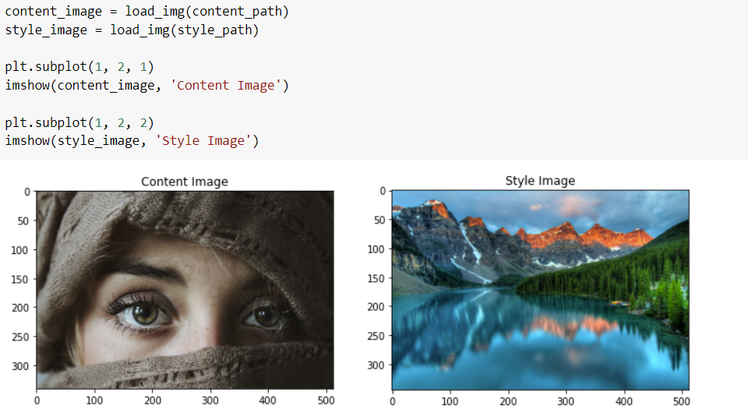
Code Overview
Using matplotlib, we visualize both the input images – the content image and the style image

Slide 18
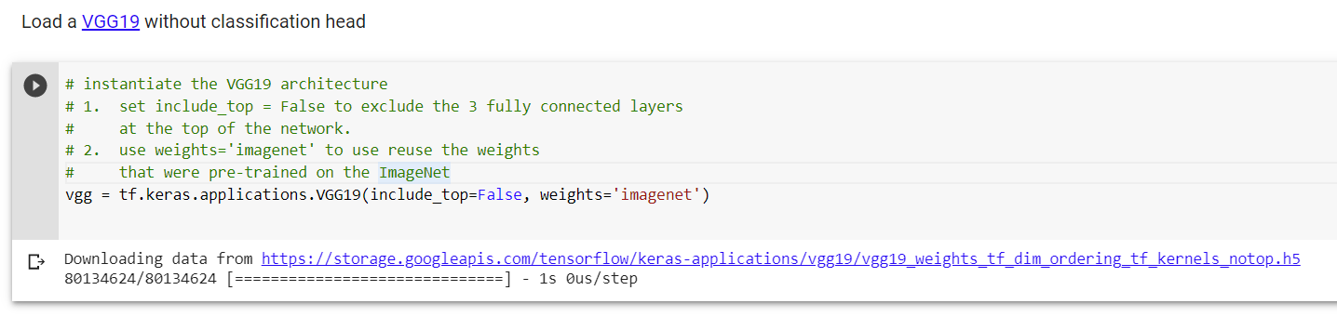
Code Overview
Load the VGG-19 pre-trained model from tf.keras

Slide 19
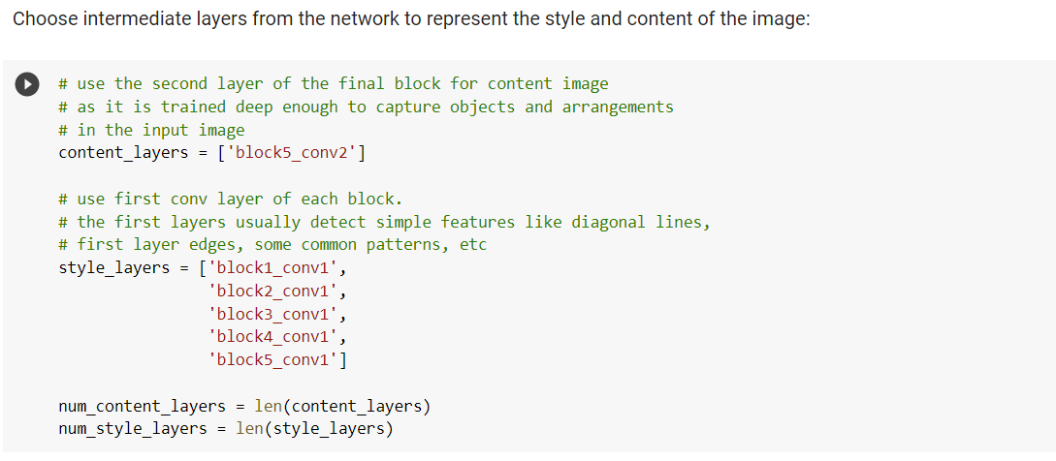
Code Overview
Set the content layers and style layers based on the names from the VGG-19 network

Slide 20
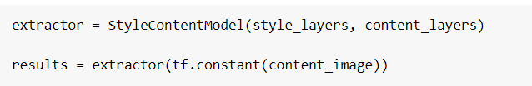
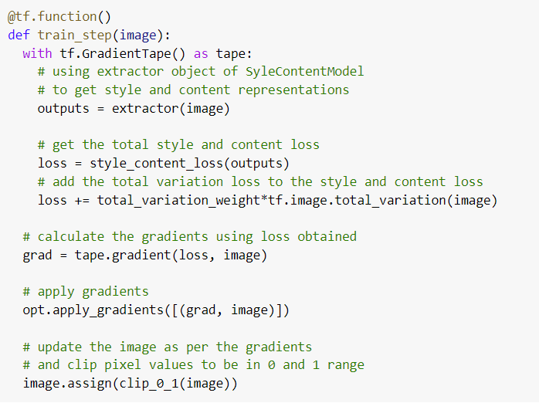
Code Overview
Using tf.GradientTape to update the image
Defining the train_step function to perform gradient calculation and update image pixel values for each train step epoch

Slide 21
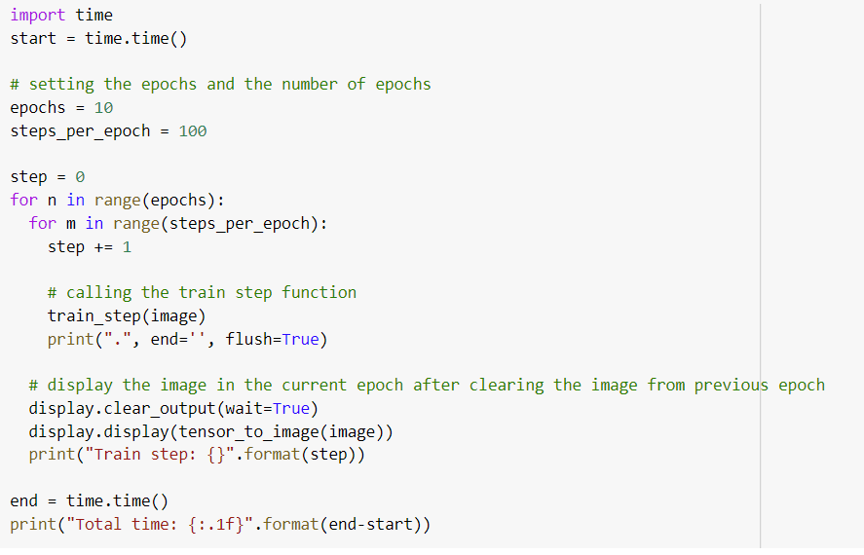
Code Overview
Run the optimization and display the final image

Slide 22
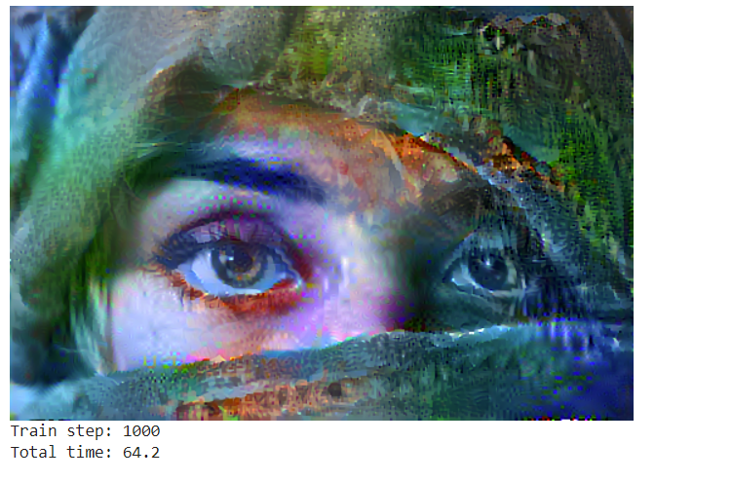
The result
Viewing the generated image after merging the style from style image on the content image

Slide 23
Computer vision project
AIGS 1010 – Final Project
Group 2 - Participation Report
Project Progress and Contributions: Throughout the course of the project, our group made significant progress in implementing neural image style transfer using CNN. Here's a summary of our contributions:
Task completed by each group member :
Shivraj Dhumal: Conducted research on existing literature related to neural image style transfer and helped implement the neural style transfer algorithm using CNN. Also helped write the project report and presentation.
Javid Sadr: Worked on brainstorming and researching for references. Also contributed to the project report and presentation. Conducted experiments to evaluate the performance of the neural style transfer algorithm on different images
Yukti Kakkar: Helped test the algorithm on different images. Also contributed to the project report and presentation. Conducted experiments to evaluate the performance of the neural style transfer algorithm on different images
Nonso Ukwuma: Conducted experiments to evaluate the performance of the neural style transfer algorithm on different images and provided valuable insights on improving the algorithm's performance. Also contributed to the project report and presentation.
Overall, each member of our group played a crucial role in the project's success, and we all contributed to the project report and presentation.

Slide 24
Thank you

