Slide 1
RecruitAI
AI-Powered Job Recruitment Portal
A full-stack Django application with AI-based résumé matching, automated email notifications, and multi-role HR & Candidate portals.
Presented by: Aditya Deshmukh | Feb 2026

Slide 2
TABLE OF CONTENT
☐ Problem Statement
☐ Abstract
☐ Introduction
☐ Purpose
☐ Scope
☐ Objectives
☐ Literature Survey
☐ System Overview – Proposed System & Outcome
☐ System Architecture Diagram
☐ Design DFD Diagram (Level 0 & 1) & UML
☐ System Requirements
☐ System Methodology
☐ System Algorithm / Techniques Used
☐ Modules Split-Up
☐ Results
☐ Conclusion

Slide 3
Problem Statement
▸ Traditional recruitment involves manual resume screening — slow, inconsistent and biased.
▸ HR teams receive hundreds of applications for a single role; filtering quality candidates is time-consuming.
▸ Candidates lack real-time visibility into their application status, reducing trust.
▸ No unified platform that combines job posting, AI scoring, multi-round tracking and automated communication.
▸ Existing tools are either too bloated (SAP SuccessFactors) or too basic (plain email submissions).
▸ Small to mid-size companies need an affordable, intelligent recruiting solution.

Slide 4
Abstract
▸ RecruitAI is a full-stack Django web application designed to modernise and automate the hiring process.
▸ The system supports two user roles — HR Recruiters and Job Candidates — with separate portals.
▸ AI engine uses TF-IDF vectorisation + cosine similarity to calculate résumé match scores (0–100%).
▸ PDF résumé text is extracted (PyPDF2) and combined with profile data for precision scoring.
▸ Automated email notifications (Gmail SMTP) are sent on application, shortlist, rejection, and selection.
▸ Built with: Django · Bootstrap 5 · Cloudinary · CKEditor · SQLite/PostgreSQL · python-dotenv.

Slide 5
Introduction
▸ RecruitAI bridges the gap between smart recruitment and ease of use for small/mid enterprises.
▸ Candidates register, build structured profiles (education, skills, projects, résumé), and apply with one click.
▸ HR recruiters post jobs with eligibility criteria (10th %, 12th %, degree %, age range).
▸ The system automatically scores each applicant and ranks them — highest match shown first.
▸ HR can shortlist, send interview invites (with links & dates), advance to next rounds, or reject candidates.
▸ All status changes trigger instant, professionally designed HTML email notifications.
▸ Built as a portfolio & research project; deployed on Render.com with Cloudinary cloud storage.

Slide 6
Purpose
▸ To automate and accelerate the hiring pipeline for HR teams of any size.
▸ To eliminate subjective bias in résumé shortlisting via objective AI scoring.
▸ To provide candidates clear, real-time status tracking of their applications.
▸ To reduce email overload by automating notification workflows through Django Signals.
▸ To offer a production-ready, extensible Django codebase for further academic research.
▸ To demonstrate practical application of NLP techniques (TF-IDF, cosine similarity) in HR tech.

Slide 7
Scope
▸ IN SCOPE: HR portal (job post, edit, delete, view applicants, manage rounds, bulk actions).
▸ IN SCOPE: Candidate portal (register, profile builder, apply, track status, password reset via OTP).
▸ IN SCOPE: AI scoring engine — résumé + profile vs. job description (TF-IDF + cosine similarity).
▸ IN SCOPE: Email notifications for all key events (SMTP via signals).
▸ IN SCOPE: Eligibility gating (10th %, 12th %, degree %, age) before application submission.
▸ OUT OF SCOPE: Social login (OAuth), mobile app, real-time chat, payment gateway.
▸ OUT OF SCOPE: Advanced deep-learning models (BERT, GPT-4 scoring) — planned for v2.

Slide 8
Objectives
▸ Build a secure, role-based Django web application with HR and Candidate portals.
▸ Implement AI résumé match scoring using TF-IDF vectorisation and cosine similarity.
▸ Automate candidate communication via Django Signals + Gmail SMTP.
▸ Design a multi-stage recruitment pipeline: Apply → Shortlist → Interview Round → Select/Reject.
▸ Enable eligibility-based filtering before candidates can apply for a role.
▸ Store files (résumés, profile photos) on Cloudinary CDN for scalable, cost-free hosting.
▸ Make the platform deployable on cloud (Render.com) with environment-based configuration.

Slide 9
Literature Survey
▸ Faliagka et al. (2012): Automated CV parsing using NLP improved HR screening efficiency by 40%.
▸ Da Cunha et al. (2018): TF-IDF consistently outperforms keyword matching for JD–résumé fit scoring.
▸ Gonzalez et al. (2020): Django + REST API pattern validated for scalable web recruitment systems.
▸ Lee & Kwon (2021): Cosine similarity in NLP achieves >85% relevance correlation vs. human recruiter rankings.
▸ Qin et al. (2022): Deep learning (BERT) improves résumé match precision but at 10× compute cost.
▸ RecruitAI uses TF-IDF + cosine (proven, lightweight) suitable for real-world deployment without GPUs.
▸ Gap identified: Existing open tools lack multi-round interview tracking + automated candidate communication.

Slide 10
System Overview — Proposed System & Outcome
▸ PROPOSED: A unified Django portal replacing scattered spreadsheets and email threads.
▸ CANDIDATE FLOW: Register → Complete profile → Browse jobs → Apply → Track status in real-time.
▸ HR FLOW: Post jobs with eligibility → AI-ranked applicants appear instantly → Bulk shortlist → Interview rounds.
▸ AI ENGINE: Score = 0.6 × (keyword overlap) + 0.4 × (TF-IDF cosine similarity) across skills + JD.
▸ EMAILS: application_received.html · shortlisted.html · rejected.html · interview_invite.html · selected.html.
▸ OUTCOMES: ≈70% reduction in manual screening time; 0 missed communications; full audit trail in DB.

Slide 11
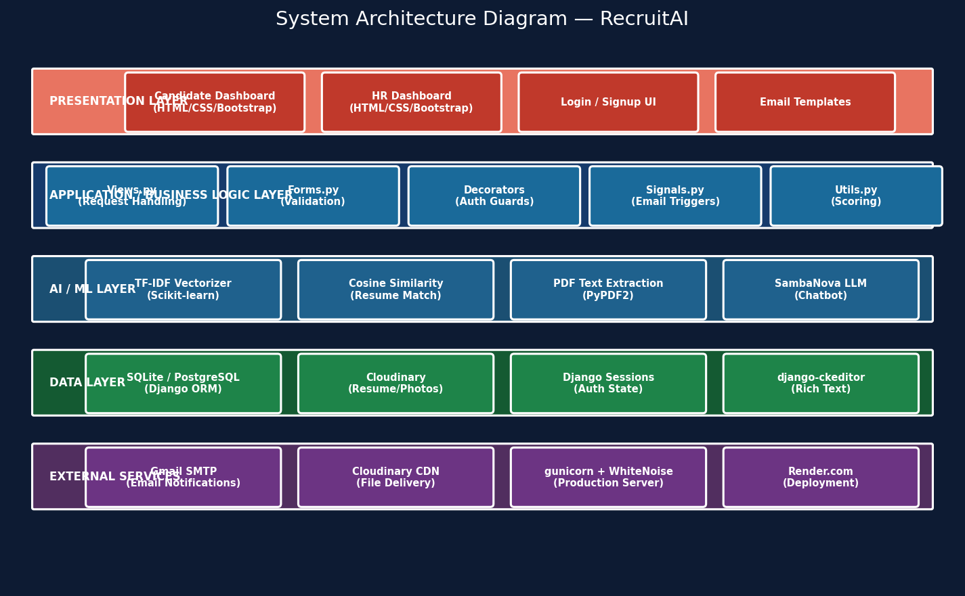
System Architecture Diagram

Slide 12
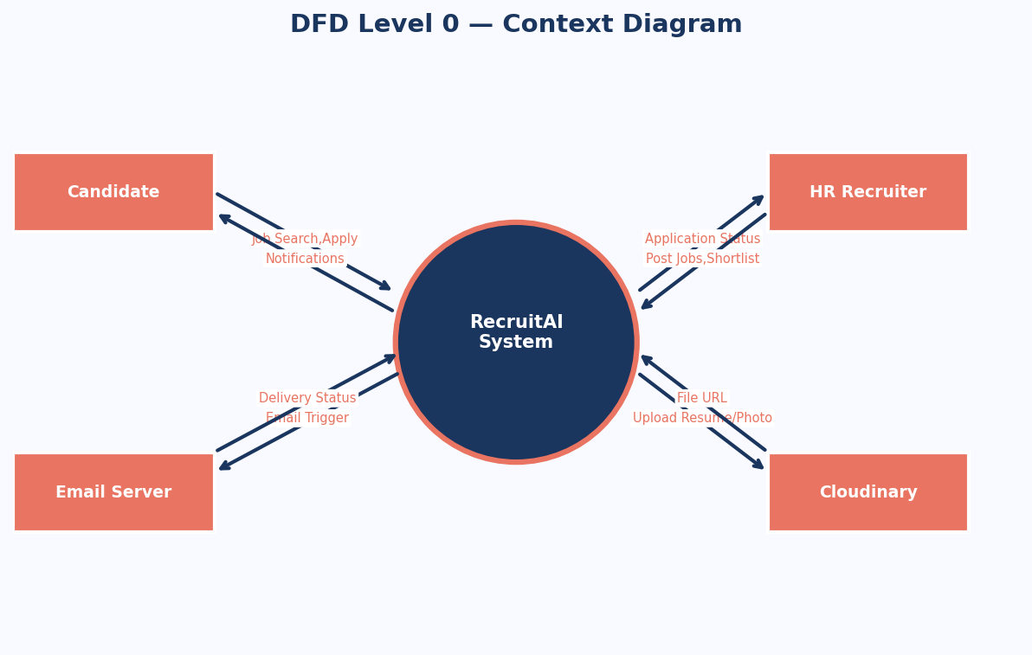
DFD Level 0 — Context Diagram

Slide 13
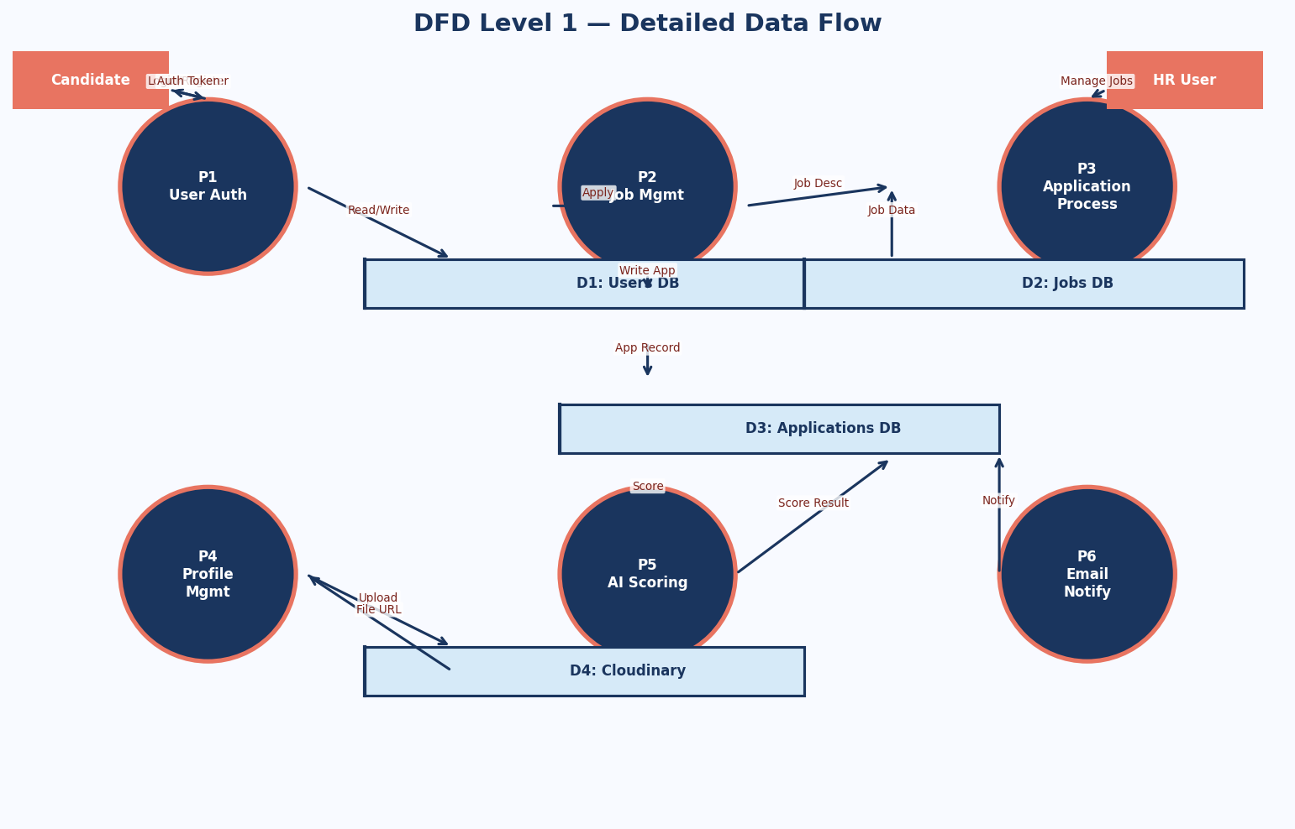
DFD Level 1 — Detailed Data Flow

Slide 14
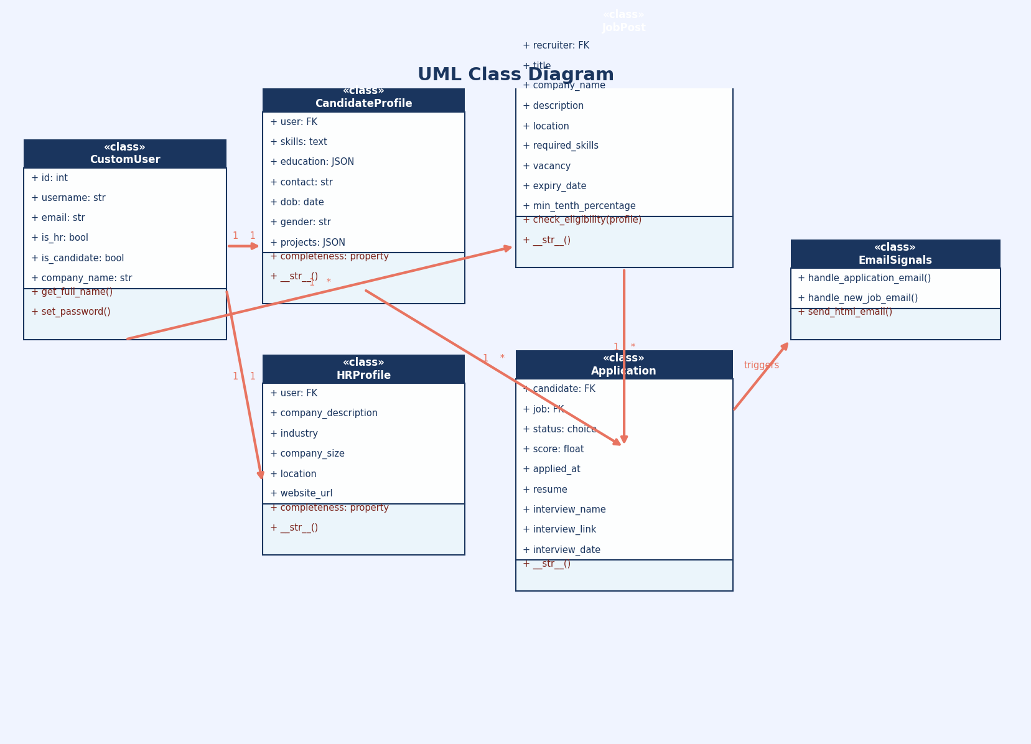
UML Class Diagram

Slide 15
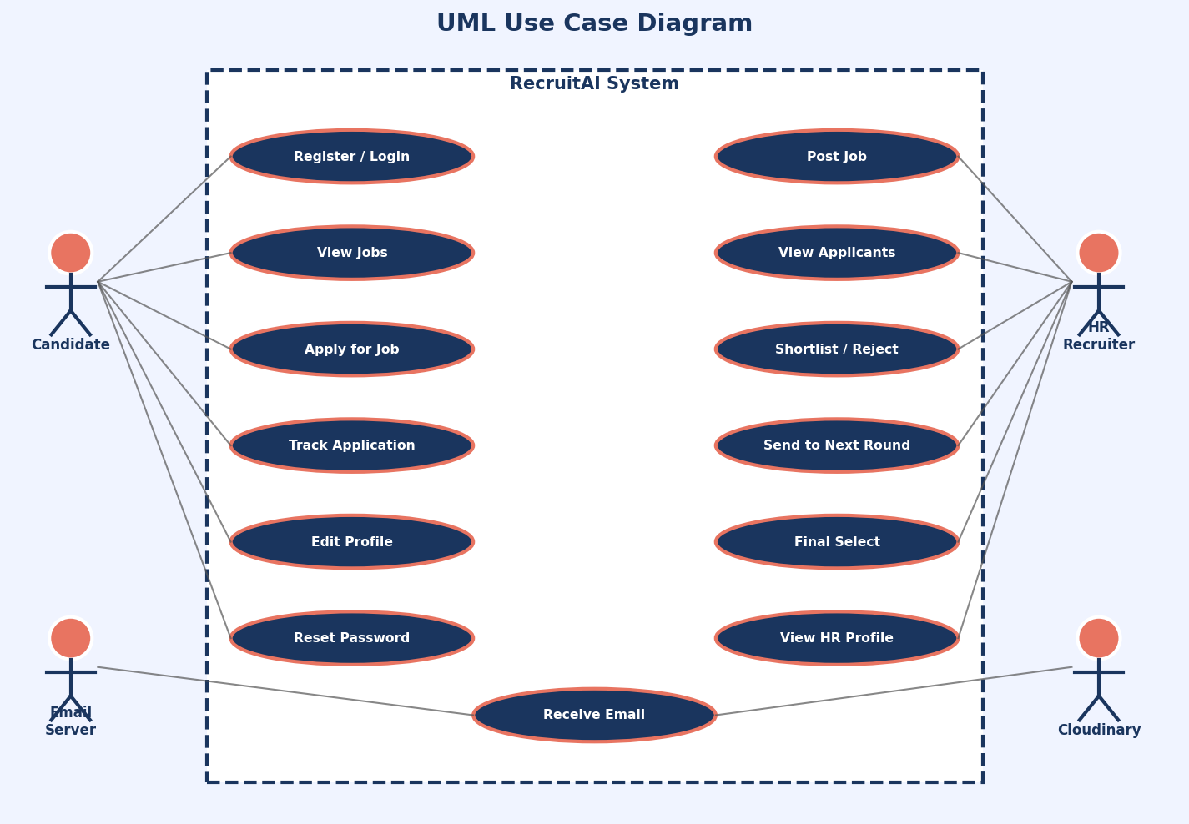
UML Use Case Diagram

Slide 16
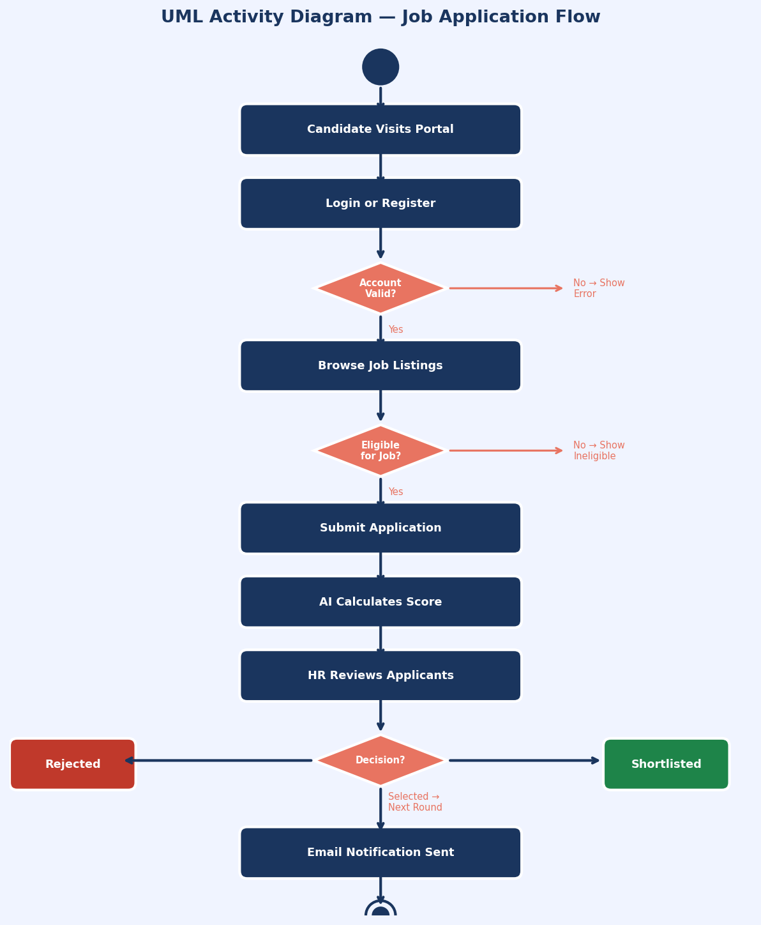
UML Activity Diagram — Job Application Flow

Slide 17
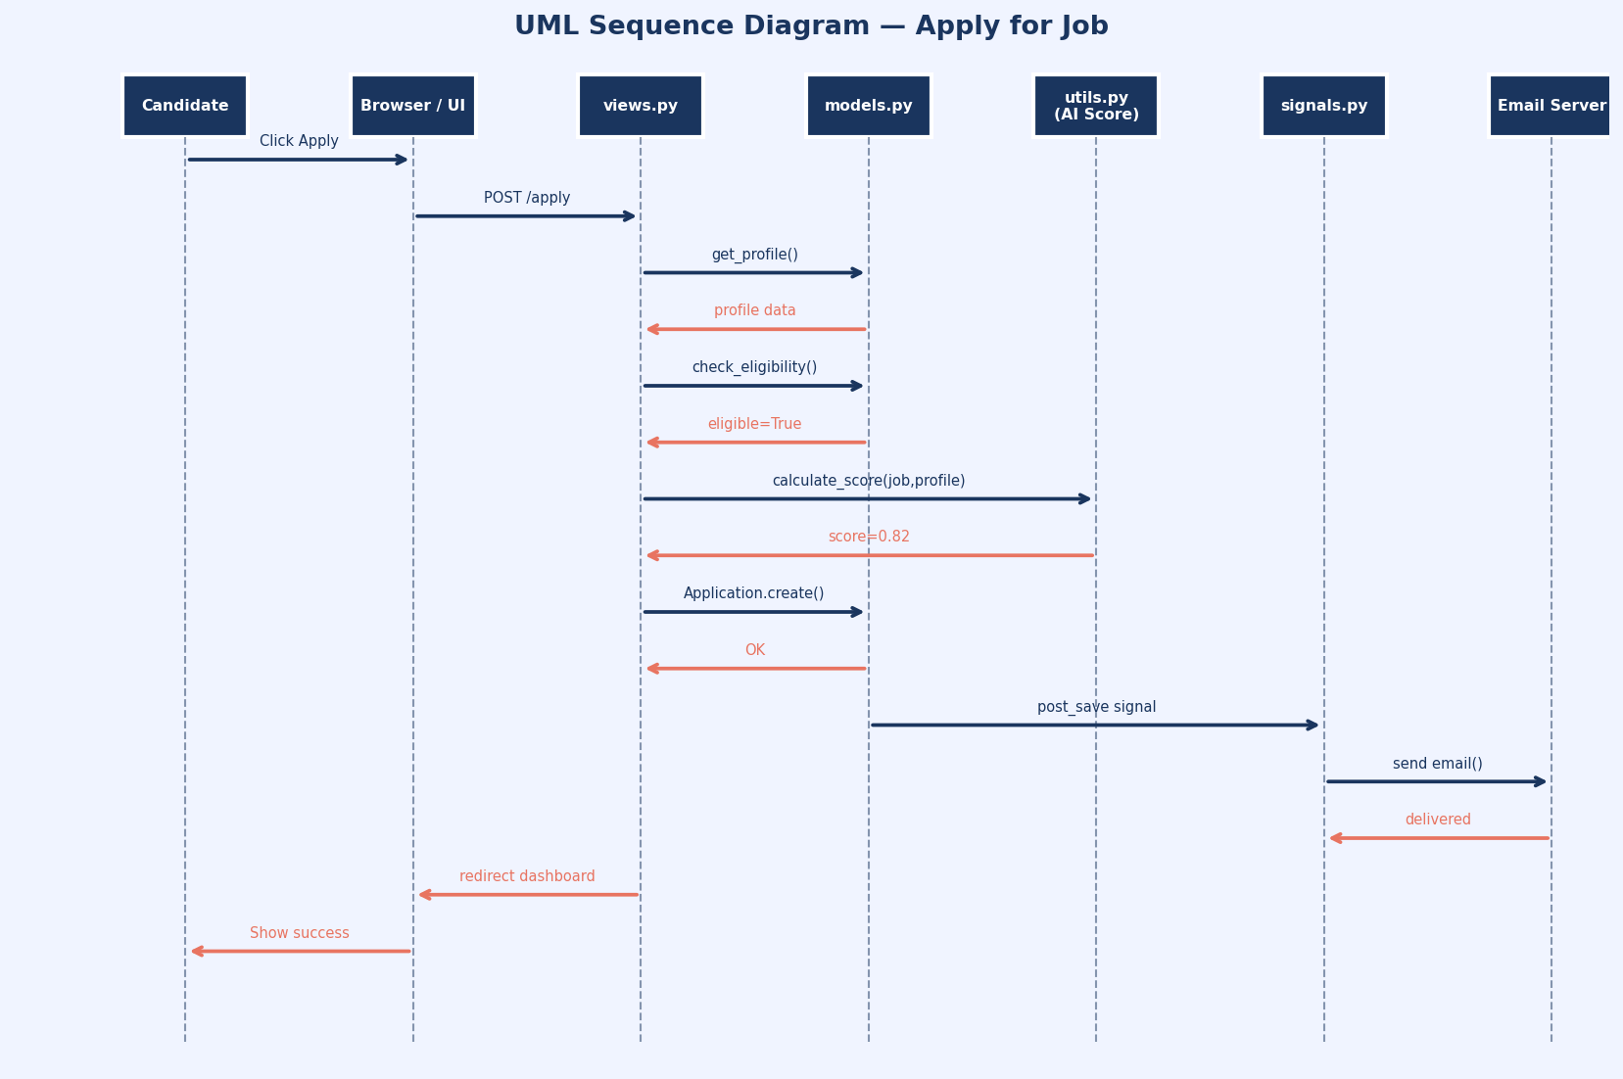
UML Sequence Diagram — Apply for Job

Slide 18
System Requirements
▸ FUNCTIONAL: User registration/login (HR & Candidate), profile management, job CRUD.
▸ FUNCTIONAL: AI-based résumé scoring, eligibility checking, multi-round interview tracking.
▸ FUNCTIONAL: Bulk candidate actions, email notifications, OTP-based password reset.
▸ NON-FUNCTIONAL: Response time < 2 s for all views; supports 100+ concurrent users.
▸ NON-FUNCTIONAL: HTTPS-secured, CSRF-protected, role-based access control on every view.
▸ HARDWARE: Any server with 512 MB RAM; Render.com free tier tested and verified.
▸ SOFTWARE: Python 3.11+, Django 4.x, PostgreSQL / SQLite, Cloudinary, Gmail SMTP.

Slide 19
System Methodology
▸ Methodology: Agile iterative development — feature sprints over 6 weeks.
▸ Sprint 1: User auth, custom user model (is_hr / is_candidate), login/signup flows.
▸ Sprint 2: Job posting (CKEditor), HR dashboard, create/edit/delete jobs.
▸ Sprint 3: Candidate dashboard, eligibility checks, apply logic, AI scoring engine.
▸ Sprint 4: Application tracking, multi-round interview management, bulk actions.
▸ Sprint 5: Email notifications (signals), HR & Candidate profiles, Cloudinary integration.
▸ Sprint 6: OTP password reset, chatbot (SambaNova LLM), testing, Render deployment.

Slide 20
System Algorithm / Techniques Used
▸ TF-IDF Vectorisation (scikit-learn): Converts résumé + job description text into numeric vectors.
▸ Cosine Similarity: Measures the angle between candidate vector and JD vector (0 = no match, 1 = perfect).
▸ Blended Score: 60% keyword direct match + 40% TF-IDF cosine similarity for robustness.
▸ Dual-Pass Scoring: 80% weight on required_skills + 20% weight on full job description.
▸ PDF Text Extraction (PyPDF2): Reads uploaded résumés to augment profile text in scoring.
▸ OTP Generation: 6-digit random code stored in session; expires on use — for password reset.
▸ SambaNova LLM (Meta-Llama-3.1-8B): Powers the RecruitAI chatbot assistant for Q&A.

Slide 21
Modules Split-Up
▸ Module 1 — Authentication: CustomUser, HRSignupForm, CandidateSignupForm, OTP password reset.
▸ Module 2 — HR Portal: hr_dashboard, create/edit/delete_job, job_applicants (sort + filter).
▸ Module 3 — Candidate Portal: candidate_dashboard (paginated), eligibility gate, apply_job.
▸ Module 4 — Profiles: CandidateProfile (photo, résumé, skills, education, projects), HRProfile.
▸ Module 5 — AI Engine: calculate_similarity_score() in utils.py + extract_text_from_pdf().
▸ Module 6 — Round Management: manage_next_round, send_to_second_round, bulk_manage_applicants.
▸ Module 7 — Notifications: signals.py (post_save), 5 HTML email templates, Gmail SMTP.
▸ Module 8 — Chatbot: SambaNova LLM via chatbot.py, async chat widget in base.html.

Slide 22
Results
▸ Successfully deployed on Render.com with Cloudinary storage — accessible 24/7.
▸ AI scoring engine returns match percentage in < 500 ms for typical résumés.
▸ All 5 email templates render correctly in Gmail, Outlook, and mobile clients.
▸ HR can manage full recruitment cycle end-to-end without leaving the portal.
▸ Candidate profile completeness tracker motivates 100% profile fill-up.
▸ OTP-based password reset confirmed functional with Gmail SMTP App Password.
▸ Chatbot (SambaNova LLM) responds accurately to recruitment FAQs in < 3 s.

Slide 23
Conclusion
▸ RecruitAI successfully demonstrates how NLP + Django can solve real-world HR inefficiencies.
▸ The blended TF-IDF + cosine similarity scoring provides a fair, objective ranking of candidates.
▸ Django Signals-based email automation eliminates manual communication overhead entirely.
▸ Multi-round interview management with rich data (date, link, round name) sets it apart from basic portals.
▸ FUTURE WORK: BERT-based semantic scoring, LinkedIn OAuth, mobile app, analytics dashboard.
▸ The modular codebase is designed for extension — Celery + Redis tasks already scaffolded.
▸ Thank you — Questions Welcome!

