Slide 1
Agentic Customer Project
AI STACK ARCHITECTURE
SHIVRAM K. IYER Nov-04-2025

Slide 2
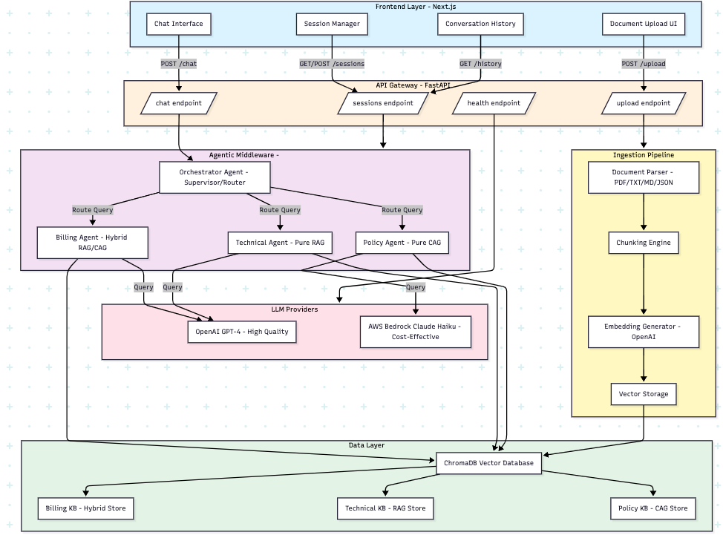
1. AGENTIC CUSTOMER PROJECT – HIGH LEVEL SYSTEM ARCHITECTURE

Slide 3
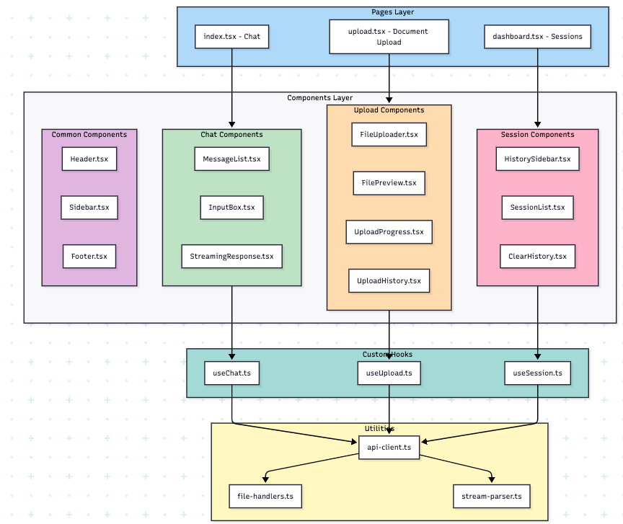
2. Frontend – Component Architecture

Slide 4
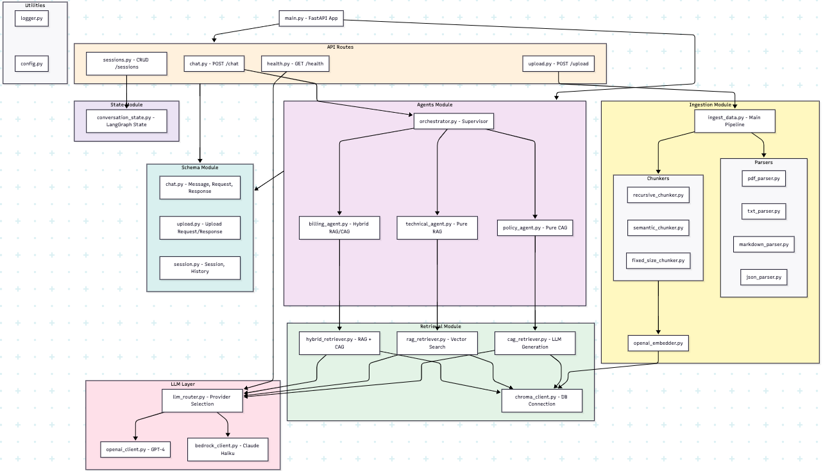
3. AGENTIC CUSTOMER PROJECT – BACKEND MODULE ARCHITECTURE

Slide 5
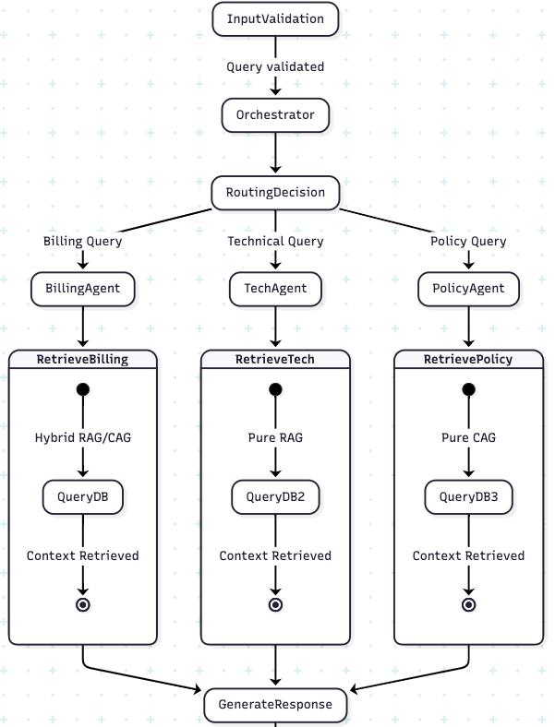
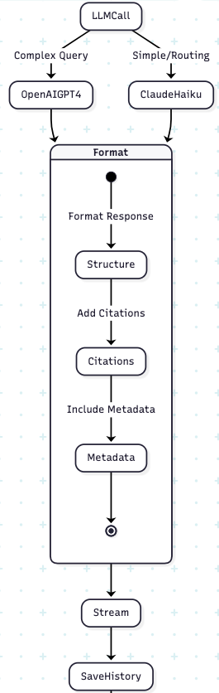
4. AGENTIC CUSTOMER PROJECT – LANGGRAPH AGENT ORCHESTRATION FLOW

Slide 6
5. AGENTIC CUSTOMER PROJECT – DOCUMENT INGESTION PIPELINE

Slide 7
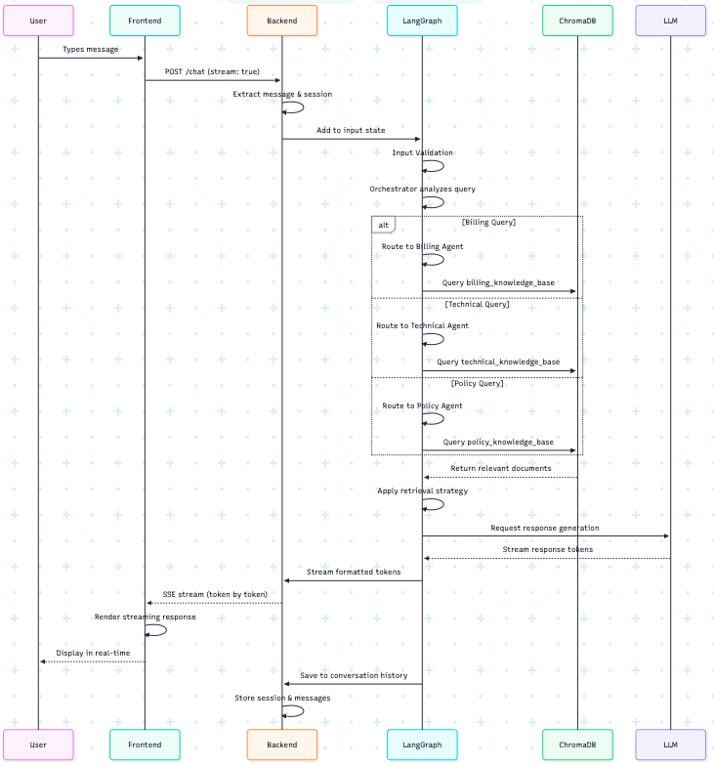
6. AGENTIC CUSTOMER PROJECT – CHAT QUERY DATA FLOW

Slide 8
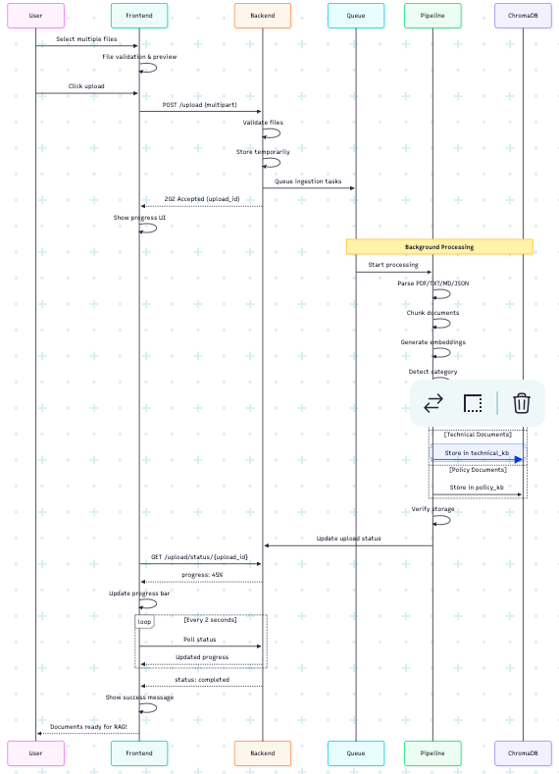
7. AGENTIC CUSTOMER PROJECT – DOCUMENT UPLOAD DATA FLOW

Slide 9
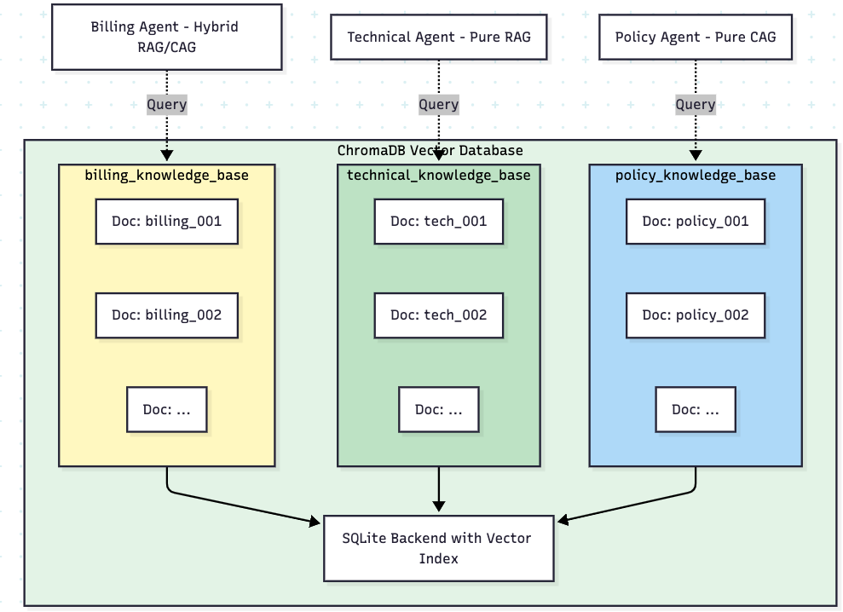
8. AGENTIC CUSTOMER PROJECT – VECTOR DATABASE - COLLECTIONS

Slide 10
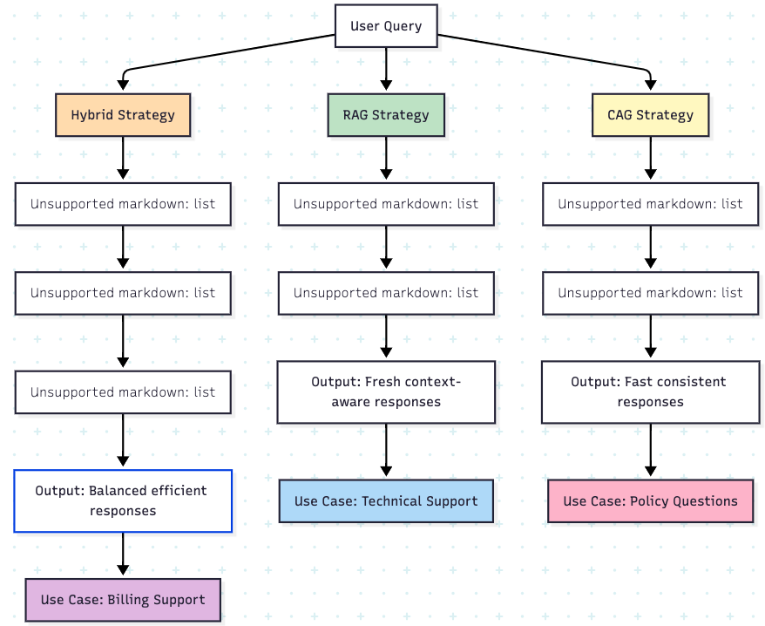
9. AGENTIC CUSTOMER PROJECT – DOCUMENT RETRIEVAL STRATEGY COMPARISON

Slide 11
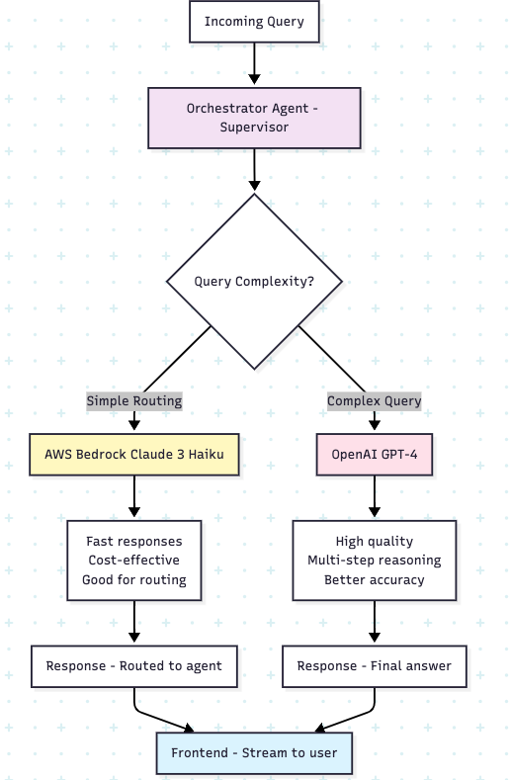
10. AGENTIC CUSTOMER PROJECT – LLM PROVIDER SELECTION STRATEGY

Slide 12
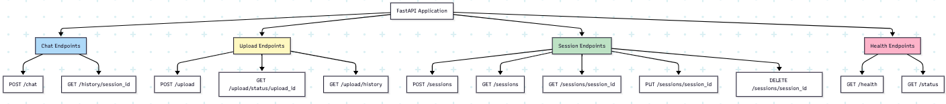
11. AGENTIC CUSTOMER PROJECT – API ENDPOINT ARCHITECTURE

Slide 13
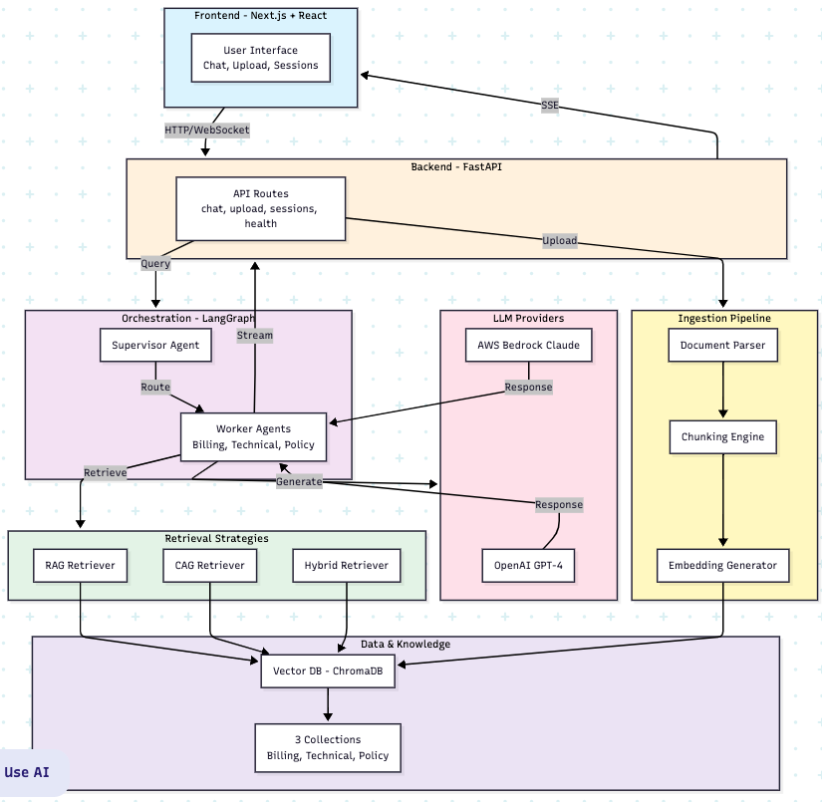
12. AGENTIC CUSTOMER PROJECT – COMPLETE SYSTEM INTEGRATION

Slide 14
Process for PDF to vector
PDF broken into text chunks of fixed number of characters – say 100.
Chunks have overlap characters with previous and subsequent chunks for context sharing.
These text chunks are broken into smaller units called “tokens” by tokenizer method of the embedding model.
Each token which is still text strings is then mapped to numerical representation aka vector for each token, by an encoding algorithm like one-hot encoding (produces sparse binary vector representation) or cl100k_base encoding from OpenAI OR Word2Vec encoding (produces dense continuous vector representation of the token) etc.
String of token vectors are then processed thru transformer models like pre-trained neural network layers which result in transforming each token’s vector into a dense vector based on semantic meaning of words within context of the text chunk.
Finally the string of dense vectors for each token is now aggregated by the embedding model to produce a single fixed-size vector that represents the entire text chunk.
This vector is known as the “embedding” of the text chunk. Similar text chunks will have embedding vectors that are close together while dissimilar chunks will be further apart.
The dimensionality of the vector generated is determined by the embedding model and is fixed for all vectors generated by that model.
Higher dimensionality allows for more complex data representation with higher accuracy but increases computational and memory requirements and therefore can slow down performance. Nomic Embed Text embedding model allows for choosing dimensionality between 64 to 768 which is the default.

