Slide 1
Design patterns in automated testing
Bindu Laxminarayan
bindu@hexbytes.com

Slide 2
Design Patterns in Automated Testing
Test Automation
Design Patterns
Zen Cart Shopping Application
Component Pattern
Template Design Pattern
Domain Test Object Pattern
Page Object Pattern
References
Questions

Slide 3
Test Automation
Test automation is the use of software to control the execution of tests, the comparison of actual outcomes to predicted outcomes, the setting up of test preconditions, and other test control and test reporting functions.
-Wikipedia
Notes:
How is automation different for each level.

Slide 4
Levels And Common problems
Types/Levels of Automation:
Unit
Integration
UI Automation
Service Level(Web Services)
Common Issues
Maintainability
Reusability
Availability of Time
Reliability
Modularization
Notes:
Maintainability –small changes to the software,

Slide 5
Design Patterns
In software engineering, a design pattern is a general reusable solution to a commonly occurring problem within a given context in software design. A design pattern is not a finished design that can be transformed directly into code.-Wikipedia

Slide 6
Classification of Design Patterns
Creational
Abstracts the instantiation process
More flexibility in what gets created, who creates it, how it gets created, and when. – Abstract Factory
Structural
Class and Object Composition
Use inheritance to compose interfaces or implementations
Compose objects during run time to obtain new functionality. - Component
Behavioral
Communication between objects. - Template
Notes:
Creational patterns- abstract the instantiation process. They help make a system independent of how its objects are created, composed, and represented. Depends more on composition than inheritance. The emphasis shifts away from hard coding a fixed set of behaviors toward defining a smaller set of fundamental behaviors that can be composed into any number of complex ones. Abstract Factory, Builder Pattern
Structural Patterns – Concerned with how classes and objects are composed from larger structures. Useful when independently developed class libraries work together. Adapter, Composite
Behavior patterns are concerned with the algorithms and the assignment of responsibilities between objects. These patterns characterize the complex control flow that’s difficult to follow at run-time. You concentrate more on the way objects are communicted. – Template and Interpreter pattern

Slide 7

Zen Cart Home Page

Slide 8
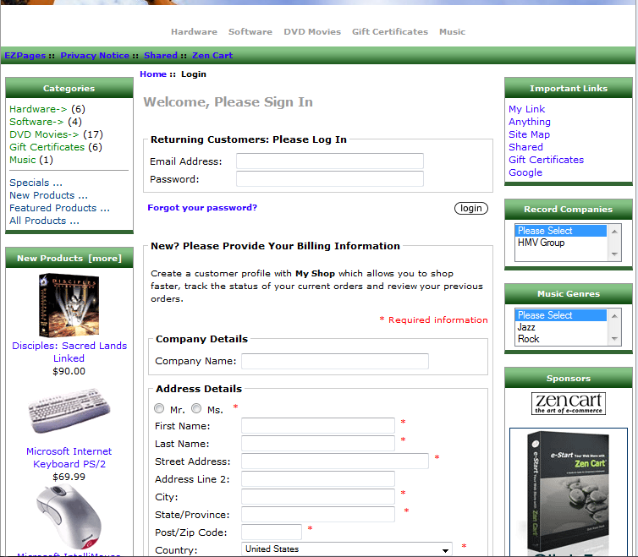
Login Page

Slide 9
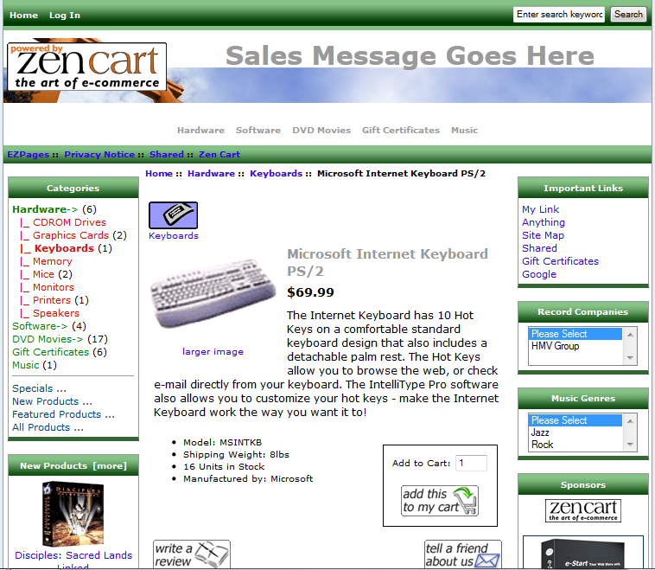
Product Page

Slide 10
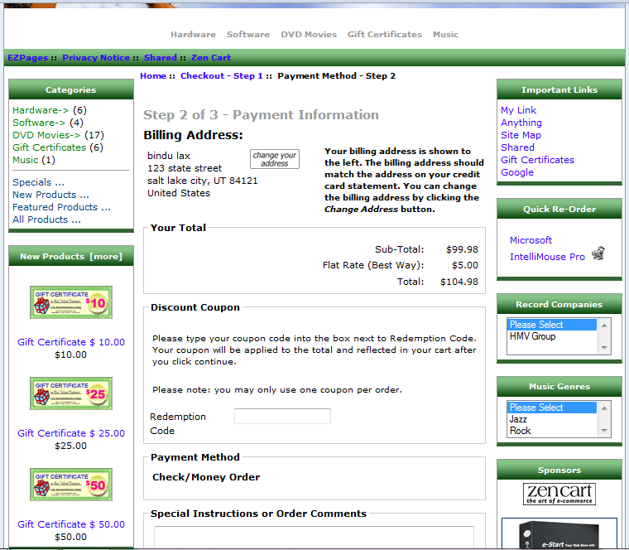
Checkout Page

Slide 11
Component Pattern
Structural Pattern
All objects are defined as separate components
Useful when the pages are formed dynamically(Multi variant Testing)
Tests are created by calling these components.
Scenario: Search for a product and verify that the price of the product starts with $

Slide 12
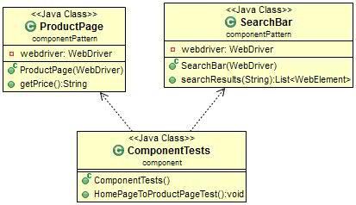
UML Diagram

Slide 13
Search Bar
public List<WebElement> searchResults(String word){
webdriver.findElement(By.id(“search”)).
sendKeys(word);
Webdriver.findElement(By.id(“srchBtn”)).
click();
List<WebElement> products = this.webdriver.findElements(By.id("productId"));
return products;
}

Slide 14
Product Page
public String getPrice(){
String productPrice = this.webdriver.findElement(By.id("price"))
.getText();
return productPrice;
}

Slide 15
Test
public void HomePageToProductPageTest(){
SearchBar searchBox = new SearchBar(driver);
List<WebElement> webelements = searchBox.searchResults("books");
webelements.get(0).click();
ProductPage productPage = new ProductPage(driver);
Assert.assertTrue(productPage.getPrice().startsWith("$"));
}

Slide 16
Advantages
Maintainability – Functionality is defined in each component
Reusability – Tests call the component
Time – Common functionality defined in the components.
Reliability – All Tests calling the same component will fail.
Modularization – Functionality of each component is defined.

Slide 17
Template Pattern
Behavioral Pattern
A template method defines the program skeleton of an algorithm.
Subclasses redefine certain steps of an algorithm without changing the algorithm’s structure.
Scenario: Tests to checkout a product with different credit card.
Add product to the Cart
Go to the Cart page
Check out with different credit cards

Slide 18
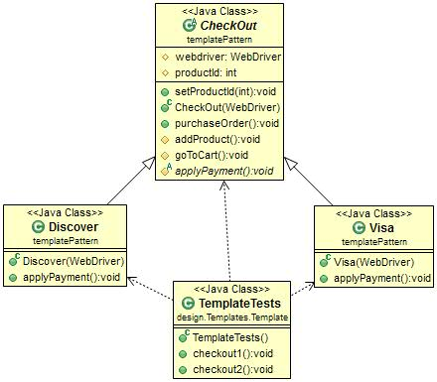
UML Diagram

Slide 19
Checkout
public void purchaseOrder(){
addProduct();
goToCart();
applyPayment();
}
protected void addProduct(){
Webdriver.get("http://www.shopping.com/"+productId+"/product.html");
}
protected void goToCart(){
Webdriver.get("http://wwww.shopping.com/cart.html");
}
abstract protected void applyPayment();

Slide 20
Apply Payment
@Override
public void applyPayment() {
Webdriver.findElement(By.id("visa")).click();
webdriver.findElement(By.id("cardno")).sendKeys("1111222233334444");
webdriver.findElement(By.id("expmon")).sendKeys("10");
webdriver.findElement(By.id("expyr")).sendKeys("2014");
webdriver.findElement(By.id("submit")).click();
}
@Override
public void applyPayment() {
webdriver.findElement(By.id("discover")).click();
webdriver.findElement(By.id("cardno")).sendKeys("4444333322221111");
webdriver.findElement(By.id("expmon")).sendKeys("10");
webdriver.findElement(By.id("expyr")).sendKeys("2014");
webdriver.findElement(By.id("submit")).click();
}

Slide 21
Tests
@Test
public void checkout1(){
WebDriver driver = new FirefoxDriver();
driver.get("http://www.shopping.com");
CheckOut checkout = new Visa(driver);
checkout.setProductId(123);
checkout.purchaseOrder();
}
@Test
public void checkout2(){
WebDriver driver = new FirefoxDriver();
driver.get("http://www.shopping.com");
CheckOut checkout = new Discover(driver);
checkout.setProductId(123);
checkout.purchaseOrder();
}

Slide 22
Advantages
Maintainability – Subclasses override the functionality if needed
Reusability – No code duplication between the classes
Time – Common functionality defined in the base classes and subclasses only define the override behavior if necessary. Easy to extend.
Reliability – Tests fail only if the defined behavior is no more relevant
Modularization – Behavior of the component is defined only once in the method/class

Slide 23
Domain Test Object
Encapsulates an application's visual components into objects that can be reused by many tests.
Used for testing the expected data – not how they are visually represented.
Scenario: Verify whether the products are correctly added to the cart (not the order of the products) and the prices are displayed correctly

Slide 24
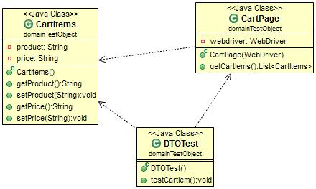
UML Diagram

Slide 25
Cart Items
public String getProduct() {
return product;
}
public void setProduct(String product) {
this.product = product;
}
public String getPrice() {
return price;
}
public void setPrice(String price) {
this.price = price;
}

Slide 26
Cart Page
public List<CartItems> getCartIems(){
List<CartItems> cart = null ;
List<WebElement> cartPro = webdriver.findElement(By.id("products")).findElements(By.className("cartProduct"));
CartItems tempItem = new CartItems();
for(WebElement cartItem: cartPro){
tempItem.setPrice(cartItem.getAttribute("price"));
tempItem.setProduct(cartItem.getAttribute("name"));
cart.add(tempItem);
tempItem = null;
}
return cart;
}

Slide 27
Test
public void testCartIem(){
String productName = "product1";
String price = "10";
WebDriver driver = new FirefoxDriver();
driver.get("http://www.shopping.com");
driver.findElement(By.id("1234")).click();
driver.findElement(By.id("addToCart")).click();
List<CartItems> cartItems = new CartPage(driver).getCartIems();
boolean isfound = false;
for(CartItems cart : cartItems){
if(cart.getProduct().equals(productName)){
isfound=true;
Assert.assertTrue(cart.getPrice().equals(price));}
}
Assert.assertTrue(isfound); }

Slide 28
Advantages
Maintainability – Functionality is separated from the visual representation
Reusability – Increases when used with other patterns.
Time – Functionality can be tested early.
Reliability – Tests fail only if functionality changes.
Modularization – Increases when used with other patterns.

Slide 29
Page Object pattern
Pages are defined as classes
Uses composition to embed the components and to form a page
Mostly used with Selenium.
Scenario: Customer placing an order in ZenCart.

Slide 30
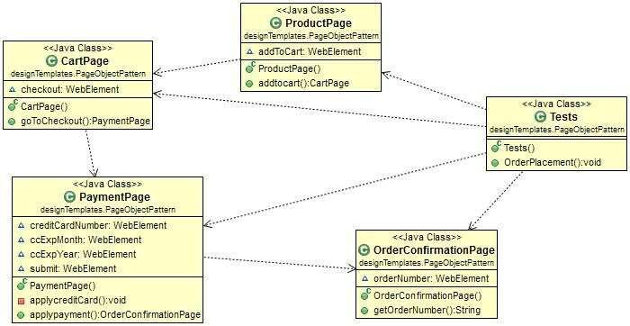
Uml Diagram

Slide 31
Product Page
@FindBy(id="addToCart")
WebElement addToCart;
public CartPage addtocart(){
addToCart.click();
return new CartPage();
}
Cart Page
@FindBy(id="goToCheckout")
WebElement checkout;
public PaymentPage goToCheckout(){
checkout.click();
return new PaymentPage();
}

Slide 32
Payment Page
private void applycreditCard(){
creditCardNumber.sendKeys("1234123412341234");
ccExpMonth.sendKeys("12");
ccExpYear.sendKeys("2014");
submit.click();
}
public OrderConfirmationPage applypayment(){
applycreditCard();
return new OrderConfirmationPage();
}

Slide 33
Order Confirmation
@FindBy(id="ordernumber")
WebElement orderNumber;
public String getOrderNumber(){
return orderNumber.getText();
}

Slide 34
Test
public void OrderPlacement(){
WebDriver driver = new FirefoxDriver();
driver.get("http://www.shopping.com/productid=1234");
ProductPage product = PageFactory.initElements(driver, ProductPage.class);
CartPage cart = product.addtocart();
PaymentPage payment = cart.goToCheckout();
OrderConfirmationPage order = payment.applypayment();
Assert.assertTrue("order is null",order.getOrderNumber()!=null);
}

Slide 35
Advantages of Design Patterns
Advantages:
Reuse
Improves Communication
Easy to Extend
Easy to Fix

Slide 36
References
http://www.seleniumhq.org
Design Patterns – Elements of Reusable Object-Oriented Software
http://www.autotestguy.com

Slide 37
Questions ????

Slide 38
Thank you
Bindu Laxminarayan
bindu@hexbytes.com

