Slide 1
Need Orchestration Layer

Slide 2
Use Case
WordPress
MySQL
Docker
LoadBalacer
Service
WordPress
WordPress
WordPress
MySQL
Docker

Slide 3
What a Typical Orchestration supports
Maintaining the lifecycle of the container application.
Managing Services, Volumes, Networking across containers.
Support container Scaling to meet the demand.
Logging and monitoring

Slide 4
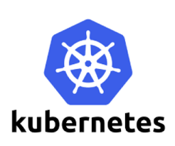
What is Kubernetes
o Kubernetes is a Container Orchestration Systems developed and open-sourced by Google.
o Kubernetes manages a cluster of nodes (VM’s or BareMetals) and is responsible for
§ Perform Scheduling decisions on which node to run workloads.
§ Manage Container Runtimes (like docker, rocket, etc) to initiate Container creation and maintenance.
§ Responsible for maintaining the state of the overall application (which consists of multiple containers, running on multiple nodes).
o Kubernetes also,
§ Enables decoupling of application components.
§ Ensuring zero-downtime during application updates.

Slide 5
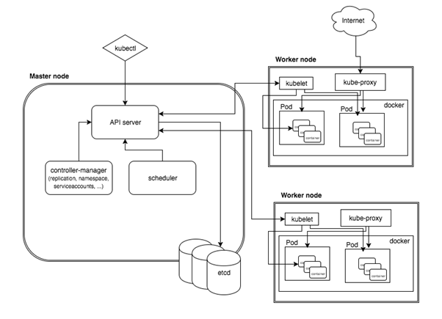
Kubernetes Architecture

Slide 6
Master Node Components
Api Server
Scheduler
Controller Manager
Ectd

Slide 7
Worker Node Components
Kubelet
Kube-Proxy
Docker

Slide 8
Various Available Setup Methods
On Cloud infrastructure
Google
AWS
Azure
IBM Blue Mix
On local machine / Bare metal
MiniKube
Ubuntu on LXD
IBM Cloud Private CE
Kubeadm – If already configure hosting resource are avaliable.

Slide 9
Installing Kubernetes with Kubeadm
Supported Platform
Ubuntu 16.04+, CentOS 7 or HypriotOS v1.0.1+
On bare metal, cloud Hosted VM’s
Master Node requirements
Kubeadm
Kubectl
Docker
Kubelet
Worker Node requirements
Kubeadm
Docker
Kubelet

Slide 10
Steps for using Kubeadm
Installing kubeadm on your hosts
Initializing your master
Installing a pod network
Joining your nodes

