Slide 1
Fuber For those who have an appetite for saving
By: Joy Gomi – Irvin Durana – Jay Lin
- Shiv Randhawa – Paul Kim

Slide 2
Overview
Features
App Walkthrough
Data Flow
Schedule
Potential Revenue

Slide 3
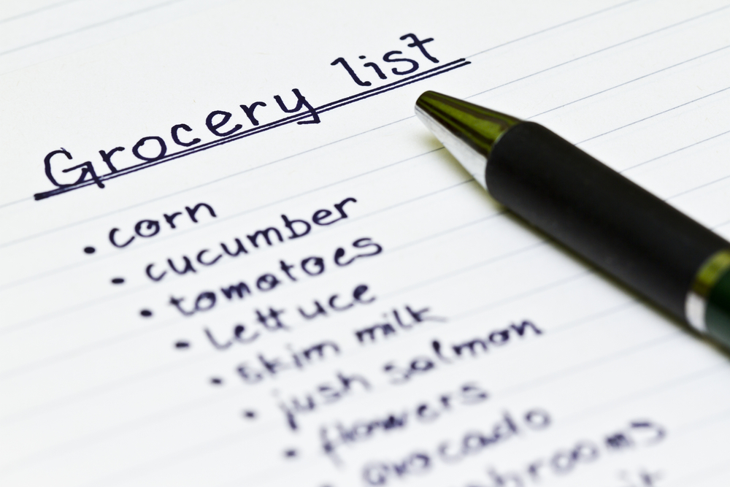
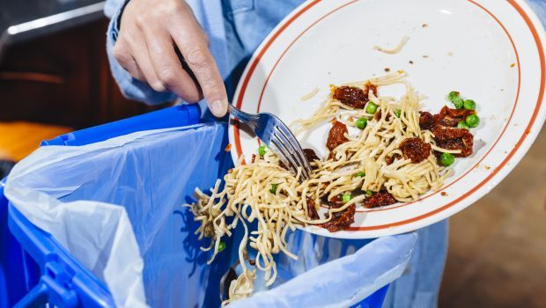
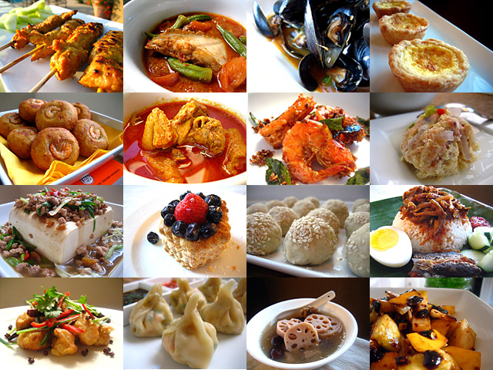
Features
QR code scanner
Keep track of your purchased Groceries
Warns you about expirations
Suggests recipes in various orders
Shopping List

Slide 4
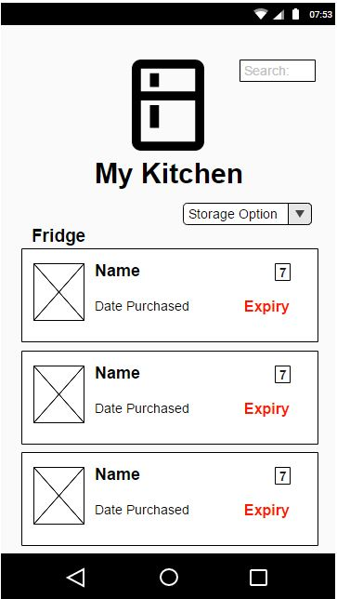
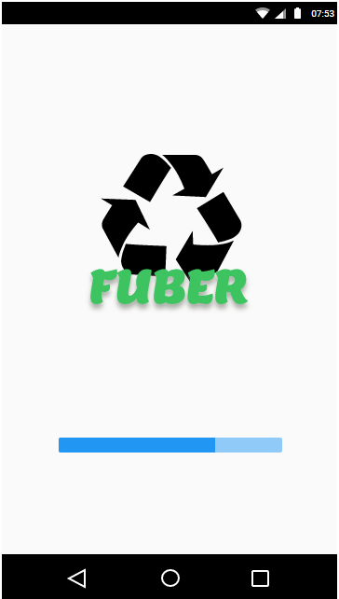
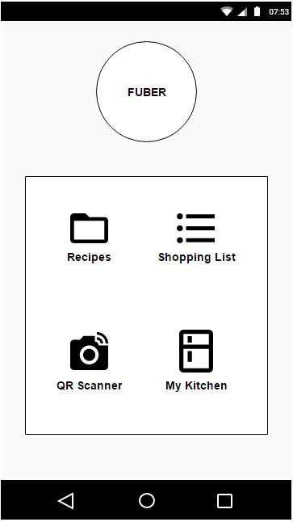
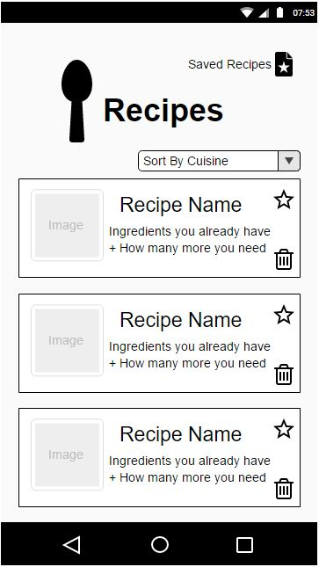
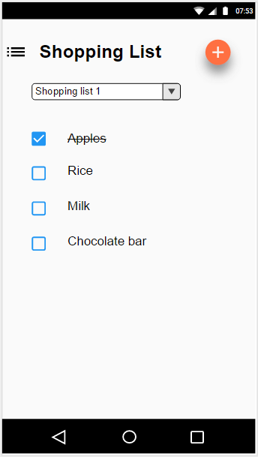
App Walkthrough
Splash Page
Home Screen
Inventory
Recipe List View
Shopping List

Slide 5
Data Flow
Grocery
Store
Fuber
App
API
Database
QR Code

Slide 6
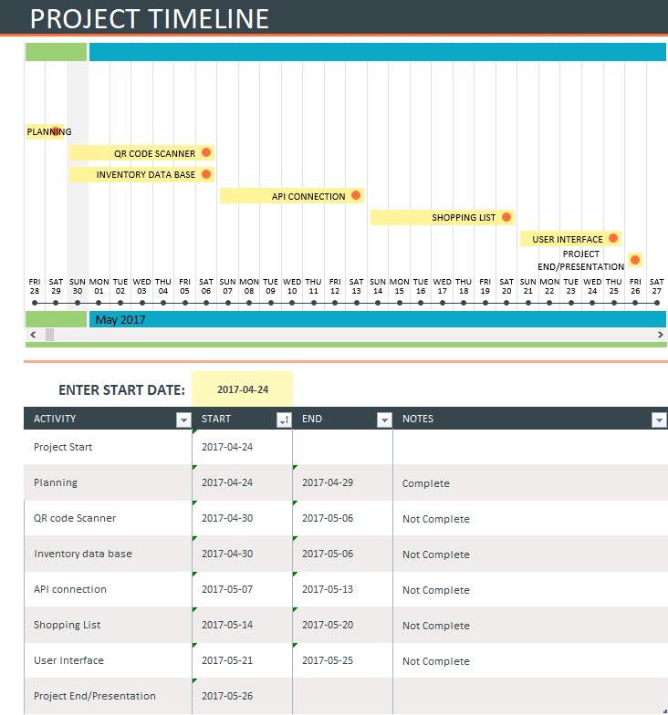
Schedule
Provide visual Timeline
List of tasks to be complete
Status update
Side notes

Slide 7
Potential Revenue
Meta data for foods
Marketing opportunities

Slide 8
_{Questions?}

