Slide 1
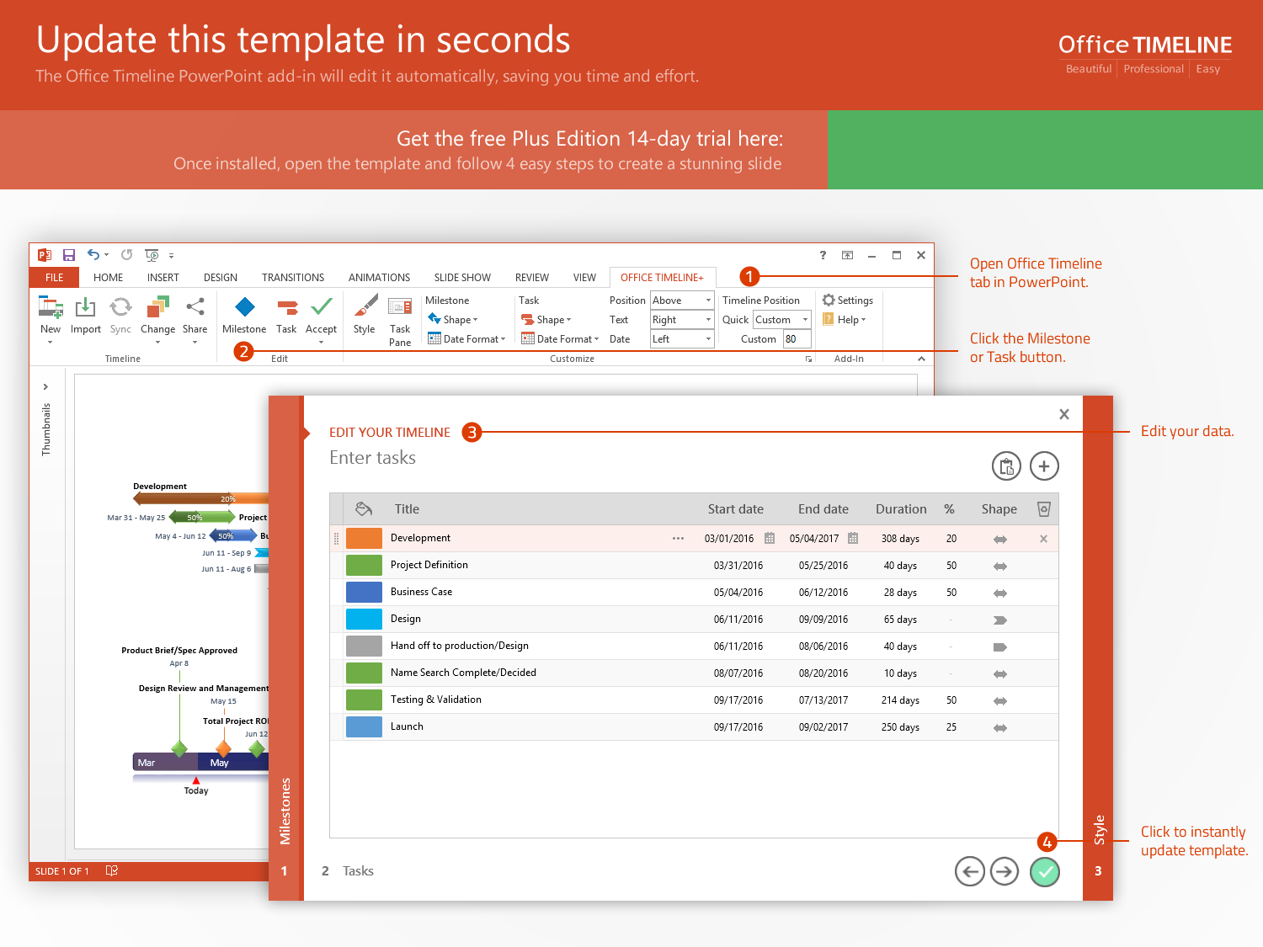
https://www.officetimeline.com/14-days-trial

Slide 2
Milestone 1
May 10
Milestone 4
Milestone 2
Aug 12
May 15
Milestone 3
Milestone 5
Milestone 7
Jul 21
Nov 7
Milestone 6
Jan 30
Dec 20
2017
May
Jun
Jul
Aug
Sep
Oct
Nov
Dec
2018
2018
6 days
Today
Task 1 Here
Jul 25 - Aug 1
18 days
Task 2 Here
Aug 15 - Sep 7
24 days
Task 3 Here
Aug 15 - Sep 17
16 days
Task 4 Here
Sep 8 - Sep 30
25 days
Task 5 Here
Oct 4 - Nov 7

