Slide 1



Slide 2
Logic Building <Complete Practical Approach>
म्हणजे { तुफान Coding }

Slide 3
आमच्या इथे स्वच्छ, ताजे, सात्विक, घरगुती पध्द्तीने Logic Build करून मिळेल

Slide 4
Boost Your Programming Skills with Our Logic Building Batch!
Master the fundamentals of programming with our hands-on batch in C, C++, and Java. Whether you're a beginner or looking to strengthen your problem-solving skills, this course will help you build a solid foundation in logic development, algorithm design, and coding. Start your journey towards becoming a skilled programmer today!

Slide 5
Problems To Get Placement & Survive in MNC
?
Lack of practical knowledge of basic concepts.
Lack of knowledge of Data structure & Algorithm's
Lack of knowledge and hands-on of the latest technologies.
Unknown with the actual Industry demand.
Weak practical and soft skills.
Wrong guidance and direction.
The advertisement of private classes contains misleading information.
So Logic Building Program is the best affordable and loyal solution to all above problems.

Slide 6
Who can join this Program ?
शिक्षणाची कोणतीही अट नाही
फक्त इच्छा आणि प्रामाणिक पणे कष्ट करणारे सगळे
Everyone
Technical
Non-Technical
Yes You!
Working

Slide 7
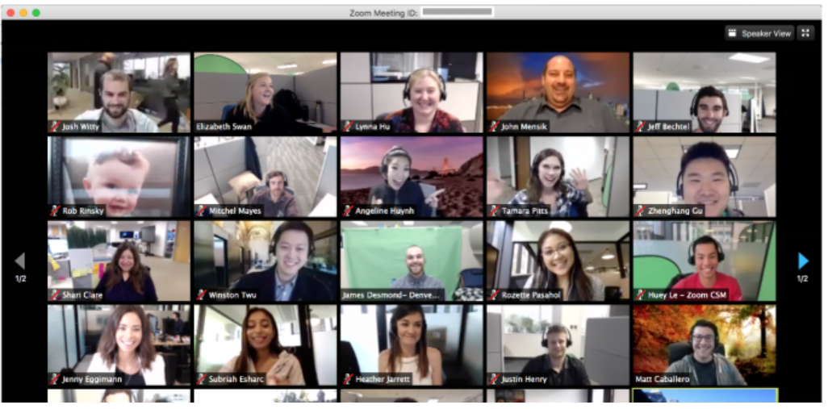
Program Mode
Complete Online and Live Sessions
Strictly Open Camera
With : Zoom, Google, Teams Meetings.

Slide 8

Logic Building Syllabus
Click the below link to download the Logic building Syllabus
Download Logic Building Syllabus

Slide 9

Teaching Language
Which is comfortable to all of you
Marathi (Highly Preferred)
Hindi
English

Slide 10

Program Duration
Duration: 3-4 months (only on weekends)
Weekends:
Saturday : 6 pm to 10 pm
Sunday : 6 pm to 10 pm
Public Holidays: 4 hours as per comfortable time

Slide 11

Class Notes & Recording
Class Notes:
Its been a part of live class
Notes are being told in live classes on each and every topic
You need to write it down in your own notebook
Audio Recording:
We will try to give you the audio recording of the lecture by uploading the audio recording of it
This will help to revise what we learnt in the lecture and helpful if unfortunately you were not present for that particular lecture

Slide 12

Assignments
Almost 30-50 assignments (Each assignment having 5-10 questions)
Questions are part of FAQ in company interview
Solving assignments is best key to be ready for the interview answers
It’s strictly mandatory to complete the submit assignments within deadline
All the assignments are checked strictly.

Slide 13




Other Activities
Yes Off-Course,
1. For making a session fully interactive We will be involved in activities like cracking jokes, Real-time examples for understanding concepts better.
2. Questions and Answers session after every lecture

Slide 14


Placement Warranty/Guaranty
Other Organizations say: we place you 100 %
We says: We are committed to providing our utmost efforts to ensure your practical skills are strengthened to 100%.
You (Student) will say:
You provide us with education and knowledge, and we (the students) commit to securing our own placements.

Slide 15

Certificate
We value our knowledge and intellectual property
We value our Certificate, it represents both of us
To get your certificate just do the following
1. Complete and submit all your assignments within the deadline to receive your certificate.

Slide 16

Affordable Fees
7,500 ₹ only
Note :
Payment to be accepted in Single Installment only
Payments is Non Refundable and Non-transferable

Slide 17

How To Join This LB Program
Its So Simple
One Click solution
Please fill the below registration form and confirm your admission.
Registration form

Slide 18
After Registration
We will be arranging a Free to All Session meeting.
Meeting link will be public and any one can join this session(those who have not registered also can join this meeting)
In free to all session we will discuss about the class rules and relevant information.
After this session and confirmation of admissions, our Private Session will start
Private session meeting links are only accessible to the registered members only, those who has paid complete amount.

Slide 19
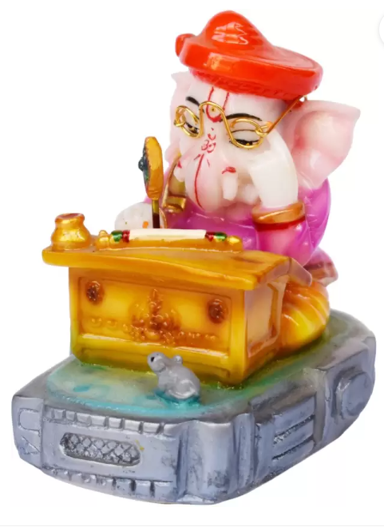
Receive blessings from Lord Ganesha as a reward
When you get placement after PPA Program:
You will be awarded with the idol of “god of knowledge” “Lord Shri Ganesha”

Slide 20

Be a Great Developer Because

Slide 21
Contact
Admin:
Shiv Salunke - 9527938556
Email : jsminfotechppa@gmail.com

Slide 22
THANK YOU
&
WELCOME TO
LOGIC BUILDING
{ Complete Practical Approach }

