Slide 1
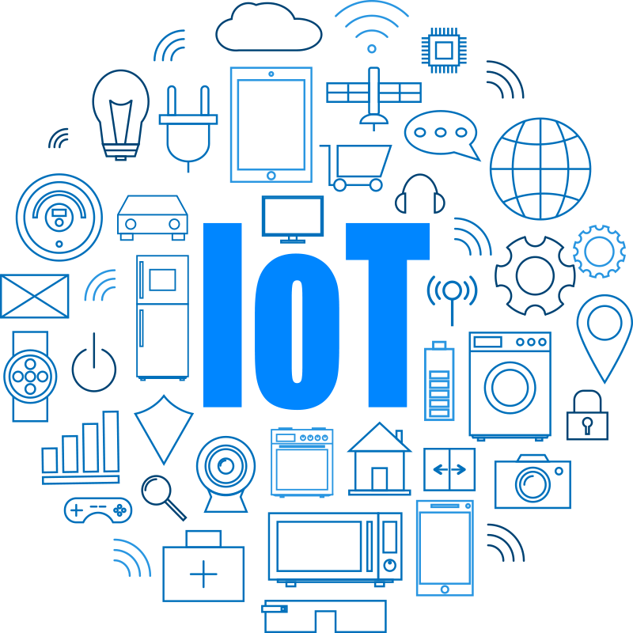

Slide 2
IOT internet of things
By: Shiv Salunke

Slide 3
Contents
Introduction to IoT
History
Evolution of IoT
IoT Architecture
IoT Architecture Layers
IoT Devices and Components
Advantages & Disadvantages
Application
Iot Impact on Economy

Slide 4
Introduction to IoT
IoT stands for Internet of Things
IoT refers to a network of interconnected physical devices, vehicles, buildings, and other objects that are embedded with sensors, actuators, and software.
These devices are equipped to collect and exchange data over the internet, enabling them to communicate and interact with each other without direct human intervention.
“anytime, anyplace, anything in connectivity.”
Internet of Things
Internet:
The Internet is a global network of billions of computers and other electronic devices
Things: Physical objects, devices.

Slide 5
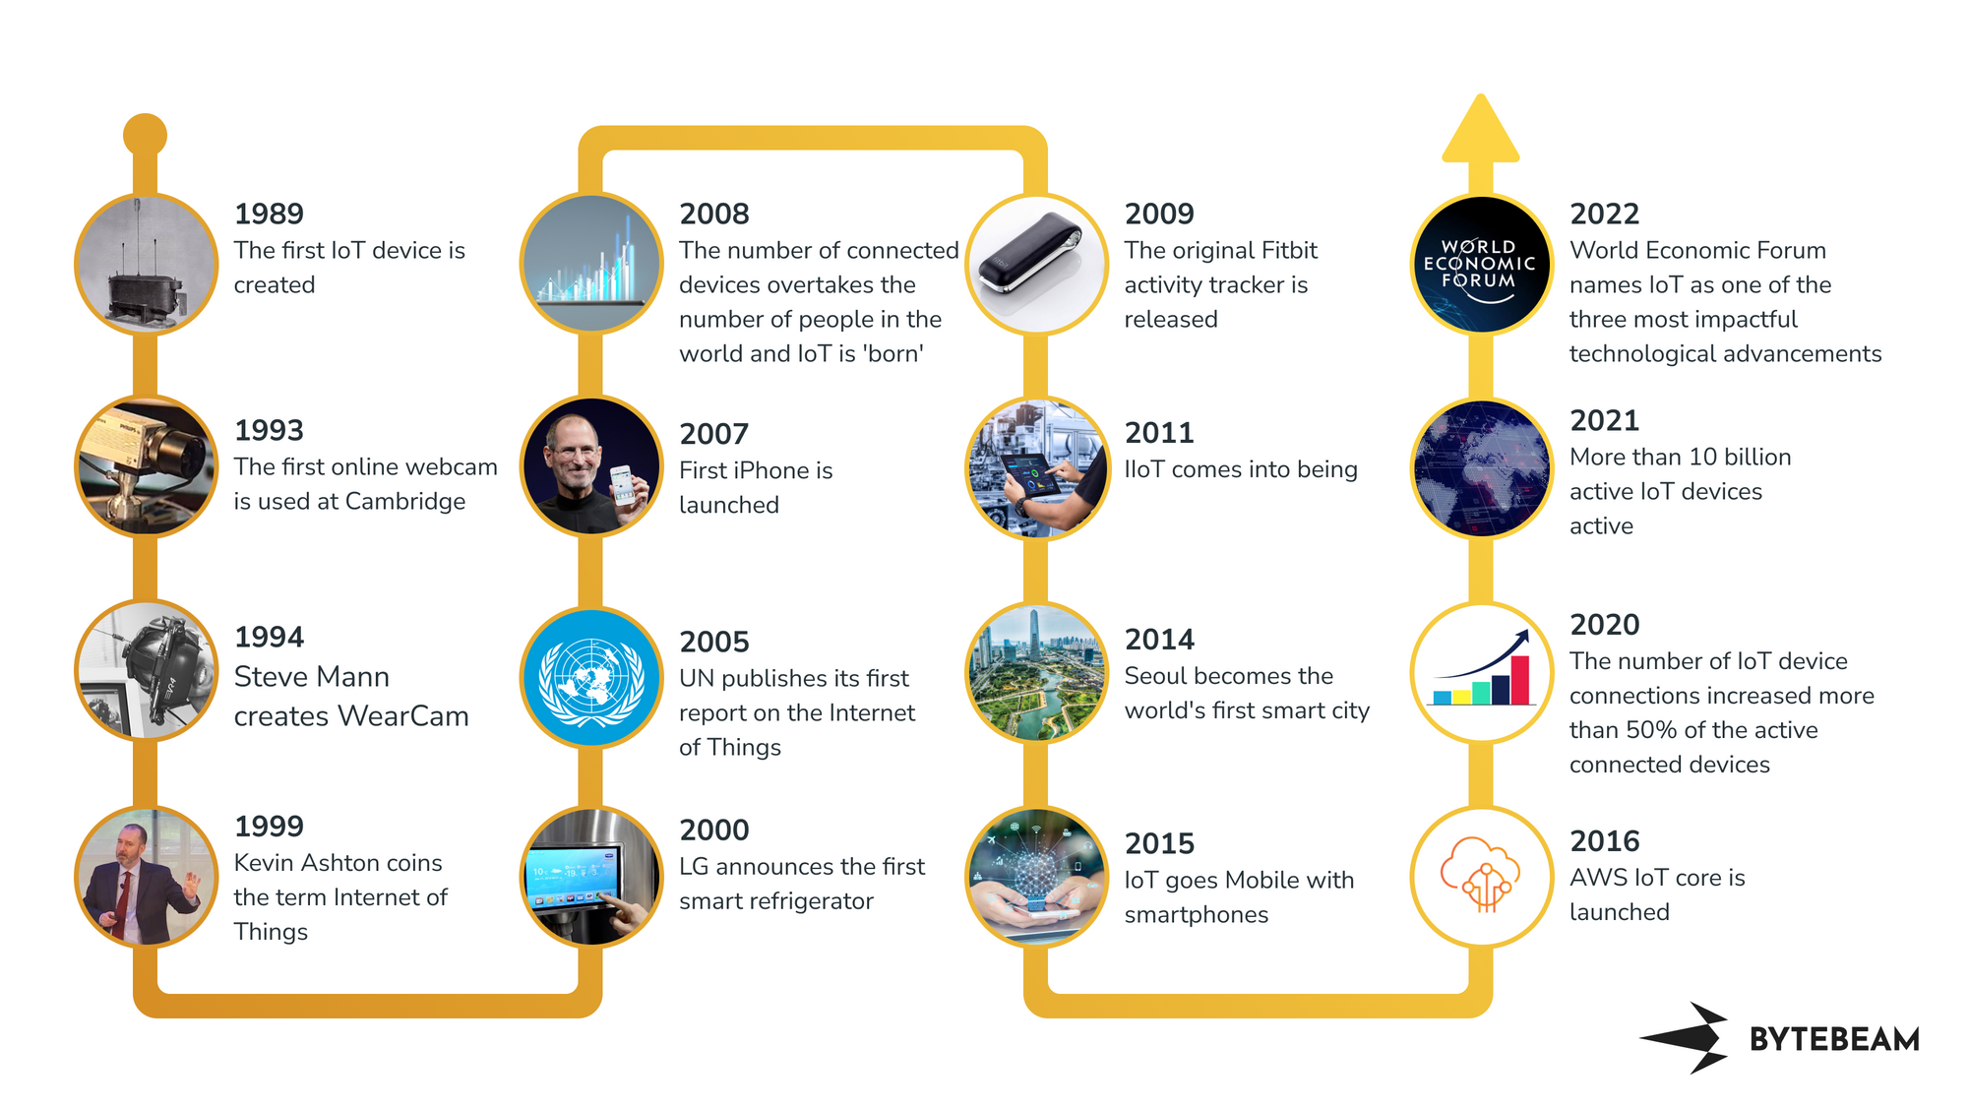
History of IoT

Slide 6
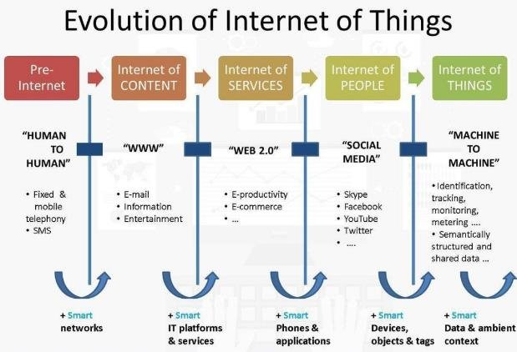

Slide 7
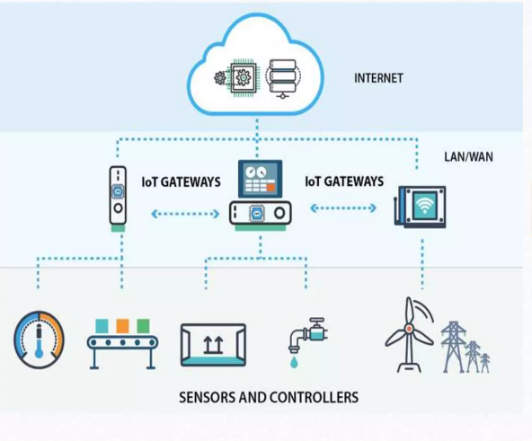
IoT Architecture
IoT Architecture:
Sensor and Actuator Networks
Communication Protocols (MQTT, CoAP, HTTP)
Edge Computing
Cloud Computing in IoT
IoT Platforms

Slide 8
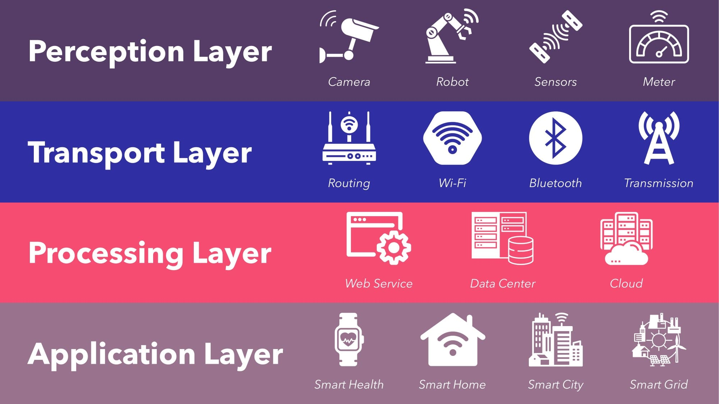
IoT Architecture layers

Slide 9
IoT Devices & Components
Microcontrollers and Microprocessors
Sensors and Actuators
Communication Modules (Wi-Fi, Bluetooth, RFID)
IoT Hardware Platforms (Arduino, NodeMCU esp8266, Raspberry Pi)

Slide 10
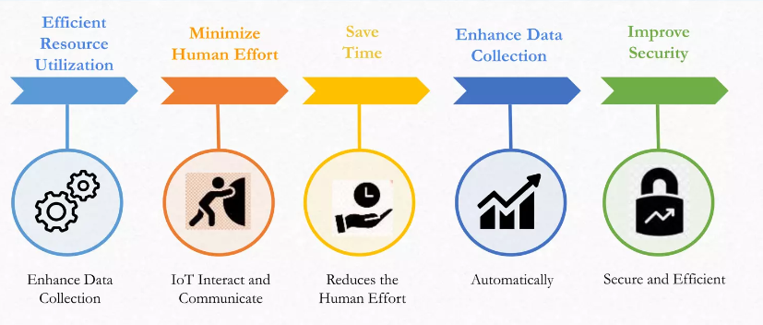
Advantages of IoT
Improved efficiency and automation of tasks.
Increased convenience and accessibility of information.
Better monitoring and control of devices and systems.
Greater ability to gather and analyze data.
Improved decision-making.
Cost savings.

Slide 11
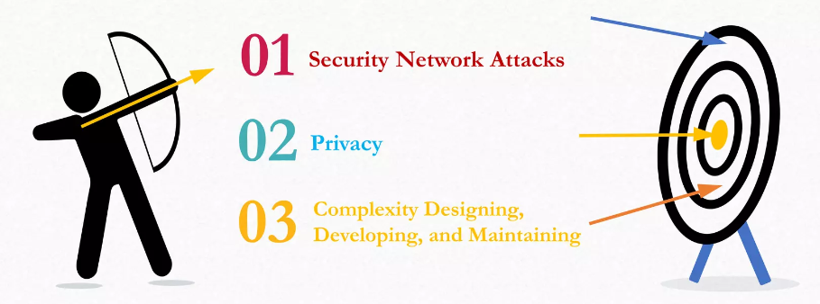
Disadvantages of IoT
Security concerns and potential for hacking or data breaches.
Privacy issues related to the collection and use of personal data.
Dependence on technology and potential for system failures.
Limited standardization and interoperability among devices.
Complexity and increased maintenance requirements.
High initial investment costs.
Limited battery life on some devices.
Concerns about job displacement due to automation.
Limited regulation and legal framework for IoT, which can lead to confusion and uncertainty.

Slide 12
IoT Applications
Smart Grids and energy saving
Smart cities
Smart homes/Home automation
Healthcare
Earthquake detection
Radiation detection/hazardous gas detection
Smartphone detection
Water flow monitoring
Traffic monitoring
Wearables
Smart door lock protection system
Robots and Drones
Healthcare and Hospitals, Telemedicine applications
Security
Biochip Transponders (For animals in farms)
Heart monitoring implants (Example Pacemaker, ECG real time tracking)
Agriculture
Industry

Slide 13
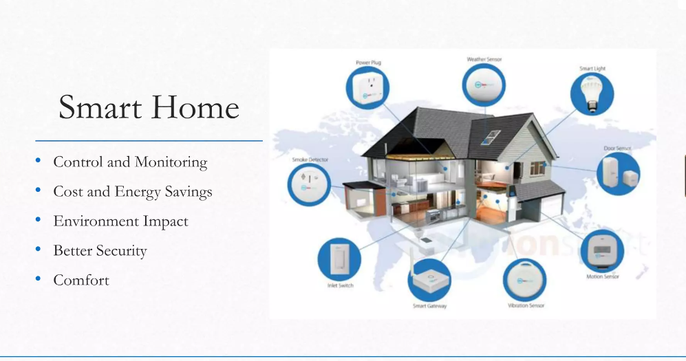
Smart Home

Slide 14
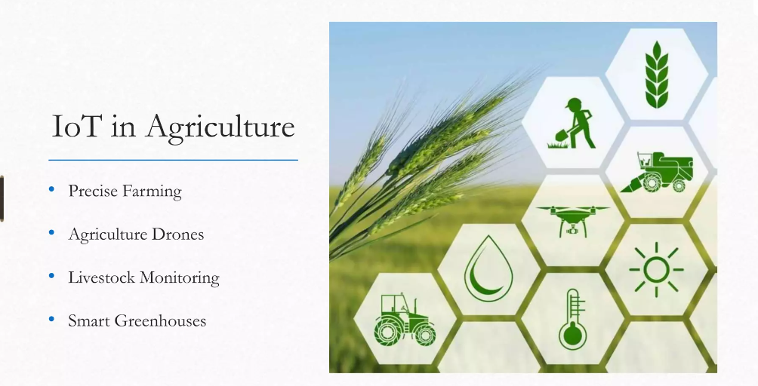
Agriculture

Slide 15
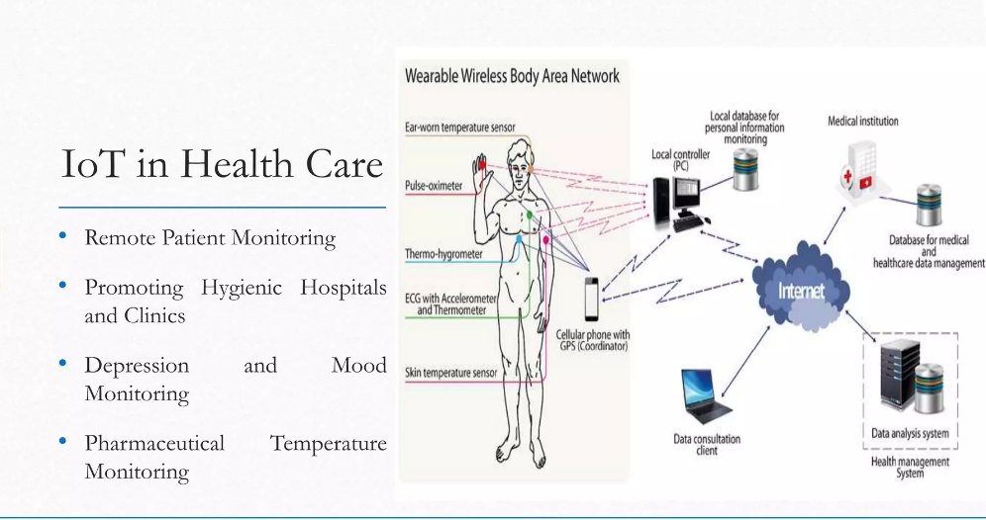
Health Care

Slide 16
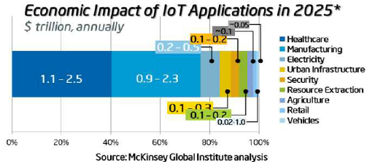
Impact of IoT on Economy

Slide 17
!! Thank You !!

