Slide 1
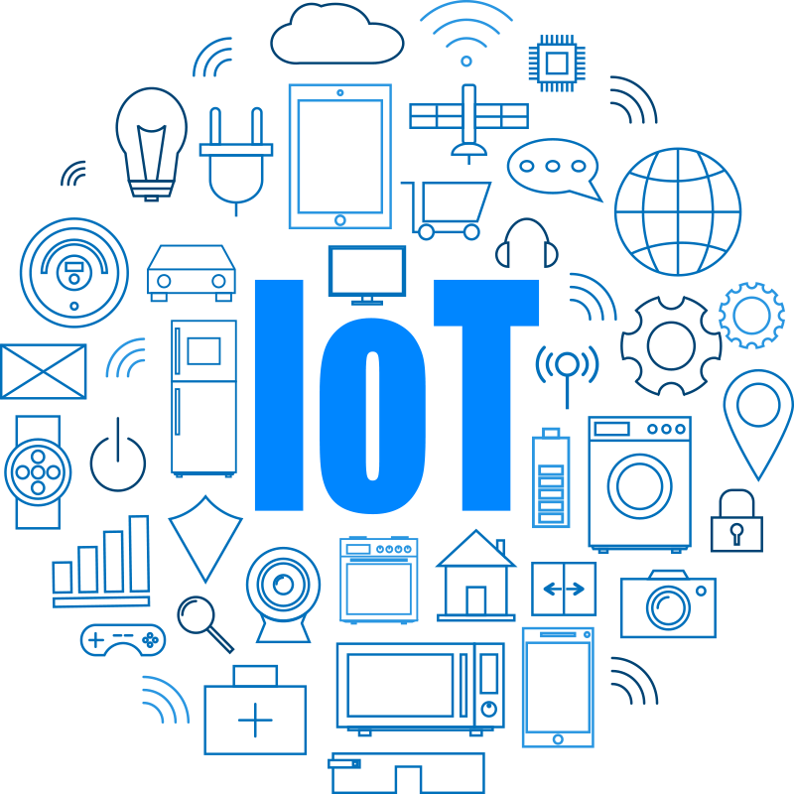

Slide 2
IOT internet of things
By: Shiv Salunke

Slide 3
Agenda
Part 1
Introduction to IoT
History,Evolution of IoT
IoT Architecture,IoT Architecture Layers
IoT Devices and Components
Advantages & Disadvantages
Application
Iot Impact on Economy
Part 2
Workshop Practicals
Introduction to Raspberry Pi
Raspberry Pi OS Installation
Interfacing of sensors with Raspberry pi
Introduction to ThingSpeak (IOT Cloud) & Using cloud to visualize the sensor data
Use of RealVNC as Raspberry Pi Controller

Slide 4
Contents
Introduction to IoT
History,Evolution of IoT
IoT Architecture,IoT Architecture Layers
IoT Devices and Components
Advantages & Disadvantages
Application
Iot Impact on Economy

Slide 5
Introduction to IoT
IoT stands for Internet of Things
IoT refers to a network of interconnected physical devices, vehicles, buildings, and other objects that are embedded with sensors, actuators, and software.
These devices are equipped to collect and exchange data over the internet, enabling them to communicate and interact with each other without direct human intervention.
“anytime, anyplace, anything in connectivity.”
Internet of Things
Internet:
The Internet is a global network of billions of computers and other electronic devices
Things: Physical objects, devices.

Slide 6
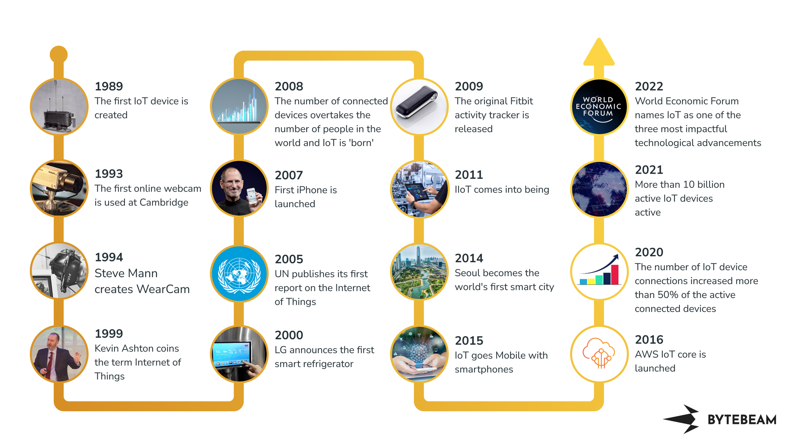
History of IoT

Slide 7
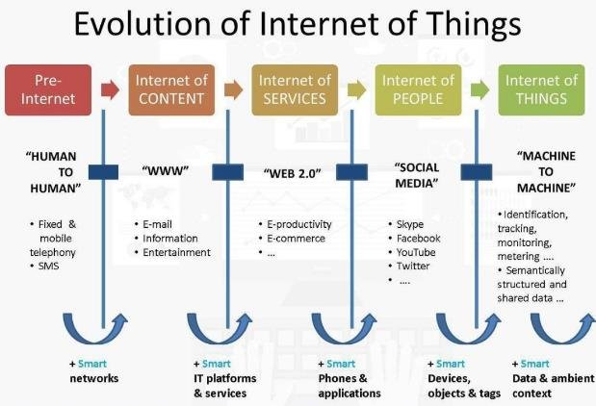

Slide 8
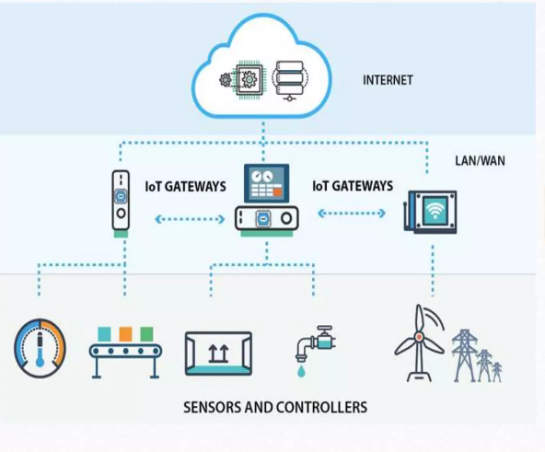
IoT Architecture
IoT Architecture:
Sensor and Actuator Networks
Communication Protocols (MQTT, CoAP, HTTP)
Edge Computing
Cloud Computing in IoT
IoT Platforms

Slide 9
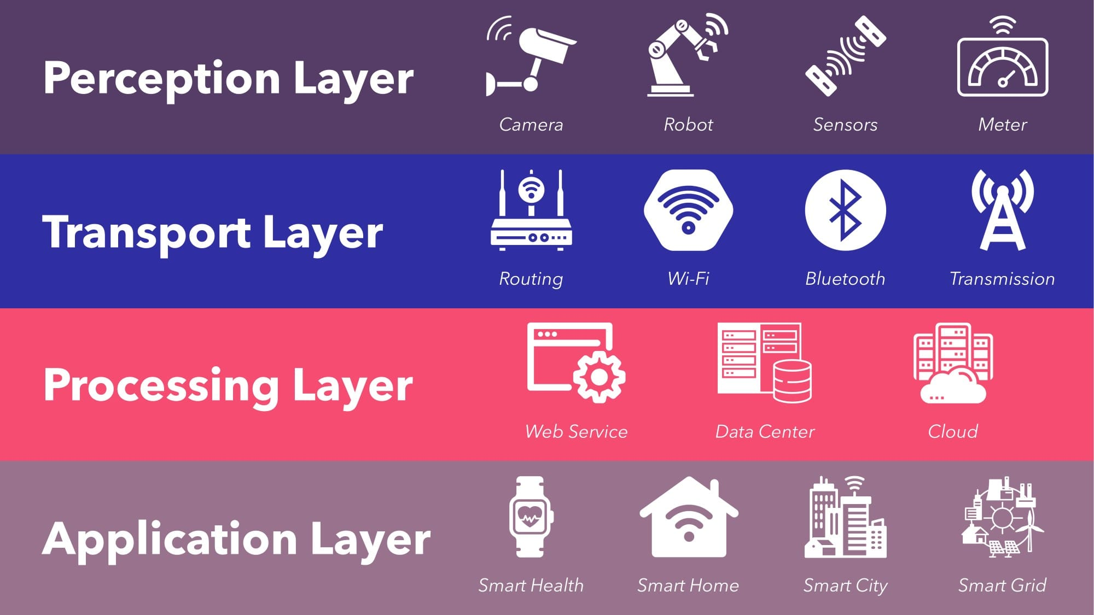
IoT Architecture layers

Slide 10
IoT Devices & Components
Microcontrollers and Microprocessors
Sensors and Actuators
Communication Modules (Wi-Fi, Bluetooth, RFID)
IoT Hardware Platforms (Arduino, NodeMCU esp8266, Raspberry Pi)

Slide 11
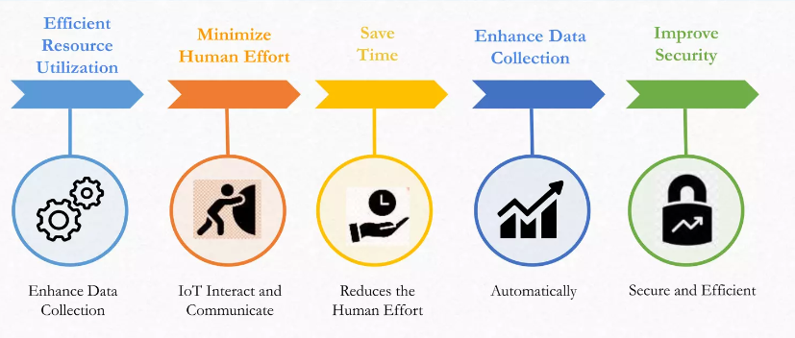
Advantages of IoT
Improved efficiency and automation of tasks.
Increased convenience and accessibility of information.
Better monitoring and control of devices and systems.
Greater ability to gather and analyze data.
Improved decision-making.
Cost savings.

Slide 12
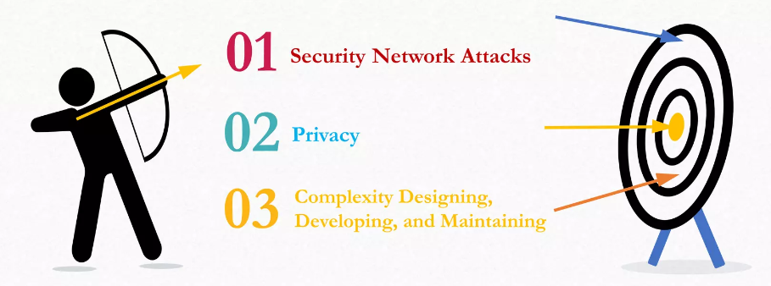
Disadvantages of IoT
Security concerns and potential for hacking or data breaches.
Privacy issues related to the collection and use of personal data.
Dependence on technology and potential for system failures.
Limited standardization and interoperability among devices.
Complexity and increased maintenance requirements.
High initial investment costs.
Limited battery life on some devices.
Concerns about job displacement due to automation.
Limited regulation and legal framework for IoT, which can lead to confusion and uncertainty.

Slide 13
IoT Applications
Smart Grids and energy saving
Smart cities
Smart homes/Home automation
Healthcare
Earthquake detection
Radiation detection/hazardous gas detection
Smartphone detection
Water flow monitoring
Traffic monitoring
Wearables
Smart door lock protection system
Robots and Drones
Healthcare and Hospitals, Telemedicine applications
Security
Biochip Transponders (For animals in farms)
Heart monitoring implants (Example Pacemaker, ECG real time tracking)
Agriculture
Industry

Slide 14
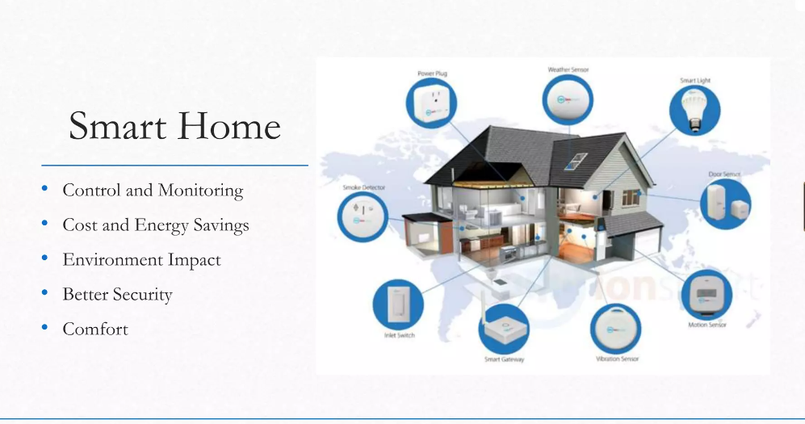
Smart Home

Slide 15
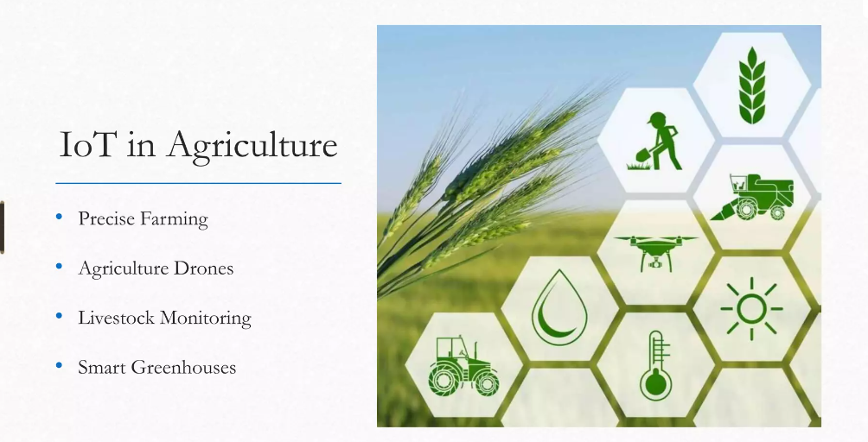
Agriculture

Slide 16
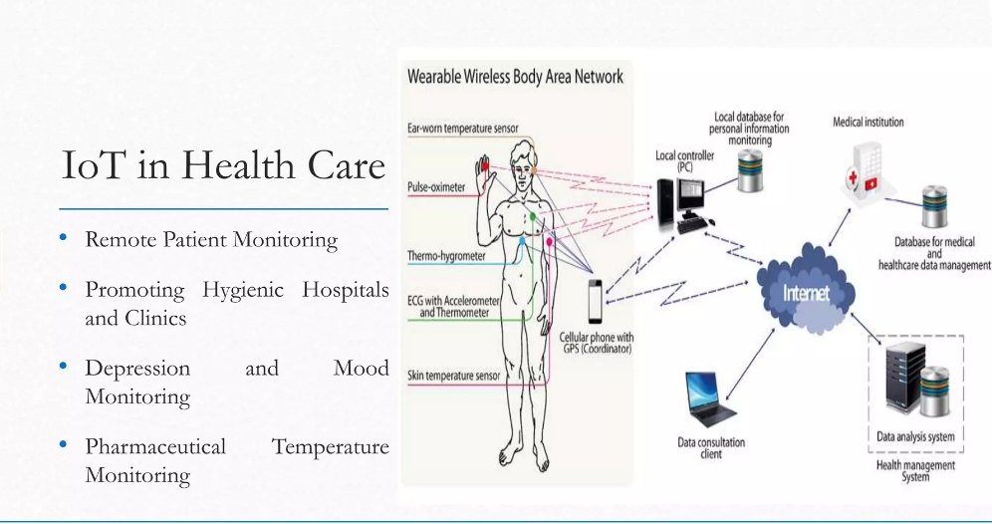
Health Care

Slide 17
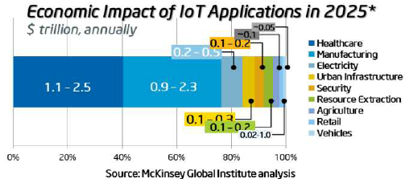
Impact of IoT on Economy

Slide 18
!! Thank You !!

