Slide 1
ENPM611 — Software Engineering | Final Project Presentation
Poetry Issues Analytics
A Multi-Feature Application of GitHub Issues for the Poetry Repository
Team
Chris Collins · Michael Hunt · Shiv Shah
15-minute presentation: 10 min talk + 5 min live demo

Slide 2
Overview
Approach and Design
Approach
Implementation
▎ Waterfall Methodology (Separate Phases)
▎ Requirements
▎ Design
▎ Implementation
▎ Testing
▎config.json + env override for the data file path
▎Two graph analyses within a feature
▎One pure CLI analysis
▎One interactive dashboard analysis
Design
Testing
▎ DataLoader · config · model.Issue · model.Event
▎ IssuePull
▎ ExampleAnalysis · LabelsAnalysis · dashboard/
▎ run.py wires everything to a --feature flag
▎ Tests: Designed to achieve 90%+ code coverage across files
ENPM611 — Poetry Issues Analytics — Team: Collins, Hunt, Shah
Overview
1 / 7

Slide 3
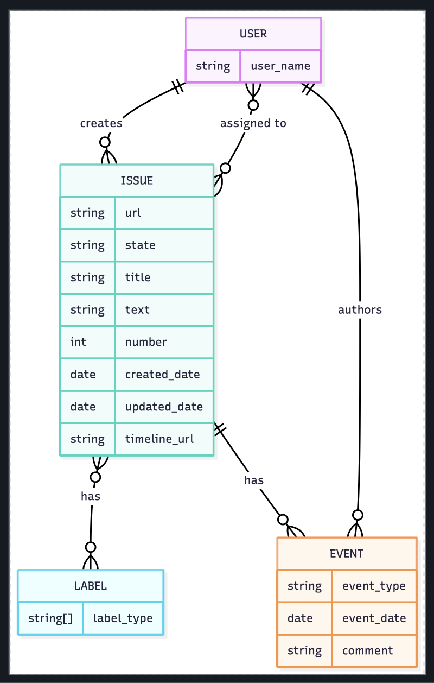
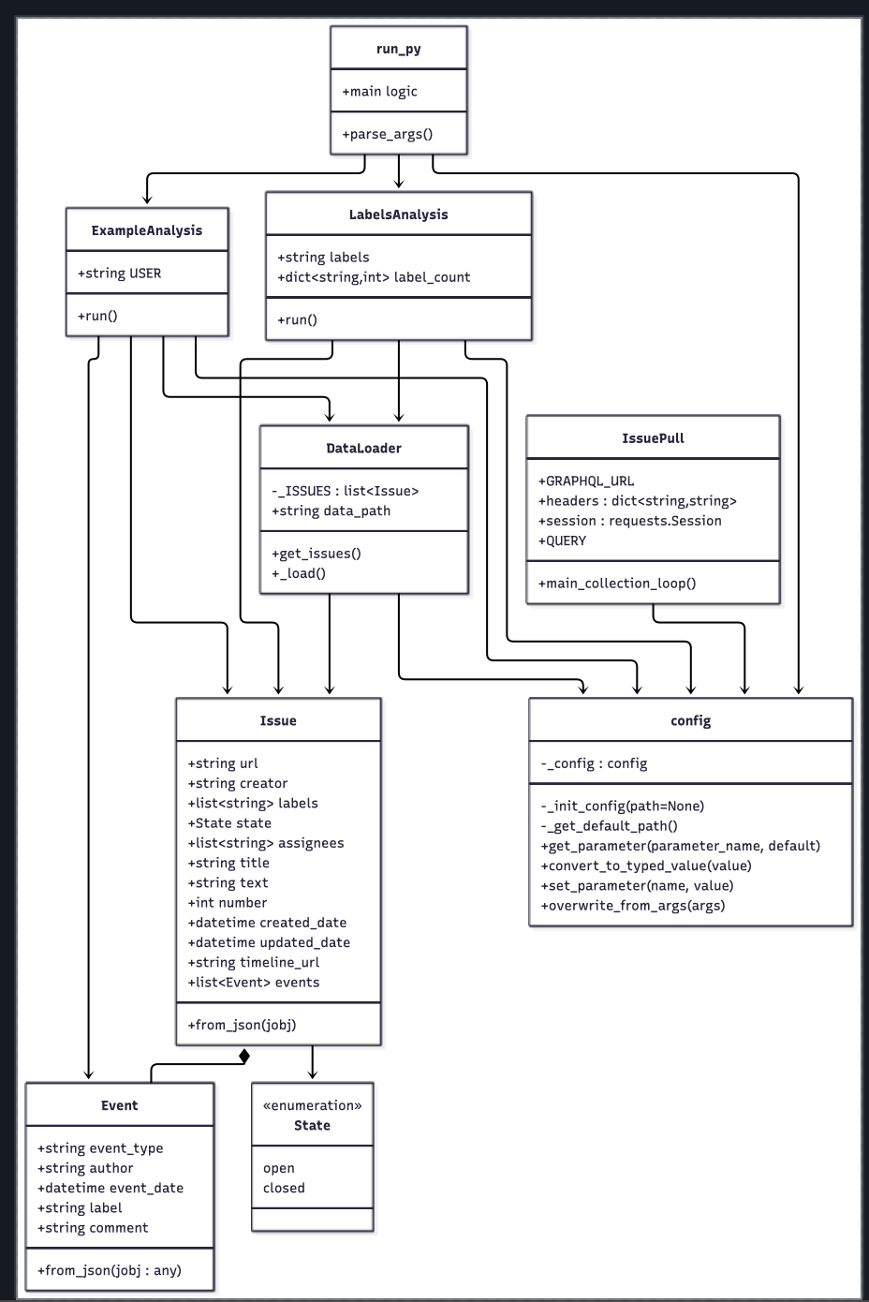
Initial Design (Milestone 1)
What we submitted: a class diagram + ERD for the CLI app
Plan at submission time
▎ Three CLI analyses, each printing tables + matplotlib charts
▎ Object-graph data model: Issue holds a list of Event
▎ config.json + env override for the data file path
▎ Tests: not yet scoped (Milestone 1 was design only)
▎ Diagrams committed to /diagrams as the source of truth
Note: there was no dashboard, no DataFrame layer, and no derived metrics in the original design.
ENPM611 — Poetry Issues Analytics — Team: Collins, Hunt, Shah
Design
2 / 7

Slide 4
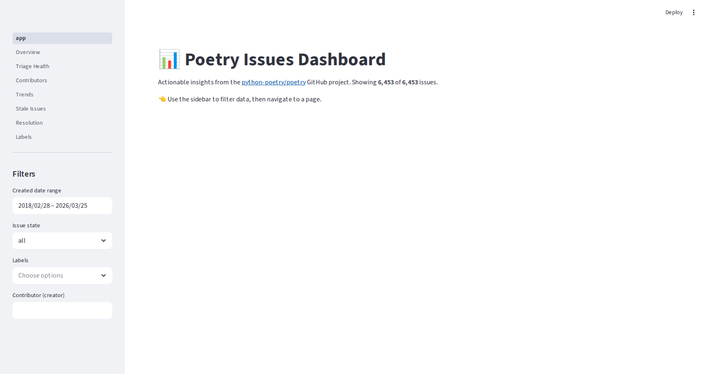
Implementation
CLI analyses + a multi-page Streamlit dashboard over 6,453 GitHub issues
▎ 3 CLI features (run.py --feature 0/1/2): Example Analysis, Labels Analysis, State Analysis
▎ 2 graph analysis (run.py --feature 1): Label occurrences across issues and average time to close label
▎ 1 CLI output (run.py --feature 2): Closed/Open status of issues
▎ 1 dashboard feature (--feature 3): Launches Streamlit Interactive Dashboard
▎ 7-page dashboard: Overview, Triage, Contributors, Trends, Stale, Resolution, Labels
▎ Sidebar filters: date range, state, labels, contributor (apply globally)
▎ Computed metrics: time-to-first-response, days-to-close, staleness buckets
Dashboard landing page · live screenshot
ENPM611 — Poetry Issues Analytics — Team: Collins, Hunt, Shah
Implementation
3 / 7

Slide 5
What changed in the final design
Three categories of divergence from the milestone-1 submission
New Dashboard
New Class
Refined Requirements
▎ Streamlit dashboard module (dashboard/)
▎ 7 page modules under dashboard/pages/
▎ Sidebar filter module (filters.py)
▎ Metrics layer (metrics.py): 6 functions
▎ Cached data loader (st.cache_data)
▎ state_analysis.py added which contains the StateAnalysis class
▎ Labels analysis would now occur in it’s own class with insights related solely to labels
▎ issue_pull.py not part of normal application usage
▎ Run once then utilize the data via config.json
▎ Normalized results, reduced running time, and circumvented API request limits
ENPM611 — Poetry Issues Analytics — Team: Collins, Hunt, Shah
Changes
4 / 7

Slide 6
DEMO

Slide 7
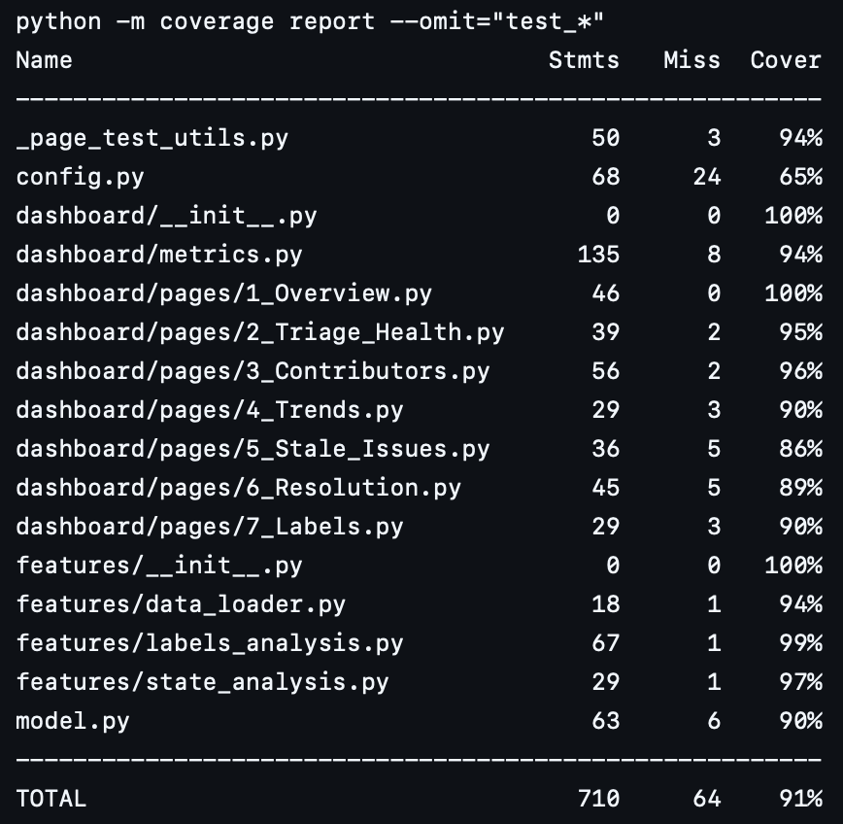
Testing Suite
unittest and coverage modules for obtaining 90%+ code coverage
Coverage by layer
Test Coverage Output
Dashboard (7 modules)
Loaded via runpy under a mocked streamlit; assert KPI labels underneath all the pages
Features (3 functions)
Heavy usage of function patching to only make the functions within the features run
Utilities (3 files)
Separately tested utilities as they were patched for features and dashboard testing. Optimized tests for code coverage.
ENPM611 — Poetry Issues Analytics — Team: Collins, Hunt, Shah
Testing
5 / 7

Slide 8
Bugs Discovered
Unexpected issues with code in main
Testing Utility Bug
The test utility had a bug in how it located the root directory, which caused path resolution problems when running tests.
→ Fix: Updated the utility to search for the project root directory during test execution.
Wrong divisor in LabelsAnalysis
Average time-to-close per label divides the per-label time sum by the TOTAL number of closed issues, not by the count of closed issues with that label.
→ Fix: Compute average close time per label by dividing each label's accumulated close time by that label's own closed-issue frequency.
Failed Configuration Load
The configuration loader is not reading the expected JSON config value during test execution (file/path loading path mismatch)
→ Fix: Ensure config.py loads from the project config.json in test context and that file-based values are merged before parameter reads.
ENPM611 — Poetry Issues Analytics — Team: Collins, Hunt, Shah
Bugs
6 / 7

Slide 9
Lessons Learned
Three honest answers — and the lesson behind each
1. Initial Design Scoping is Difficult
Milestone 1 asked for entity relationships and class structure, so we delivered exactly that. We never asked the next question — "what additional features might we want to implement" — until we started building. Sticking to the design diagram during implementation felt more restrictive than useful.
→ Lesson: Look beyond the milestone deadline to make a decision on what will be implemented and how the design will be done.
2. GitHub Issues Tracking is Super Useful
Before Milestone 2 we were coordinating all of our efforts via calls and text messages. It quickly became difficult to keep track of who was doing what and what needed to get done.
→ Lesson: GitHub Issues exists for a reason. This made tracking progress and milestone related tasks so much easier.
3. Testing May Result in Restructure
Our goal with Milestone 3 was to write tests such that 90%+ code coverage would be achieved. It turns out that the current code base wasn’t easily testable, requiring file structure and functions to be moved around to enable testing and achieve coverage.
→ Lesson: Consider entry points for testing when writing code.
ENPM611 — Poetry Issues Analytics — Team: Collins, Hunt, Shah
Lessons
7 / 7

