Slide 1

OBJECT TRACKING IN SURVEILLANCE VIDEOS
Infosys Springboard 5.0

Slide 2
INTRODUCTION
2
Object detection in surveillance videos uses computer vision and deep learning to identify and classify objects like people and vehicles.
It enhances security by automating threat detection, generating real-time alerts, and significantly reducing manual monitoring efforts.
This technology improves efficiency by saving time, preventing crimes, and providing critical insights into crowd density, unusual activities, and traffic patterns.
Future advancements include AI-driven predictive analytics, real-time edge computing, and behavior analysis for anomaly detection, improving proactive threat prevention.
Beyond security, it has applications in smart cities, traffic management, retail, and healthcare monitoring systems.
Infosys Springboard 5.0

Slide 3
3
IMPLEMENTATION
Phase 1
Phase 3
Image Processing:
Object Tracking:
Enhances visuals, extracts features, optimizes data.
Monitors object movement across frames.
Infosys Springboard 5.0
Phase 2
Phase 4
Object Detection:
Frontend Implementation:
Identifies and classifies objects in images and Videos.
Designs user interface for interaction..

Slide 4
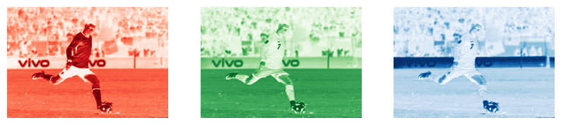
IMAGE PROCESSING
4
Overview & Key Tasks
Applications & Importance
Uses OpenCV and Matplotlib for image analysis.
Tasks include image loading, visualization, color conversion, blurring, and pixel intensity analysis.
Enhances image quality and prepares data for advanced tasks.
Used in object detection, segmentation, and feature extraction.
Helps in medical imaging, satellite imagery, and noise reduction.
Provides foundational concepts for computer vision and AI-based analysis.
Sample Output:
Infosys Springboard 5.0

Slide 5
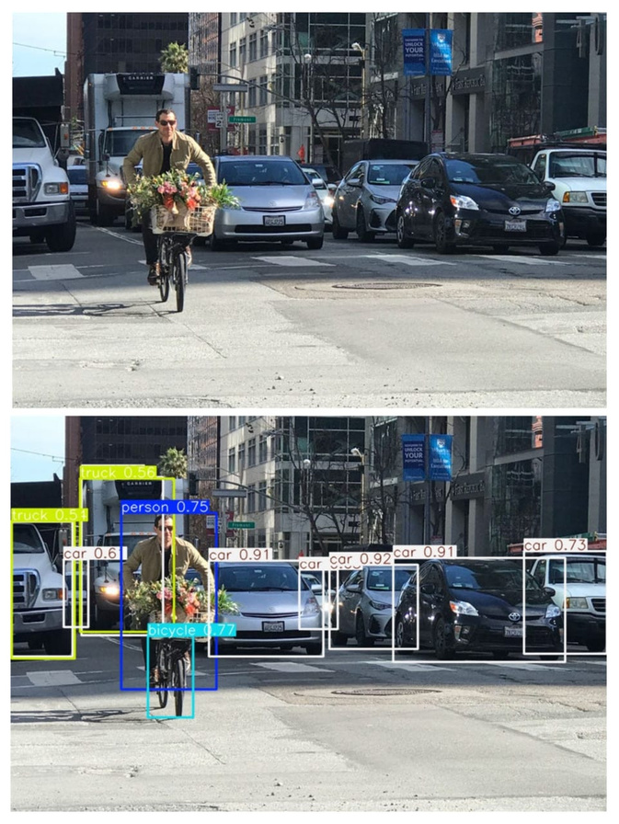
OBJECT DETECTION
5
Overview & Importance
Sample Output
Applications & Importance
Real-time object detection in videos using Tiny-YOLOv3.
Uses ImageAI for efficient video frame analysis.
Lightweight and optimized for resource-limited devices.
Enhances security, automation, and data-driven decision-making
Used in surveillance, traffic monitoring, and retail analytics.
Why YOLO?
Fast & Efficient – Processes the entire image in one pass, ensuring real-time detection.
Versatile & Scalable – Outperforms multi-stage models like R-CNN, ideal for surveillance, traffic monitoring, and automation.
Use Cases:
Security & Monitoring – Detects threats, tracks objects in surveillance, and analyzes traffic violations.
Retail & Wildlife – Enhances customer analytics and enables automated wildlife tracking with drones.
Infosys Springboard 5.0

Slide 6
OBJECT TRACKING
6
•Introduction:
•The project focuses on object detection and tracking using YOLOv4.
•YOLOv4 is a real-time deep learning model.
•It detects objects in video frames and tracks their movement.
•The output is a processed video with bounding boxes and unique IDs for each object.
•Why YOLO is Used for Object Tracking:
•Real-time speed and accuracy with a single-stage design.
•Combines detection and tracking in one process.
•Minimizes false positives, even on resource-limited devices.
•Ideal for surveillance and traffic monitoring applications.
•Use Cases:
•Traffic Monitoring: Detecting and tracking vehicles.
•Surveillance Systems: Monitoring people or objects in restricted zones.
•Sports Analytics: Tracking players or objects like balls in games.
•Importance:
The system is valuable for automation in tasks like traffic monitoring, surveillance, and sports analytics. It reduces the need for manual monitoring and enhances real-time decision-making capabilities.
Infosys Springboard 5.0

Slide 7



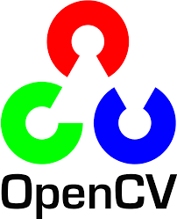

FRONTEND IMPLEMENTATION
7
Tech Stack Used:
Features:
File Upload Feature
Allows users to upload video files for object detection.
Progressive Loading and Feedback
Displays a loading indicator and provides real-time feedback on upload and object detection progress.
Image Display for Detection Results
After object detection, the frontend displays the output image with bounding boxes and labels for detected objects.
Download Processed Video
After processing, a download link for the video with detected objects and labels is provided.
Infosys Springboard 5.0

Slide 8
8
CONCLUSION
In conclusion, this project showcases the immense potential of object tracking in surveillance videos, harnessing cutting-edge computer vision techniques such as YOLO and optical flow. It demonstrates how these technologies can provide real-time, efficient, and scalable solutions in ever-evolving environments.
The scope of this work goes beyond surveillance, with promising applications in fields like traffic management, sports analytics, and robotics. As AI and edge computing continue to advance, we can expect these systems to drive further innovation in automation, decision-making, and safety, ultimately shaping the future of various industries.
Larana University | 2024

Slide 9
Infosys Springboard 5.0
THANK YOU

