Slide 1


Sales Management Analysis for Amazon Dataset
Using ETL and Analytical Tools to gain valuable insights from Amazon's sales data.
by Shivam Singh Raghuvanshi
May 17, 2024

Slide 2

Problem Statement
Effective sales management is critical for businesses to stay competitive, improve distribution channels, and optimize costs to increase profits. The goal of this analysis is to thoroughly examine Amazon's sales data to uncover key trends, metrics, and actionable insights that can guide strategic decision-making.
Identify critical patterns and fluctuations in sales over time to adapt to changing market conditions.
Determine the most impactful factors and drivers of sales performance, such as product categories, promotions, and seasonal effects.
Provide data-driven recommendations to optimize sales strategies and maximize revenue growth for the Amazon business.

Slide 3
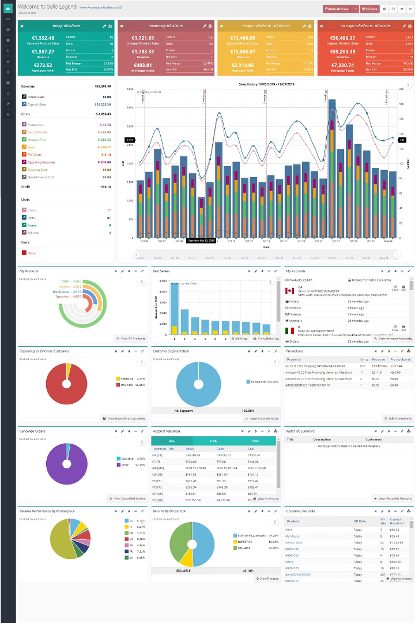
Dataset Overview
The analysis is based on a comprehensive Amazon sales dataset that provides detailed transaction-level data. The dataset includes a wide range of attributes such as date, product, sales amount, and other relevant information to enable a thorough examination of sales trends and performance drivers. The dataset can be accessed through the provided Dataset Link.

Slide 4
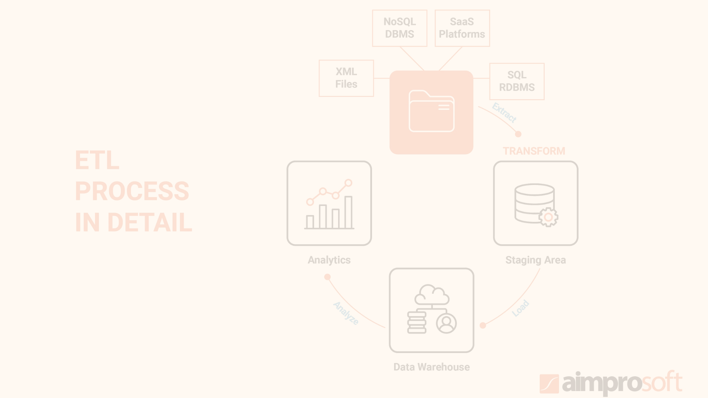



ETL Process
Extract
Load the comprehensive Amazon sales dataset from the provided link, ensuring data integrity and completeness.
Transform
Clean and preprocess the data, handling missing values and correcting data types. Aggregate the data for monthly, yearly, and yearly-monthly analysis.
Load
Store the transformed data in a suitable format, such as data frames or databases, for in-depth analysis and reporting.

Slide 5
Tools and Techniques
Programming Language
Data Analysis Libraries
Visualization Tools
The analysis was conducted using the powerful and versatile Python programming language, known for its extensive libraries and ease of use in data-intensive tasks.
Pandas for efficient data manipulation and analysis
To present the findings in a visually compelling and interactive manner, the analysis leveraged industry-leading Tableau and Power BI platforms for creating dashboards and reports.
Matplotlib and Seaborn for creating insightful data visualizations
NumPy for advanced numerical computations and statistical analysis

Slide 6
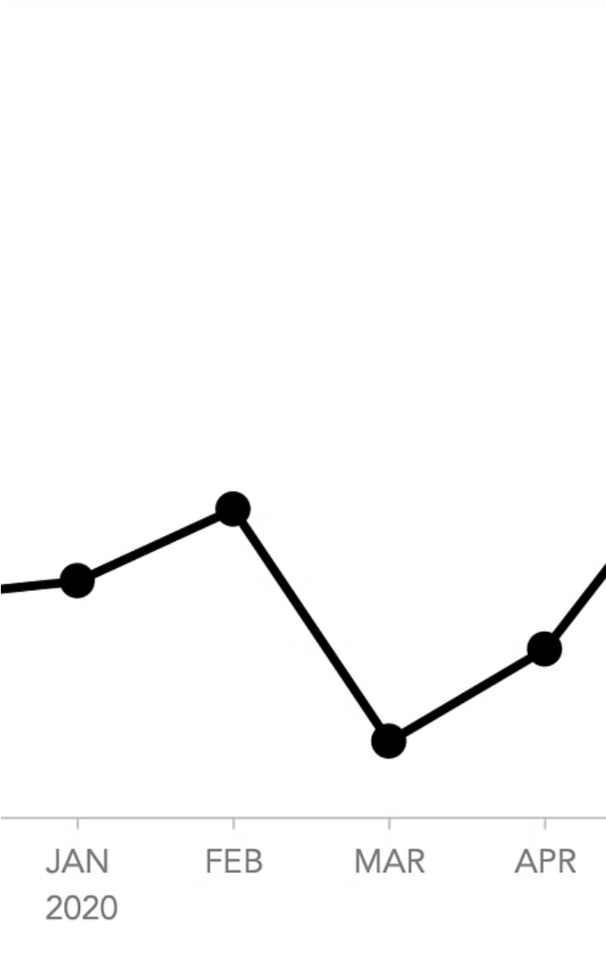
Sales Trend Analysis
Our analysis of the monthly sales trends reveals clear peaks and valleys in sales volume throughout the year. Line charts help us visualize these fluctuations and identify the most lucrative and slowest sales periods.
Examining the year-over-year sales data, we see a steady upward trend with some variations. Bar charts allow us to easily compare the sales performance across different fiscal years and gauge the overall growth or decline of the business.
To further investigate the seasonal patterns, we created heatmaps and line charts to display the sales trends for each month across multiple years. This helps uncover consistent high and low points that can guide future planning and inventory management.

Slide 7
Key Metrics and Factors
Total Sales
Average Monthly Sales
The cumulative sales over the entire analysis period, providing a high-level view of the overall business performance.
The mean sales value for each month, offering insights into seasonal trends and typical sales volume.
Sales Growth Rate
Top Selling Products
The percentage increase or decrease in sales from one year to the next, highlighting the business's growth trajectory.
The products with the highest sales volume, which can inform product selection, inventory management, and marketing strategies.

Slide 8
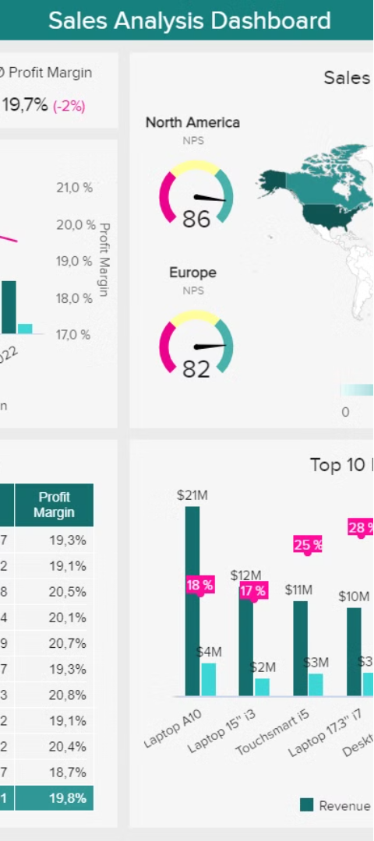
Relationship Analysis
1
Correlation Analysis
Identify the relationships between sales performance and other key attributes, such as product category and geographic region. This can reveal important insights about the underlying drivers of sales.
2
Seasonal Patterns
Determine if certain time periods, like specific months or quarters, consistently show higher or lower sales volumes. Recognizing these seasonal trends can inform strategic inventory planning and marketing campaigns.
3
Promotional Impact
Assess the impact of promotions, discounts, and other sales incentives on the overall sales volume. This analysis can guide the design and timing of future promotional activities.

Slide 9
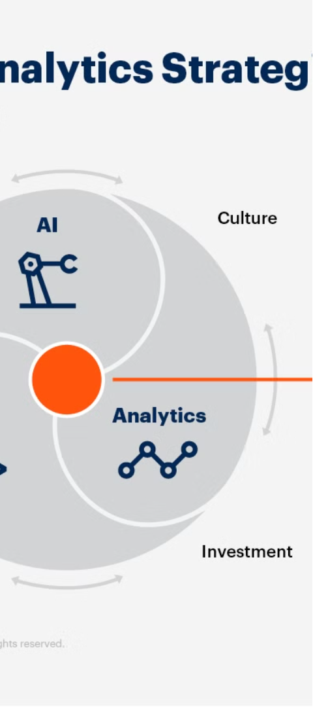
Findings and Insights
1
Monthly and Yearly Trends
2
Key Sales Drivers
The analysis revealed significant sales fluctuations during specific months and years, indicating the need to closely monitor and adapt to changing market conditions.
Certain high-performing product categories and well-timed promotional activities were identified as the primary drivers of increased sales volume.
3
Actionable Insights
Based on the identified trends, the analysis provides data-driven recommendations to optimize sales strategies and capitalize on emerging opportunities.

Slide 10
Conclusion and Next Steps
1
Summary of Analysis
Key trends, metrics, and insights uncovered
2
Recommendations
Strategic actions to optimize sales strategies
Future Work
3
Suggestions for further analysis and data collection
In conclusion, this comprehensive sales analysis of the Amazon dataset has revealed critical trends, performance drivers, and actionable recommendations to help guide strategic decision-making. By identifying monthly and yearly fluctuations, key sales metrics, and underlying factors, we can now provide data-driven insights to improve the company's sales management and capitalize on emerging opportunities.

Slide 11
Thank You
We appreciate you taking the time to review this presentation. The insights and recommendations provided should help guide your strategic decision-making and unlock new opportunities for growth. Please let us know if you have any other questions or if there is anything else we can assist with. We look forward to continuing our partnership and supporting your success.

