Slide 1


Competitive Analysis of Top 500 Companies in India
Dive into the market capitalization and quarterly sales of India's leading businesses, uncovering insights to drive strategic decision-making.
by Shivam Singh Raghuvanshi

Slide 2
Problem Statement
The objective of this competitive analysis is to examine the market capitalization and quarterly sales of the top 500 companies in India. This insight is crucial for strategic planning and market positioning, allowing businesses to better understand the competitive landscape and make informed decisions to drive better results.
Analyze the competition for improved business performance
Focus on market capitalization and quarterly sales of India's leading enterprises
Understand the competition is essential for strategic planning and market positioning

Slide 3
Dataset Overview
The analysis is based on a comprehensive dataset of the top 500 companies in India. The dataset includes key financial metrics such as market capitalization and quarterly sales for each company. The data attributes provide valuable insights into the competitive landscape, enabling deeper understanding of the market dynamics.
The dataset can be accessed at the provided Dataset Link. It includes the following information for each company:
Serial Number
Name of Company
Market Capitalization (in Crores)
Quarterly Sales (in Crores)

Slide 4




ETL Process
Extract
The dataset is loaded from the provided link, ensuring the data's integrity and completeness for further analysis.
Transform
The data is cleaned and preprocessed, handling any missing values and correcting data types. Key metrics are then aggregated and summarized for deeper insights.
Load
The transformed data is stored in a format suitable for comprehensive analysis and impactful data visualization.

Slide 5
Tools and Techniques
Programming Language
Libraries Used
Visualization Tools
The analysis is conducted using the versatile Python programming language, known for its robust data manipulation and analysis capabilities.
Pandas: Utilized for efficient data handling and transformation
The insights are presented using powerful business intelligence platforms, such as Tableau and Power BI, which enable the creation of interactive and dynamic dashboards.
Matplotlib/Seaborn: Leveraged for creating visually appealing and informative data visualizations
NumPy: Employed for advanced numerical computations and statistical analysis

Slide 6
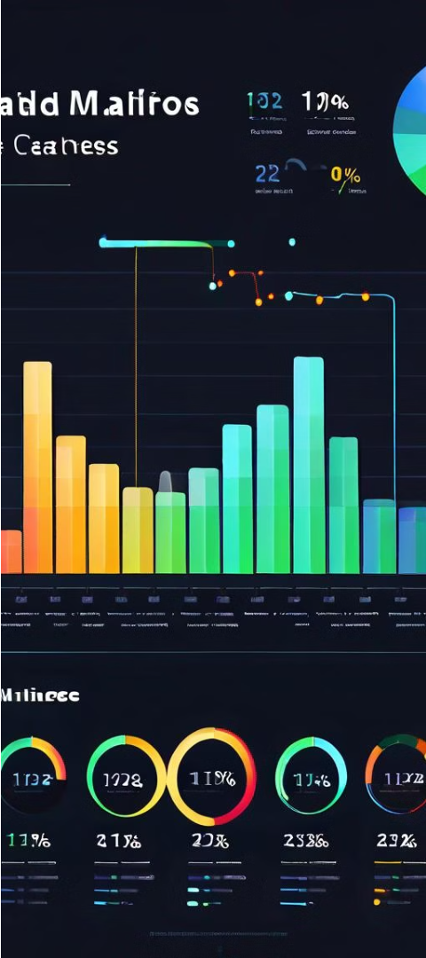
Key Metrics
Market Capitalization
Quarterly Sales
The total market capitalization of the top 500 Indian companies is the sum of their individual market caps. The average market capitalization provides insight into the typical company size. The top 10 companies by market cap represent the industry leaders.
The total quarterly sales across all 500 companies indicates the combined revenue generation. The average quarterly sales offers a benchmark for typical company performance. Identifying the top 10 companies by sales uncovers the market's largest and most successful enterprises.

Slide 7



Relationship Analysis
Correlation Analysis
1
Examine the relationship between market capitalization and quarterly sales.
2
Segmentation Analysis
Analyze market cap and sales across industry sectors.
Growth Potential
3
Identify companies with high sales but lower market cap.
The relationship analysis takes a comprehensive look at the interdependence between key financial metrics. By uncovering the correlation between market capitalization and quarterly sales, we can better understand the drivers of a company's valuation. Additionally, segmenting the data by industry provides insights into how different sectors perform in terms of both market cap and sales.
Identifying companies with high sales but relatively lower market caps could uncover hidden growth opportunities. These firms may be undervalued and represent potential investment prospects with the ability to generate significant shareholder returns.

Slide 8
Findings and Insights
1
Key Observations
2
Significant Trends
The analysis reveals that the top companies by market capitalization are Reliance Industries, TCS, HDFC Bank, Infosys, and ICICI Bank. The largest firms by quarterly sales include Reliance Industries, Indian Oil, Bharat Petroleum, Tata Motors, and Hindustan Petroleum.
A strong positive correlation was observed between market capitalization and quarterly sales, indicating that companies with higher sales volumes tend to have higher market valuations.
3
Actionable Insights
4
Future Work
The insights can inform strategic planning and market positioning, helping businesses identify growth opportunities and understand their competitive landscape.
Additional data collection and analysis, such as segmenting by industry sector or incorporating historical trends, could provide further valuable insights to guide decision-making.

Slide 9
Conclusion and Next Steps
Summary of Analysis: The analysis revealed key insights on the relationship between market capitalization and quarterly sales, showcasing that the top companies by market cap are not always the highest in sales volume.
Strategic Recommendations: The findings can inform strategic decision-making, helping businesses identify growth opportunities and strengthen their competitive positioning within their respective industries.
Future Initiatives: To build upon these insights, further research could explore historical trends, incorporate additional data sources, and delve deeper into industry-specific dynamics to uncover more comprehensive and actionable intelligence.

Slide 10
Thank You
We greatly appreciate your time and attention throughout this presentation. The insights and analysis we have shared today represent the culmination of extensive research and cross-functional collaboration within our team.
The data-driven findings outlined in this deck can serve as a valuable foundation to inform strategic decision-making and guide your organization towards continued growth and success. We welcome the opportunity to discuss these results in greater depth and explore potential next steps for implementation.
Once again, thank you for your engagement. We look forward to continued partnership and to supporting your ongoing business objectives.

