Slide 1
TRACK YOUR COURIER
By:
Vivek and Shiv

Slide 2

Introduction:
It aims at automation of maintaining consignment records and their tracking.
It is not just an application, it is a real life service made for common man.
It has been made using HTML, CSS, JavaScript, PHP, MySQL.
The can pretty much help you improve your reflexes.

Slide 3
Features of the application
The Application allows customers to make account giving their phone no. and email ID
The customers can then schedule courier pickups when an employee from TrackUrCor will come to pickup there stuff for transit.
The same application is used by the employees the only extram thing is that the employees need to get verified by the admin.

Slide 4
Features of the application(contd.)
The one and only admin has the power and privilege to add, change or remove any customer, consignmennt or employee.
you have to press the key corresponding to that before it disappears.
Initially the service is provided to specific cities.
This can be further changed by admin
All The Best

Slide 5
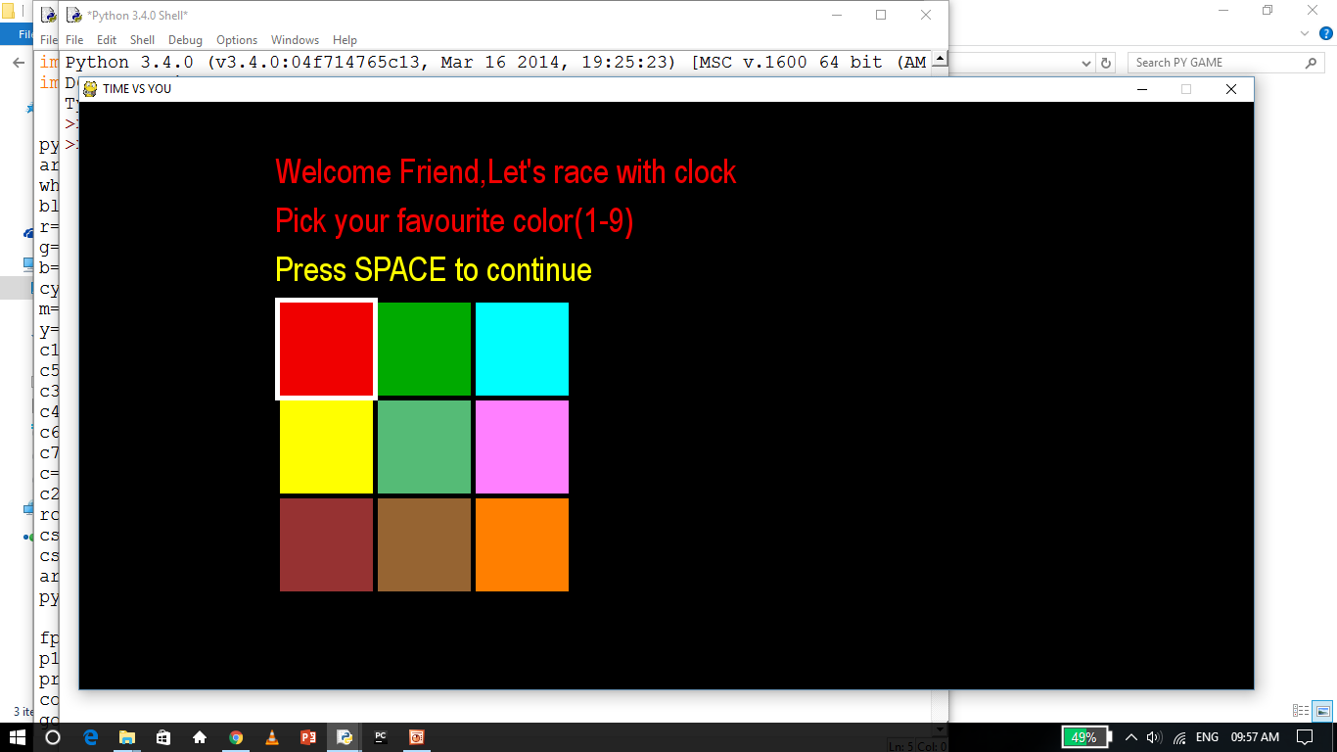
SCREEN SHOTS

Slide 6
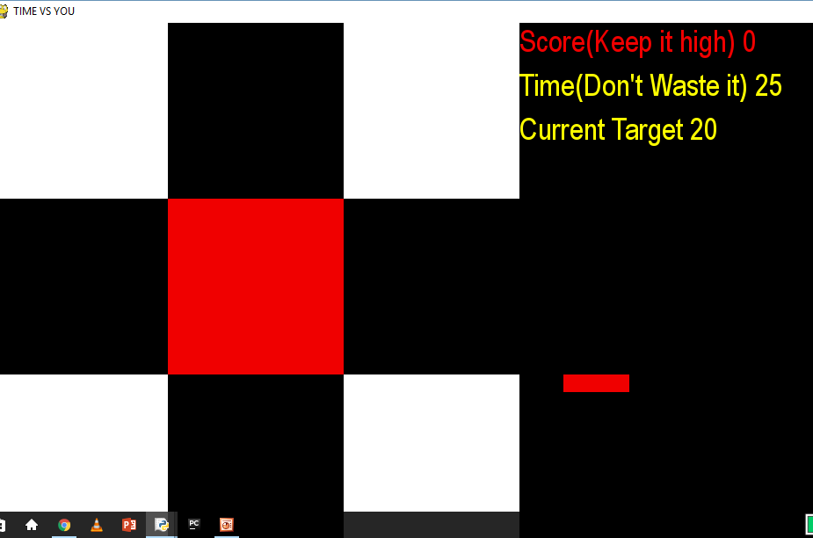
SCREEN SHOTS

Slide 7
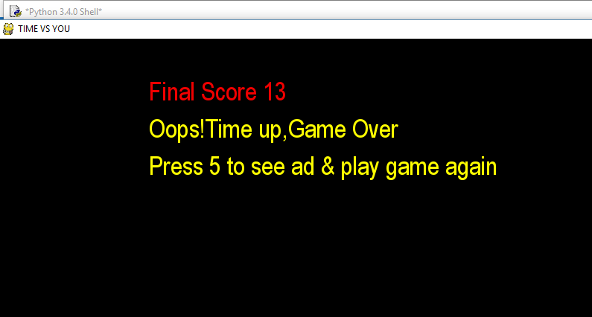
SCREEN SHOTS

Slide 8
Used In The Game
The game has been made in HTML,CSS,PHP,MySQL,JS
Xampp server has been used for testing
The software is pretty light
an Image containing our names(jpg file)
Bootstrap*

Slide 9
A Game By:
Guided By:
Prof. Sangeeta Sharma
Vivek Upadhyay-(151112108)
Shiv Kumar-(151112109)

