Slide 1
1,000
Human-AI Synergy
Primary Dataset Rows
Quantifying the Impact of Explanation
Quality on User Trust
4 Models
Built & Evaluated
Shivam Thakkar
CS628-151W: Data Science | Monroe University, King Graduate School
Professor Khadhirunissa Shaik | March 2026
R² = 0.674
Best Model (RF)
WoA
Behavioral Framework
Weight of Advice (WoA) Framework · Python / scikit-learn / statsmodels
Notes:
SLIDE 1 — TITLE (~30 seconds) Good morning/afternoon, everyone. My name is Shivam Thakkar, and today I'm presenting my final project for CS628. The project is called "Human-AI Synergy: Quantifying the Impact of Explanation Quality on User Trust." The central question I'm asking is: when an AI system explains itself more clearly, does that actually change how much humans trust it — and more importantly, does that trust translate into them actually following its advice? To answer this, I built a complete data science pipeline across two datasets, four machine learning models, and over 1,500 data points. Let me walk you through what I found.

Slide 2
02
Research Background & Motivation
The Problem
The WoA Framework
AI adoption lags behind capability — the bottleneck is human trust, not algorithm accuracy
Black-box AI creates a gap between what AI knows and what users believe
Existing research measures F1 scores — not human behavioral response
A new "science of human-AI decision-making" is needed (Wen et al., 2025; Lai et al., 2023)
Weight of Advice measures how much a person actually updates their decision after receiving AI advice.
WoA = (Final − Initial) / (AI Score − Initial)
WoA = 0
Completely ignored AI
WoA = 0.5
Split the difference equally
WoA = 1
Fully adopted AI advice
RQ: Does higher AI explanation transparency lead to higher trust — and does trust change behavior?
Shivam Thakkar | CS628 Final Presentation | Human-AI Synergy
Notes:
SLIDE 2 — BACKGROUND (~60 seconds) The core problem I'm addressing is this: AI systems are becoming more capable every year, but adoption in high-stakes decisions hasn't kept pace. That gap is about trust. Most existing research evaluates AI on objective metrics — accuracy, F1 scores. But those don't tell us whether humans actually accept the AI's advice. My project uses the Weight of Advice framework — WoA — which comes from behavioral decision science. It measures the ratio between how much a person actually moved their answer toward the AI versus how far they could have moved. So WoA of 0 means they ignored the AI completely. WoA of 1 means they fully adopted it. My specific research question is: does higher explanation transparency lead to higher stated trust — and does that stated trust actually change behavior as measured by WoA?

Slide 3
03
Data & Methodology
Primary Dataset
1,000 × 23
Secondary Dataset
526 × 158
AI model outputs + user trust scores + skepticism categories
Engineered: Explanation Transparency Score (composite of 5 features: confidence %, cited sources, hedging words, disclaimer, detail level)
SPSS experimental data (OSF repository) — lunar estimation task
Computed: WoA + AITrust composite (5-item Likert scale)
Data Science Pipeline
1
2
3
4
5
Acquisition
►
Preparation
►
EDA
►
Modeling
►
Evaluation
CSV + SPSS via
pandas & pyreadstat
Missing values, outliers,
encoding & scaling
Correlations, distributions,
transparency engineering
Simple LR, Multiple LR,
Random Forest, Logistic
R², MAE, 5-fold CV,
feature importance
Shivam Thakkar | CS628 Final Presentation | Human-AI Synergy
Notes:
SLIDE 3 — DATA & METHODOLOGY (~75 seconds) I used two datasets. The primary dataset has 1,000 rows and 23 columns — it captures AI model outputs alongside user trust scores and skepticism categories. The key feature I engineered is the Explanation Transparency Score — a composite of 5 normalized variables including AI confidence percentage, whether sources were cited, use of hedging words, inclusion of a disclaimer, and answer detail level. The secondary dataset comes from an SPSS file hosted on the Open Science Framework — a real behavioral experiment where 526 participants estimated the time to walk around the Moon, before and after receiving AI advice. From this, I computed the Weight of Advice. My pipeline followed 5 standard data science steps: data acquisition, preparation, exploratory analysis, modeling, and evaluation. I used Python throughout — pandas, numpy, scikit-learn, statsmodels, and seaborn.

Slide 4
04
Key Results — Model Performance
Model | Test R² | CV R² | Test MAE | RMSE
M1 — Simple Linear | 0.071 | 0.032 | 1.482 | 1.815
M2 — Multiple Linear | 0.467 | 0.411 | 1.097 | 1.376
M3 — Random Forest ★ | 0.674 | 0.639 | 0.891 | 1.075
M4 — Logistic Regression | 68.0% acc. | 63.2% | — | F1 = 0.629
β = +1.475
44.7%
r = 0.078
7% → 67%
p < 0.001
Feature Importance
Trust → WoA
R² improvement
Transparency significantly
predicts trust
AI Confidence %
is #1 trust driver (RF)
Attitude-behavior gap:
weak link to action
Progressive gains
with more features
Shivam Thakkar | CS628 Final Presentation | Human-AI Synergy
Notes:
SLIDE 4 — RESULTS (~75 seconds) Let me walk you through the model results. I built four models, each adding complexity. Model 1, Simple Linear Regression, gave me an R-squared of 0.071 — meaning transparency alone explains just 7% of variance in trust. That's statistically significant at p less than 0.001, with a coefficient of +1.475, but it's a weak predictor on its own. Model 2, Multiple Linear Regression, jumped to 0.467 by adding digital literacy, AI familiarity, and answer accuracy. Nearly 47% of variance explained. Model 3, Random Forest, performed best with R-squared of 0.674 — 67% of variance explained, and a mean absolute error under 0.9 points on a 10-point trust scale. This was confirmed by 5-fold cross-validation at 0.639. Model 4, Logistic Regression, classified users into 4 skepticism categories at 68% accuracy — well above the 25% random baseline. The four key takeaways are on screen: transparency is significant, AI confidence percentage is the strongest driver, but the attitude-behavior gap is real — stated trust only weakly correlates with actual advice-following.

Slide 5
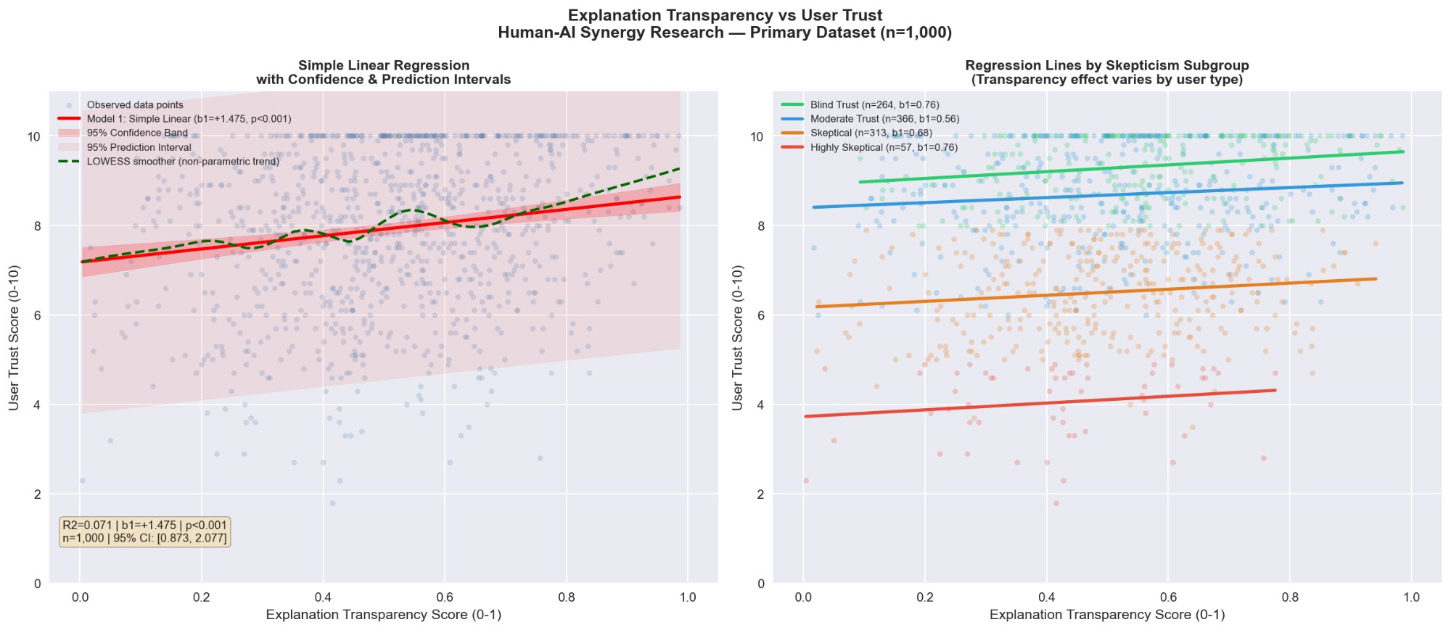
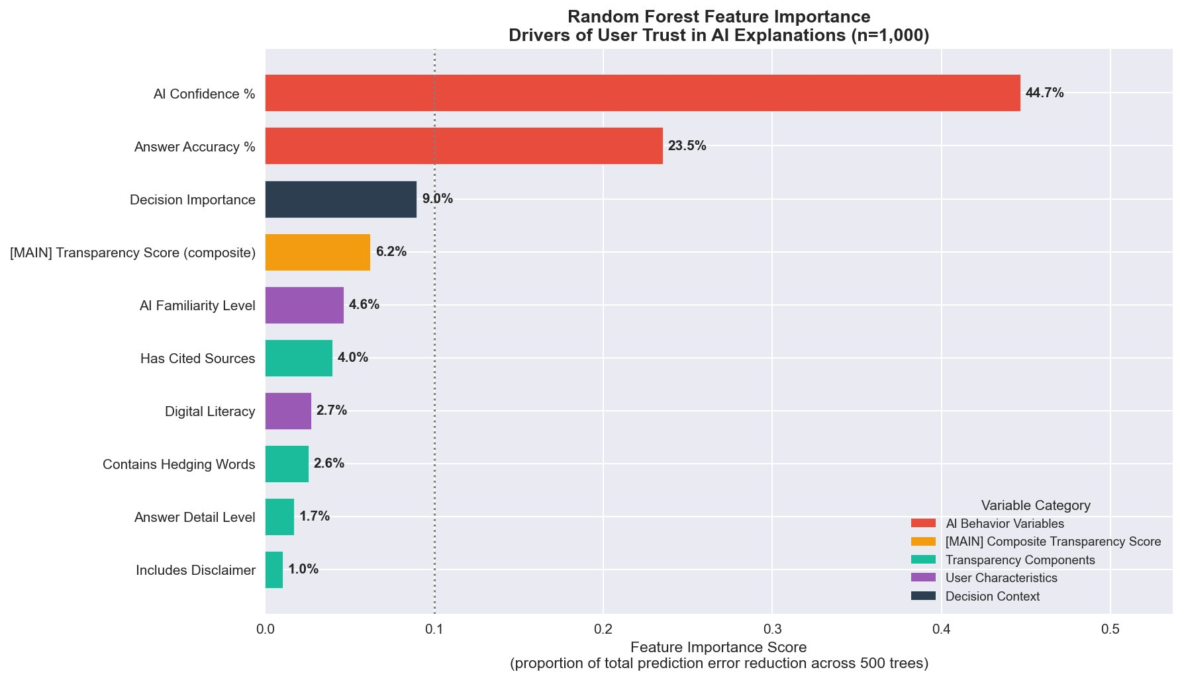
05
Core Findings — Transparency & Feature Importance
Shivam Thakkar | CS628 Final Presentation | Human-AI Synergy
Notes:
SLIDE 5 — VISUALIZATIONS: CORE FINDINGS (~60 seconds) The top figure shows the core relationship between Explanation Transparency and User Trust. On the left, you can see the simple linear regression with confidence and prediction intervals across all 1,000 data points. The positive slope is clear — beta of +1.475 — but the wide prediction interval shows there's a lot of individual variation. On the right, the same data is broken out by skepticism group. Notice how Blind Trust users stay high regardless of transparency level, while Highly Skeptical users stay low. The Moderate Trust group follows the transparency trend most closely — these are the users where explanation quality makes the biggest difference. The bottom figure is the Random Forest Feature Importance chart. AI Confidence Percentage dominates at 44.7%. Answer Accuracy is second at 23.5%. Our main transparency score ranks 4th at 6.2%. This tells us that behavioral signals from the AI — how confident it appears — matter more than structural explanation features.

Slide 6
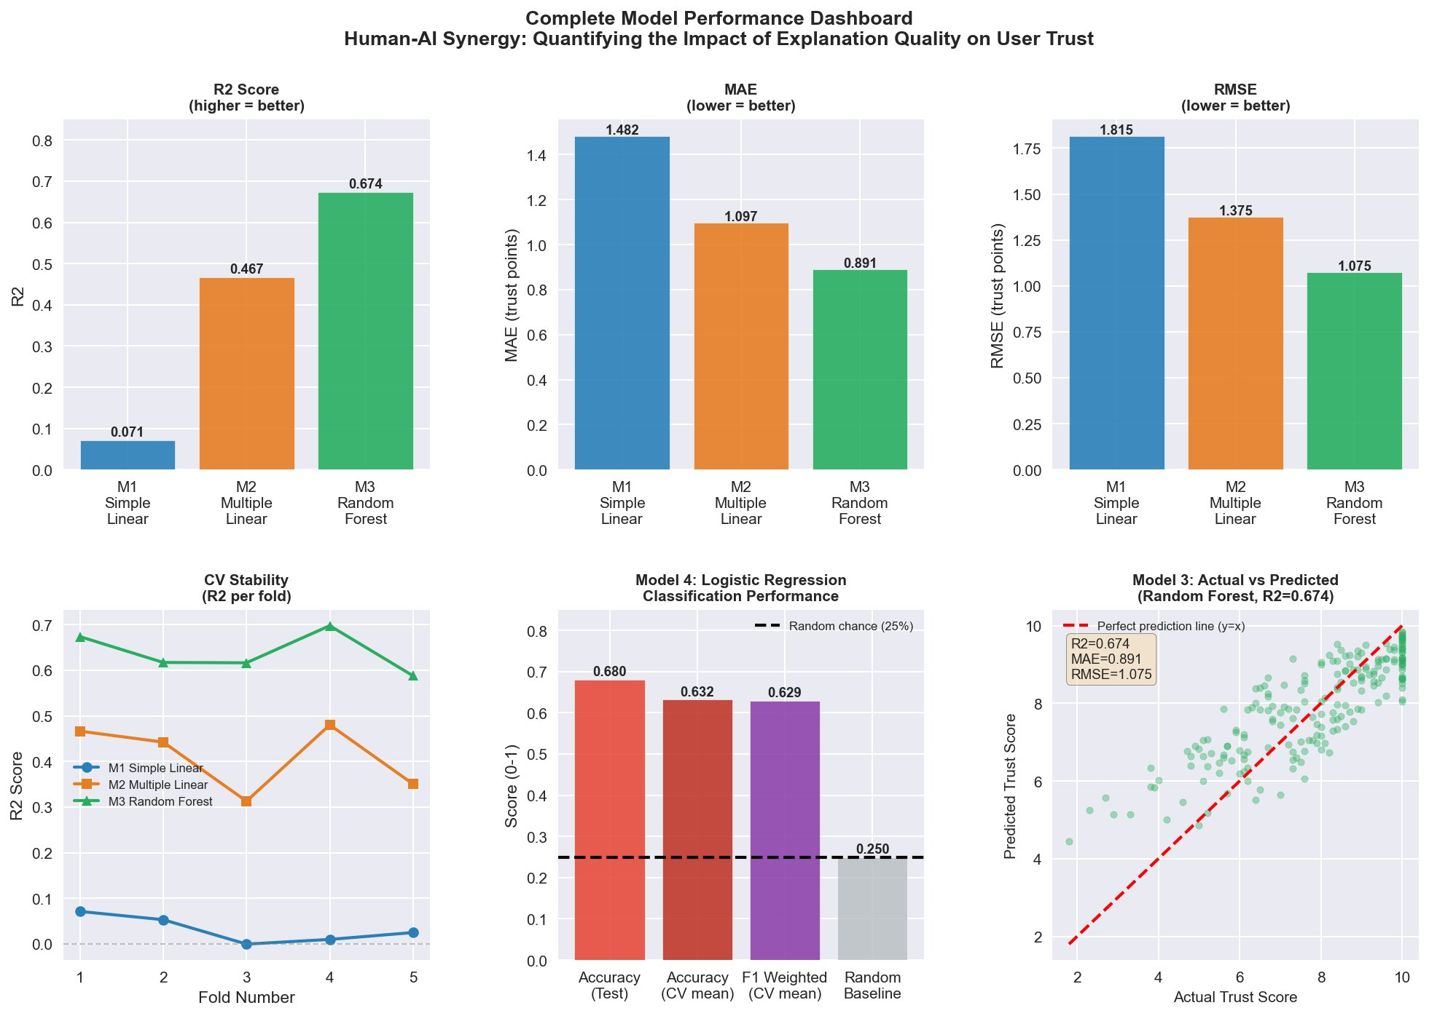
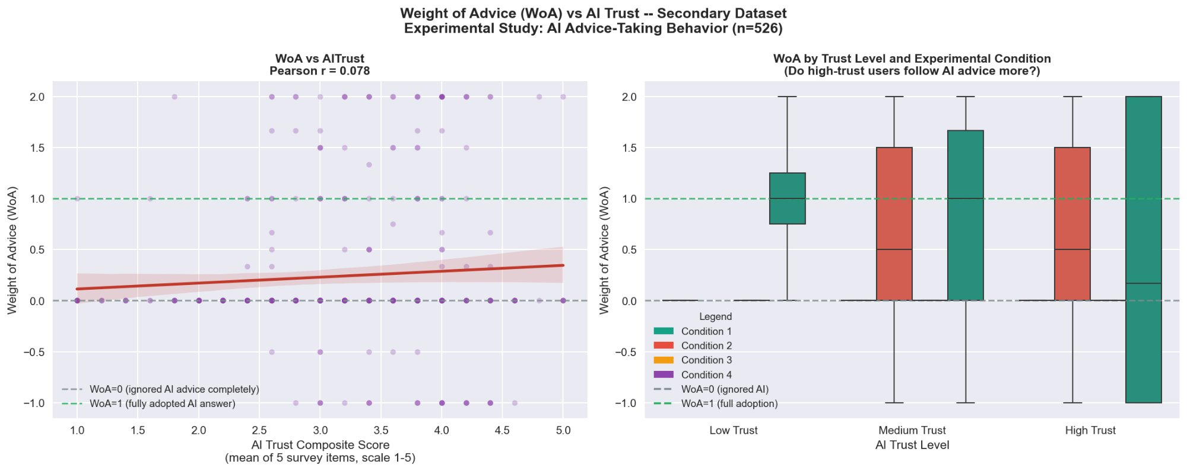
06
Model Dashboard & Behavioral Validation
Key Insight: Attitude–Behavior Gap
r = 0.078
Trust → WoA correlation
People who report high trust don't necessarily follow AI advice. Designing for felt trust is necessary but not sufficient — behavioral nudges are needed.
Shivam Thakkar | CS628 Final Presentation | Human-AI Synergy
Notes:
SLIDE 6 — MODEL DASHBOARD & BEHAVIORAL VALIDATION (~60 seconds) This dashboard on the left puts all model results in one view. Top row: R-squared climbs from 0.071 to 0.467 to 0.674 as we move from simple to multiple to Random Forest regression. MAE drops from 1.48 to 0.89 — each improvement is meaningful for a 0-10 trust scale. Bottom left shows CV stability — the Random Forest maintains strong performance across all 5 folds, confirming it's not overfitting. Bottom middle is the Logistic Regression classification — 68% test accuracy against a 25% random baseline. Bottom right is the actual-versus-predicted scatter for Random Forest. On the right, the WoA scatter plot from the secondary dataset reveals the most provocative finding: even people who report high trust don't necessarily update their answers toward the AI. The correlation between stated trust and actual advice-following is only r equals 0.078. This attitude-behavior gap suggests that designing AI to feel trustworthy may not be enough to drive real adoption.

Slide 7
07
Conclusions & Implications
What We Found
What This Means
Future Research
Transparency significantly predicts trust (β=+1.475, p<0.001)
Random Forest explains 67.4% of trust variance — best model
AI Confidence % is the #1 trust driver (44.7% importance)
Attitude-behavior gap: stated trust weakly predicts WoA (r=0.078)
Higher digital literacy & AI familiarity reduce naive trust
Technical accuracy alone is insufficient for AI adoption
How AI communicates confidence matters more than structural explanation features
AI designers should calibrate confidence displays to optimize trust
High-literacy users need evidence, not just confidence signals
Behavioral nudges are needed to bridge stated trust to actual use
Expand with personality variables as moderators
Test non-linear trust models (polynomial, interactions)
Add cognitive load & domain expertise variables
Replicate with real organizational decision-making data
Longitudinal design to track trust calibration over time
"Technical accuracy is insufficient for AI adoption — Cognitive Fit and Explanation Quality are the true drivers of human-AI synergy."
Shivam Thakkar | CS628 Final Presentation | Human-AI Synergy
Notes:
SLIDE 7 — CONCLUSIONS (~45 seconds) To summarize: Explanation transparency does significantly predict user trust — and Random Forest explains 67% of that variance. But the most important driver turned out to be how the AI communicates its confidence level — not the structural explanation features I initially focused on. The attitude-behavior gap — where stated trust has only a weak correlation of 0.078 with actual advice-following — is the most important practical implication. It suggests that designing AI to feel trustworthy is necessary but not sufficient. We need behavioral mechanisms that bridge the gap. For future work, I'd extend this to include personality variables, test non-linear trust models, and use longitudinal designs to see how trust calibrates over time. The bottom line: technical accuracy alone is not enough for AI adoption. How AI explains itself — particularly its confidence — is the real driver of synergy between humans and machines. Thank you. I'm happy to take any questions.

Slide 8
References
1. Ebermann, C., Selisky, M., & Weibelzahl, S. (2023). Explainable AI: The effect of contradictory decisions and explanations on users' acceptance. International Journal of Human-Computer Interaction, 39(9), 1807-1826.
2. Jiang, L., et al. (2023). Who should be first? How and when AI-human order influences procedural justice. PLoS ONE, 18(7), e0284840.
3. Lai, V., Chen, C., Smith-Renner, A. M., Liao, Q. V., & Tan, C. (2023). Towards a science of human-AI decision making. FAccT '23 Proceedings.
4. Neri, G., et al. (2025). Data visualization in AI-assisted decision-making: A systematic review. Frontiers in Communication, 10, 1605655.
5. Wen, Y., Wang, J., & Chen, X. (2025). Trust and AI weight: Human-AI collaboration in organizational management decision-making. Frontiers in Organizational Psychology, 3, 1419403.
6. Yaniv, I., & Kleinberger, E. (2000). Advice taking in decision making: Egocentric discounting and reputation formation. Organizational Behavior and Human Decision Processes, 83(2), 260-281.
Shivam Thakkar | CS628 Final Presentation | Human-AI Synergy
Notes:
Reference slide — no speaking notes needed. Available for Q&A.

