Slide 1
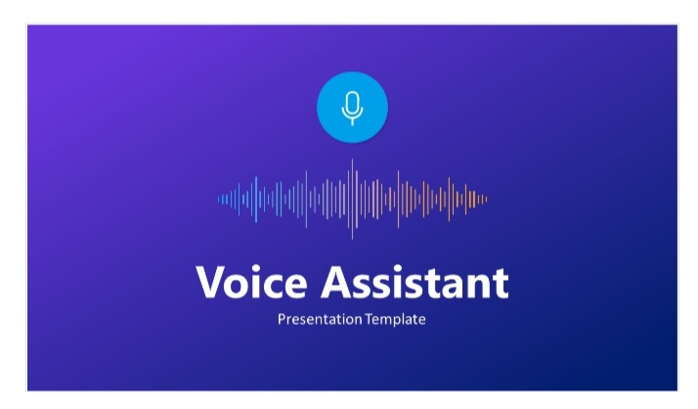
TITLE = DESKTOP VOICE ASSISNTANT

Slide 2
NO. OF MEMBERS : 5
SIT 32 Siddhi Shelke
SIT 21 Shivani Joldapke
SIT 34 Preshita Ingale
SIT 59 Kshitij Khaire
SIT 61 Nakul Gite

Slide 3
*ABSTRACT *
* Voice assistants are programs on digital devices that listen and respond to verbal commands. A user can say, “What is the weather?” and the voice assistant will answer with the weather report for that day and location. They could say, “Tell me a story,“ and the assistant will jump into a tale . The user could even say, “Order my favorite pizza ,” and dinner will be on its way!

Slide 4
*ABSTRACT*
* Voice assistants are so easy to use that many people forget to stop and WONDER how they work. How do voice assistants understand us? Is it magic? A complex system of codes? An actual person listening on the other end ?The answer is less complicated than you might think. The application works like Siri , Google Assistant etc. The U.I of application is self – explainable and very minimum. It takes voice as input. The system is being designed in such a way that all the services provided by the devices are accessible by the end user on the user’s voice commands.

Slide 5
*INTRODUCTION*
Well , We had the similar thought before we started making our the DESKTOP VOICE ASSISTANT. Though it is not as capable and high as like Amazon’s Alexa or Google Assistant ,Home or Apple’s Siri or JARIVS from Iron Man. Nowadays, People are troubled by typing commands into the computer. Be it procrastination or a busy schedule. Typing is a big obsolete process.

Slide 6
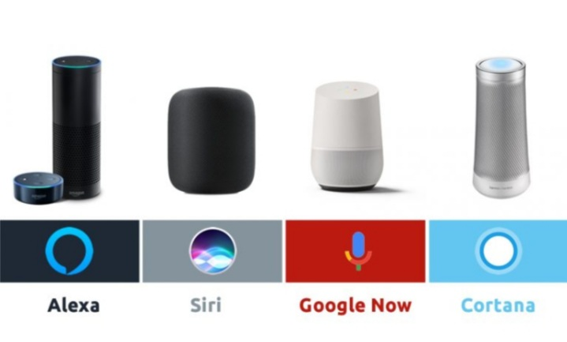

Slide 7
*INTRODUCTION*
The solution to this is that we switch over to an assistant which understands us and do the initial work for us. An assistant is the best replacement for typing commands.
Its named as DESKTOP VOICE ASSISTANT with voice recognition intelligence, which takes the user input in form of user’s voice and processes it and return the output in various ways like an action to be performed or the search result is speaked out to the end user.
Keywords : Voice Assistant ,Python’s Speech Recognition, Python text-to –speech library pyttsx3,Python3.8

Slide 8
*METHODOLGY*
The part where we can tell you the basic requirement for this project. That is we shall be using pyttsx3 package which is a text-to –speech library for Python. The another basic requirement of this project will be Python’s Speech Recognition library.

Slide 9
There are other requirements for the project which are listed below;
Data collection in the form of user’s voice
Voice analysis and conversion to text
Data storage and processing
Generating the task to be done from the processed text output

Slide 10
*LITERATURE SURVEY*
Virtual assistants are available on most smart phones and tablets, traditional computers, and now, standalone devices like the Amazon Echo and Google Home.
They combine specialized computers chips, microphones ,and software that listen for specific spoken commands from you and usually answers back with a voice that select.
Virtual assistants are what are called passive listening devices that respond once they recognize a command or greeting (such as “Hey Siri”)Passive listening means the device is always hearing what’s happening around it, which raises privacy concerns.

Slide 11
*PROBLEM STATEMENT*
We are well aware about Cortana , Siri, Google Assistant and many other virtual assistants which are designed to aid the tasks of users in Windows ,Android and iOS platforms.
But how cool it would be if we develop our personal Desktop Assistant ourselves using Python by taking inspiration from above mentioned big giants ?

Slide 12
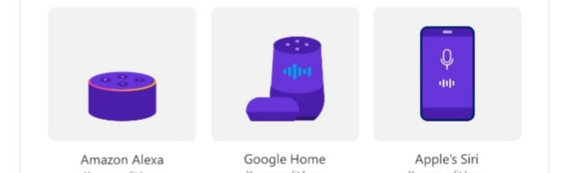


Slide 13
*PROBLEM STATEMENT*
PURPOSE:
This Software aims at developing a personal assistant for our Desktop.
The main purpose of the software is to perform the tasks of the user at certain commands, provided in either of the ways, speech or text . It will ease most of the work of the user as a complete task can be done on a single command.
Users can interact with the assistant either through voice commands or keyboard input.

Slide 14
*BLOCK DIAGRAM*
START
Storing the info in a document
Recording audio
Converting text to speech by text analysis
Converting speech to text
Speech o/p through speakers
Comparing text with command list
Processing info for matched commands
If interrupt

Slide 15
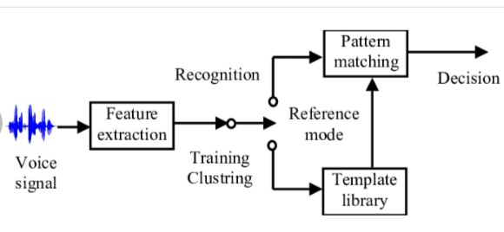

Slide 16
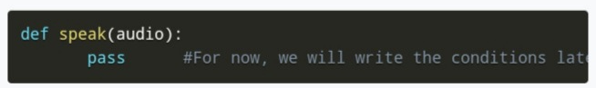
*Hardware and Software*
The first and foremost thing for an A.I assistant is that it should be able to speak. So for it we will make a function called speak().This function will take audio as an argument, and then it will pronounce it.

Slide 17
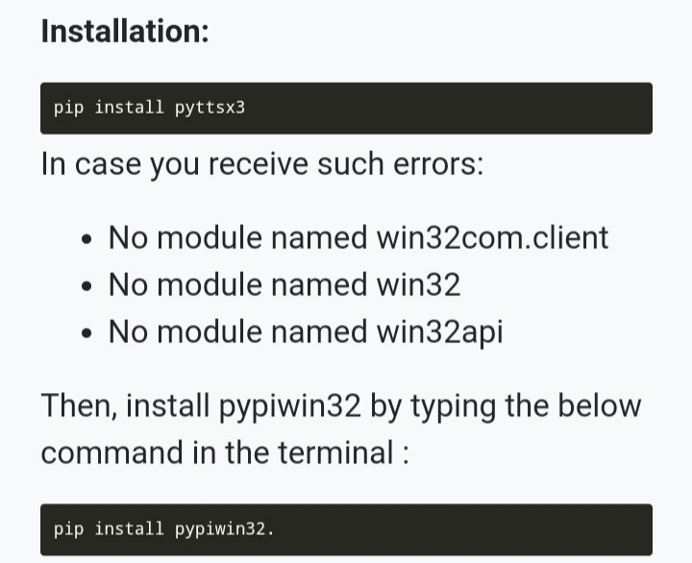
Now, the next thing we need is audio. We must supply audio so that we can pronounce it using the speak() function we made. We are going to install a module called pyttsx3.

Slide 18
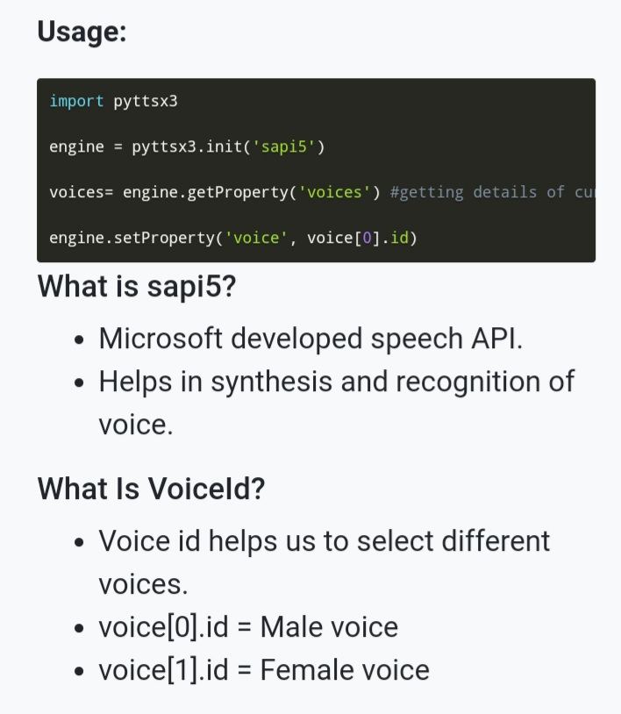

Slide 19
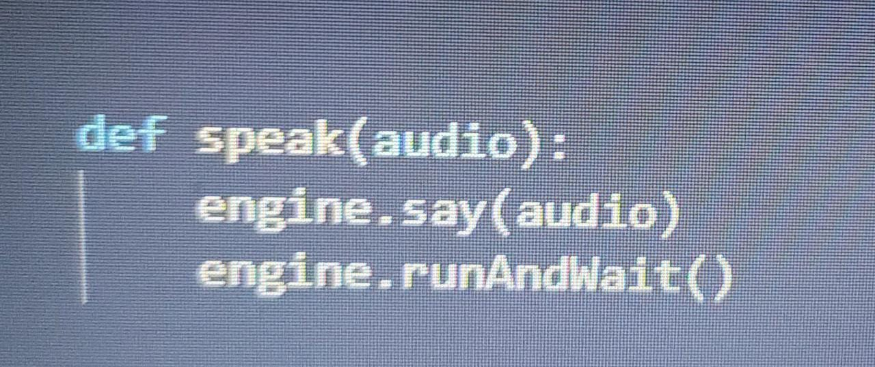
*Defining Speak()Function:*
We will write our speak ()function to convert our text to speech.

Slide 20
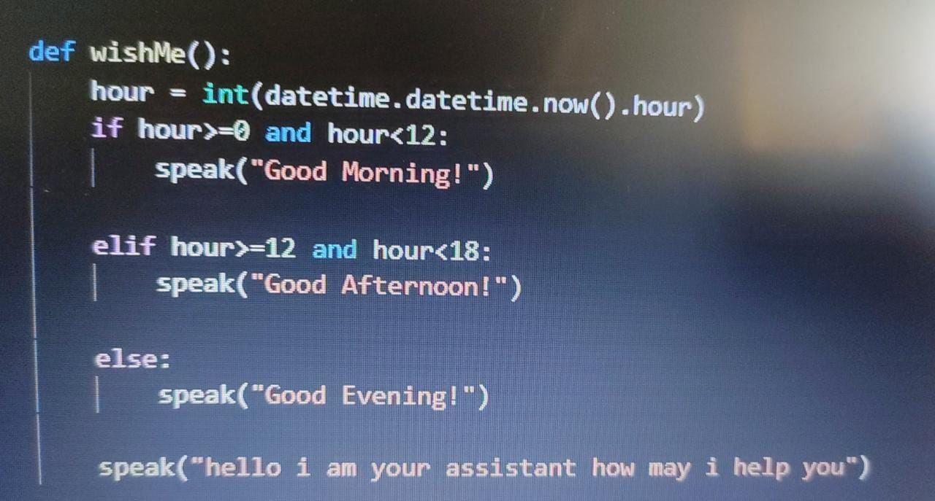
*Defining Wish me()Function:*

Slide 21
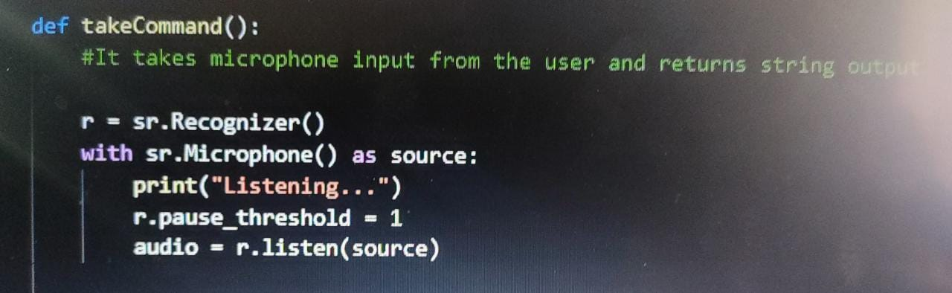
*DEFINING TAKE FUNCTION():*

Slide 22
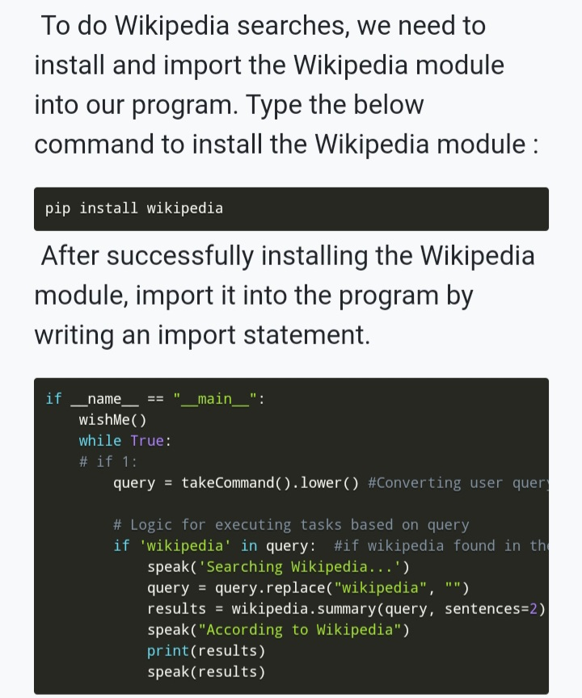
TASK 1: TO SEARCH SOMETHING ON WIKIPEDIA

Slide 23
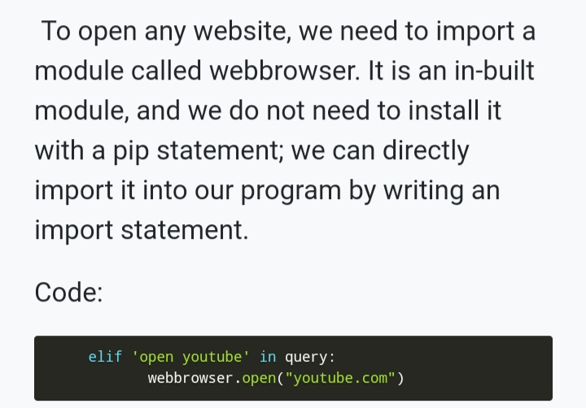
TASK 2: TO OPEN YOUTUBE SITE IN A WEB-BROWSER

Slide 24
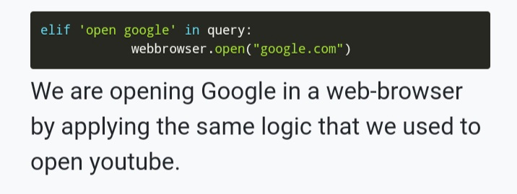
TASK 3:TO OPEN GOOGLE SITE IN A WEB-BROWSER

Slide 25
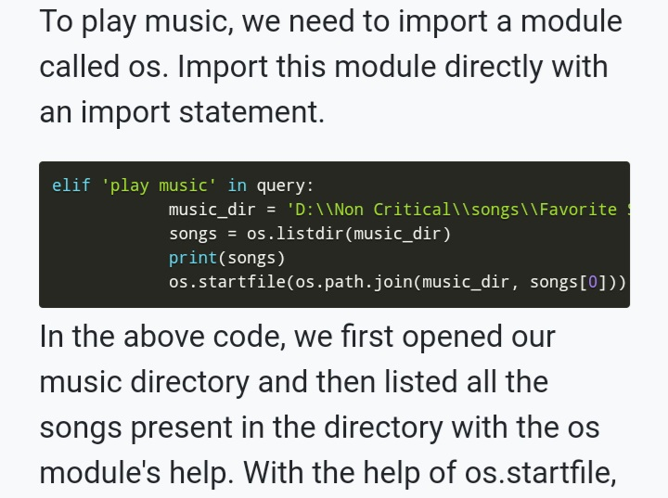
TASK 4: TO PLAY MUSIC

Slide 26
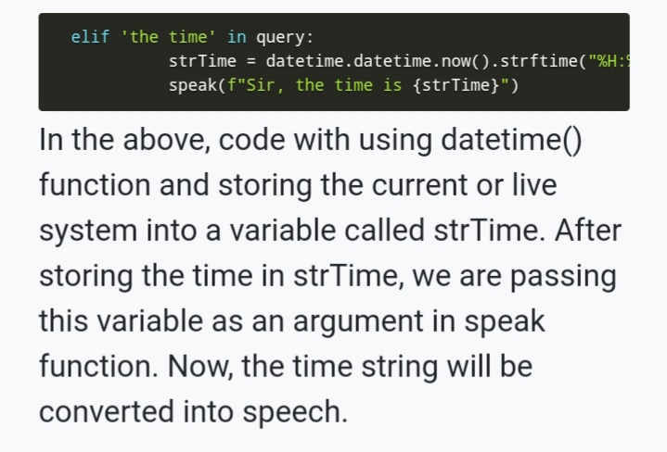
TASK 5: TO KNOW THE CURRENT TIME

Slide 27
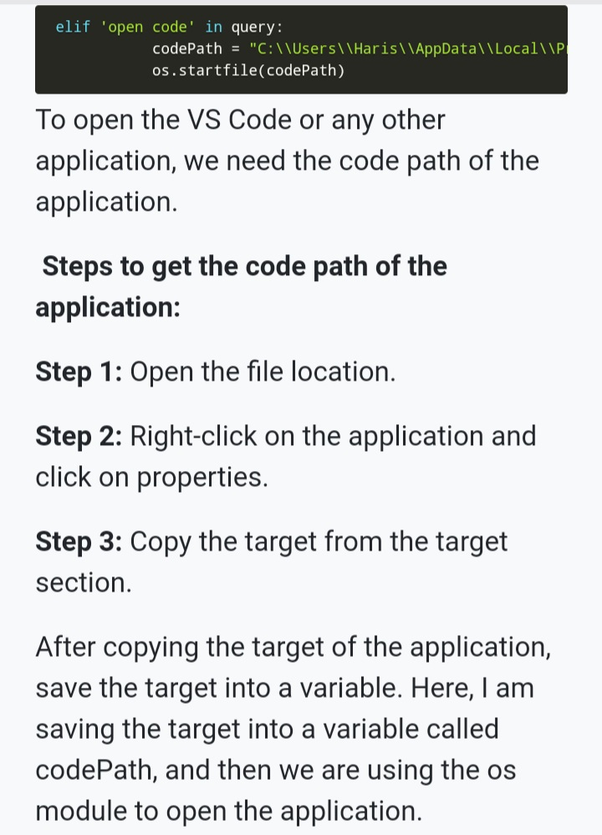
TASK 6:TO OPEN THE VS CODE PROGRAM

Slide 28
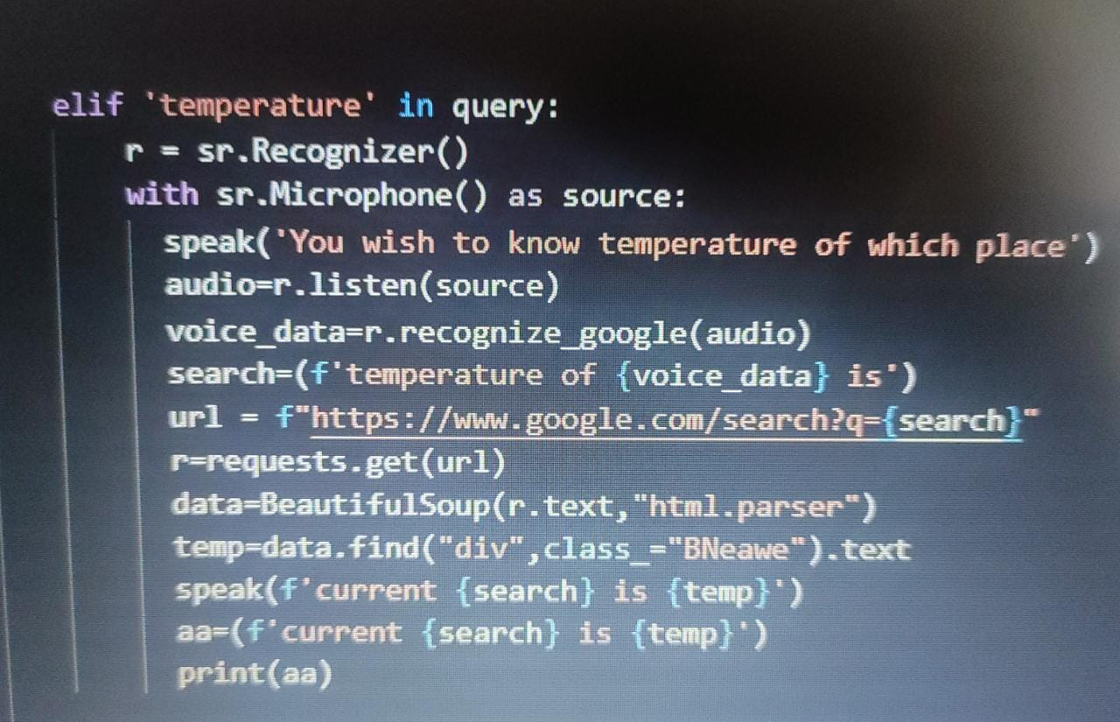
ADDED FEATURES TASK 7: TO KNOW THE CURRENT WEATHER AND TEMPERATURE OF ALMOST ANY PLACE
So the assistant tells you the maximum and minimum temperature of any city around world. We just need to say something like “tell me the current temperature of Pune city”.

Slide 29

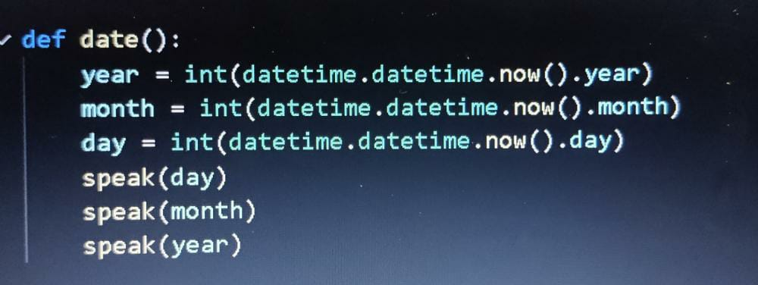
TASK 8: TO KNOW THE DATE
So here the assistant tells you the date of that day .

Slide 30
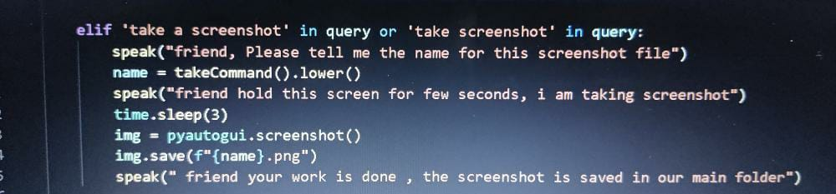
TASK 9: TO TAKE A SCREENSHOT
Here the assistant takes the screenshot of the desktop . We just have to say that “Take a screenshot “ the assistant asks the name of screenshot file and its done.

Slide 31
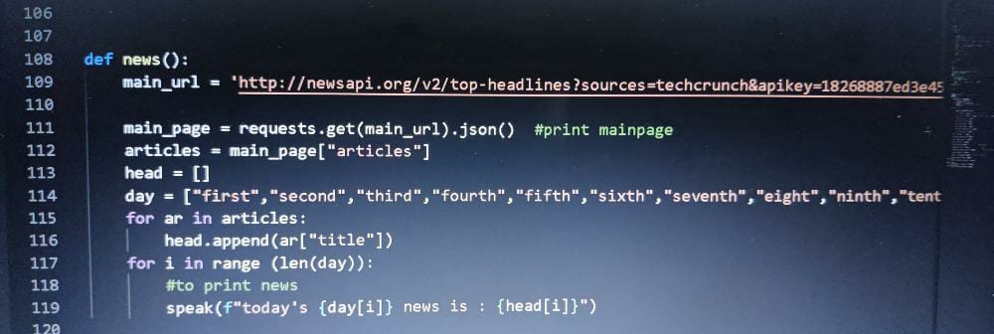
TASK 10: TELLS YOU THE LATEST NEWS FEEDS
Here we come to know about the latest news updates just by saying “What are the top news for today? Or “tell me the news for today”.

Slide 32
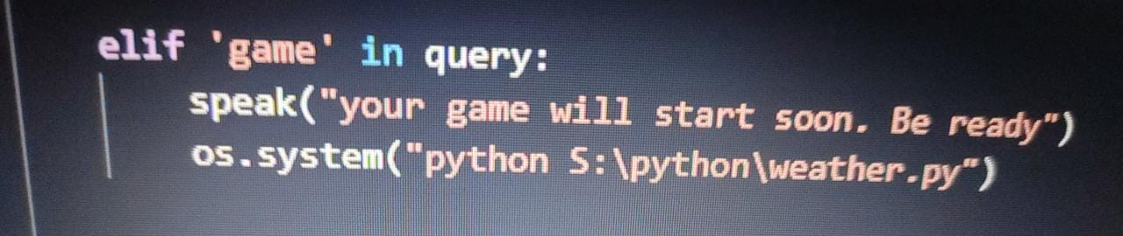
TASK 11: LAUNCH GAMES
Here we can just say “ Want to play game “or “I wish to play game “. The assistant launches the game on desktop screen .

Slide 33
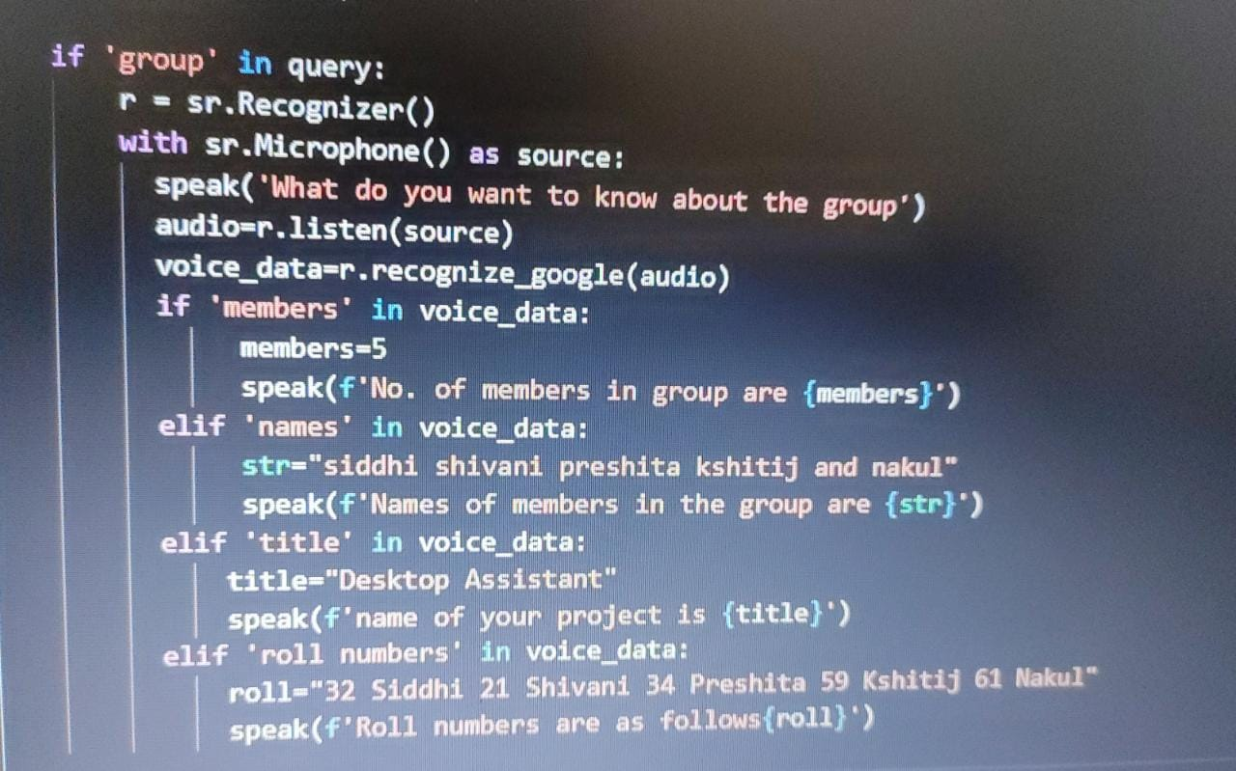
TASK 12:DETAILS OF GROUP MEMBERS
Here we can know about the group , no. of the members , names of the group members.

Slide 34
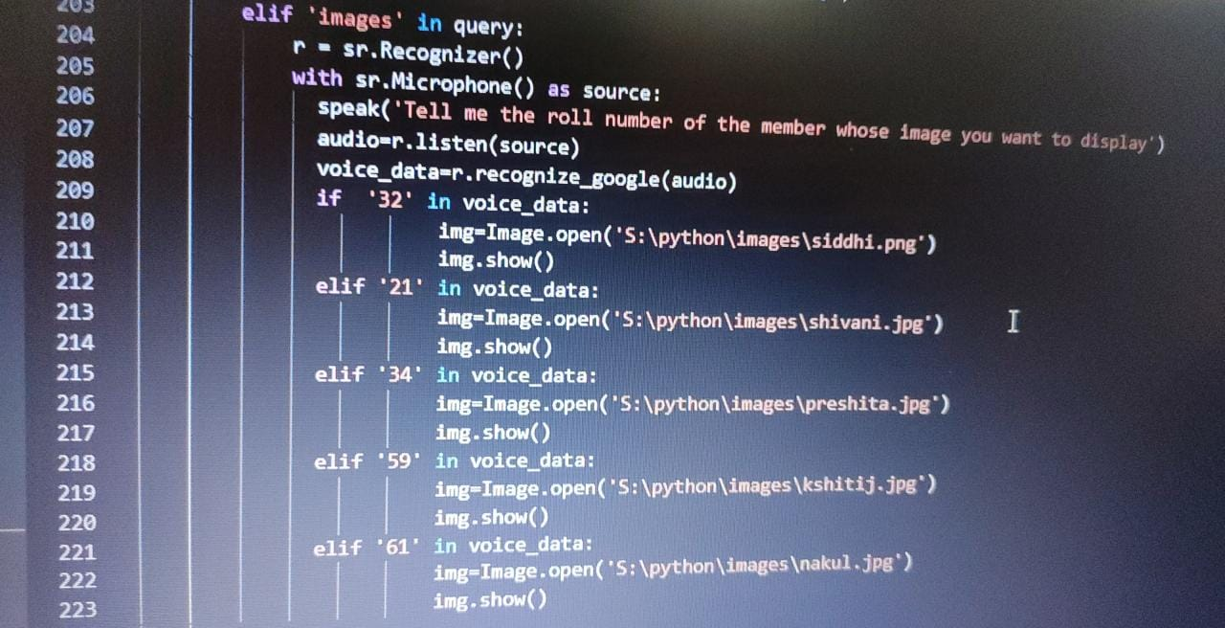

Slide 35
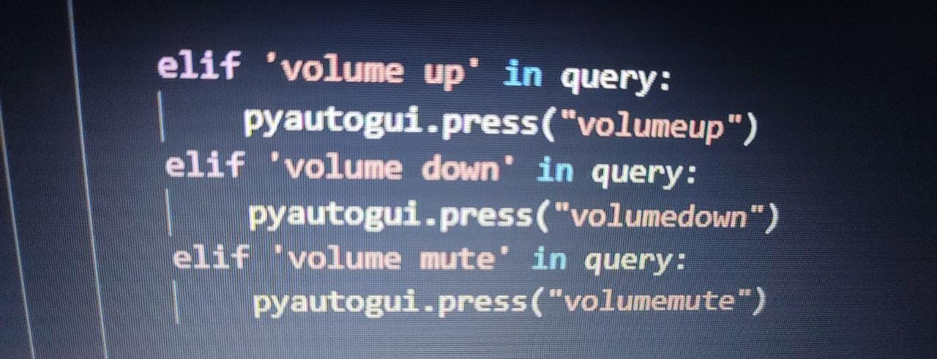
TASK 13: TO CONTROL THE SYSTEMs VOLUME
Here we can control the volumes of the system with the help of assistant .

Slide 36
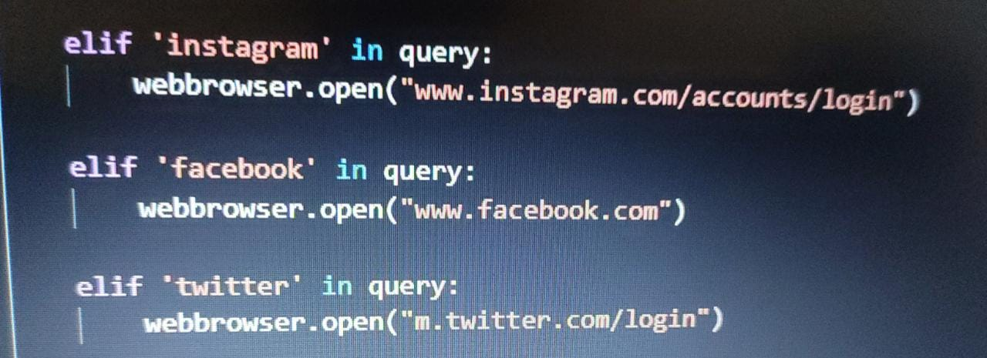
TASK 14: TO ACCESS SOCIAL MEDIA AND JOKES
So here the assistant helps us to have a look on social media accounts.

Slide 37
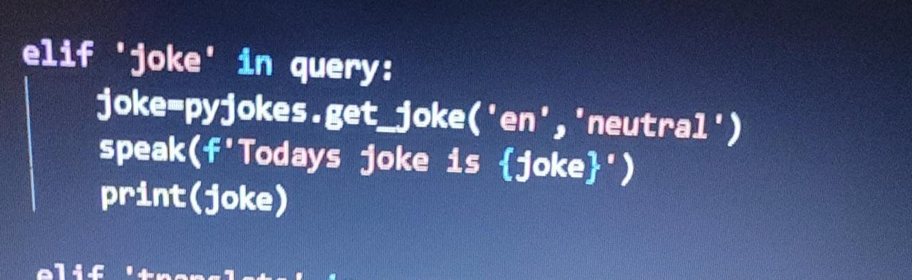
Here the assistant tells us about some funny outcomes.

Slide 38
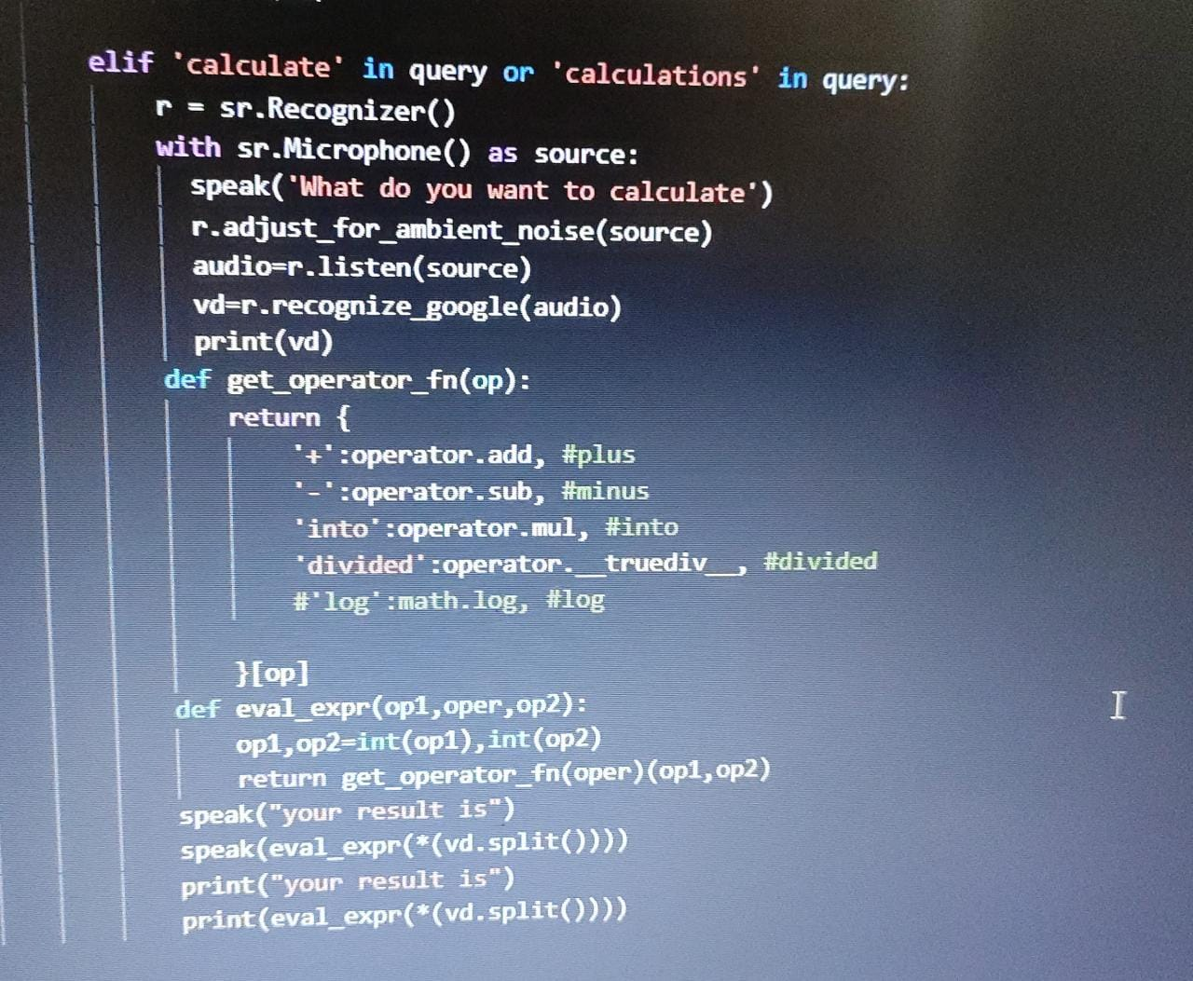
TASK 15: TO DO MATHEMATICAL CALCULATIONS (CALCULATOR)
It helps us to solve simple mathematical equations and problems in minimum time period.

Slide 39
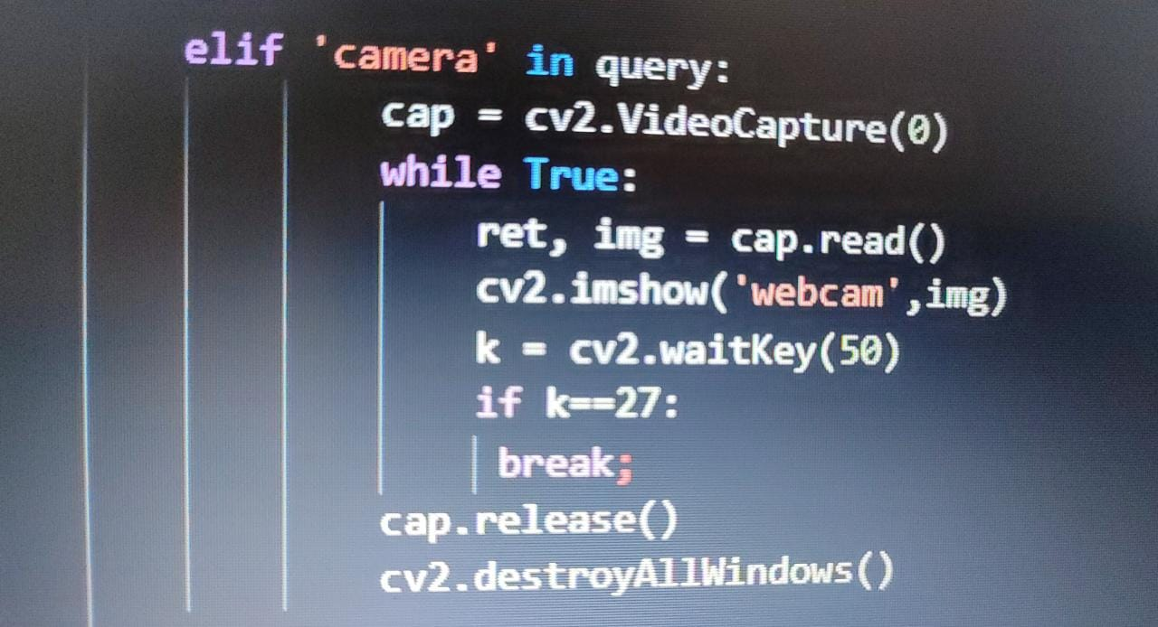
TASK 16: TO OPEN CAMERA

Slide 40
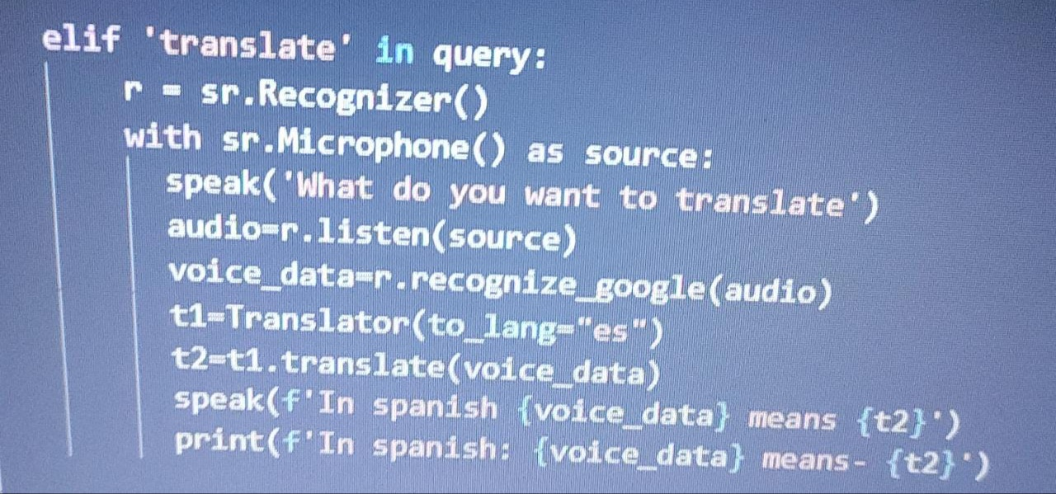
TASK 17: TRANSLATOR

Slide 41
CONCLUSION
Through this voice assistant, we have automated various services using a single line command. It eases most of the tasks of the user like searching the web, retrieving weather forecast details, vocabulary help and medical related queries. We aim to make this project a complete server assistant and make it smart enough to act as a replacement for a general server administration. The future plans include integrating Buddy with mobile using React Native to provide a synchronised experience between the two connected devices. Further, in the long run, Buddy is planned to feature auto deployment supporting elastic beanstalk, backup files, and all operations which a general Server Administrator does. The functionality would be seamless enough to replace the Server Administrator with Buddy.

