Slide 1


A Presentation on IoT-Based Smart Helmet with Accident Detection and Location Tracking
KLE’S
Department of Electronics and Communication Engineering
K. L. E. INSTITUTE OF TECHNOLOGY,
HUBBALLI
Presented by
T K SAI RENU 2KE23EC169
SHIVANAND SURESH MADAR 2KE23EC135
SUSWIT S LIMBALKAR 2KE24EC413
VINAYAKUMAR B MUDENGUDI 2KE24EC416
Under the Guidance of
Mrs. Safalliya

Slide 2
Introduction
Road accidents are a major concern worldwide, especially for two-wheeler riders.
To address these issues, we have designed a smart helmet using Internet of Things (IoT) technology. This helmet not only ensures rider safety but also detects accidents in real-time.
In case of an accident, it automatically sends the rider’s location to emergency contacts, helping provide quick medical support.
Our system aims to enhance road safety, reduce accident fatalities, and promote responsible riding habits through smart technology.

Slide 3
Literature survey
Sl. No | Title | Author | Key findings | Publishing details
[1] | Konnect: IoT Smart Helmet (2016) | Sreenithy Chandran Sneha Chandrasekar | The Konnect IoT Smart Helmet (2016) detects accidents using sensors and automatically sends the rider’s GPS location to emergency contacts through a wireless system. | December 2016 Place: Bangalore, India
[2] | Smart Helmet for Accident Detection using IoT (Review Paper, 2019) | H.C. Impana H.T. Chethana | IoT smart helmets use sensors (accelerometer, vibration, GPS, GSM) for accident detection. They provide real-time accident detection and location tracking. | EAI Endorsed Transactions on Internet of Things. October (30 October 2019)
[3] | IoT-Based Smart Helmet & Accident Identification System (2020) | Abid Hasan Ishman Rahman | Proposes an IoT-enabled smart helmet for accident detection. Uses accelerometer sensor to identify crash impact. | 5 June 2020
[4] | IoT-Based Smart Helmet for Real-Time Crash Detection (2025) | Mustafa Al-Sheikh | Introduces real-time crash detection system Uses IoT for continuous monitoring | IEEE/IoT research October 2025

Slide 4

Methodology
Smart helmet system based on IoT technology
Uses microcontroller (Arduino/NodeMCU) for control
IR sensor detects whether helmet is worn
Accelerometer sensor monitors impact and motion
Accident detected when values exceed threshold limit
GPS module retrieves real-time location
GSM module sends alert message with location
Alert sent to emergency contacts automatically
Buzzer activated during accident detection

Slide 5
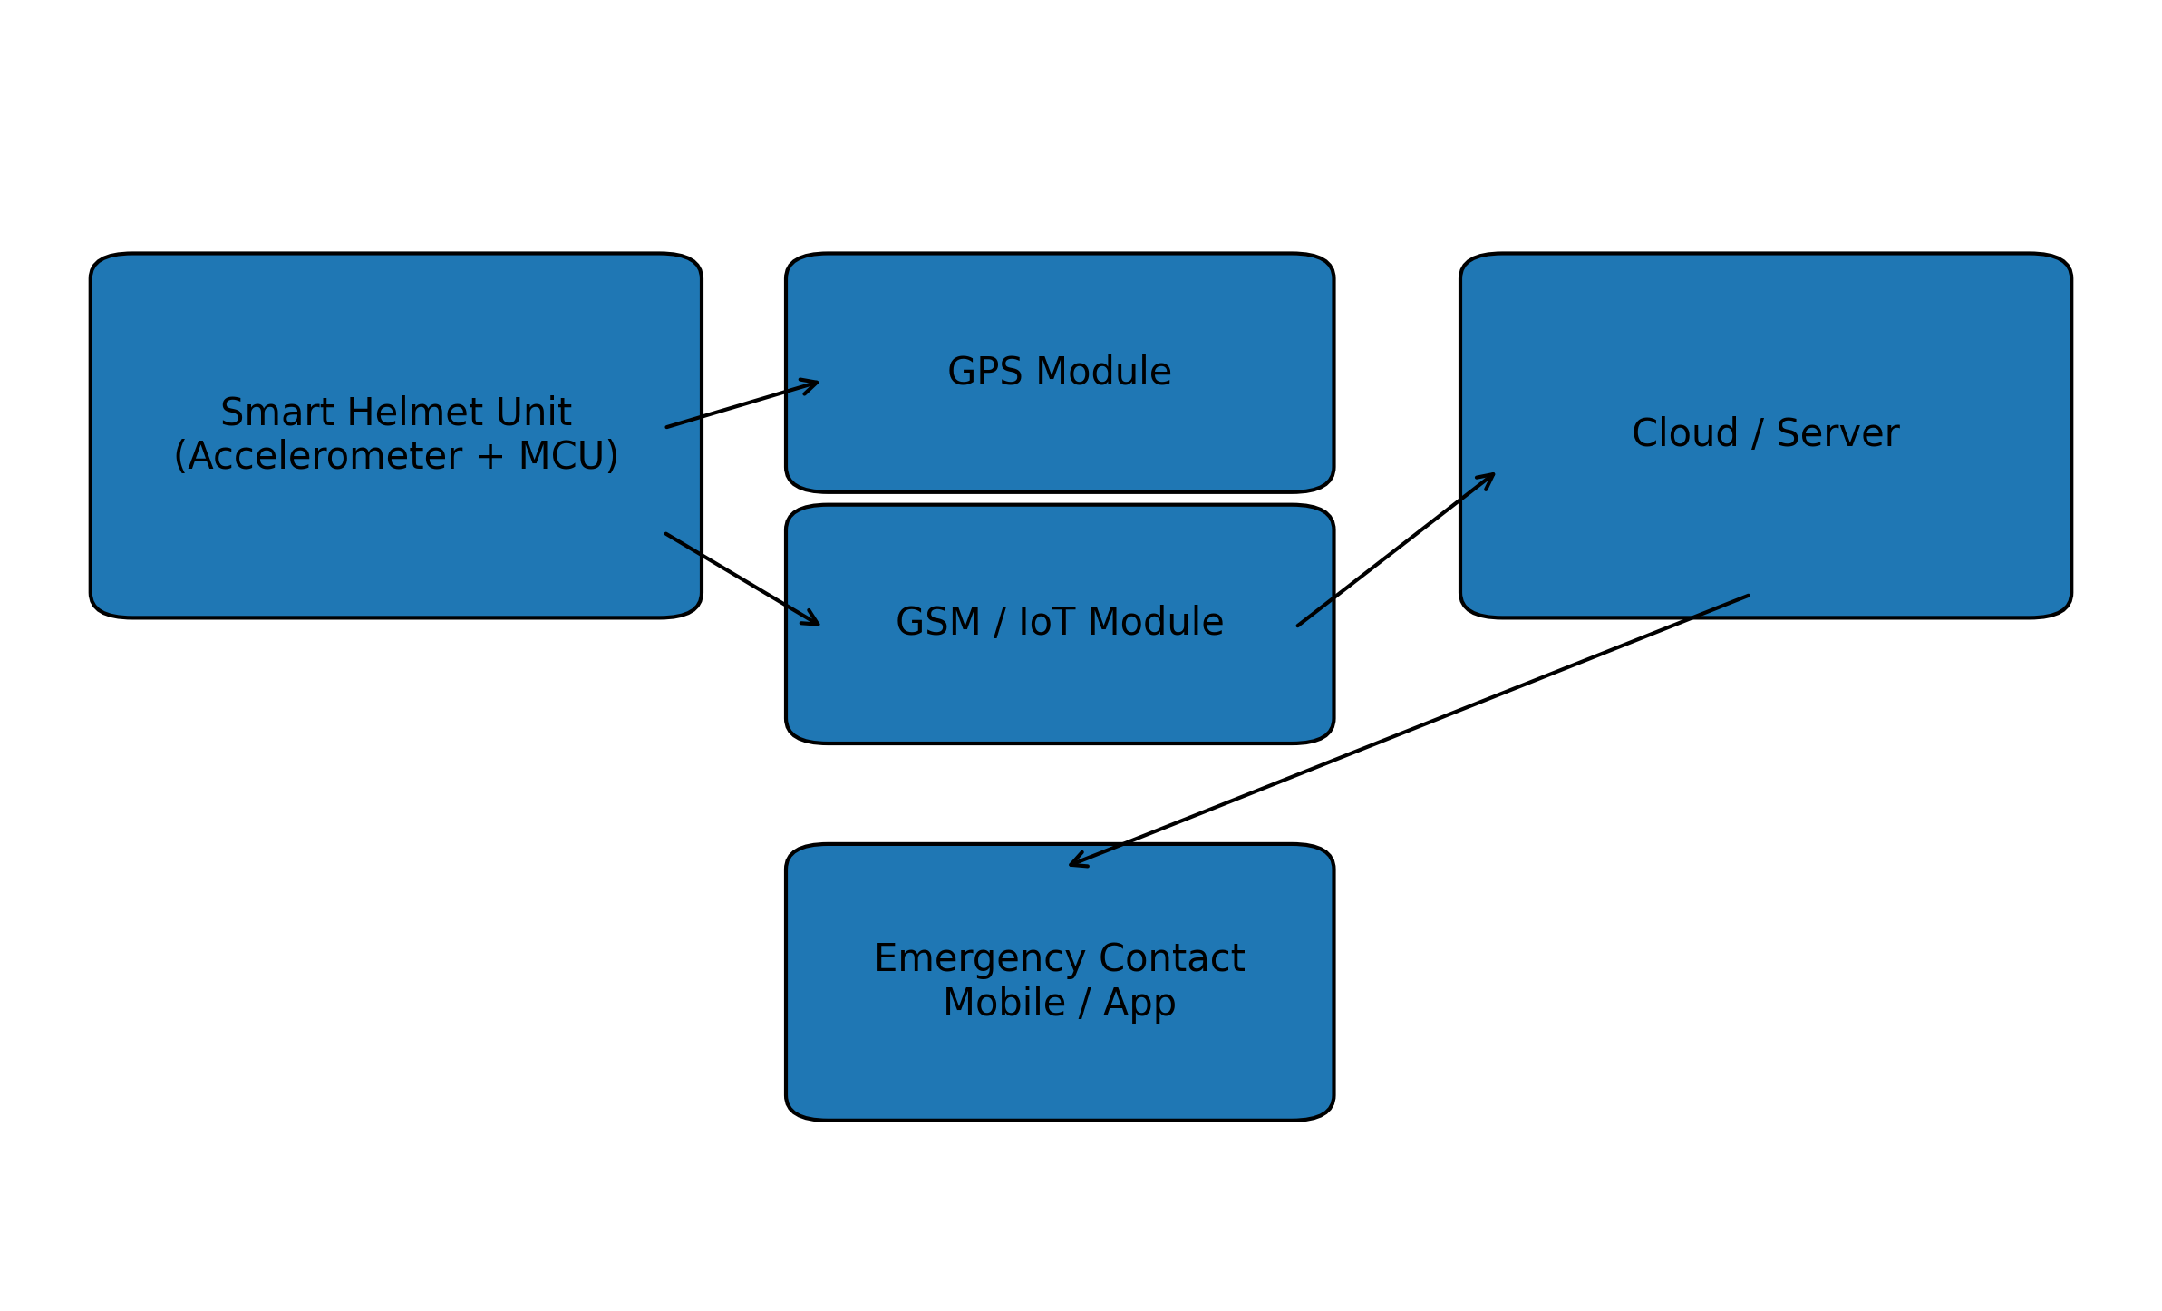
Flow Diagram

Slide 6
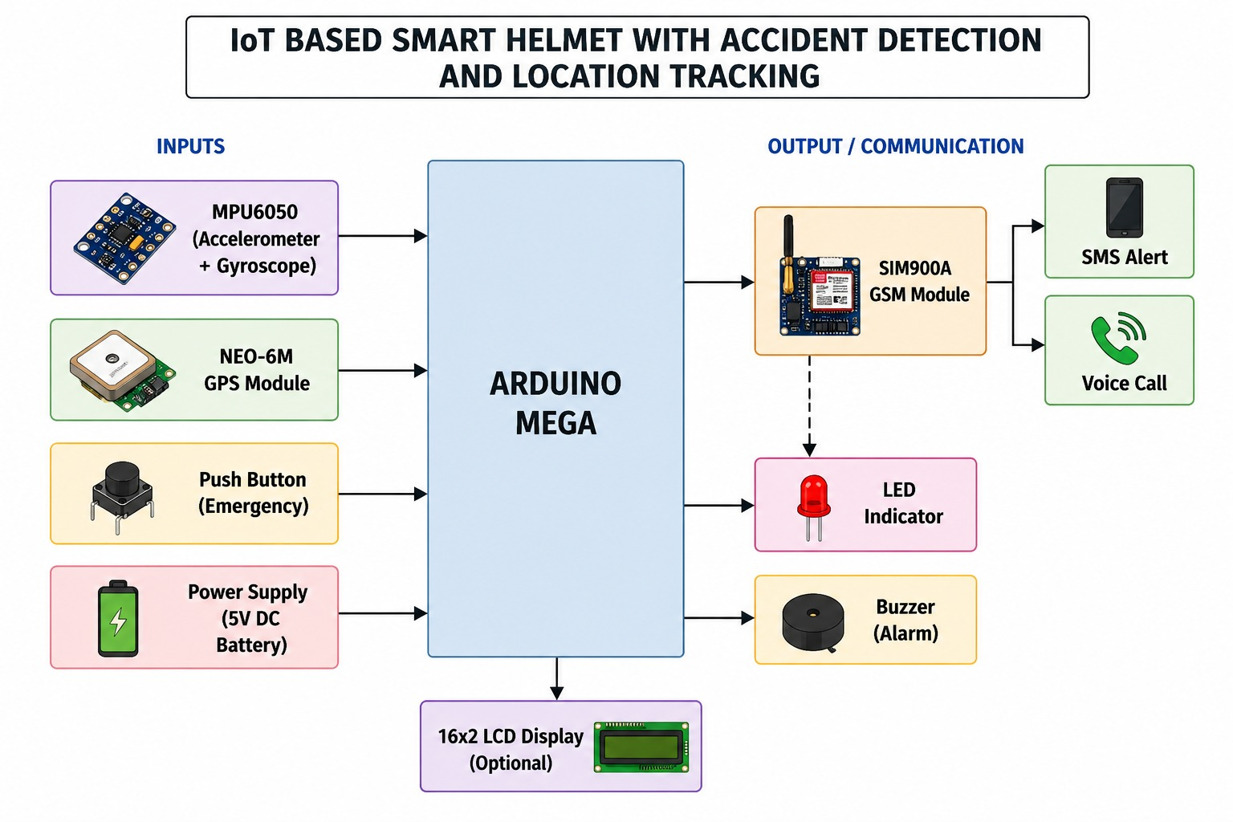
Block Diagram

Slide 7
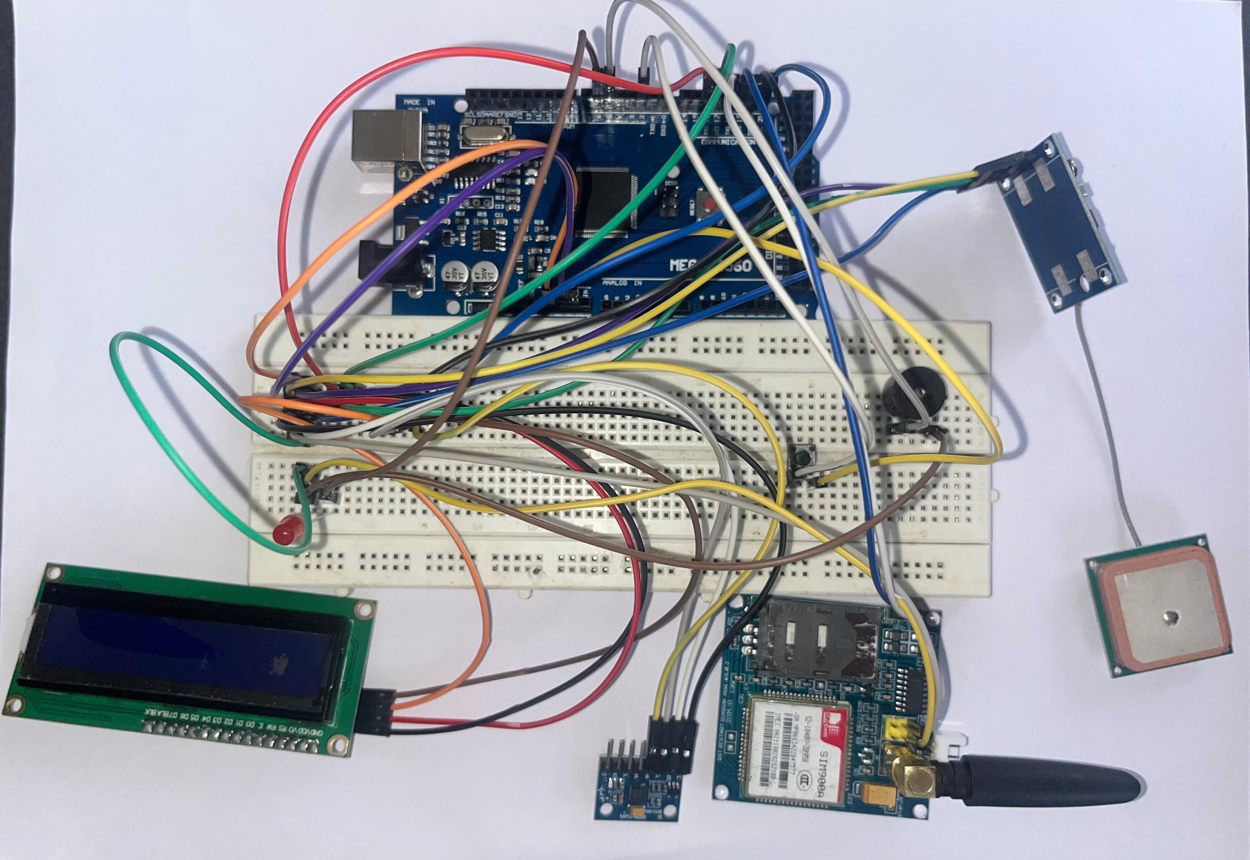
Circuit Diagram

Slide 8
Requirements
Hardware Components
Software Components
GPS Module (NEO-6M)
GSM Module (SIM900)
Mega Arduino 2560
MPU
Buzzer
LED Light
Arduino IDE (for ESP32 / Arduino programming)
IoT Platforms (optional but useful)
Mobile Application

Slide 9
Future Scope
Integration with a mobile app for real-time alerts and tracking
Use of AI/ML algorithms to improve accident detection accuracy
Adding alcohol detection sensor to prevent drunk driving
Cloud storage for data logging and analysis
Integration with emergency services (ambulance/911 API)
Implementation of live GPS tracking dashboard
Adding heart rate / health monitoring sensors

Slide 10
Conclusion
The IoT-based smart helmet system helps in improving rider safety by detecting accidents automatically.
It uses sensors like accelerometer and GPS to identify accidents and track the location.
The GSM module sends alert messages to emergency contacts, which helps in quick response.
The system reduces the time required to inform others during an accident.
Overall, this project provides an efficient and low-cost solution for accident detection and rider safety using IoT
technology.

Slide 11
References
IoT-Based Smart Helmet and Accident Detection System – Research Paper (ResearchGate)
Design and Implementation of IoT-Based Smart Helmet – IEEE / Research Paper
Review on Smart Helmet for Accident Detection using IoT – Survey Paper
NEO-6M GPS Module Datasheet – u-blox Official Documentation
SIM800L / SIM900 GSM Module Datasheet – SIMCom Documentation
Arduino Uno Official Documentation – Arduino.cc
MPU6050 Sensor Datasheet – InvenSense / TDK
Embedded Systems and IoT Concepts – Standard Textbooks on Embedded Systems

Slide 12
thank you

