Slide 1

SMART INDIA HACKATHON 2026
IDEA PRESENTATION
Problem Statement ID : 26076
Problem Statement Title : Development of Personalized Homepage for 'Mausam' Mobile Application
Theme : Smart Automation
PS Category : Software
Team ID :
Team Name : BugNotFound

Slide 2
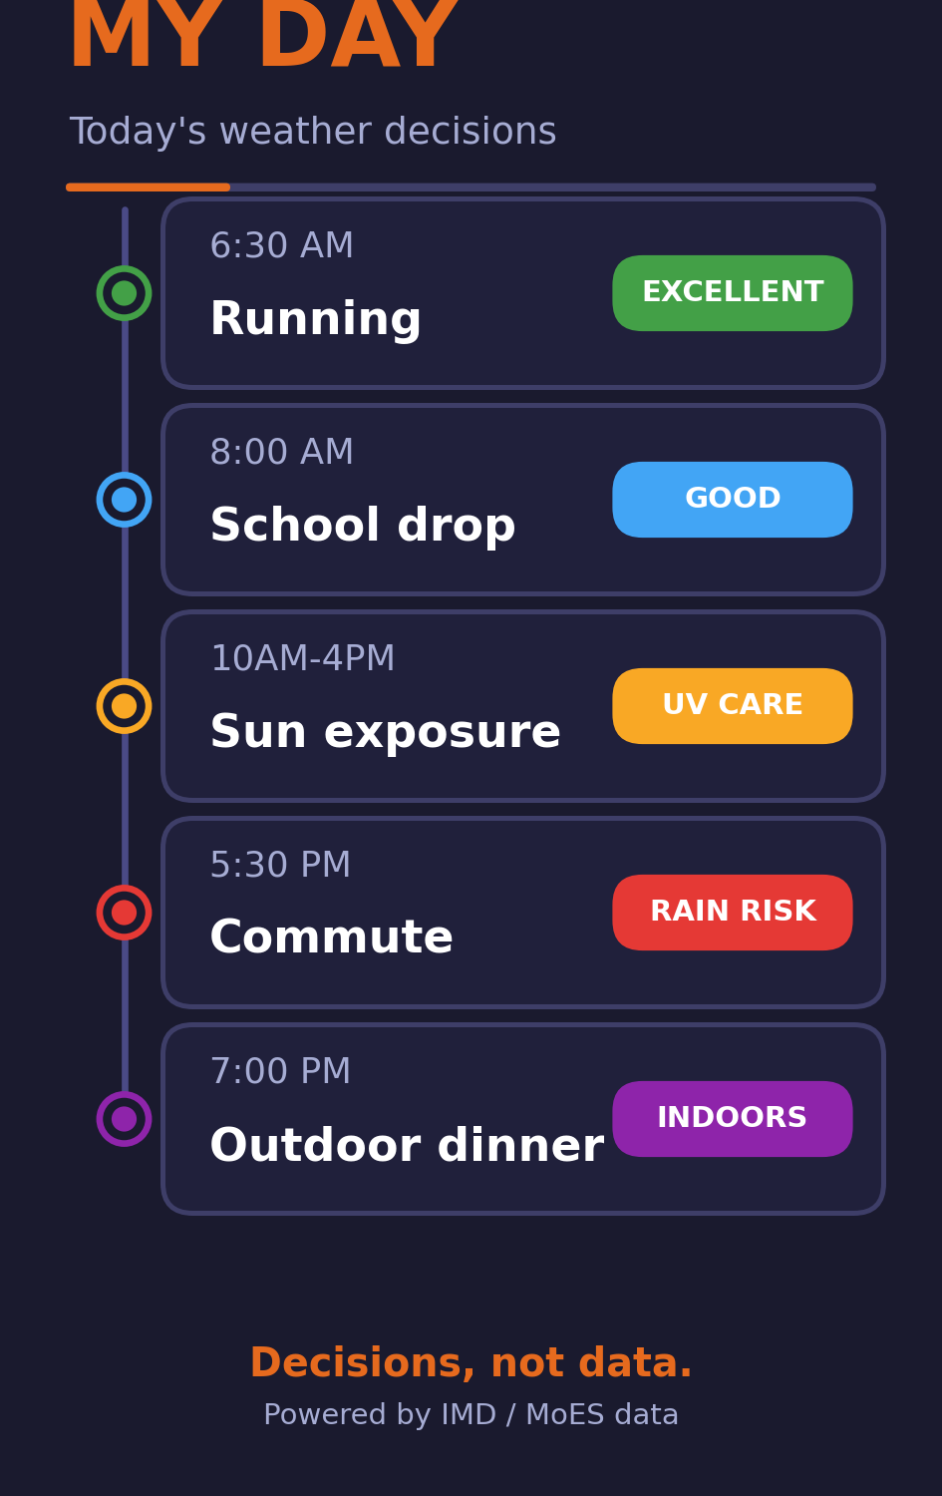
IDEA TITLE
BugNotFound
Proposed Solution (Describe your Idea/Solution/Prototype)
Mausam 2.0 - a Personalized Weather Intelligence Engine on authoritative IMD / MoES data. It knows WHO / WHERE / WHAT you plan - and shows decisions, not raw data.
Detailed explanation of the proposed solution
- Context Engine, not widget picking: Score = Interest x Context x Urgency x Time x Location x Behaviour
- 'My Day' hero: weather as a timeline of decisions (6:30 Run - excellent; 5:30 commute - rain risk)
- Explainable impact indices with WHY: Running, Beach, Commute, Event, Farm, Health (AQI/UV/pollen/heat)
- Official IMD warnings always pinned first, separated from derived advice
- Autonomous inference from time, GPS, calendar & saved places - no persona picker
How it addresses the problem
- ONE adaptive homepage for 8 personas instead of eight separate apps
- Geofenced route alerts: 'rain on your route - leave before 6:40 AM'
- Health profiles tune weights (asthma -> higher AQI weight)
- Works on 2G, offline-first, 11 Indian languages, budget phones
Innovation and uniqueness of the solution
- Decisions-over-Data + Trust-through-Transparency: every card explainable, source cited
- 5-layer moat: IMD authority | context engine | impact models | India-first | micro-climate + API
- My Day + Health Intelligence + Activity engine - a combo no rival (AccuWeather/Windy/Carrot) has

Slide 3
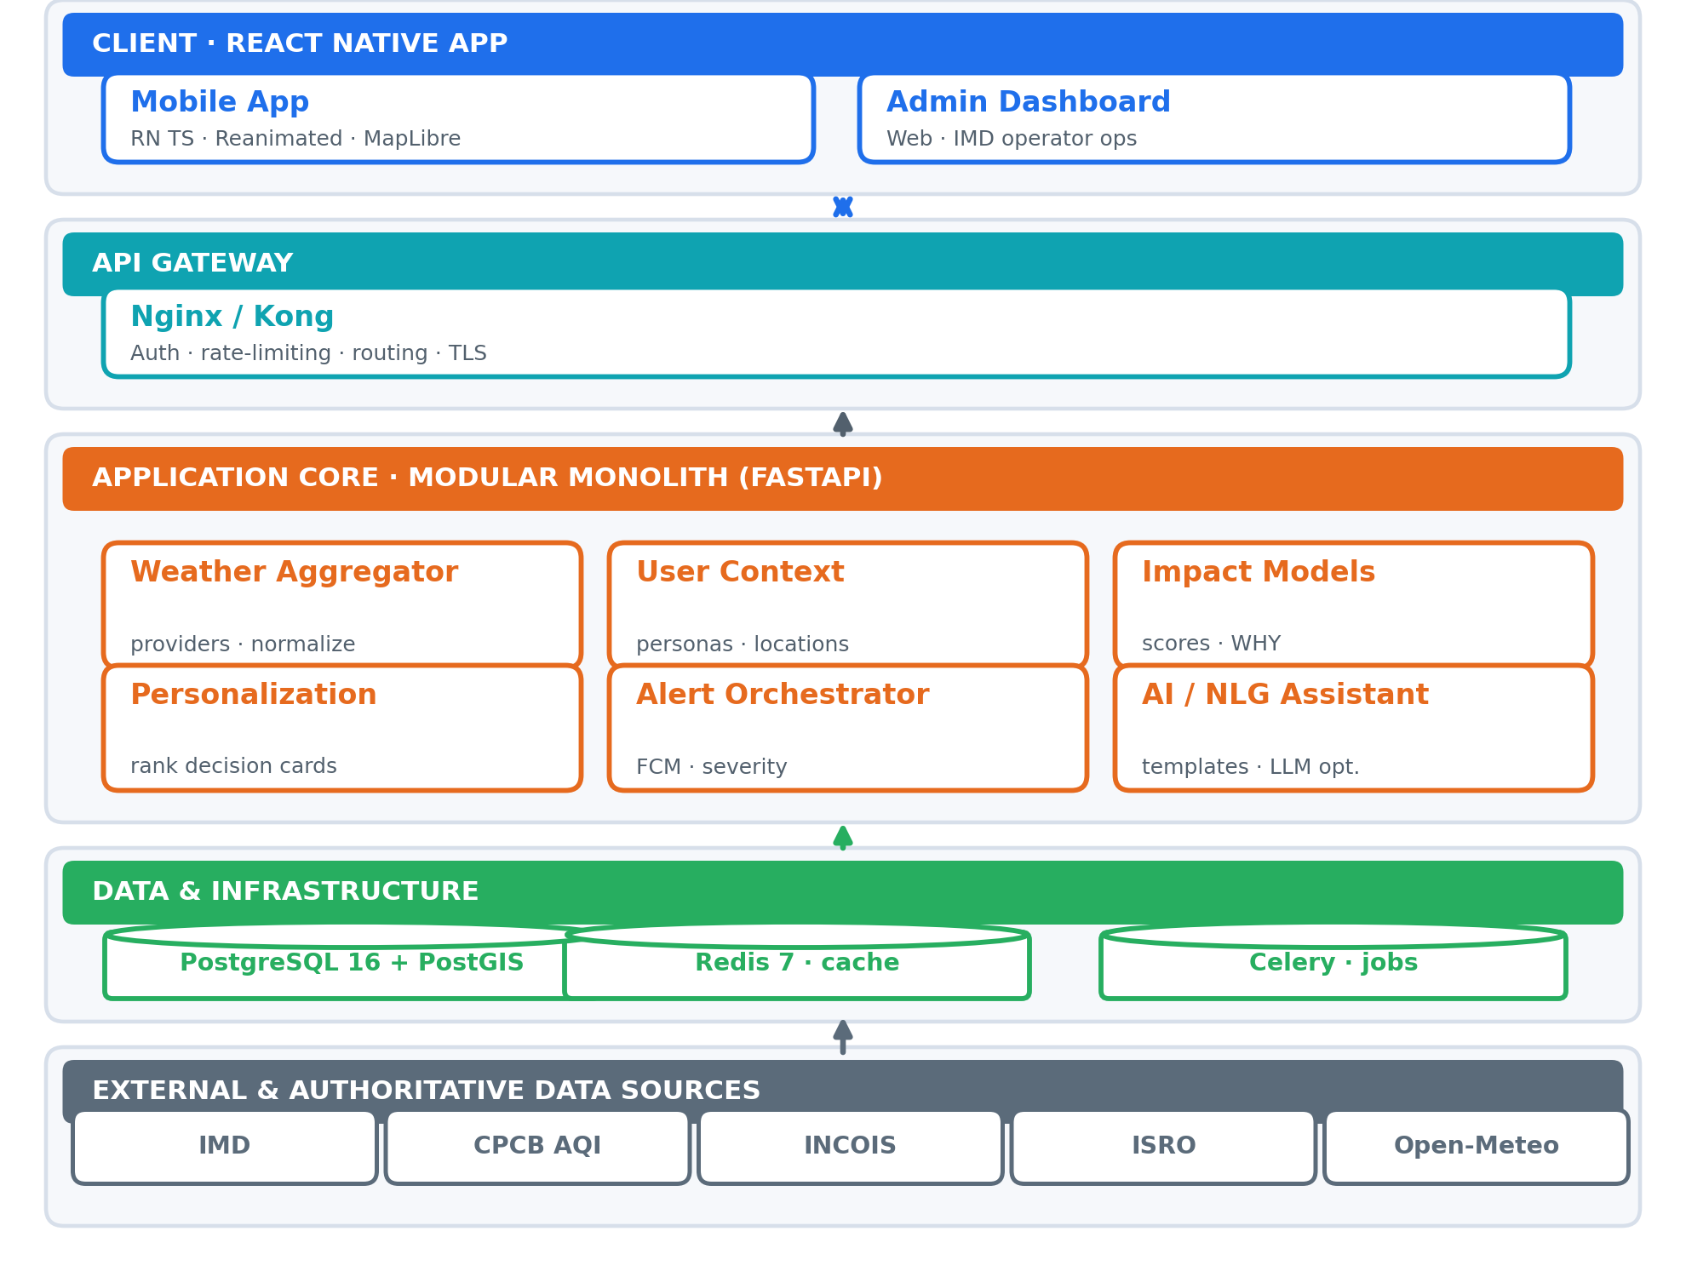
TECHNICAL APPROACH
BugNotFound
Technologies to be used (e.g. programming languages, frameworks, hardware)
- Mobile: React Native (TypeScript · Hermes) · React Navigation (deep links) · Zustand + React Query
- Animations & maps: Reanimated 3 + Skia decision rings & staggers · MapLibre + OpenStreetMap
- Offline-first: WatermelonDB (SQLite) cache · MMKV + Keychain secure stores · 11-language i18n
- Push: Firebase FCM + Notifee geofenced severe alerts (always-on)
- Backend: Python 3.12 + FastAPI monolith | PostgreSQL 16 + PostGIS 3.4 + Redis 7 + Celery
- Infra & quality: Docker-Kubernetes · GitHub Actions · Grafana · Sentry · Jest + Detox + Locust
Methodology and process for implementation (Flow Charts / Images / working prototype)
- Pipeline: ingest -> normalize -> PostGIS -> impact models -> personalization -> alerts -> mobile UI
- 6 services: Aggregator, User Context, Impact Models, Personalization Engine, Alert Orchestrator, Template-first NLG (LLM optional)
- Key APIs: GET /homepage/cards (ranked), /cards/{activity}, /briefing/daily, /ask, profile & locations
- 30-day agile build: Foundation -> Intelligence -> Refinement -> Polish, day-by-day sprints
- IMD admin dashboard: provider status, alert map, publish warnings (gov-tech credibility)

Slide 4
FEASIBILITY AND VIABILITY
BugNotFound
Analysis of the feasibility of the idea
- Core data is FREE & public (IMD, CPCB, INCOIS); provider abstraction + mocks = resilient to API changes
- Proven low-cost stack; MVP shippable in the hackathon window; modular monolith scales to national load
- Offline-first + 2G/low-bandwidth; works on low-end devices and in 11 languages (DPDP-compliant consent)
Potential challenges and risks
- IMD API changes / downtime / licensing (Med - High)
- Data inaccuracy & provenance (Med - High)
- Established-app competition - AccuWeather, Windy, Carrot (High - Med)
- Low-end device performance (Med)
- Privacy of location & health data (Low - High)
- Agronomic / safety-claim liability (Med)
Strategies for overcoming these challenges
- Fallback chain + confidence scoring + provenance display; verify IMD licensing during SIH
- Relevance-ranked, de-duplicated alerts + quiet hours (22:00-06:00); Priority = Severity x Location x Activity x Time x Pref
- Performance budget, lazy loading, offline-first; local processing + transparent consent, export & delete (DPDP)

Slide 5
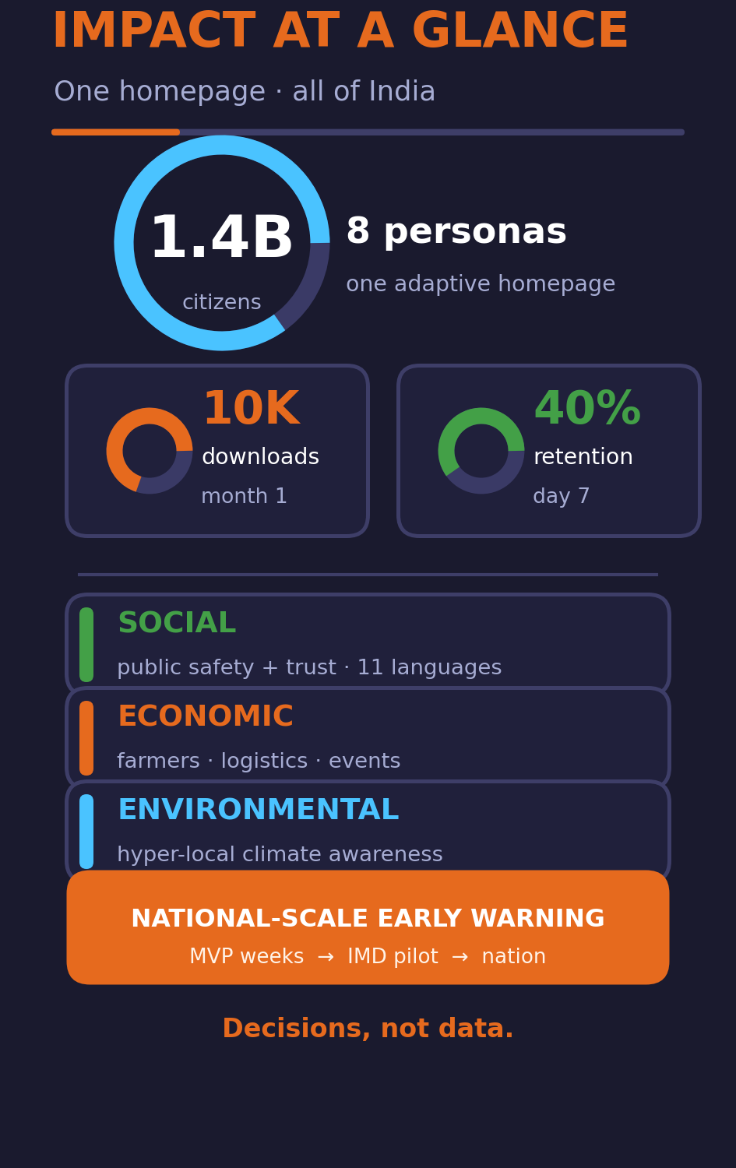
IMPACT AND BENEFITS
BugNotFound
Potential impact on the target audience
- Serves all 1.4 billion Indians across 8 personas: health-sensitive, parents, farmers, travellers, commuters, event planners, beach & fitness
- Personalized disaster early-warning at national scale; safer commutes; better health decisions
- Month-1 targets: 10K downloads, 4.5+ rating, day-7 retention 40%
Benefits of the solution (social, economic, environmental, etc.)
Social - public safety and trust through transparent, explainable IMD-backed warnings; accessibility + 11 languages
Economic - farmers protect crops; B2B Weather Impact API (logistics, insurance, agritech, events); commuters & planners avoid losses
Environmental - hyper-local climate awareness; crowdsourced micro-climate research as data moat
Time to impact: usable MVP in weeks; IMD pilot in 2-3 high-variability states; national-scale ready in a quarter

Slide 6
RESEARCH AND REFERENCES
BugNotFound
Details / Links of the reference and research work
- IMD (official weather & warnings): https://mausam.imd.gov.in
- CPCB National Air Quality Index: https://airquality.cpcb.gov.in
- INCOIS Ocean State Forecast (tides / waves / SST): https://incois.gov.in/portal/osf
- ISRO Bhuvan (geospatial + soil moisture): https://bhuvan.nrsc.gov.in
- Govt Open Data Platform: https://data.gov.in
- Open-Meteo (fallback: pollen / UV / AQI): https://open-meteo.com
- DPDP Act (data protection & consent): https://www.meity.gov.in
- Competitive research: AccuWeather, Weather.com, Windy, IMD Mausam, Carrot Weather - gap: no activity-aware India-first personalization
- SIH 2026 PS 26076 - MoES / IMD

