Slide 1

SMART INDIA HACKATHON 2026
IDEA PRESENTATION
Problem Statement ID : 26076
Problem Statement Title : Development of Personalized Homepage for 'Mausam' Mobile Application
Theme : Smart Automation
PS Category : Software
Team ID : —
Team Name (Registered on portal) : BugNotFound

Slide 2
IDEA TITLE
BugNotFound
Mausam 2.0 — Personalized Weather Intelligence on official IMD / MoES data
THE IDEA
Knows WHO you are, WHERE you are and WHAT you plan.
Shows you decisions, not raw numbers.
Delivered as a personalized homepage inside the official Mausam app.
HOW IT WORKS
Context Engine, not widget-picking.
Score = Interest x Context x Urgency x Time x Location x Behaviour
'My Day' = weather as a timeline of decisions (6:30 run - great; 5:30 commute - rain risk).
WHAT'S UNIQUE
8 personas, 11 languages, offline-first.
Explainable AI - every card shows 'Why?'.
'Ask' AI copilot answers like a human.

Slide 3
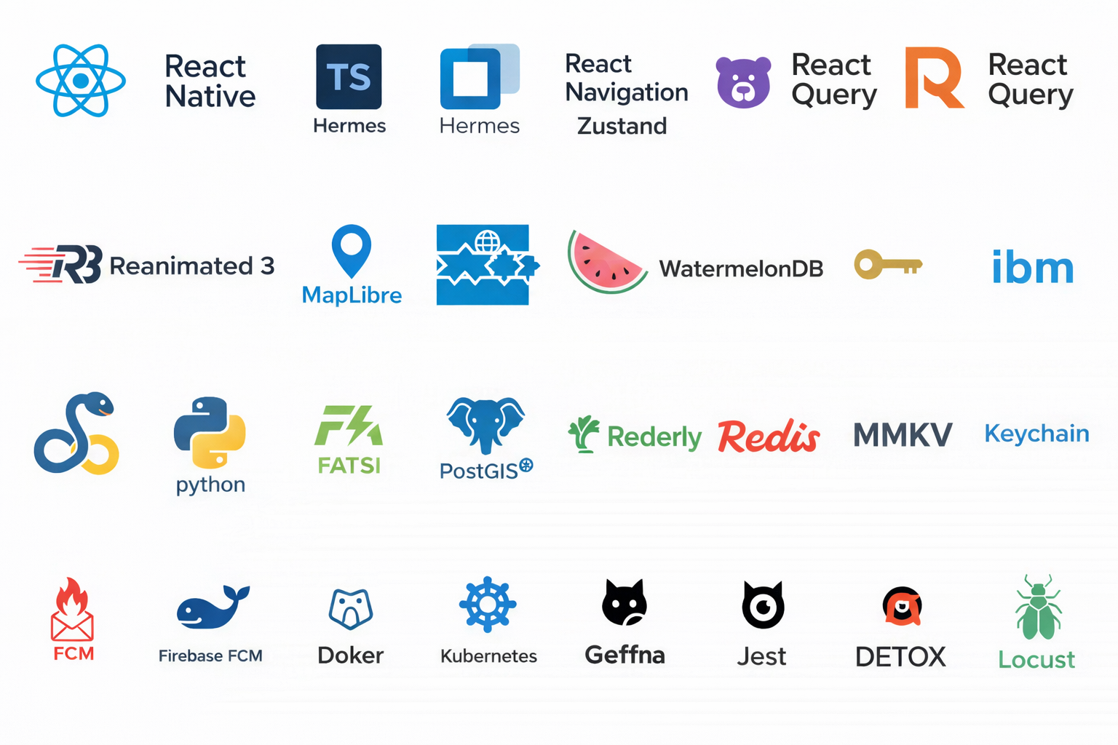
TECHNICAL APPROACH
BugNotFound
TECHNOLOGY STACK
Mobile - React Native + Expo (TS, Hermes) - offline-first - 11-language i18n
Backend - Python 3.12 + FastAPI - PostgreSQL + PostGIS - Redis
STEP 1 · YOU open the Mausam App
persona · location · what you plan
BACKEND (FastAPI, Python 3.12)
Data Aggregator
IMD · Open-Meteo · CPCB · INCOIS · ISRO
DATA SOURCES (free & public)
IMD + Open-Meteo (live now) - CPCB - INCOIS - ISRO via provider abstraction
Personalization & Ranking
Score = Interest×Context×Urgency×Time×Location×Behaviour
PostgreSQL + PostGIS
Severe-Weather Push Alerts
WORKING PROTOTYPE (live)
Delivery layer
push · in-app cards · "Ask" (AI)
STEP 3 · END RESULT
8-persona Homepage · My Day · Ask (AI) · Alerts
decisions, not raw data

Slide 4
FEASIBILITY AND VIABILITY
BugNotFound
FEASIBLE TODAY
FREE & public data - IMD, CPCB, INCOIS, ISRO.
Open-Meteo live now -> demo never blocks on an API.
Proven low-cost stack (FastAPI + Expo).
Offline-first, 2G-friendly, works on budget phones.
Modular monolith scales to national load.
CHALLENGES & RISKS
IMD API changes / downtime / licensing (Med-High)
Data inaccuracy & provenance (Med-High)
Scale to full national traffic (Med)
Battery & data use on low-end devices (Low-Med)
STRATEGY TO DE-RISK
Multi-source fallback chain + mocks.
Confidence scoring + provenance labels.
DPDP-compliant consent; licensing verified in SIH week.

Slide 5
IMPACT AND BENEFITS
BugNotFound
WHO IT HELPS
Serves 1.4 billion Indians - 8 personas: health, fitness, beach, traveller, parent, farmer, commuter, event planner.
Personalized disaster early-warning at national scale.
Safer commutes, better health & farm decisions.
MONTH-1 GOALS
10,000+ downloads | 4.5+ rating | 40% day-7 retention
60% complete onboarding | 30% use 'Ask' weekly
Cold-start < 2.5s | homepage p95 < 500ms | crash < 0.5%
SOCIAL
Public safety & trust via transparent, explainable IMD-backed warnings.
ECONOMIC
Free forever; low-cost adoption for people, schools, government.
ENVIRONMENTAL
Climate awareness, better farm water use, greener choices.

Slide 6
RESEARCH AND REFERENCES
BugNotFound
IMD - official weather & warnings
mausam.imd.gov.in
CPCB - National Air Quality Index
airquality.cpcb.gov.in
INCOIS - Ocean State Forecast (tides / waves / SST)
incois.gov.in/portal/osf
ISRO Bhuvan - geospatial + soil moisture
bhuvan.nrsc.gov.in
Govt Open Data Platform
data.gov.in
Open-Meteo - live fallback (pollen / UV / AQI)
open-meteo.com
DPDP Act - data protection & consent
meity.gov.in

