Slide 1


SMART INDIA HACKATHON 2026
TITLE PAGE
Problem Statement ID – SIH26076
Problem Statement Title - Development of Personalized Homepage for 'Mausam' Mobile Application
Theme- Smart Automation
PS Category - Software
Team ID -
Team Name (Registered on portal) - BugNotFound

Slide 2
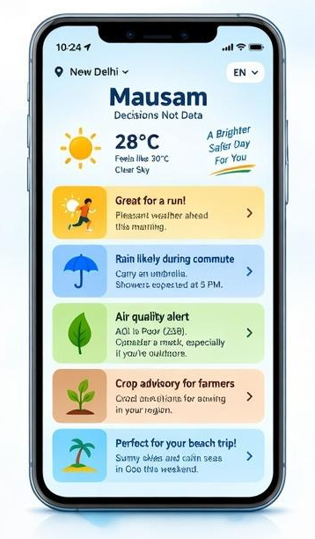
SOLUTION
BugNot
Found
Solution :-
Mausam 2.0 is a personalized weather intelligence engine using authoritative IMD/MoES data.
IMD Data + User Context → Impact Analysis → Smart Recommendation
It adapts one homepage for Health, Fitness, Travel, Beach, Family, Agriculture, Commute and Events.
How It Addresses the Problem
Improves decision-making. One adaptive homepage instead of separate experiences for 8 user groups.Combines weather + location + time + activities + optional calendar.
Provides personalized alerts and recommendations.
Keeps official IMD warnings separate and prioritized.
Converts complex forecasts into simple decisions.
Innovation & Uniqueness
Decisions, not Data: Converts weather data into actionable recommendations. Context Engine: Understands Who + Where + What + When.
Automatically reorganizes widgets and alerts based on user type (farmers, commuters, travelers).
Offline Mesh Sync: Caches emergency storm alerts locally during rural network outages.
@SIH Idea submission- Template
2
@SIH Idea submission- Template

Slide 3
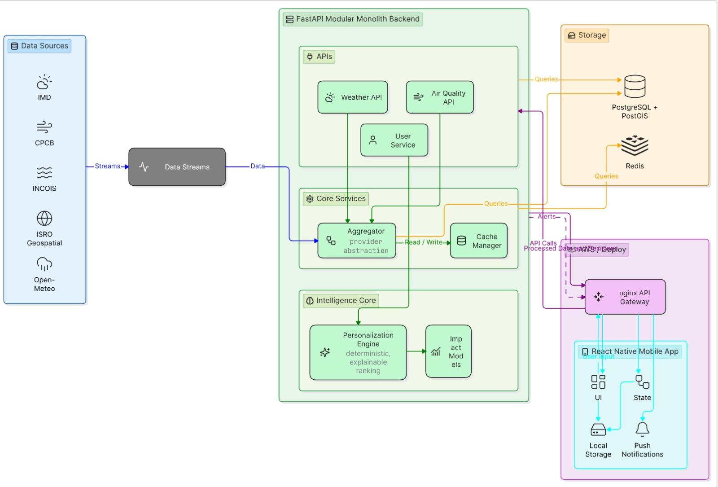
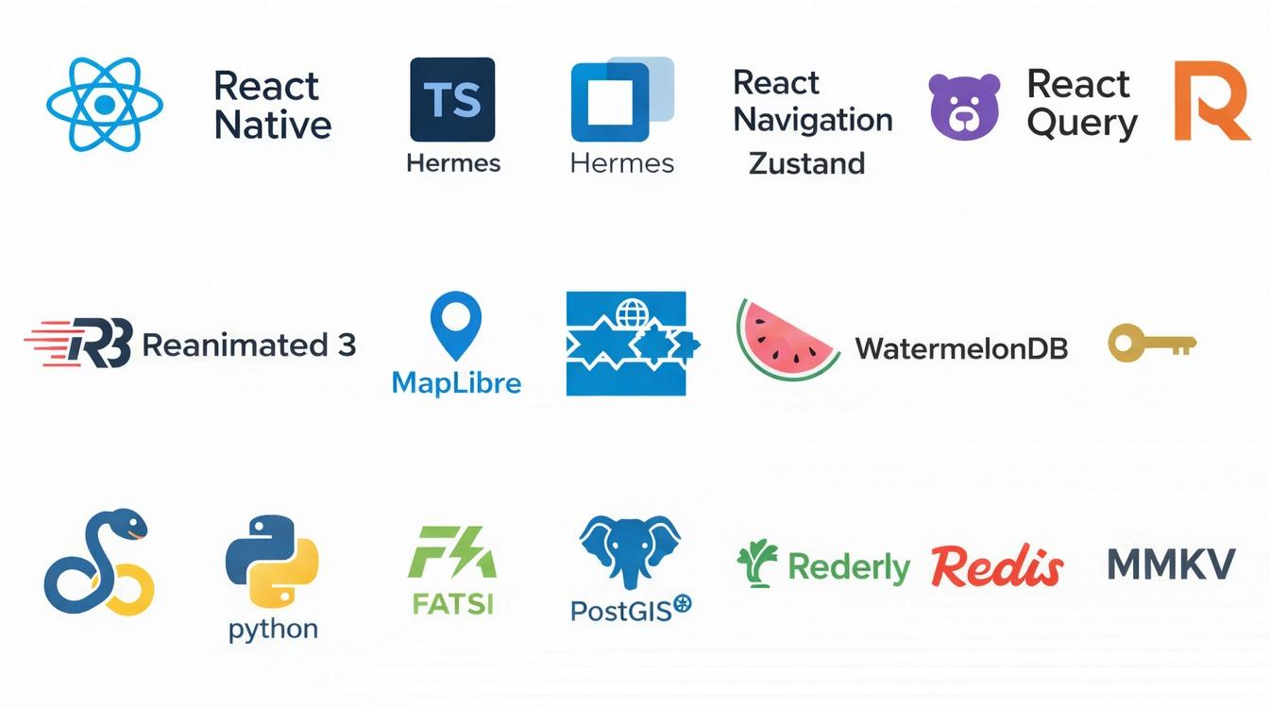
TECHNICAL APPROACH
BugNot
Found
Technical Approach : -
Context-aware personalization based on user persona + location.
Adaptive widget ranking based on user behavior.
Proximity-based weather alerts for nearby severe conditions.
Offline caching for low-connectivity areas.
Feedback-driven recommendations to continuously improve personalization.
@SIH Idea submission- Template

Slide 4
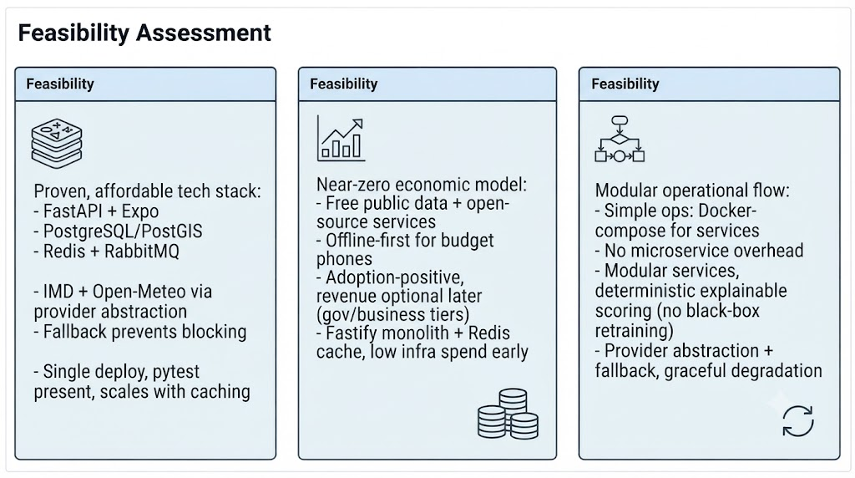
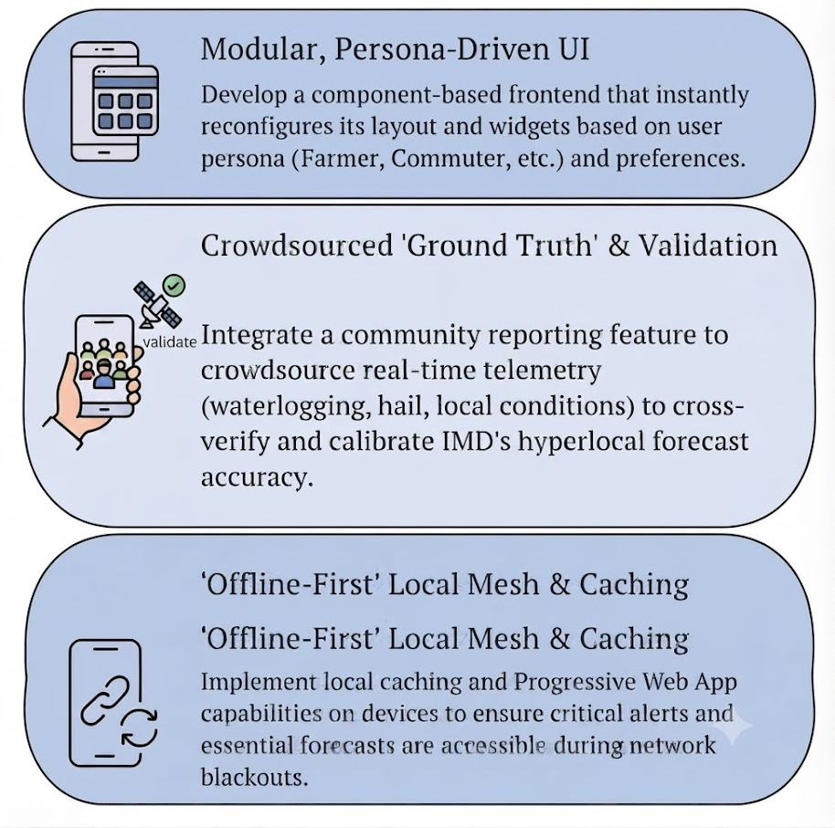
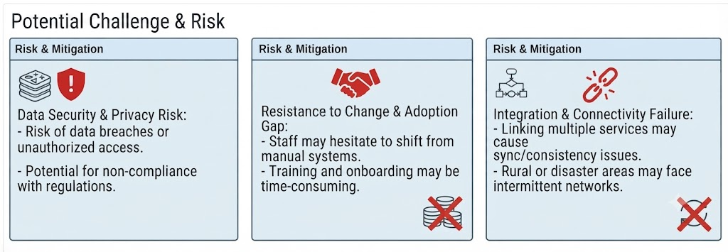
FEASIBILITY AND VIABILITY
BugNot
Found
Implementation Strategies
@SIH Idea submission- Template

Slide 5
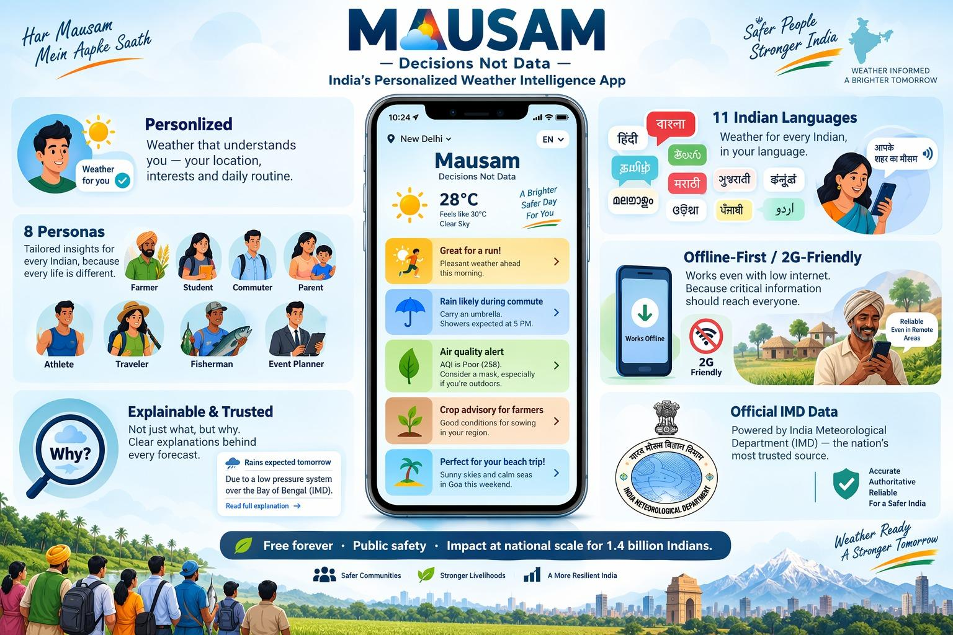




IMPACT AND BENEFITS
BugNot
Found
Feature | Mausam (Our Solution) | AccuWeather | Weather Channel | Google Weather
Personalized Homepage | ✅ AI-based | ⚠️ Limited | ⚠️ Limited | ⚠️ Basic
User Persona | ✅ | ❌ | ❌ | ❌
Adaptive Widgets | ✅ | ⚠️ | ⚠️ | ❌
Hyperlocal Weather | ✅ | ✅ | ✅ | ✅
Persona-based Alerts | ✅ | ❌ | ❌ | ❌
Severe Weather Proximity | ✅ | ✅ | ✅ | ⚠️
Offline Support | ✅ | ⚠️ | ⚠️ | ⚠️
India-focused | ✅ IMD/Mausam | ❌ | ❌ | ❌
@SIH Idea submission- Template

Slide 6
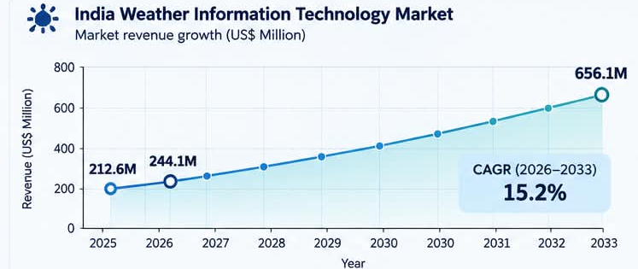

RESEARCH AND REFERENCES
BugNot
Found
Persona-Driven Weather Customization
Reference: Stamoulis & Giannopoulos (2022), "My personal forecast": the digital transformation of the weather forecast communication using a fuzzy logic recommendation system [cite: Stamoulis, D. S., & Giannopoulos, P. A. (2022). “My personal forecast”: the digital transformation of the weather forecast communication using a fuzzy logic recommendation system. Advances in Science and Research, 19, 9–12.].
Usage: Proves the effectiveness of shifting from generic dashboards to tailored, fuzzy-logic-based weather recommendations.
Cognitive Load & Usability
Reference: Eachus & Keim (2019), Users’ Perceptions of Smartphone Weather Applications’ Usability.
Usage: Highlights how filtering out non-essential parameters reduces clutter and improves quick decision-making during severe weather.
Context-Aware Recommender Systems (CARS)
Reference: Ricci, Rokach, & Shapira (2015), Recommender Systems Handbook (Springer).
Usage: Provides the architectural backbone for dynamically changing the UI based on real-time location, time, and user persona.
Business Model
B2G: Partnership with IMD & Government departments for public weather services.
B2B: Weather insights/API services for agriculture, logistics, tourism & disaster-management organizations.
Freemium: Free personalized weather + premium advanced insights/features.
API Licensing: Provide weather-personalization APIs to third-party apps.
Sponsored Alerts: Relevant, non-intrusive location-based promotions.
Data Insights: Anonymized & aggregated weather-usage analytics for organizations.
@SIH Idea submission- Template

