Slide 1


SMART INDIA HACKATHON 2026
TITLE PAGE
Problem Statement ID – SIH26076
Problem Statement Title - Development of Personalized Homepage for 'Mausam' Mobile Application
Theme- Smart Automation
PS Category - Software
Team ID - [Portal Team ID]
Team Name (Registered on portal) - BugNotFound

Slide 2
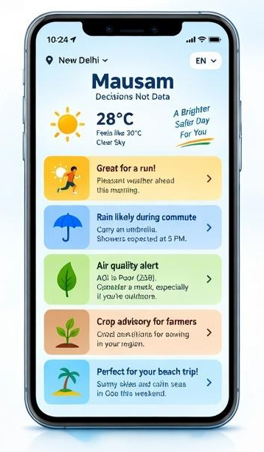
SOLUTION
BugNot
Found
Solution :-
Mausam 2.0 is a personalized weather intelligence engine built on official IMD/MoES warnings with a provider-agnostic live-data layer.
Weather Data + User Context → Impact Analysis → Smart Recommendation
It adapts one homepage for Health, Fitness, Travel, Beach, Family, Agriculture, Commute and Events.
How It Addresses the Problem
Improves decision-making. One adaptive homepage instead of separate experiences for 8 user groups.Combines weather + location + time + activities.
Provides personalized alerts and recommendations.
Keeps official IMD warnings separate and prioritized.
Converts complex forecasts into simple decisions.
Innovation & Uniqueness
Decisions, not Data: Converts weather data into actionable recommendations. Context Engine: Understands Who + Where + What + When.
Automatically reorganizes widgets and alerts based on user type (farmers, commuters, travelers).
Offline Cache: Caches emergency storm alerts locally for low-connectivity rural areas.
BugNotFound · SIH 2026
2
BugNotFound · SIH 2026

Slide 3
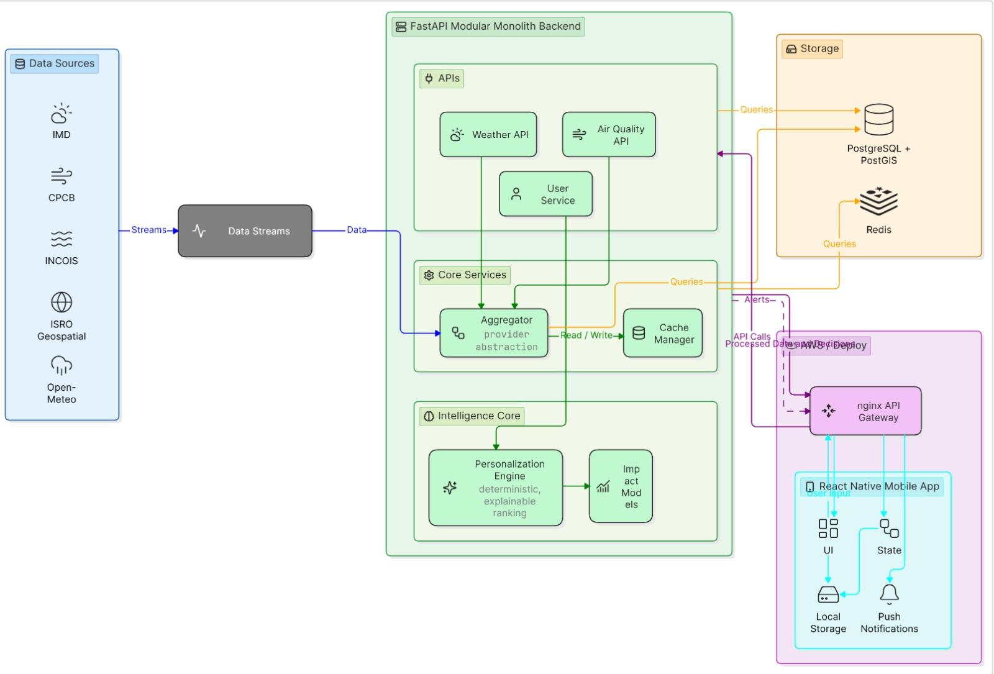
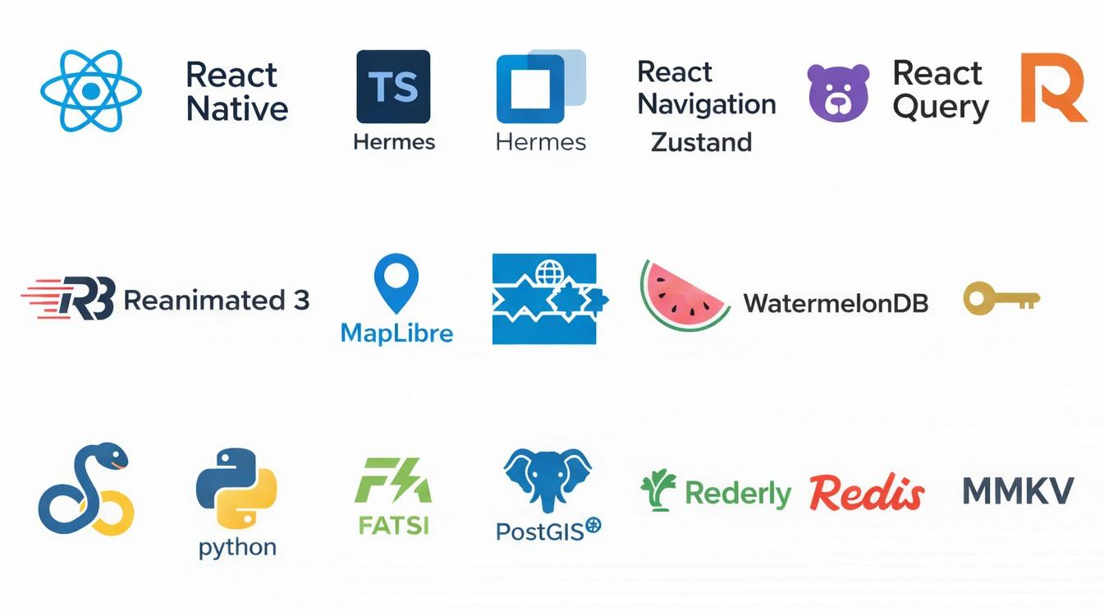
TECHNICAL APPROACH
BugNot
Found
Technical Approach : -
Context-aware personalization based on user persona + location.
Adaptive widget ranking context-aware & rule-based today; behavior-learning on the roadmap.
Proximity-based weather alerts for nearby severe conditions.
Offline caching for low-connectivity areas.
Feedback loop (roadmap) user interactions tune widget ranking over time.
BugNotFound · SIH 2026

Slide 4
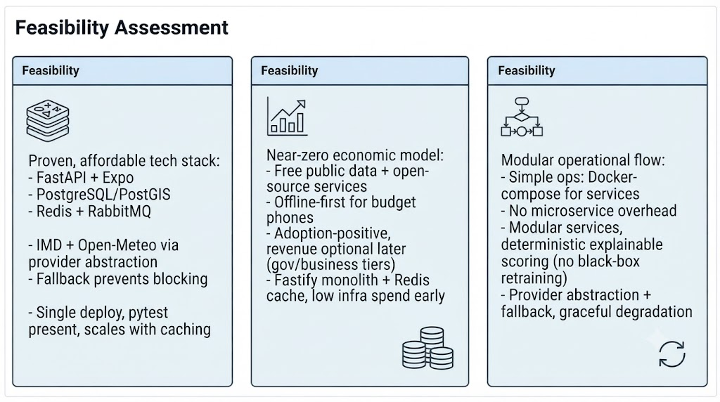
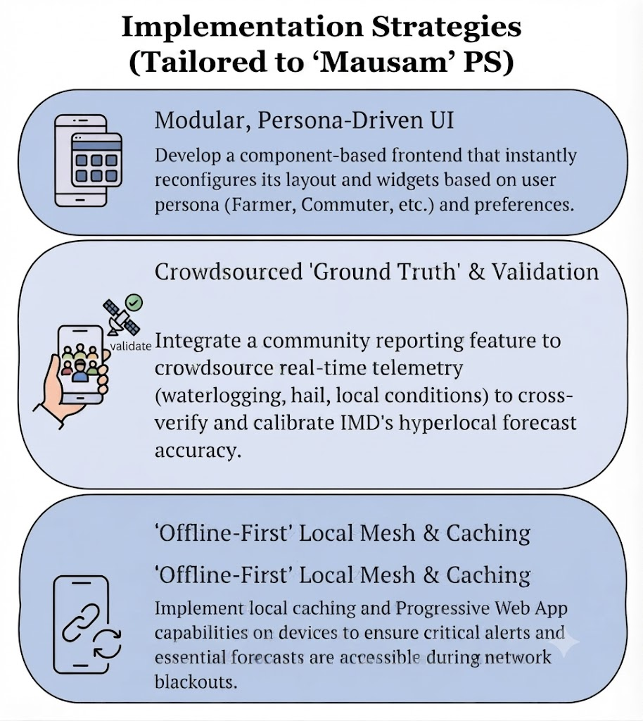
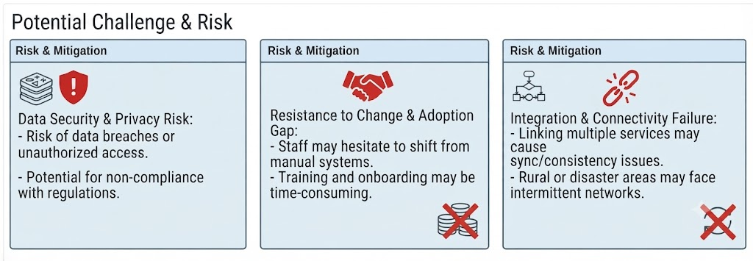
FEASIBILITY AND VIABILITY
BugNot
Found
FEASIBILITY
• Budget-first: React Native runs on entry Android phones; offline cache for patchy rural networks.
• Live data: Open-Meteo today; IMD/CPCB/INCOIS adapters sit behind a provider abstraction — mocks never block delivery.
• Licensing: MoES/IMD open-data terms confirmed during SIH; the design is license-agnostic.
• Risks → mitigation: provider fallback chain, local offline cache, and source/confidence labels on every card.
VIABILITY — BUSINESS MODEL
• B2G: IMD & government departments for public weather services.
• B2B: weather-personalization API for agriculture, logistics, tourism & disaster management.
• Freemium: free personalized weather; premium briefings, maps & alert add-ons.
• Partners: API licensing + non-intrusive sponsored alerts.
BugNotFound · SIH 2026

Slide 5
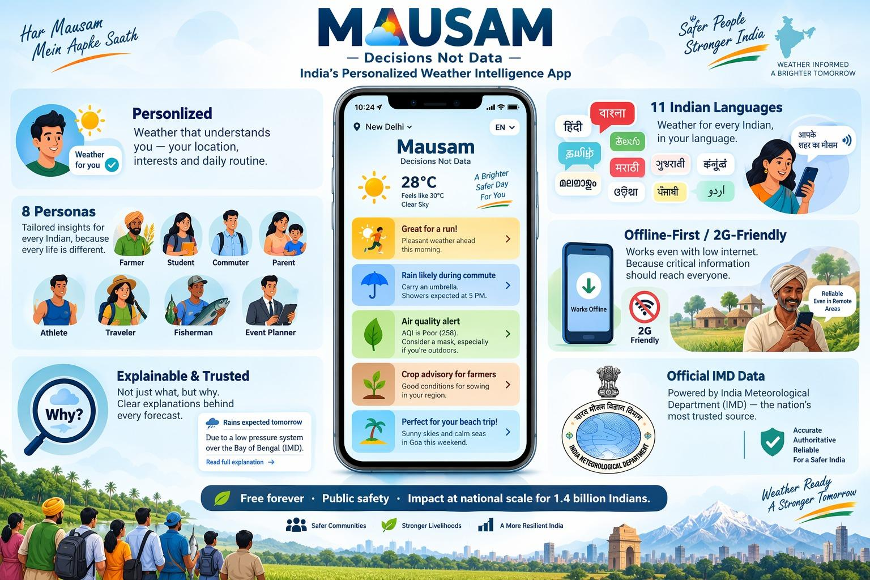




IMPACT AND BENEFITS
BugNot
Found
Feature | Mausam (Our Solution) | AccuWeather | Weather Channel | Google Weather
Personalized Homepage | ✅ Context-aware | ⚠️ Limited | ⚠️ Limited | ⚠️ Basic
User Persona | ✅ | ❌ | ❌ | ❌
Adaptive Widgets | ✅ | ⚠️ | ⚠️ | ❌
Location-based weather | ✅ | ✅ | ✅ | ✅
Persona-based Alerts | ✅ | ❌ | ❌ | ❌
Severe Weather Proximity | ✅ | ✅ | ✅ | ⚠️
Offline Support | ✅ | ⚠️ | ⚠️ | ⚠️
India-focused | ✅ IMD/Mausam | ❌ | ❌ | ❌
BugNotFound · SIH 2026

Slide 6
RESEARCH AND REFERENCES
BugNot
Found
Persona-Driven Weather Customization
Reference: Stamoulis & Giannopoulos (2022), "My personal forecast": the digital transformation of the weather forecast communication using a fuzzy logic recommendation system [cite: Stamoulis, D. S., & Giannopoulos, P. A. (2022). “My personal forecast”: the digital transformation of the weather forecast communication using a fuzzy logic recommendation system. Advances in Science and Research, 19, 9–12.].
Usage: Proves the effectiveness of shifting from generic dashboards to tailored, fuzzy-logic-based weather recommendations.
Cognitive Load & Usability
Reference: Eachus & Keim (2019), Users’ Perceptions of Smartphone Weather Applications’ Usability.
Usage: Highlights how filtering out non-essential parameters reduces clutter and improves quick decision-making during severe weather.
Context-Aware Recommender Systems (CARS)
Reference: Ricci, Rokach, & Shapira (2015), Recommender Systems Handbook (Springer).
Usage: Provides the architectural backbone for dynamically changing the UI based on real-time location, time, and user persona.
BugNotFound · SIH 2026

