Slide 1


SMART INDIA HACKATHON 2025
TITLE PAGE
Problem Statement ID – SIH25103
Problem Statement Title - ERP-based Integrated Student Management system
Theme- Smart Automation
PS Category - Software
Team ID - 84258
Team Name (Registered on portal) - BUDDHI

Slide 2
BUDDHI
Team BUDDHI
Unified ERP System integrating:
Admissions
Fees
Hostel
Exams
Library
Innovation & Uniqueness
AI-powered features
  Predictions for students at-risk of dropping
Smart Support
  Integrated chatbot for instant query resolution
Ease of Adoption
  Low-cost deployment using familiar tools
  Ensures broad adoption across institutions
How It Addresses the Problem
Eliminates inefficiencies
  Removes data duplication
  Reduces manual effort
Improves decision-making
  Real-time insights & reports
Affordable Solution
  Low-cost alternative to expensive ERP suites
Single Secure Database with:
Automated workflows
Role-based dashboards (Student / Faculty / Admin)
Encrypted transactions
Regular backups
Project demo video link - https://youtu.be/BARvEvkGaPU
@SIH Idea submission- Template
2

Slide 3

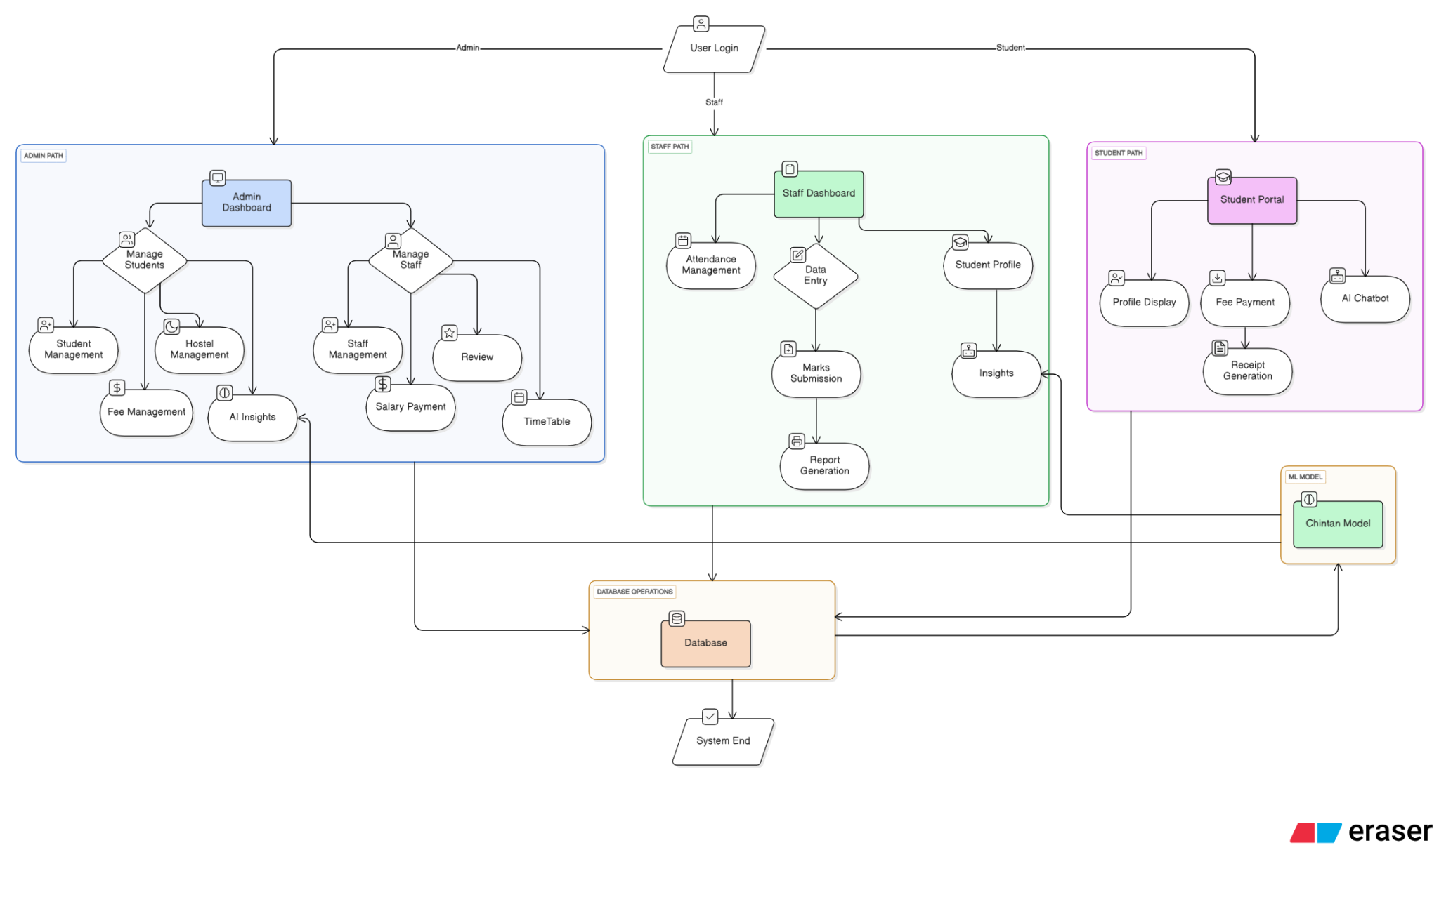










TECHNICAL APPROACH
Team BUDDHI
Dataset Creation & Annotation:
Built a self-curated dataset of 501 student records, annotated by 2 experts.
Features include attendance, CGPA, fees, and library time.
Students labeled as “at-risk,” “on the verge,” or “normal.”
Fleiss’ Kappa = 0.68, showing substantial inter-annotator agreement.

Slide 4
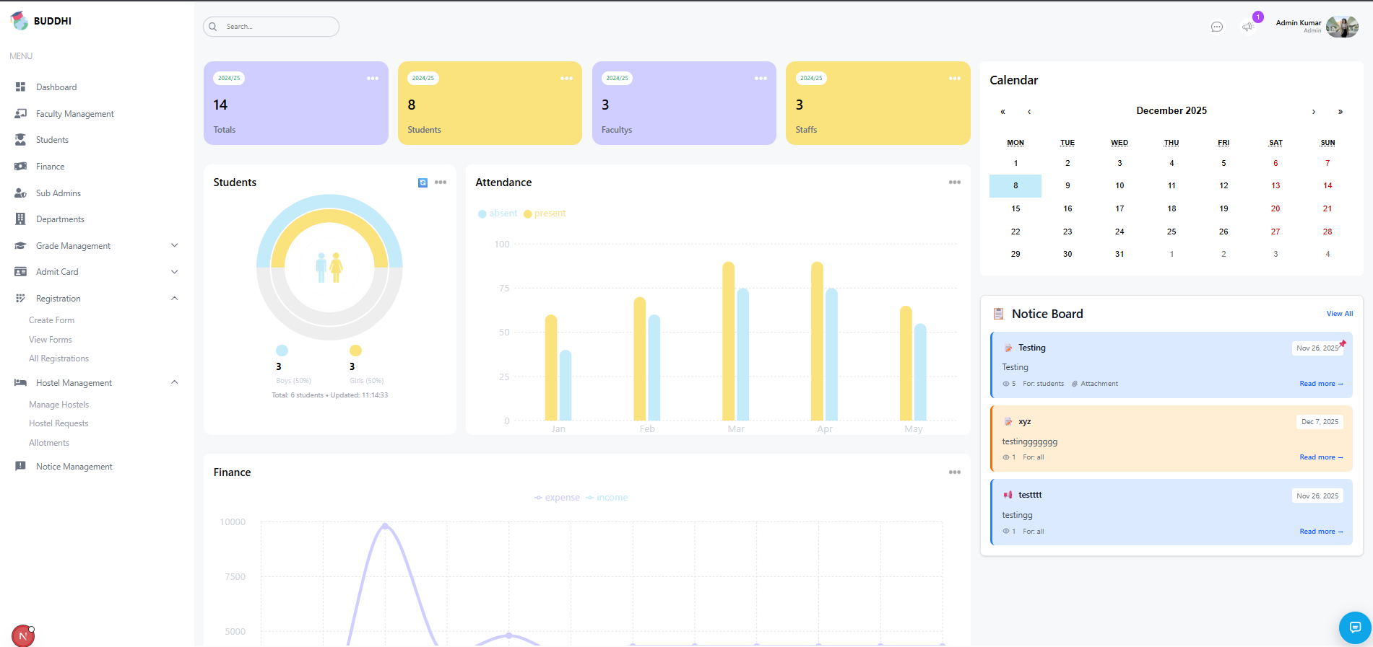
Admin Dashboard

Slide 5
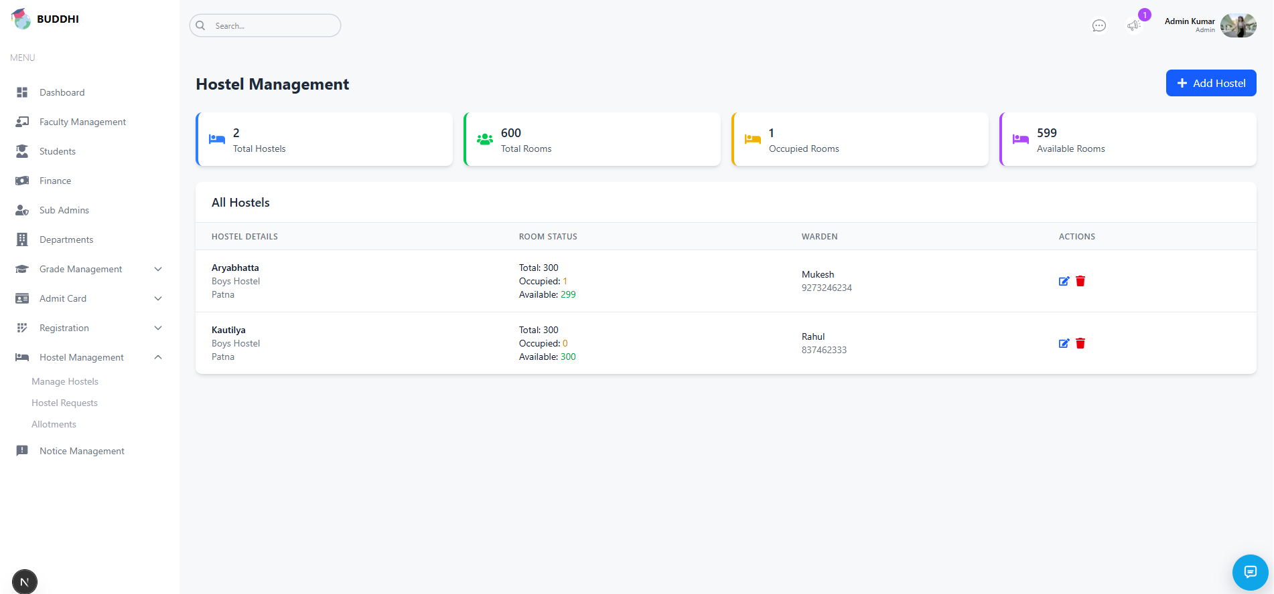
Automated Hostel Management for Admin

Slide 6
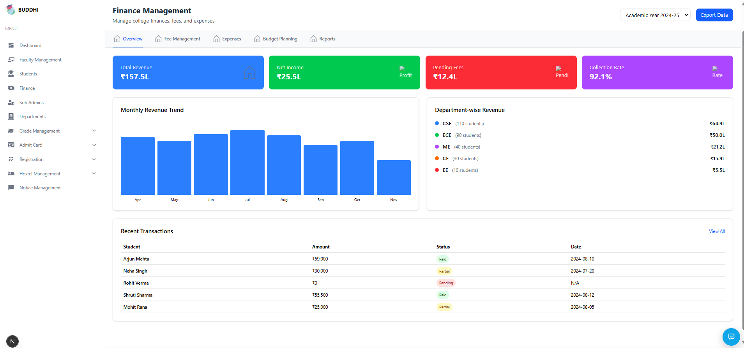
Financial Management and Automated Receipting for Admin

Slide 7
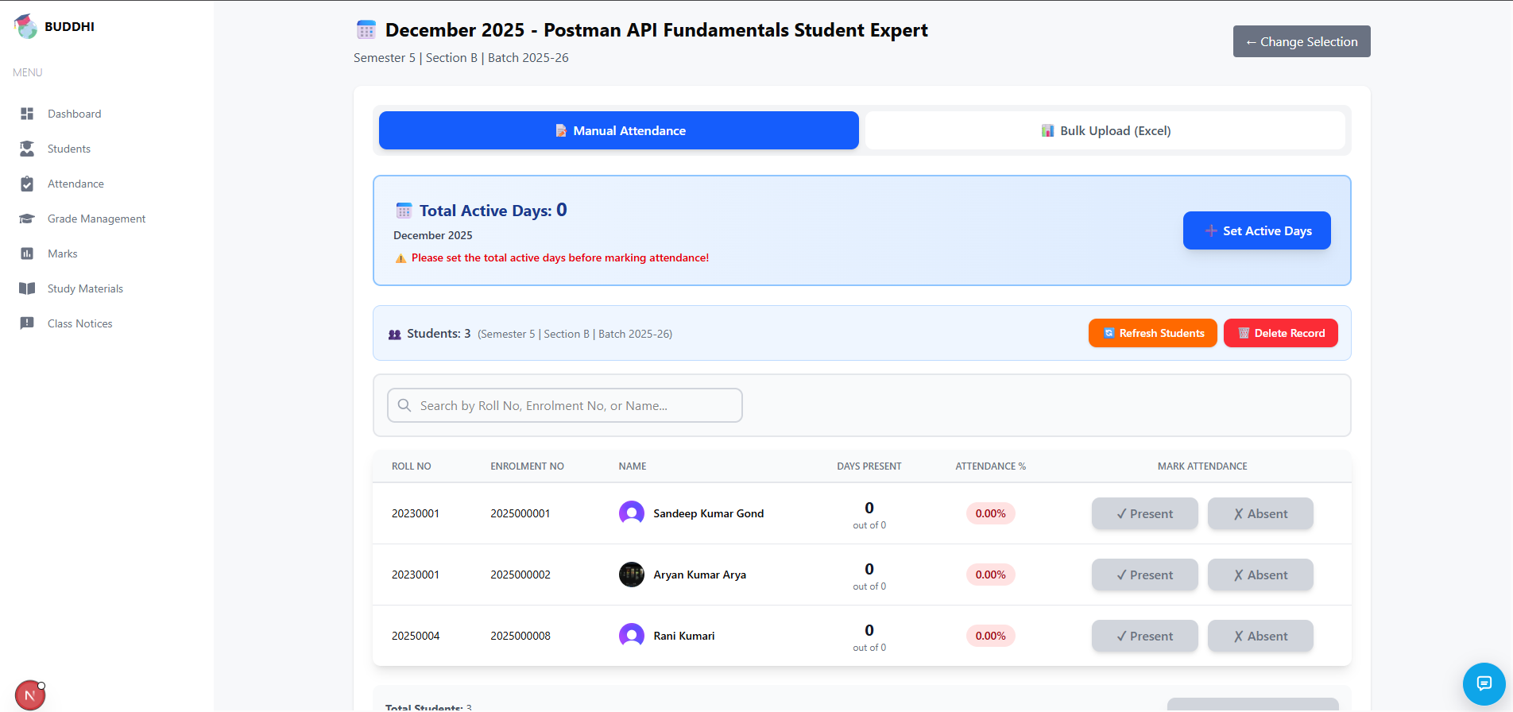
Smart Attendance Management for Faculty

Slide 8
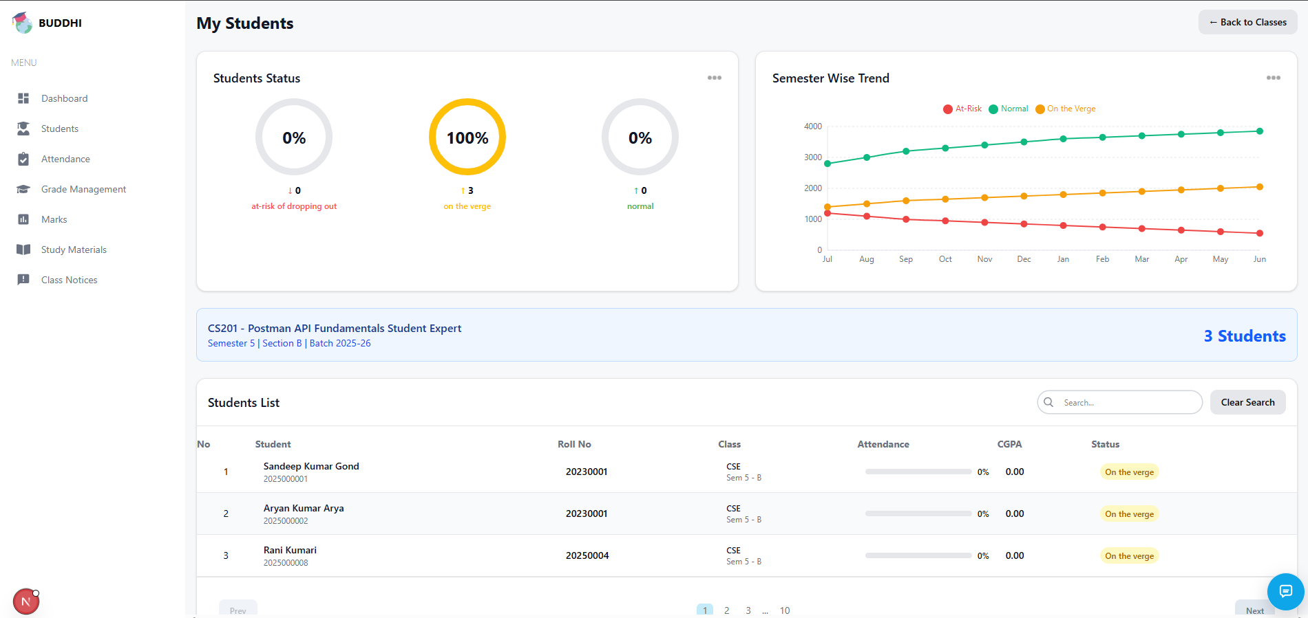
Smart Student Management for Faculty

Slide 9
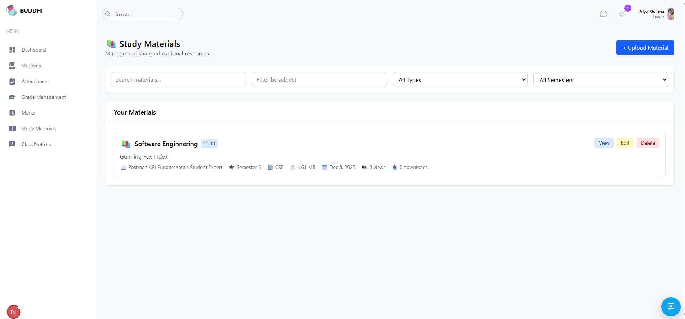
Study Material Management by Faculty

Slide 10
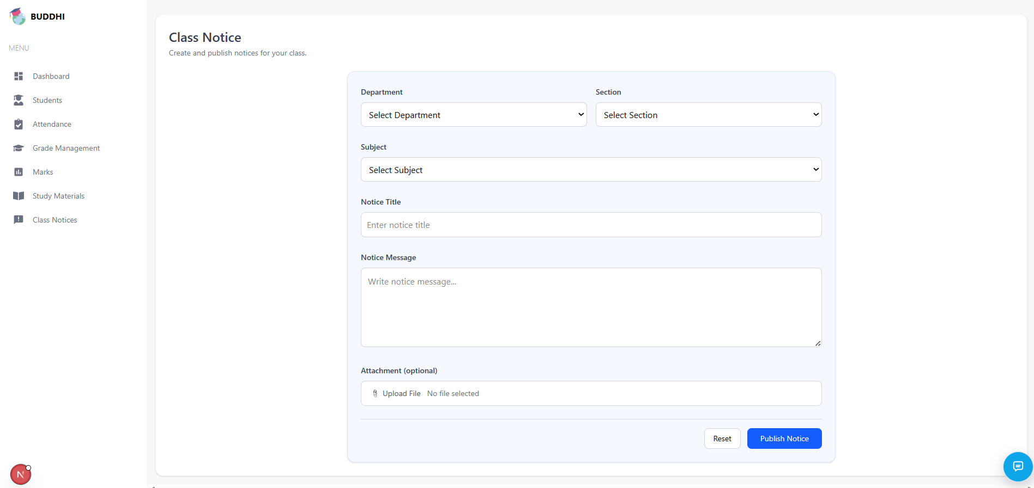
Class Notice uploaded by Faculty

Slide 11
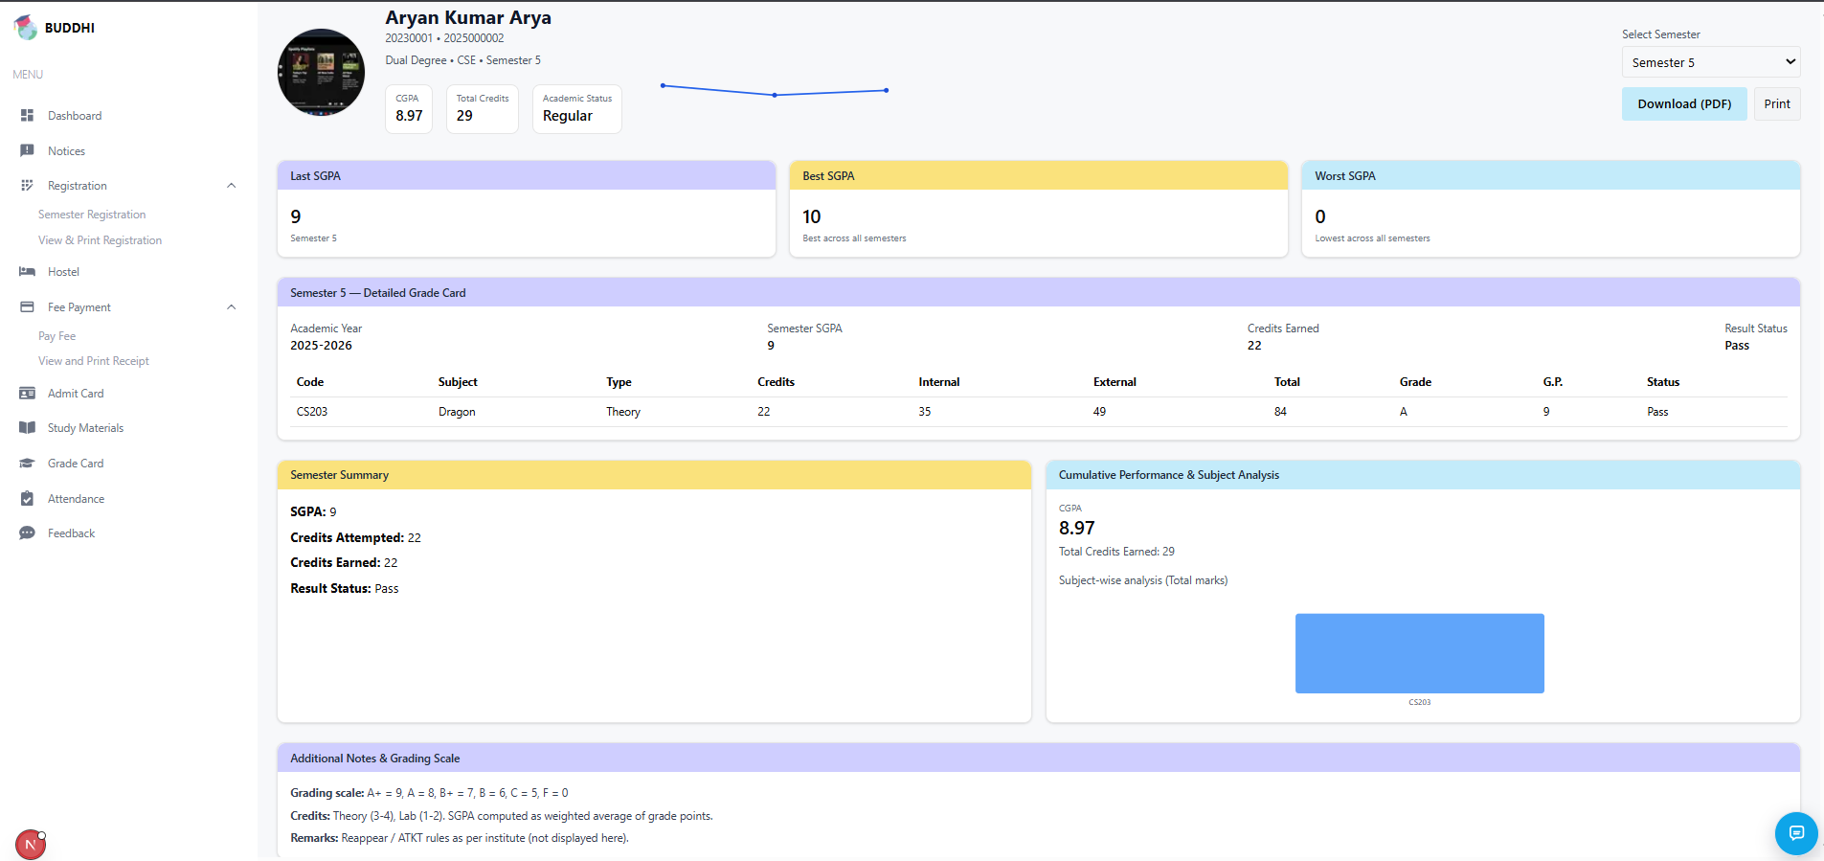
Grade Card for Students

Slide 12
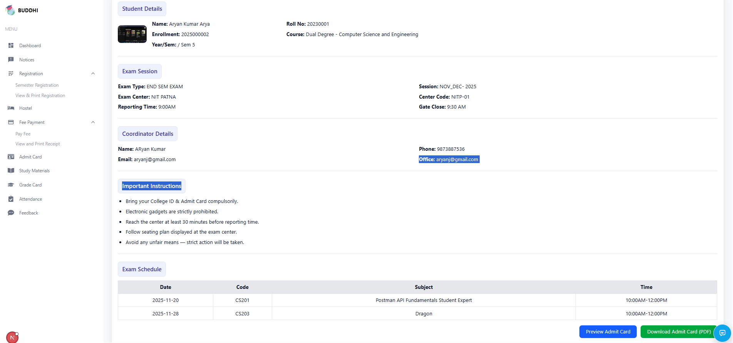
Admit Card for Student

Slide 13
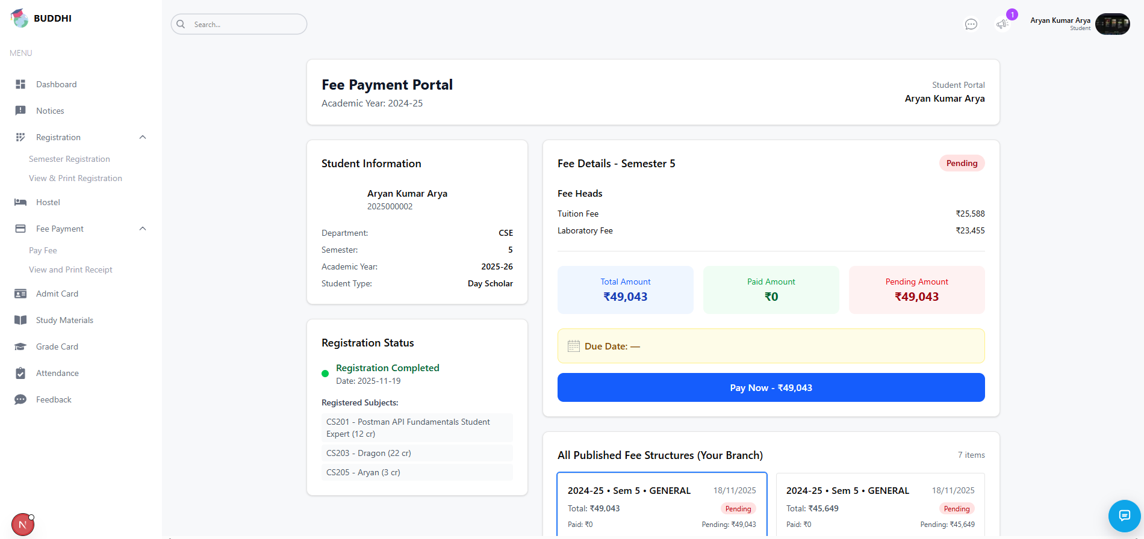
Fee Portal for Students

Slide 14
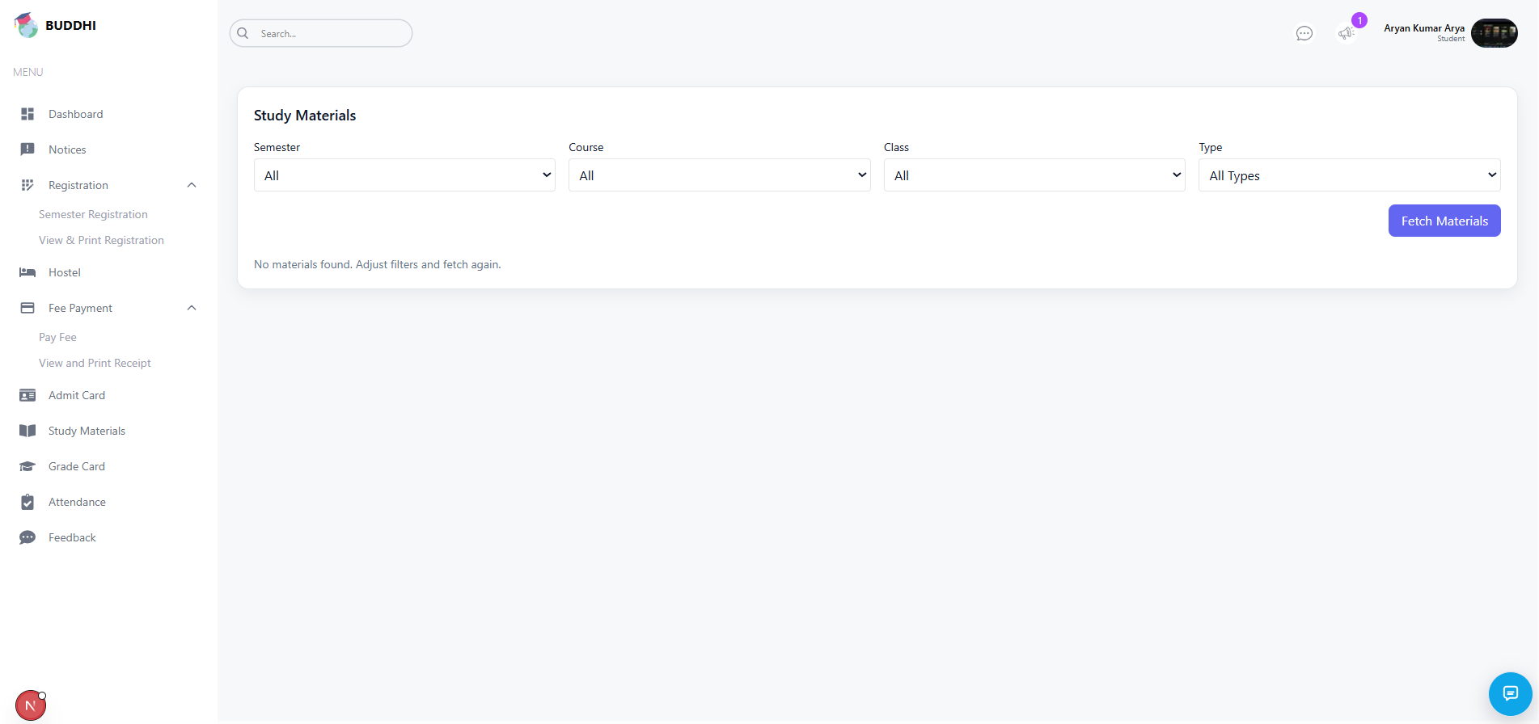
Study Material for Students

Slide 15
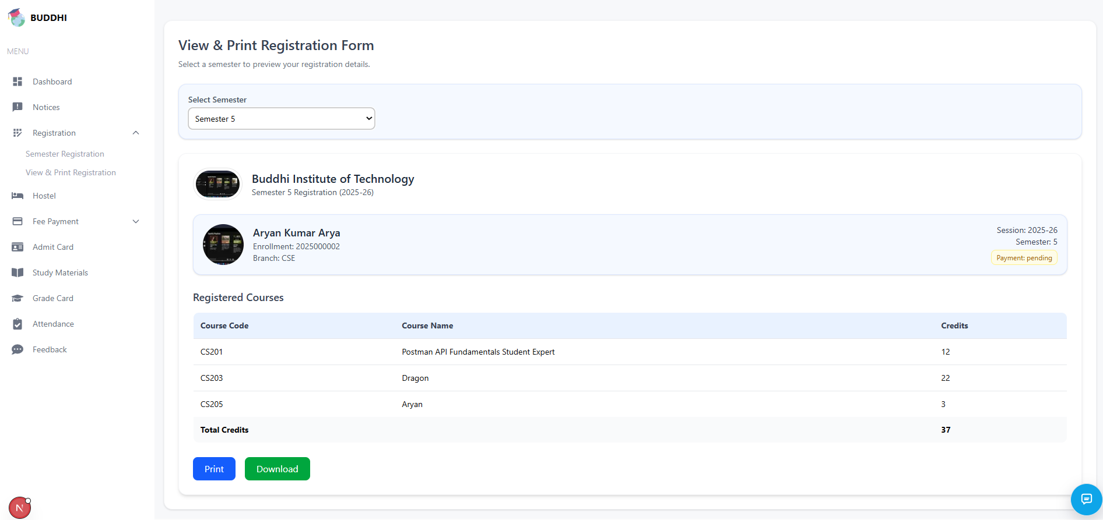
Registration Portal for Students

Slide 16
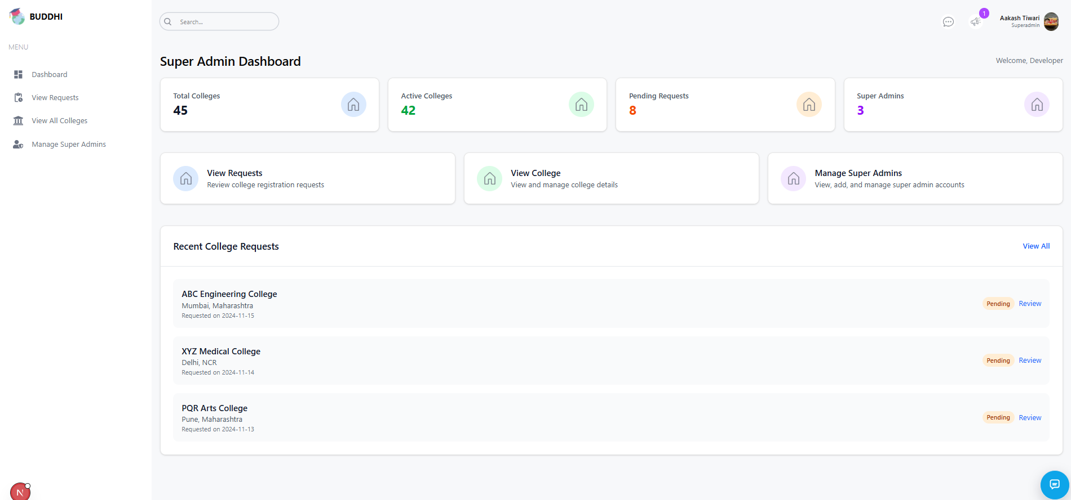
Superadmin Dashboard

Slide 17
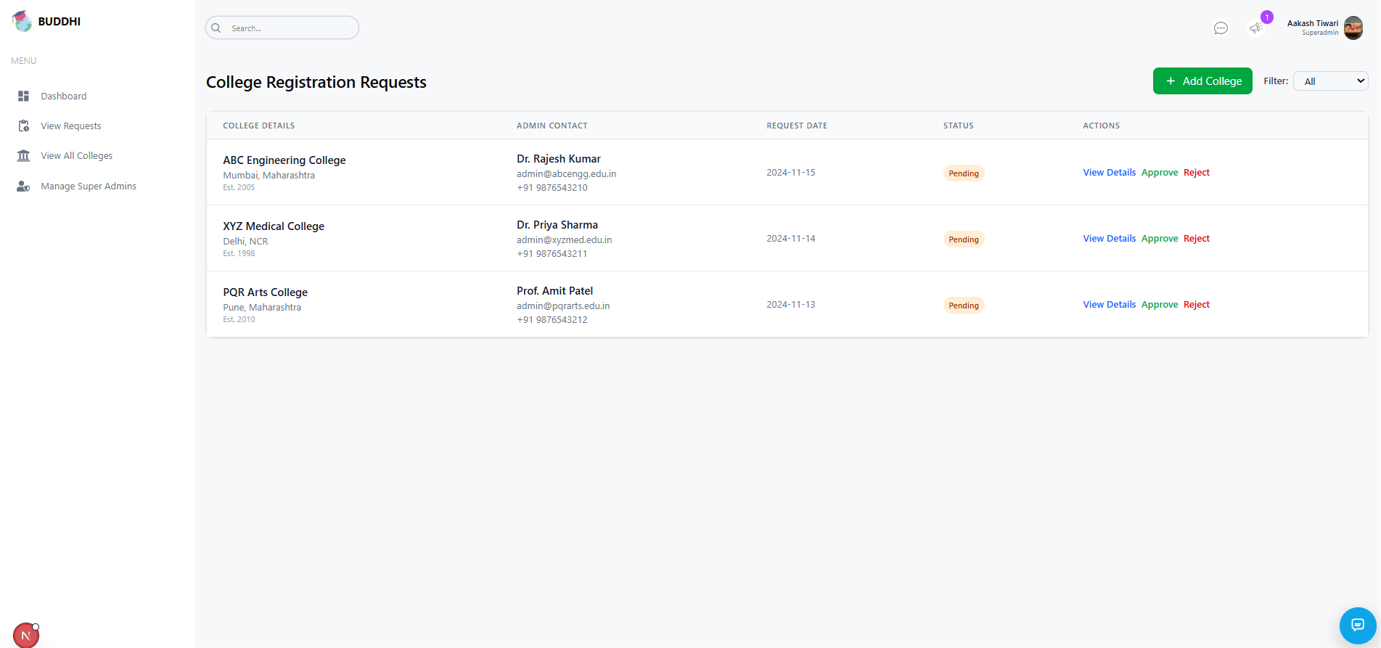
College Registration by Superadmin

Slide 18
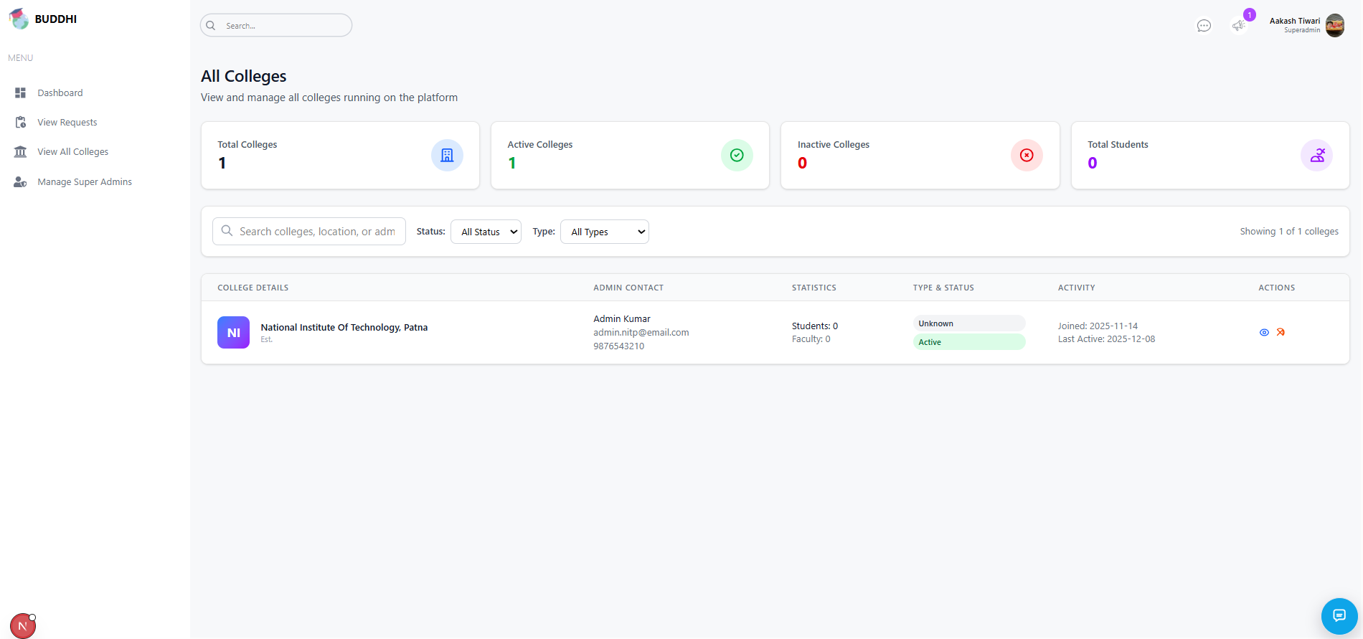
Registered colleges as viewed by superadmin

Slide 19
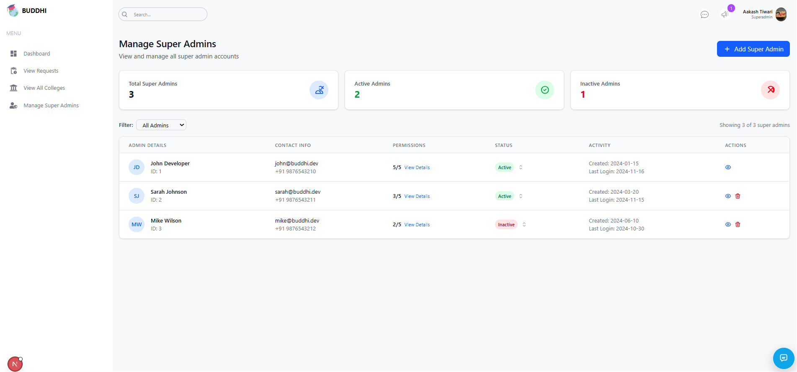
Superadmin Management

Slide 20
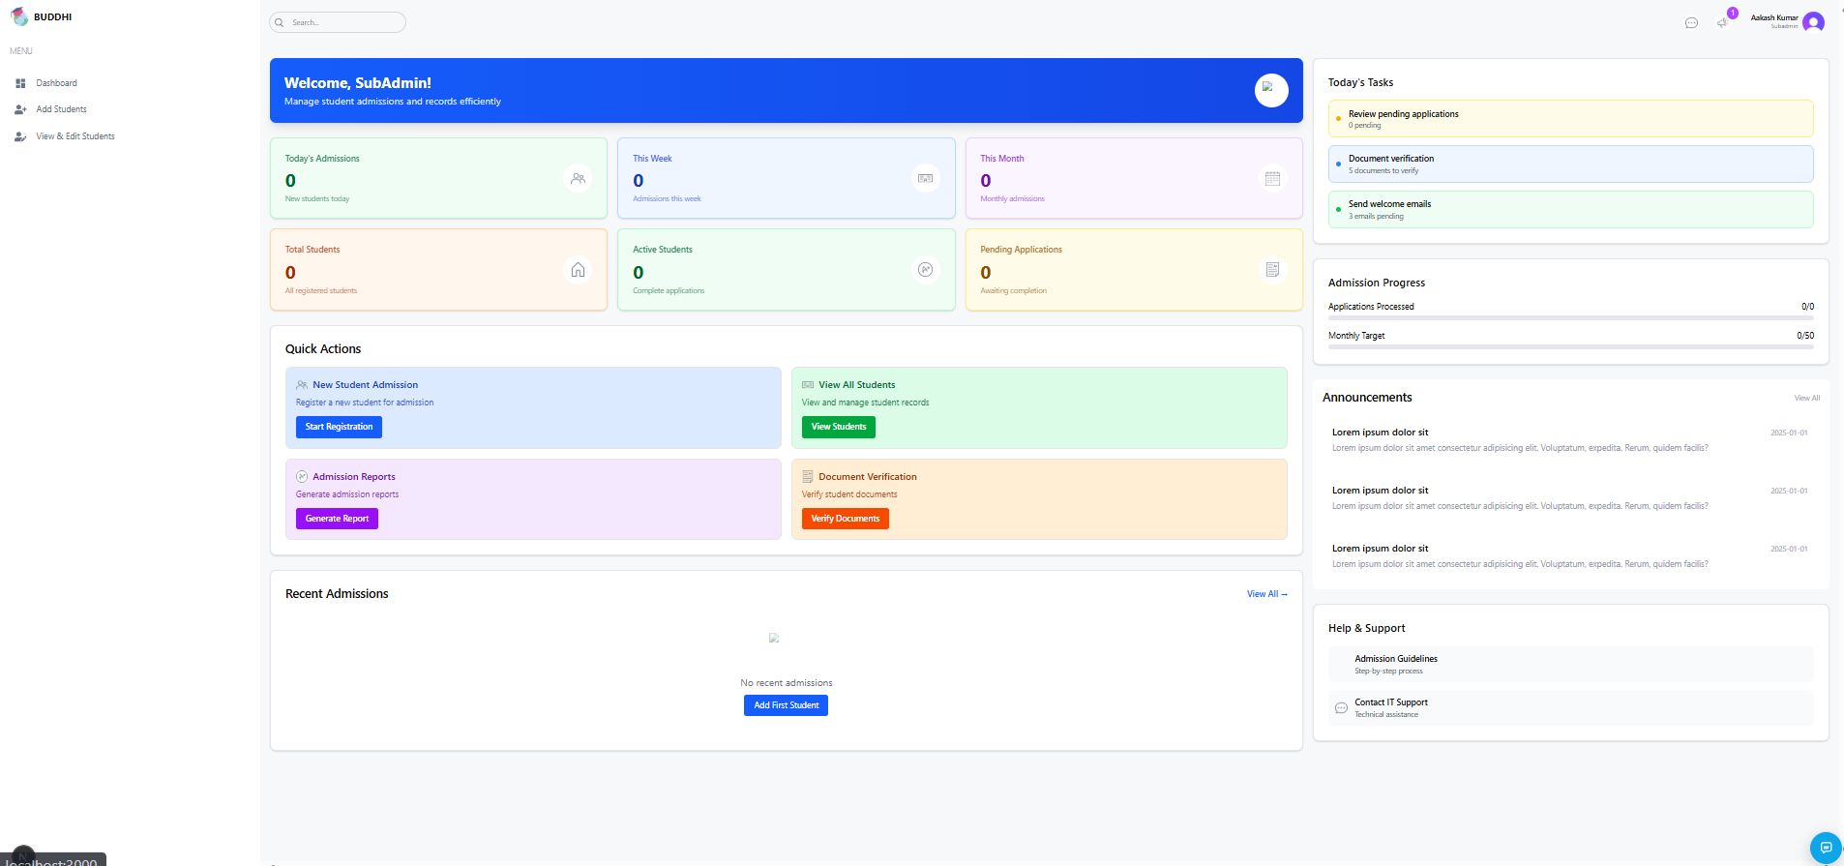
Subadmin Dashboard

Slide 21
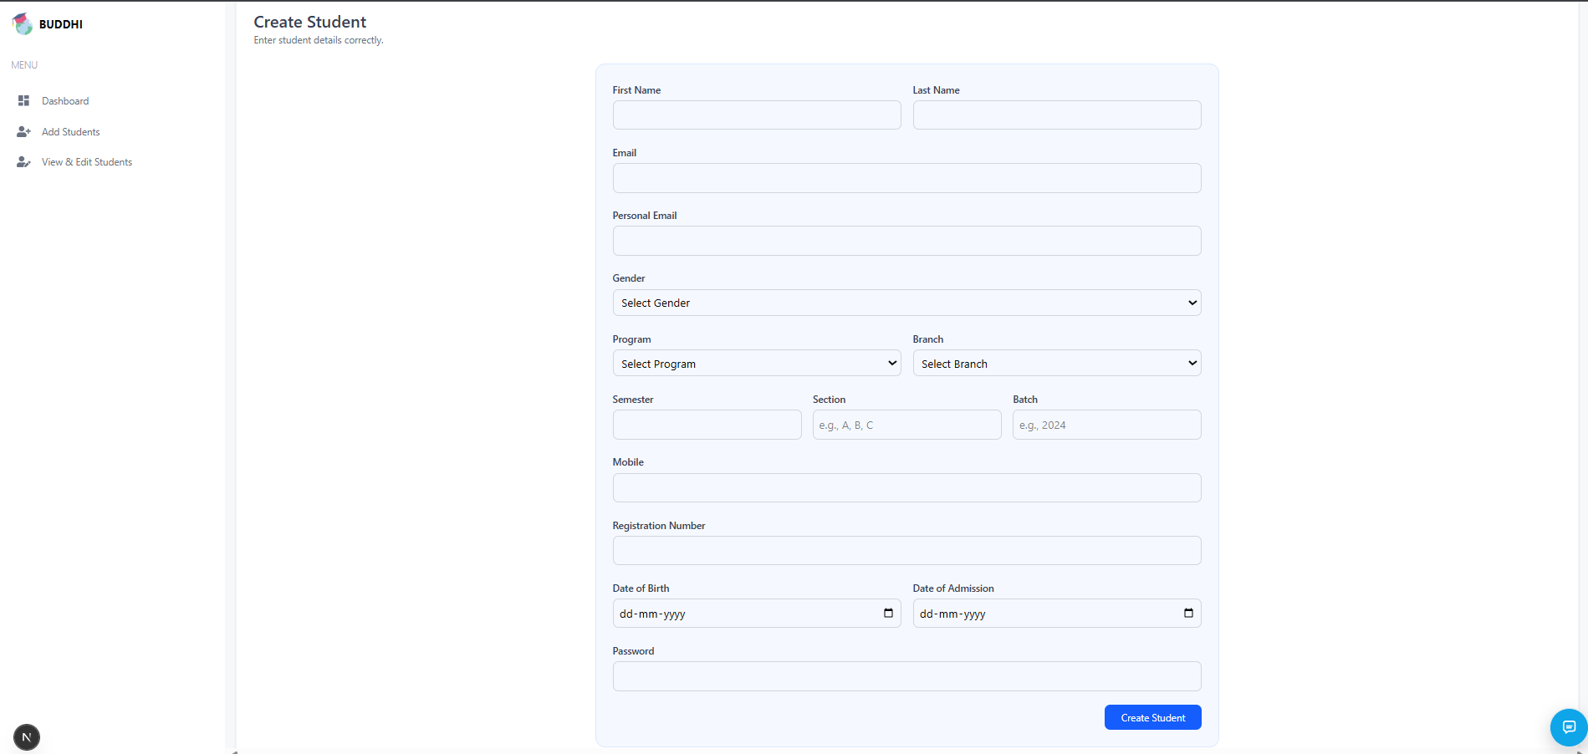
Addition of students into the System by subadmin

Slide 22
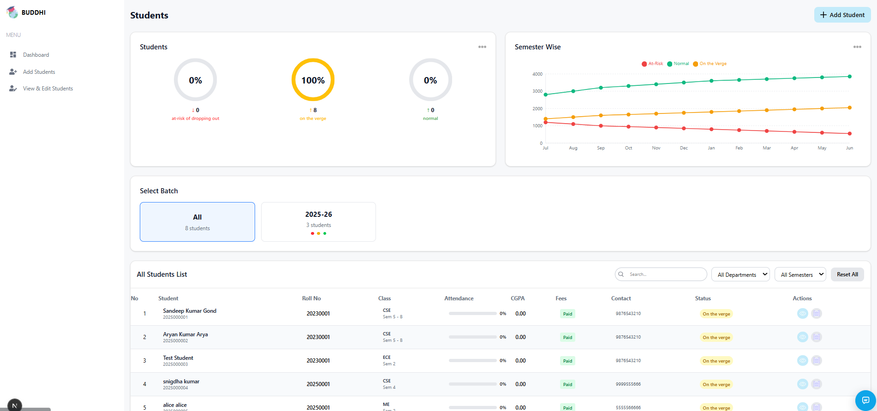
Student details edited by Subadmin

Slide 23
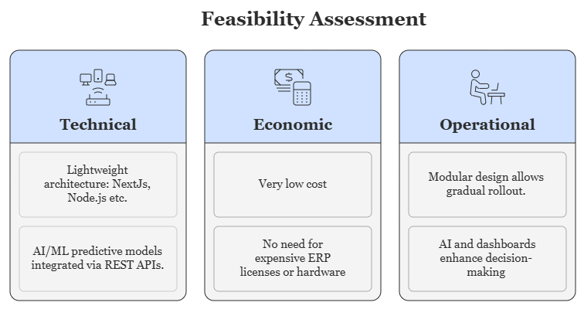
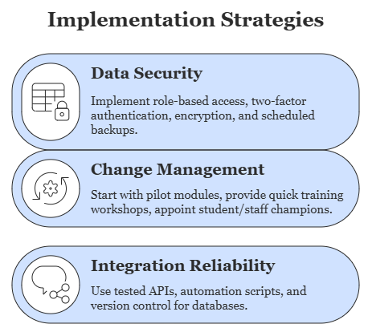
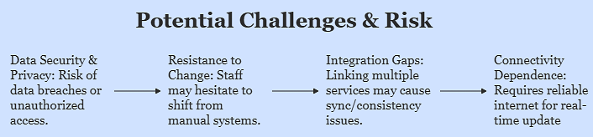
FEASIBILITY AND VIABILITY
Team BUDDHI

Slide 24
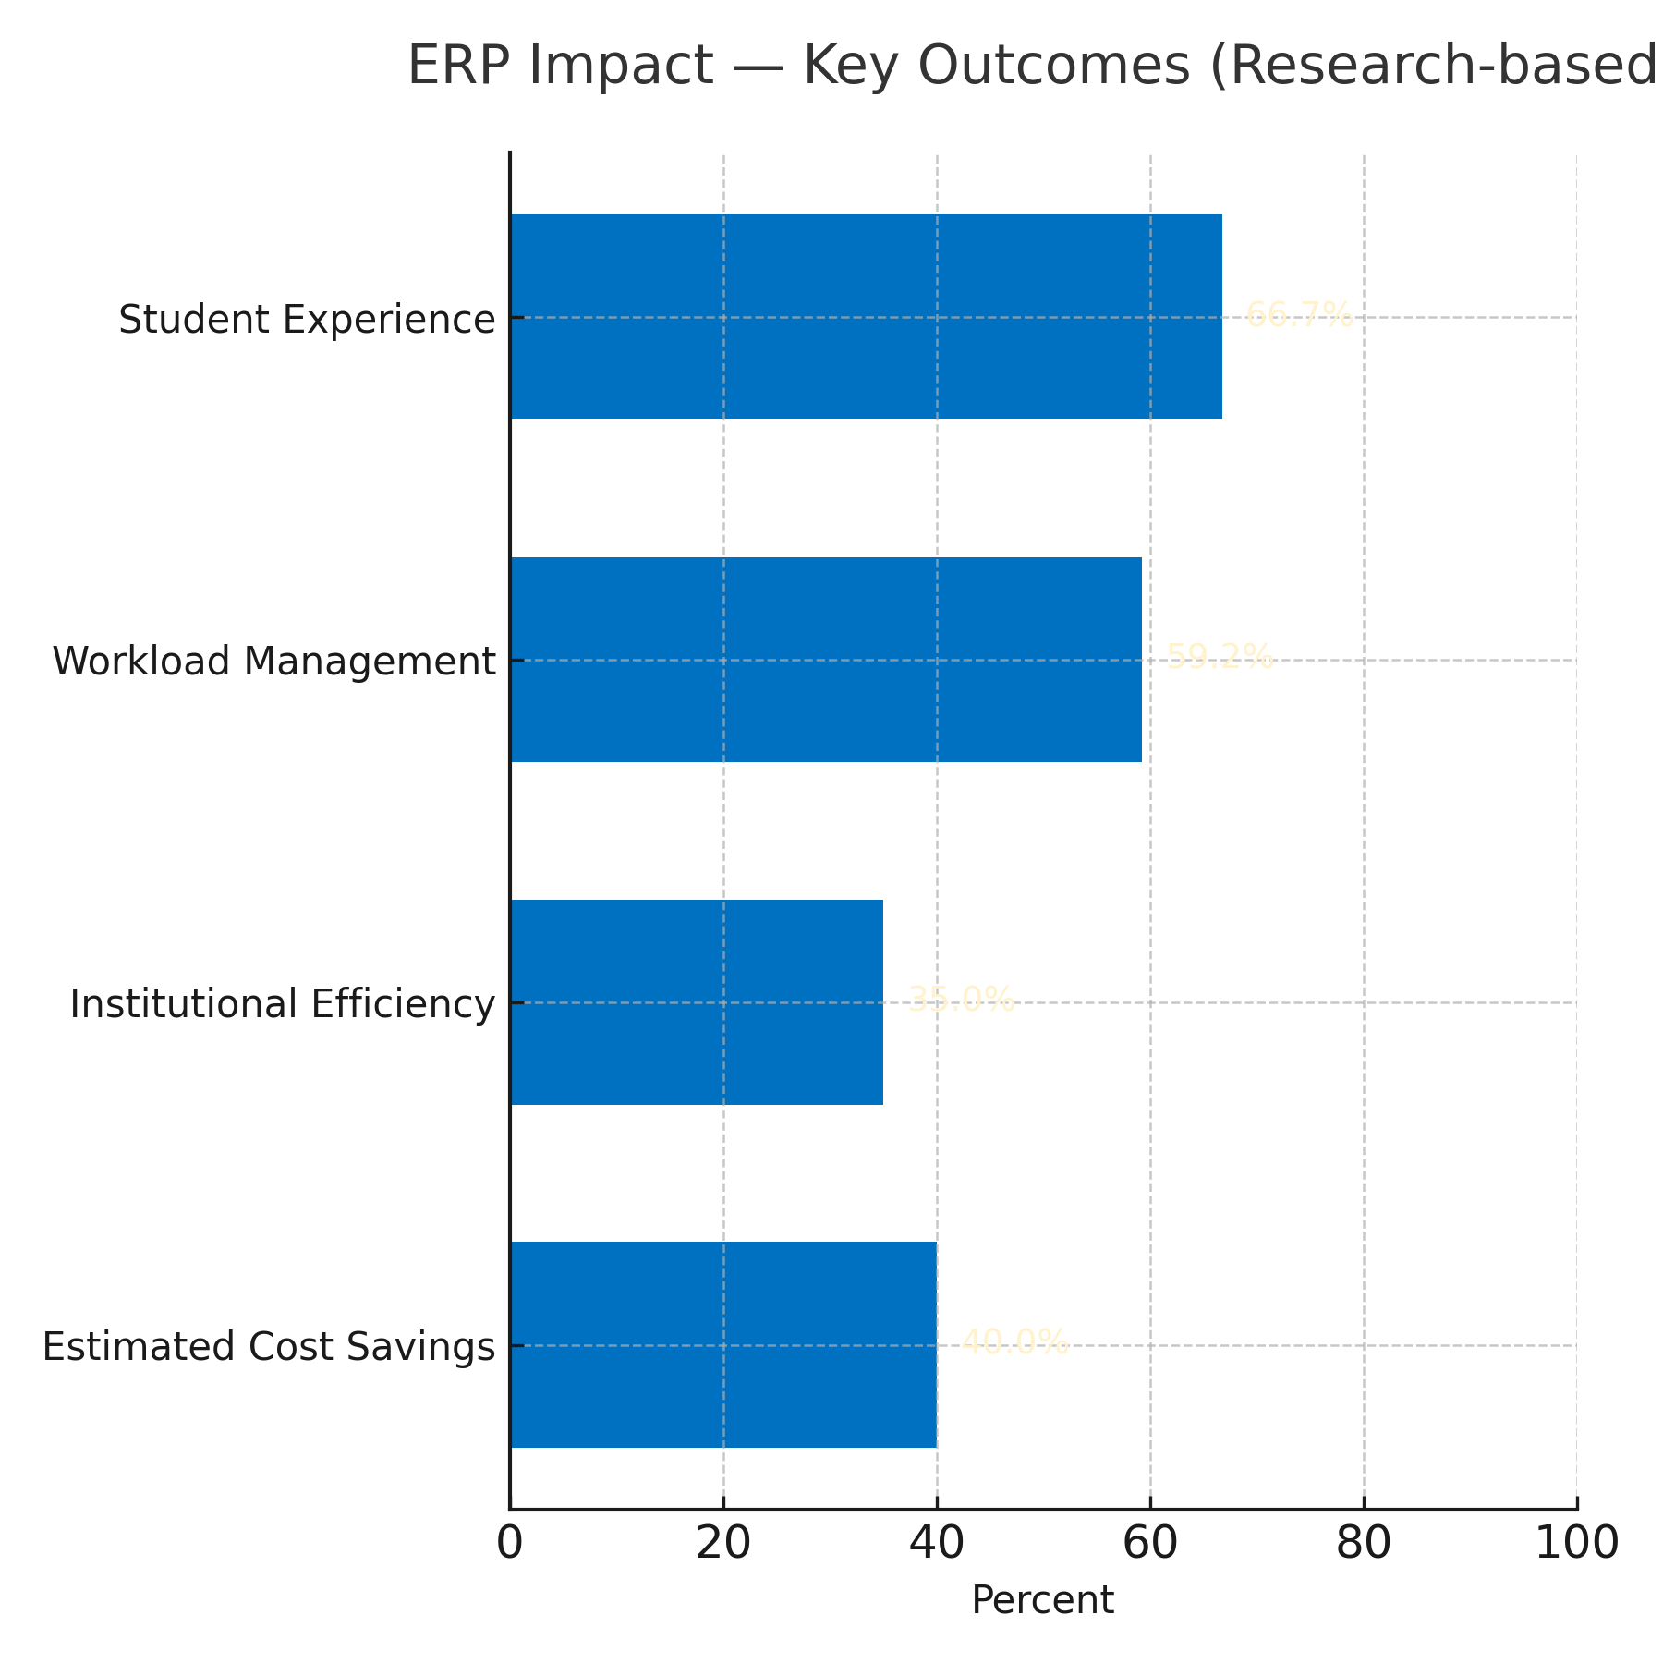
RESEARCH AND REFERENCES
Team BUDDHI
D. Zhang, "Deep Learning-Based Optimization of Cloud Enterprise Resource Planning (ERP) Systems for Adaptive Decision Support and Management Effectiveness Analysis," IEEE Access, vol. 12, pp. 177471-177482, 2024, doi: 10.1109/ACCESS.2024.3514879.
R. Al-Shabandar, A. Hussain, P. Liatsis, and R. Keight, "Detecting At-Risk Students With Early Interventions Using Machine Learning Techniques," IEEE Access, vol. 7, pp. 149464-149478, 2019, doi: 10.1109/ACCESS.2019.2943351.
L. Labadze, M. Grigolia, and L. Machaidze, "Role of AI chatbots in education: systematic literature review," Int. J. Educ. Technol. High. Educ., vol. 20, art. no. 56, Oct. 2023, doi: 10.1186/s41239-023-00426-1.
S. Tongsuksai, S. Mathrani, and K. Weerasinghe, "Influential Characteristics and Benefits of Cloud ERP Adoption in New Zealand SMEs: A Vendors' Perspective," IEEE Access, vol. 11, pp. 27514-27530, 2023, doi: 10.1109/ACCESS.2023.3259352.
"3 ERP Implementation Case Studies," Oracle Corp., Redwood Shores, CA, USA, Tech. Rep., Jan. 2023. [Online]. Available: https://www.oracle.com/erp/what-is-erp/erp-implementation-case-study/
J. L. Fleiss, 'Measuring nominal scale agreement among many raters,' Psychological Bulletin, vol. 76, no. 5, pp. 378-382, 1971.
Dhote, S. A., Jarad, R. S., Yadav, M., Suryavanshi, P., Bhavsar, D., & Moholkar, N., “Study and Evaluate the Impact of ERP System Implementation on Student Performance,” International Journal of Research Publication & Reviews, vol. 6, no. 4, pp. 7658–7667, Apr. 2025. DOI: 10.55248/gengpi.6.0425.14196.
Kumar, M., & Garg, A., “Impact Of ERP Implementation In Higher Education In India — A Review,” 2020. (Review of ERP benefits, adoption barriers and outcomes).
BUSINESS ASPECT
TAM (India Education ERP): USD 0.8B in 2024, projected to USD 3.4B by 2030 (CAGR 27.7%).
SAM (Public HEIs): ~30K institutions; potential USD 0.5B (low-cost adoption at $15K avg./yr).
Revenue Model: SaaS subscription; $500-2K/institution/yr, scalable to 10% market share ($80M potential).
ROI: 30-50% cost savings for colleges via automation; 2-3 yr payback.

Slide 25
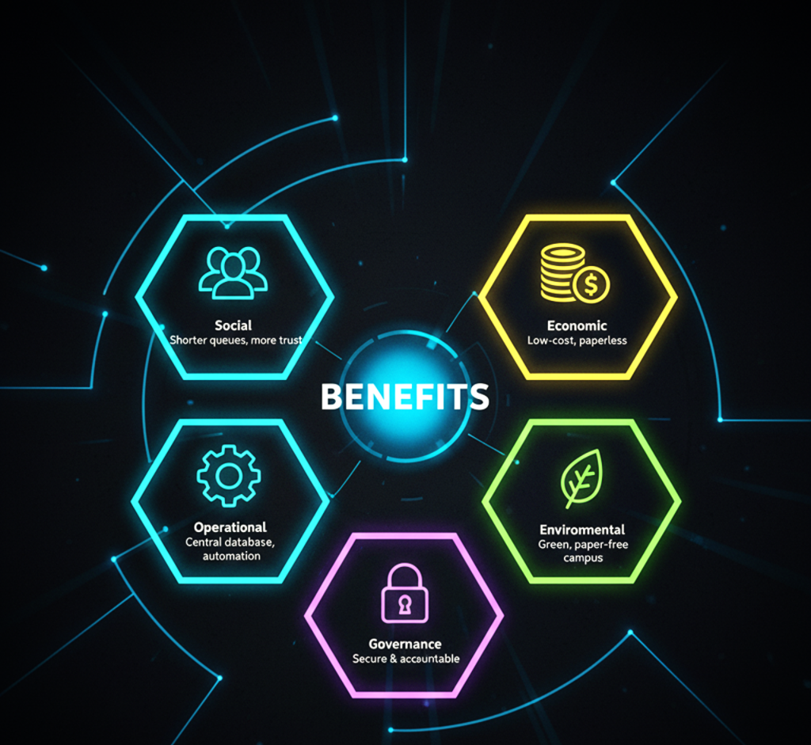




IMPACT AND BENEFITS
Team
BUDDHI
Website | AI-Powered Student Risk Prediction | Chatbot Support | Instant Digital Receipts | Low-Cost | Fully Paperless Workflows | Fast Deployment
BUDDHI | ✅ | ✅ | ✅ | ✅ | ✅ | ✅
Oracle ERP Cloud | ✅(AI/ML but enterprise focus) | ✅ | ✅ | ❌ | ✅ | ❌(complex setup)
Samarth (UGC ERP) | ❌ | ❌ | ⚠️(basic online fees, not instant) | ✅ | ⚠️(partly digital) | ❌
Fedena | ❌ | ❌ | ✅ | ✅ | ✅ | ✅

