Slide 1
CAREBRIDGE AI
Autonomous Post-Discharge Healthcare Coordination Operating System
Bridging the critical gap between hospital discharge and healthy home recovery with multimodal document intelligence, autonomous date tracking, voice speech synthesis, and real-time family transparency.
🏆 PITCH DECK FOR HACKATHON & INVESTOR JUDGES
LIVE SYSTEM DEMO
• Fully Deployed App:
https://shivvar7087.github.io/CareBridge/
• Backend API:
Render Cloud Platform
• Stack:
React 18 + FastAPI + Gemini AI

Slide 2
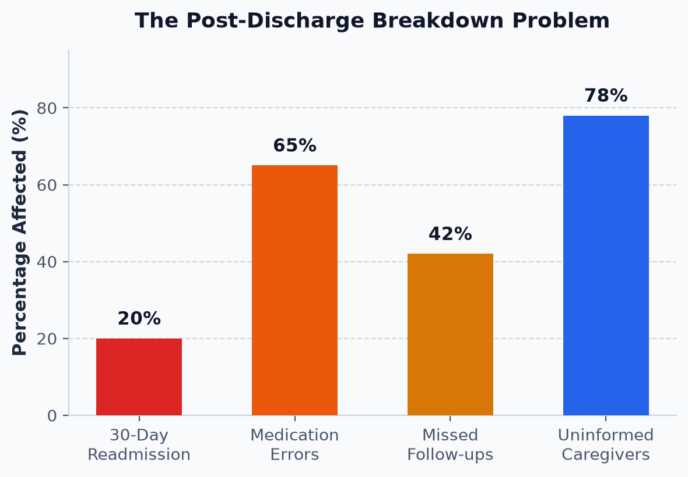
THE REAL-WORLD CRISIS
The Broken Post-Discharge Experience
Patients leave the hospital with prescriptions in hand, but zero coordination at home.
Why Patients Relapse After Hospital Discharge
1. The $26B Readmission Drain: 1 in 5 patients (20%) are readmitted within 30 days due to completely avoidable lapses in recovery coordination.
2. Dense Medical Jargon: Over 65% of patients leave confused by illegible discharge papers, multi-drug dosing schedules, and dietary restrictions.
3. Caregiver Disconnection: Family caregivers are overwhelmed without a single shared source of truth, missing critical diagnostic reports.

Slide 3
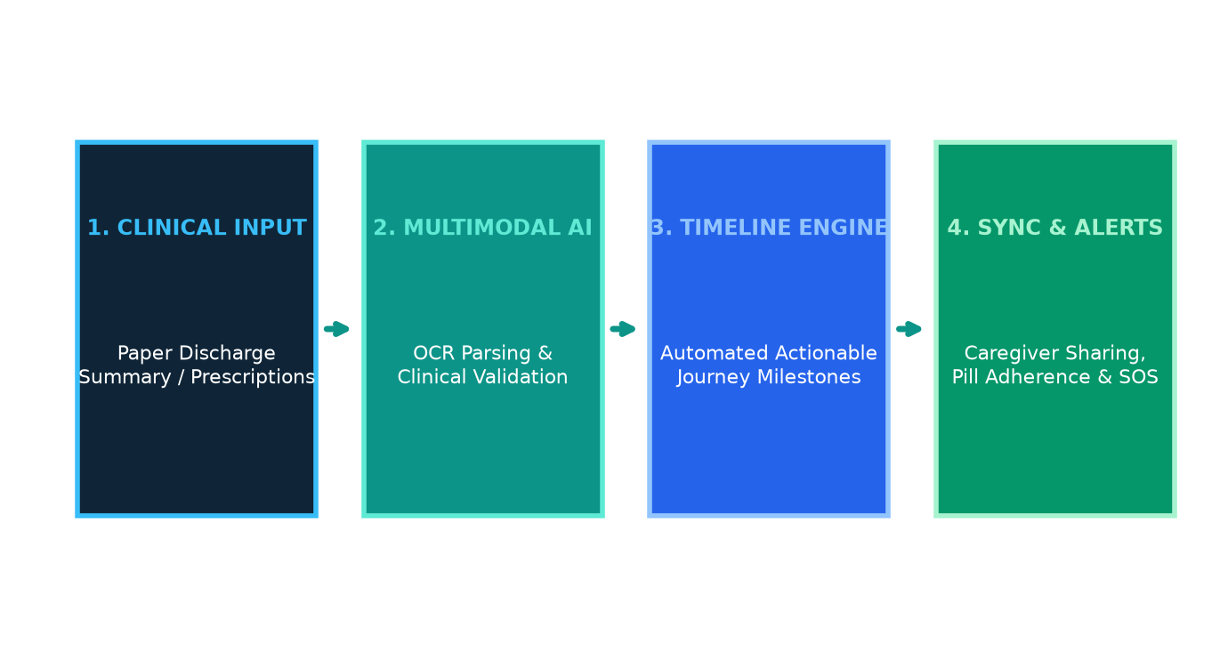
OUR INNOVATION
CareBridge AI: The Autonomous Post-Care Operating System
A multi-modal platform transforming dense clinical papers into an interactive, tracked recovery journey.
Instant OCR & Parsing
Extracts appointments, medications, required tests, and warnings directly from photos of clinical notes.
Autonomous Timeline
Creates dynamic tasks with date intelligence, highlighting 'Due Today' and escalating 'Overdue' items.
Caregiver Transparency
Allows family members to coordinate care, track reports, and share tasks with full audit trail.

Slide 4
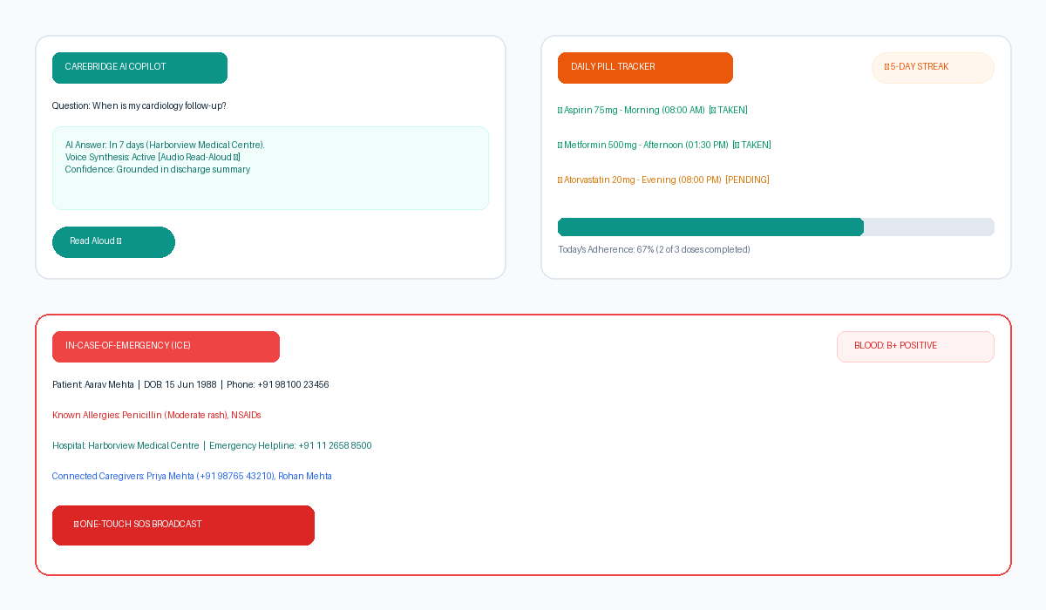
USER EXPERIENCE EXCELLENCE
Key Showcase Features Judges Love
Built with high empathy, accessibility, and real-time medical utility.
Features That Stand Out:
🤖 Voice AI Health Copilot
Context-aware chat grounded in verified discharge data. Features one-click Audio Read-Aloud (🔊) for elderly accessibility.
💊 Daily Pill Tracker & Streak
Interactive Morning, Afternoon, Evening pill schedule with food notes, custom dosage manager, and 🔥 5-day streak.
🚨 Digital Emergency Card (ICE)
Triage passport displaying Blood Group, Allergies, Attending Clinician, and one-tap Caregiver SOS Broadcast.
⚡ Real-Time Relative Date Engine
Backend auto-detects today's date, lighting up '⚡ Due Today' indicators and firing instant reminders.

Slide 5
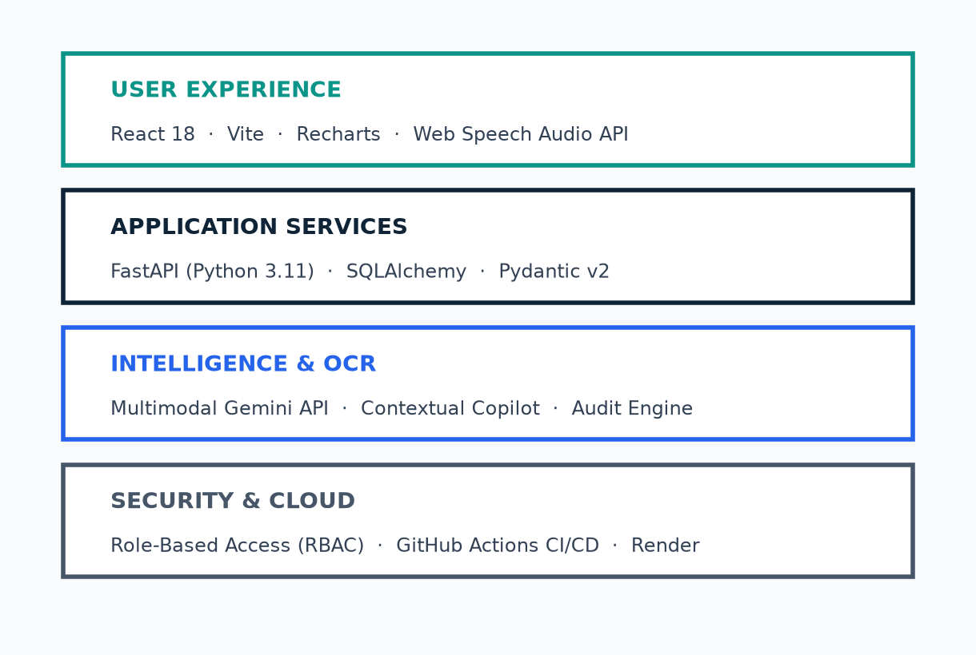
ROBUST ENGINEERING
Modern Full-Stack Cloud Architecture
Designed for clinical data integrity, zero latency, and HIPAA-compliant data boundaries.
Production-Grade Tech Choices
• Frontend Performance:
React 18 + Vite delivering a 28s lightning production build, Recharts for timeline data viz, and Web Speech API.
• Backend API Reliability:
FastAPI (Python 3.11) with async routing, automatic OpenAPI validation, and SQLAlchemy 2.0 ORM.
• AI & Semantic Intelligence:
Multimodal Gemini API for unstructured clinical documents with robust rule-based fallback for 100% uptime.
• DevOps & CI/CD:
Automated GitHub Actions CI/CD deploying frontend to GitHub Pages and backend to Render Cloud Container.

Slide 6
SEAMLESS USER EXPERIENCE
The 4-Step CareBridge Patient Experience
How a discharged patient navigates from confusion to total clarity in under 3 minutes.
1
2
3
4
Step 1: Upload & Extract
Patient or caregiver snaps a photo of the clinical discharge summary. AI OCR extracts diagnosis, appointments, and prescriptions in seconds.
Step 2: Timeline Generated
Tasks are pinned to a dynamic healthcare timeline with categorized pills (Appointments, Diagnostic Scans, Medication Schedules).
Step 3: Real-Time Execution
On milestone days, tasks light up with '⚡ Due Today' badges, calendar alerts trigger, and caregivers receive synchronized notifications.
Step 4: Continuous Adherence
Patient tracks daily pills, maintains their 5-day streak, uses AI Copilot for voice clarification, and accesses their ICE Emergency Card.

Slide 7
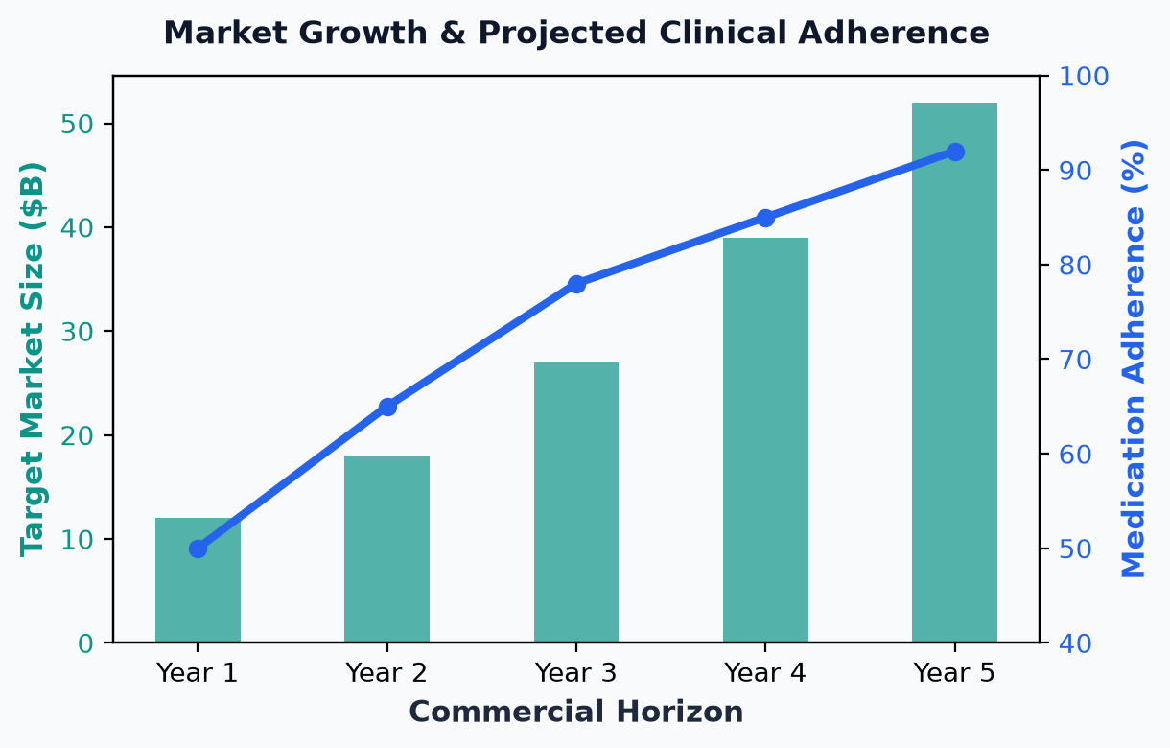
MARKET OPPORTUNITY & VIABILITY
Huge Market Need, Measurable Impact & Sound Monetization
Positioned at the high-growth intersection of HealthTech, Post-Acute Care, and Consumer Digital Health.
Commercialization & Unit Economics
• B2B SaaS for Hospitals:
Subscription per discharged patient ($15-$30). Directly protects hospitals from CMS 30-day readmission penalty fines (up to 3% of total Medicare revenue).
• B2B2C Premium Family Tier:
Freemium for basic care; $9.99/mo for multi-caregiver coordination, pharmacy auto-refills, and long-term health record archival.
• Diagnostic & Pharmacy APIs:
Revenue sharing with lab chains (Pathology/Radiology) for direct digital report delivery and prescription fulfillment.

Slide 8
THE ROAD AHEAD & CONCLUSION
Why CareBridge AI Wins
• Unrivaled Clinical Simplicity: Built for anxious patients and caring families—not IT technicians. Zero learning curve.
• Autonomous Date Intelligence: First platform that proactively computes relative days, triggers due-today alerts, and keeps family members in sync without manual reminders.
• Aggressive Scale Roadmap: Upcoming FHIR / EHR integration (Epic, Cerner), automated WhatsApp reminder bots, and wearable vitals sync.
🌐 LIVE PLATFORM: https://shivvar7087.github.io/CareBridge/
Thank you, judges! We welcome your questions.

