Slide 1

Deep Learning
Project
Aviral Sirotiya
Bhargav Singh Jasrotia
Ayush Shaw
Shivya Garg

Slide 2
Abstract
Lung CT image segmentation is a necessary initial step for lung image analysis, it is a prerequisite step to provide an accurate lung CT image analysis such as lung cancer detection. In this work, we propose a lung CT image segmentation using the U-net architecture, one of the most used architectures in deep learning for image segmentation. The architecture consists of a contracting path to extract high level information and a symmetric expanding path that recovers the information needed. This network can be trained end-to- end from very few images and outperforms many methods.

Slide 3
Lung Segmentation

Slide 4
Introduction
Lung cancer is a lethal lung disease that causes more than one million of deaths yearly. It is one of the most common medical conditions in the world. By definition, lung cancer is a malignant lung tumor that is characterized by uncontrollable growth in the lung tissue. Early detection of lung cancer could reduce the mortality rate and increase the patient’s survival rate when the treatment is more likely curative. Computed tomography (CT) imaging is an efficient medical screening test used for lung cancer diagnosis and detection. The physician uses the obtained CT images to analyze and diagnose the lung tissues. However, in many frequent cases, it is difficult for the physician to obtain an accurate diagnosis without the help of additional tool known as Computed Aided Diagnosis (CAD) System.

Slide 5
Methodology
A. Convolutional Neural Networks(CNN)
A Convolutional Neural Network (CNN) is a type of feed forward neural network which is inspired by biological visual system models , where the individual neurons are lined in such a way that they respond to
overlapping regions in its receptive field and continues to be reliable with the modern perceptive of the structure of the image system . When neurons with the same parameters are applied on overlapping regions of the previous layer, at different locations, a form of translational invariance is obtained.

Slide 6
This allows CNNs to detect objects in their receptive field in a way that is invariant to their size, location,orientation, and other visual properties. Besides this restricted connectivity of CNNs minimizes the computational requirements of training compared to fully connected neural networks . The architecture of a Convolutional neural network as shown in the figure.1 is a multi-layered feed-forward neural network, made by stacking many hidden layers on top of each other in sequence. It is this sequential design that allows Convolutional neural networks to learn hierarchical features. The hidden layers are typically convolutional layers followed by activationlayers, some of them followed by pooling layers.

Slide 7
CNN Basic Architecture for Segmentation
The Basic Blocks a Architecture of CNN comprise of three major layers such as an input,
Convolutional, pooling and fully-connected layers.
1) Convolutional layer: This layer accepts the input images of specified size suitable for the network
training, which is then, translated into feature maps by using filters or Convolutional kernels. The filters used in
this layer are moved through the dimensions.
2) Pooling layer: The important function of this layer is to downsize the matrix and to minimize the
parameters hence this layer does down-sampling from the feature maps of Convolutional layers. This layer
calculates maximum value or weighted average by moving filters across the output of Convolutional layer.
3) Fully-connected layer: The objective of this layer is to classify the resulting images of the previous two
layers into a label. Since this layer utilizes the sofmax layer so as to find the probabilities of values in between 0
and 1. Besides it uses Batch normalization to enhance the training rate and to minimize over fitting.

Slide 8
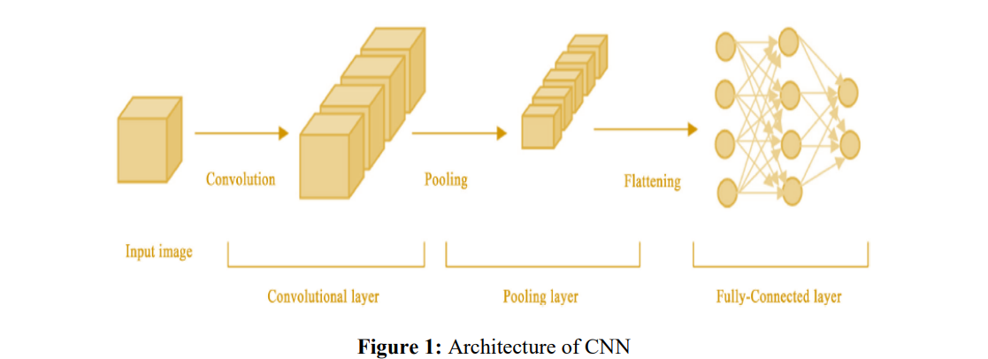

Slide 9
Training a deep CNN
Back-propagation algorithms are used to train the Deep CNN using CT images of size 256x256x3. It consists of two phase, training phase and testing phase. In the first phase DCNNs are trained using CT images where 900 images are being used to train the network for the classification of lung as either cancerous or non-cancerous. In the testing phase an image unknown to the network is applied as input to classify as cancerous or noncancerous.
For minimum loss of features images are trained and tested in the DICOM format itself by modifying the network parameters such that it can take DICOM images. The proposed designed network accuracy can be achieved by suitable evaluation.

Slide 10
Conclusion
The application of pattern recognition techniques has proven to be very useful in many situations in the real world. Several papers propose using machine learning methods to identify pneumonia and lung cancer in CXR images with encouraging results. However, very few proposed to use lung segmentation to avoid any data leak or overfitting, and only focused on the classification performance.
Considering a real-world application, segmentation is an important step since it removes background information, reduces the chance of data leak, and forces the model to focus only on important image areas. Segmentation might not improve the classification performance, but as it forces the model to use only the lung area information, it increases the model’s reliability and quality.

Slide 11
References
S.No | Links
1. | https://medium.com/analytics-vidhya/image-processing-using-opencv-cnn-and-keras-backed-by-tensor-flow-c9adf22bb271
2. | https://vitalflux.com/cnn-basic-architecture-for-classification-segmentation/
3. | https://www.sciencedirect.com/science/article/pii/S1877050918301157#:~:text=Lung%20CT%20image%20segmentation%20is,such%20as%20lung%20cancer%20detection.

Slide 12
Referred Articles
S.No | Project Name | Publishing Year | Journal Name | Author Name
1. | Pneumonia Detection on Chest X-Ray Using Machine Learning Paradigm[1] | 2019 | Springer | Tej Bahadur Chandra, Kesari Verma
2. | ResNet-50 vs VGG19 vs training from scratch: A comparative analysis of the segmentation and classification of Pneumonia from chest X-ray images[2] | 2021 | KeAi | A.Victor Ikechukwu,S.Murali, R.Deepu, R.C.Shivamurthy
3. | An effective approach for CT lung segmentation using mask region-based convolutional neural networks[3] | 2020 | ELSEVIER | Qinhua Hu, Luís Fabrício de F. Souza, Gabriel Bandeira Holanda, Shara S.A.Alves, Francisco Hércules dos S. Silva, Tao Han, Pedro P. Rebouças Filhob

Slide 13
S.No | Project Name | Publishing Year | Journal Name | Author Name
4. | A Deep Learning Method for Lung Segmentation on Large Size Chest X-Ray Image[4] | 2019 | IEEE | Hieu Trung Huynh, Vo Nguyen Nhat Anh
5. | Enhanced lung image segmentation using deep learning[5] | 2022 | Springer | Shilpa Gite, Abhinav Mishra & Ketan Kotecha
6. | Survey on image segmentation techniques[6] | 2017 | Procedia Computer Science | Zaitoun, N. M., and M. J. Aqel.

Slide 14
Thank You

