Slide 1
Team Members
Supriya Shiwakoti
Shatakshi Shiwakoti
Bishal Thapa
Bipin Basnet

Slide 2
Introduction
Tic-Tac-Toe game
Built by focusing children of 3-7 years
Simple design made by using HTML, CSS and JAVASCRIPT

Slide 3

Front Page (Game)

Slide 4
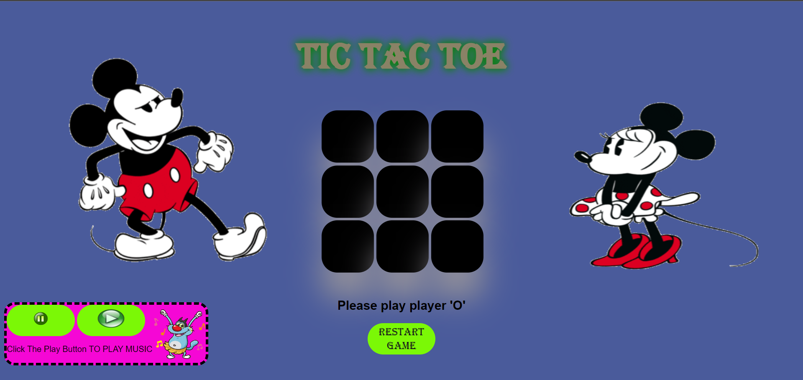
Game Page

Slide 5
Conclusion
Designs are made by understanding children choices
Cartoon character's are used to prevent player from being bore.

Slide 6
Thankyou!!

