Slide 1

TOPIC FAKE NEWS DETECTION USING NATURAL LANGUAGE PROCESSING
MINOR PROJECT EVALUATION
SUBMITTED BY :
SHIWALI SINGH (9917102145)
PRASENJIT KATHURIA (9917102259)
UNDER THE GUIDENCE OF:
MRS. JYOTI VYAS

Slide 2
TABLE OF CONTENTS
What is Fake news?
Literature Survey
Motivation
Tasks to Perform
Dataset
Natural language processing
Data cleaning
Exploratory data analysis
Algorithms Used
Model Combination
Results
Model Evaluation
Conclusion
References

Slide 3
WHAT IS FAKE NEWS?
The term fake news has become a buzz word these days.
However, an agreed definition of the term “fake news” is a type of yellow journalism or propaganda that consists of deliberate misinformation or hoaxes spread via traditional print and broadcast news media or online social media.
These are published usually with the intent to mislead in order to damage a community or person, create chaos, and gain financially or politically.

Slide 4
LITERATURE SURVEY
https://www.datacamp.com/community/tutorials/web-scraping-python-nlp:
Learned to scrape novels from the web and plot word frequency distributions; gained experience with Python packages requests. In this, we used some basic Natural Language Processing to plot the most frequently occurring words. In doing so, we also see the efficacy of thinking in terms of the following Data Science pipeline with a constant regard for process.
https://arxiv.org/pdf/1911.03854v2.pdf
According to a Pew Research Centre report, 50% of Americans view fake news as a critical problem, placing it above violent crime. In addition, the report found that 68% of Americans view fake news as having a significant impact on their confidence of the government and 54% viewed it as having a large impact in their trust in one another. As such, research in the area of fake news detection is of high importance for society. We overcome these limitations posed by conventional datasets through the dataset we made ourselves. Our dataset will expand fake news research into the multimodal space and allow researchers to develop stronger, more generalized, fine-grained fake news detection systems.

Slide 5

MOTIVATION
Recent progress in Natural Language Processing generation has raised dual-use concerns.
Since people are often unable to spend enough time to cross-check reference and be sure of the credibility of news, automated detection of fake news is indispensable.
We were curious about how WhatsApp created their fake news filter, so we used open source data from Reddit to make one ourselves

Slide 6
TASKS TO PERFORM
While building this model, we optimized for accuracy. That is, we wanted to have the highest possible outcomes of True Negatives and True Positives, and least number of False Positives and False Negatives. Our tasks include:
Web scraping ~30000 News articles from the Website Reddit and building a dataset that can be used for our challenge and that will help others in the future as well.
Cleaning the data manually while looking for articles that might be duplicate or might be having redundant information.
Using natural Language Processing Techniques to prepare the text for modelling and also analyse trends that might give useful insights.
After analysing the trends , implementing the Machine learning Algorithms that are best suited for our data.

Slide 7
DATASET
We have extracted ~30000 news articles using pushshiftAPI from 2 Reddit pages: TheOnion and nottheonion.
The Onion is a website that publishes made-up stories that are by their topics ridiculous, but reasonable enough that they seem plausible.
nottheonion on the other hand is a subreddit that concentrates on real news that seem so out of this world that one would easily mistake them for parody news.
We will try distinguish articles from these 2 sources through text classification techniques Based on Natural Language Processing.

Slide 8
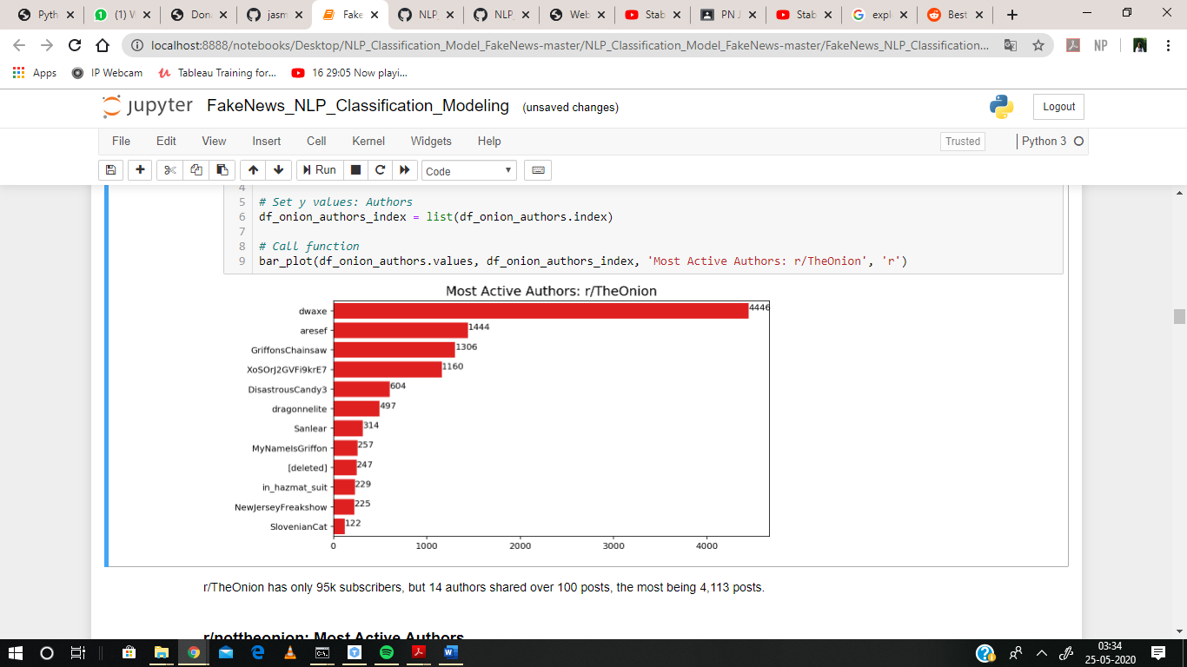
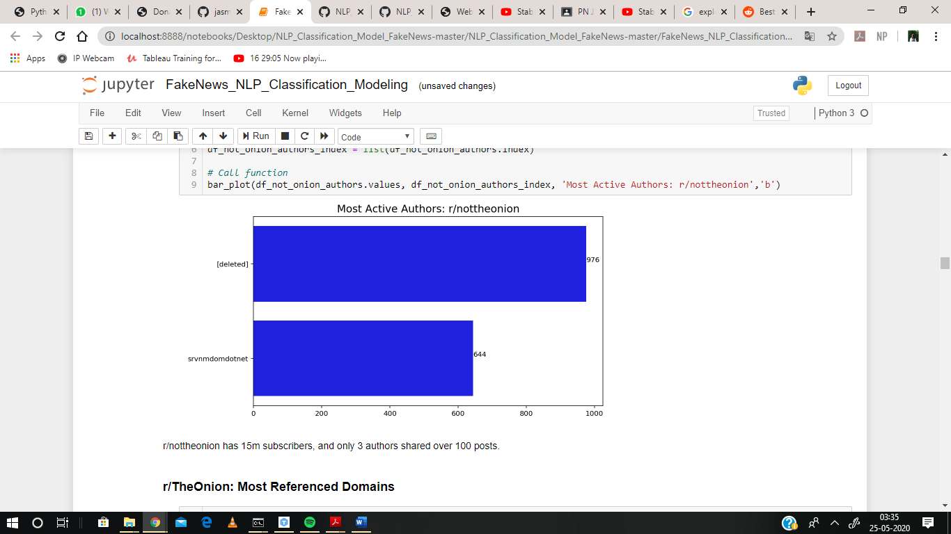
EXPLORATROY DATA ANALYSIS
EDA is an approach to analysing data sets to summarize their main characteristics, often with visual methods.
We have plotted box plot to analyse the most active author of both the subreddits

Slide 9
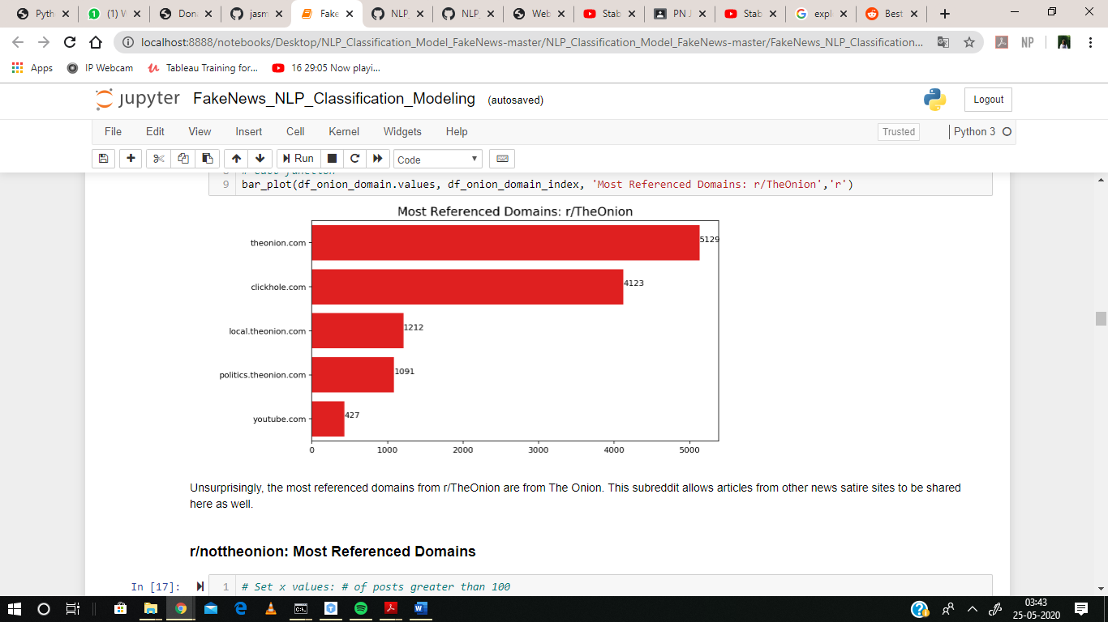
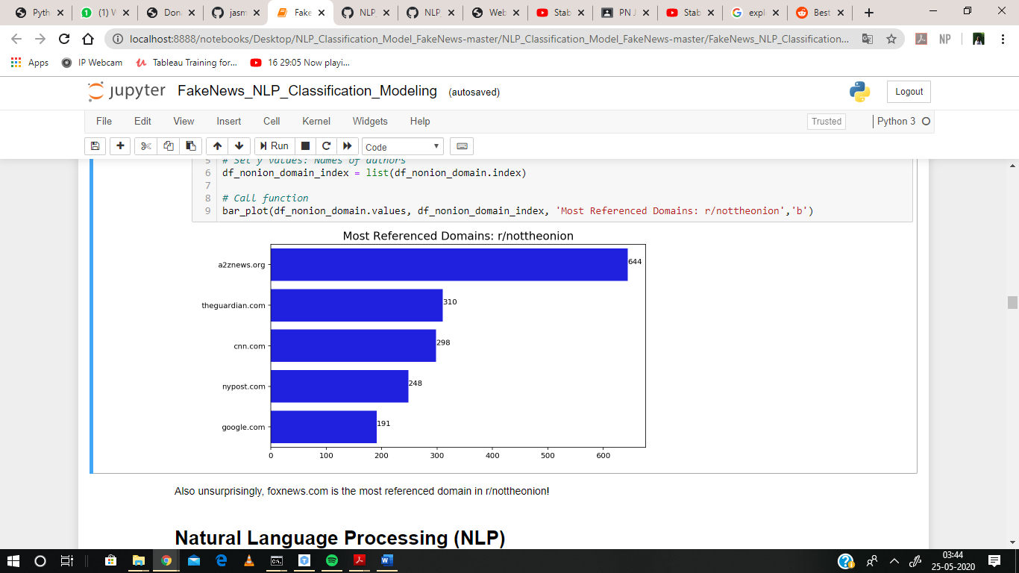
EXPLORATROY DATA ANALYSIS
After that we have plotted the most used website from which these subreddits post news content.

Slide 10
NATURAL LANGUAGE PROCESSING
Natural language processing involves the reading and understanding of spoken or written language through the medium of a computer.
NLP on subreddit data
a) Count Vectorizer
It s used in DataFrame where subreddit is `0` and subreddit is `1` with ngram_range = (1,1). The top 5 most used words are then plotted.

Slide 11
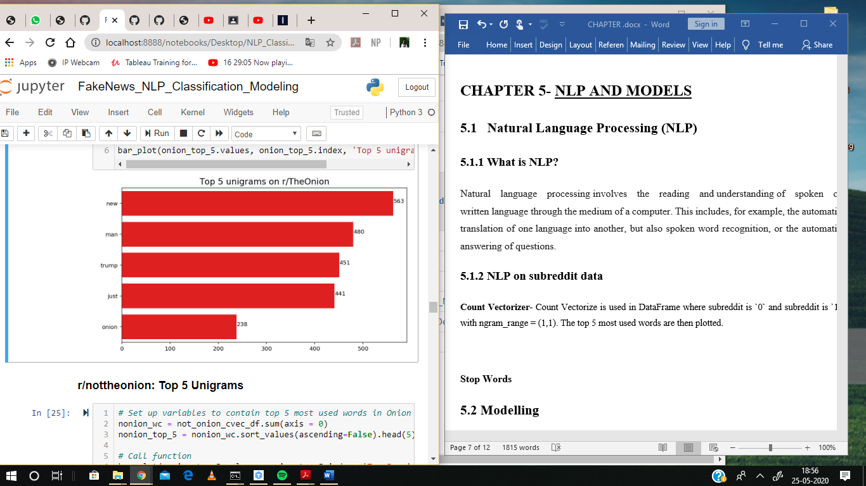
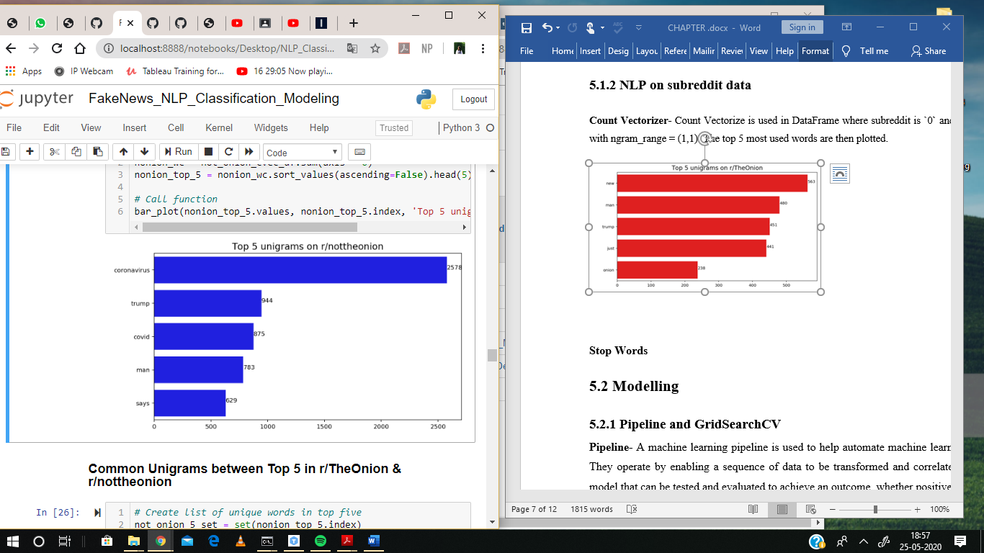
NATURAL LANGUAGE PROCESSING
Unigram on TheOnion
Unigram on notheonion

Slide 12
NATURAL LANGUAGE PROCESSING
b) Tf-idf vectorizer
Tf-idf is a very common technique for determining roughly what each document in a set of documents is “about”.
It cleverly accomplishes this by looking at two simple metrics: tf (term frequency) and idf (inverse document frequency).
Term frequency is the proportion of occurrences of a specific term to total number of terms in a document. Inverse document frequency is the inverse of the proportion of documents that contain that word/phrase.

Slide 13
DATA CLEANING
We took stop words out that is the most appeared words from the dataset when modelling, since these words occur frequently in both subreddits. E.g. New, man, trump, etc.
After collecting our data, we look for Null values, outliers and duplicates that could hamper our accuracy of the model and we drop all these rows.
We also remove numbers and convert all the data into lowercase. After this, our data is ready.

Slide 14
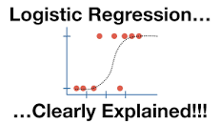
ALGORITHMS USED
We have conducted model-prep and use Pipeline and GridSearchCV to determine the most optimal model to run data on. We decided that the best algorithms that can be used on our data are:
1) Logistic regression
It’s a classification algorithm, that is used where the response variable is categorical. The idea of Logistic Regression is to find a relationship between features and probability of particular outcome. E.g. When we have to predict if a news article is fake or real.
This type of a problem is referred to as Binomial Logistic Regression, where the response variable has two values 0 and 1 or pass and fail or true and false.

Slide 15
ALGORITHMS USED
2) MultinomialNB
The multinomial Naive Bayes classifier is suitable for classification with discrete features (e.g., word counts for text classification). The multinomial distribution normally requires integer feature counts. However, in practice, fractional counts such as tf-idf may also work.
Parameters
alpha: float, optional (default=1.0) Additive smoothing parameter (0 for no smoothing).
fit prior: Boolean. Whether to learn class prior probabilities or not. If false, a uniform prior will be used.
class prior: array-like, size Prior probabilities of the classes. If specified the priors are not adjusted according to the data.

Slide 16
MODEL COMBINATION
We have combined all the models into 4 different models to get the best results. The combined models are: -
Model 1: CountVectorizer & Logistic Regression
Model 2: TfidfVectorize & Logistic Regression
Model 3: CountVectorizer & MultinomialNB
Model 4: TfidfVectorizer & MultinomialNB

Slide 17
RESULTS AND CONCLUSION
Model 1 | Best Coefficient Interpretability: Count Vectorizer & Logistic Regression
Train score 0.96
Test score 0.87
Model 2: TfidfVectorizer & Logistic Regression
Train score 0.90
Test score 0.86
Model 3 | Best Accuracy Score: Count Vectorizer & MultinomialNB
Train score 0.995
Test score 0.89
Model 4: TfidfVectorizer & MultinomialNB
Train score 0.92
Test score 0.86

Slide 18
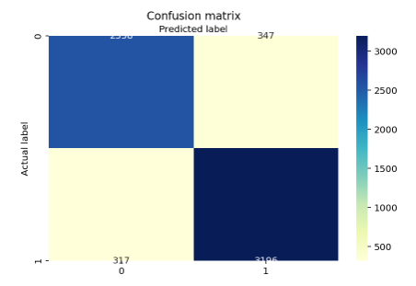
MODEL EVALUATION
This is a visualization of my confusion matrix for model 3
Then we calculated the following parameter to analyse the output of confusion matrix
Accuracy: 89.65 %
Precision: 90.21 %
Recall: 90.98 %
Specificity: 88.06 %
Misclassification Rate: 11.49 %

Slide 19
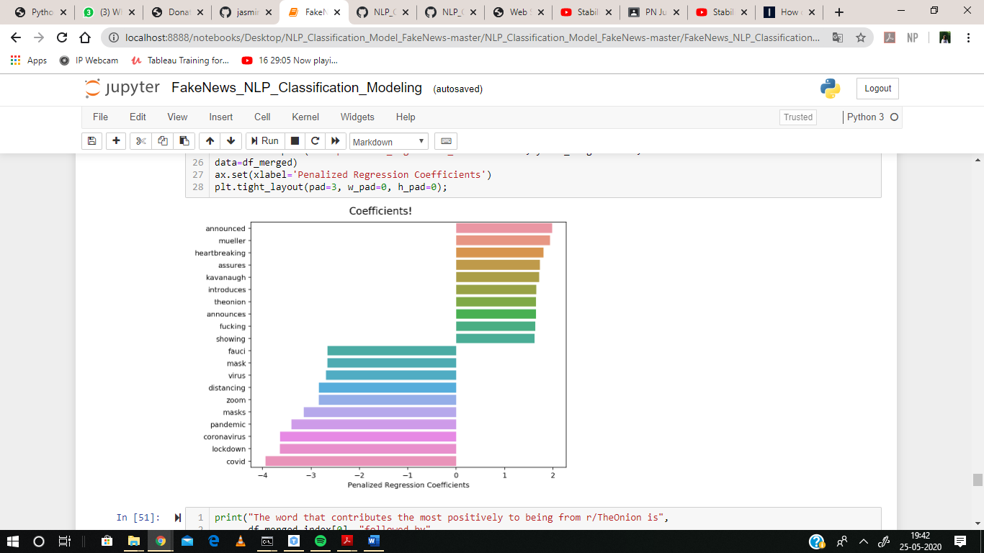
MODEL EVALUATION
Penalized regression coefficients
Output of regression coefficients:
The onion
Mueller and heart-breaking.
Nottheonion
covid , lockdown and coronavirus.

Slide 20
CONCLUSION
The goal of this project has been to comprehensively and extensively review, summarize and evaluate the current research on fake news.
This includes the qualitative and quantitative analysis of fake news, as well as detection and intervention strategies for fake news from four perspectives:
The false knowledge fake news communicates
Its writing style
Its propagation patterns
Its credibility

Slide 21
REFERENCES
Nakamura, Kai & Levy, Sharon & Wang, William. (2019). r/Fakeddit: A New Multimodal Benchmark Dataset for Fine-grained Fake News Detection.
https://www.reddit.com/r/TheOnion/
https://www.reddit.com/r/nottheonion/
(2020). Survey on Web scraping technology. WAFFEN-UND KOSTUMKUNDE JOURNAL. 16. 10.37896/whjj16.06/001.
https://pushshift.io/
Yang, Kai-Chou & Niven, Timothy & Kao, Hung-Yu. (2019). Fake News Detection as Natural Language Inference.
Yang, Feng-Jen. (2018). An Implementation of Naive Bayes Classifier. 301-306. 10.1109/CSCI46756.2018.00065.

