Slide 1

Marketing Management Project Presentation
on
Presented by:
Group 7
Group 7
Parag Agrawal | B2021029
Nishant Keswani | B2021028
Shiwang Agarwal | B2021041
Sarthak Kumar Bal | B2021039
Harshita Khandelwal | B2021020
Dhairya Manish Chawda | B2021017

Slide 2
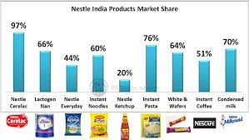
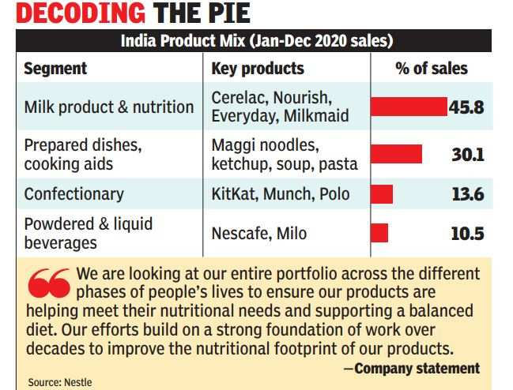
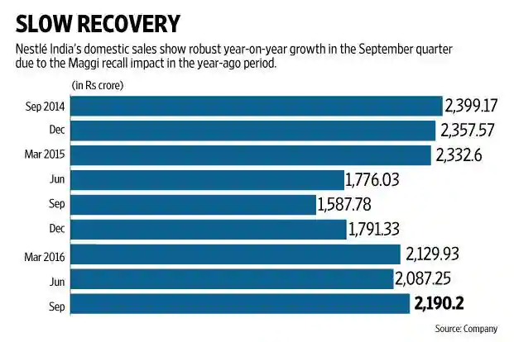
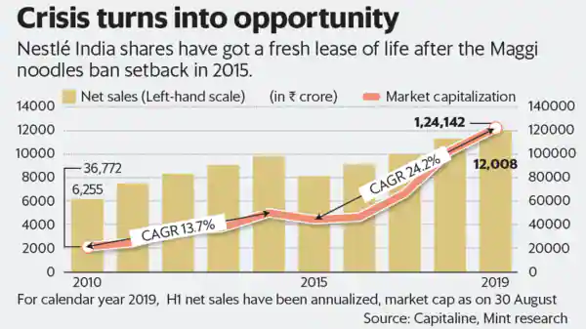
Nestle’s Brand Movement (Major Phases)
Market Capture
Product Sales
Slow Recovery
Bounce-Back

Slide 3
Marketing Objectives
Product
Product Penetration complements the Wide range of Categories.
(Top: Nestea, KitKat, Maggi)
Company
Heavy expenditure on R&D in multiple segments
Increased Scoping in distribution & promotion strategies
Product
Promotion
People
Price
Process
Physical Evidence
Place
Company
Competitor
Collaborator
Customer
Climate
Price
Low Cost-High Trust establishes Customer Loyalty
Customer
Based on Age, Gender, Income, Education, Purchase Pattern, Growth Indicators
Place
Supermarkets & Consolidated Local Stores with All Products under One roof

Slide 4
Consumer Segmentation
Geographical
Consumption Pattern changes based on seasons and regions
Ex: Nescafe Singapore weather based beverage
Psychographic
Segmentation based on Life-Style & Personality
KitKat: those who want to enjoy chocolate
Nescafe 3in1: For Busy Consumers (inclusive product)
Behavioural
Based on Buying Pattern of different customers
Convince consumers based on product content
Ex: Cerelac & Milk Products
Demographics
Nestle’s initial target based on its Nutritional Components
Children
Senior Citizens
Ex: Cerelac, Lectogen, Koko Krunch, Nido

Slide 5
Competitor analysis
Buyer’s Bargaining Power
High substitute availability
A wide number of alternatives
Low economic and psychological switching costs
Supplier’s Bargaining Power
A large number of suppliers
High overall supply
Suppliers’ weak control over their distribution network
Competitive Rivalry
Rivalry among segments makes it difficult for market growth.
Low Product Differentiation
Threats of Substitutes
High performance/cost ratio of substitute products
High availability of substitute products
Low switching cost
Threats of New Entrants
High brand development cost weakens the threat
Low switching cost increases the threat
High capital cost weakens the threat

Slide 6
Swot analysis
STRENGTHS
WEAKENESSES
Reputed brand value
Global Recognition
Increased Company Diversity
Extensive product portfolio
Corporate Ventures & Large distribution system
Efficient R&D Structure
Price fluctuations
Span of control & organizational structure
Water controversy
Social criticism
Maggi Noodles controversy
Racial Insensitivity
OPPORTUNITIES
THREATS
Venturing small food start-ups
Online shopping (E-Commerce)
Market penetration (breakfast cereals )
Expanding ready-to-drink tea and coffee market
Partnerships / Joint Ventures
Expansion through Acquisitions (medical)
Refocus on Profitable Ventures
Illegal rainforest destruction controversy
Water scarcity
Rising competition
Government regulations and prices
Economic Uncertainty

Slide 7

PESTEL analysis
POLITICAL
ECONOMICAL
SOCIAL
TECHNOLOGICAL
ENVIRONMENTAL
LEGAL
Nestle’s Presence in 190 countries makes its logistics expensive and challenging
Impact of Policies on:
Import
Taxation
Environment
Labour Laws
Maintaining Brand Value
Countering a Nationalist Sentiment
Affordability of Product & Brand as a whole
Raw Material Availability
US China Trade War
Decline in Conventional Base Pricing due to deflation
Subsidy for Local Competitors
Change in Consumer Trend
Product Quality & Growth Potential
CSR Functions
Carbon Negative Logistic Approach
Sustainability for various segments
Digital Segment Expansion
E-Commerce push is necessary as it can increase Revenue Inflow significantly after Logistics Costing challenge is resolved
Real-Time Water Consumption Monitoring
SmartLabel Initiative
Zero Impact Pro-Environment Initiative
Targeted 100% Recyclable Plastic Usage
Palm Oil Sustainability Setback by RSPO
2.6% Reduction
in Greenhouse
Sustainability for various segments
Company Policies and Compliance
Employee Health and Safety
Product Quality and Hygiene
Labour and Ecological Laws
Trademark/Patent for Documentation
Ex: Nestle’s Chocolate Trademark

Slide 8
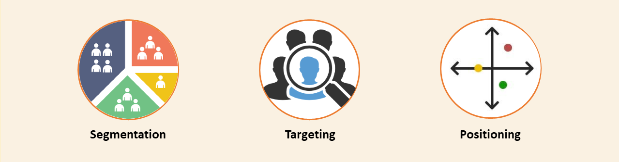
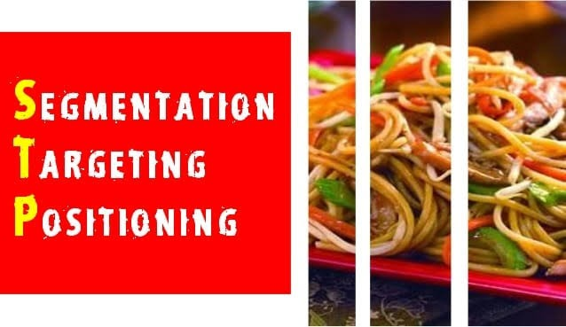
STP for a specific Product (Maggi)
Lifestyle & Eating Habits
2. Age groups
3. Geographic Regions
Kids
Youth
Working Women
Product Differentiation
Positioning statement
The most famous slogans like "2 Mins Noodles", "Taste bhi Health bhi", "Mummy bhookh lagi hai"

Slide 9
Hybrid Solutions for Market Expansion
Influencer Marketing
Provide a detailed view of the Product Quality through Social Media Influencers endorsing a product in an organic manner.
Incentivize Genuine Reviews
Identify genuine reviews based on SEO Algorithms and increase the accuracy by approximately 11% and link it to product purchase through QR Authentication.
Provision of Nestle Ecosystem
The target is to provide entire product range to Low-Budget Vendors across various geographical locations.

Slide 10
Thank You

