Slide 1
Stop Trying to Delight Your Customers (To really win their loyalty, forget the bells and whistles and just solve their problems)
Team Profile: Sarthak Kumar Bal, Parag Agarwal, Shiwang Agarwal, Nishant Keswani, Harshita Khandelwal, Dhairya Manish Chawda
Which Customer Service Increases Loyalty and which doesn’t?
Can a company increase the loyalty without increasing their service operating cost
How Important is Customer Service to Loyalty?
Existing Tactics employed by Companies
Discount
Refund
Premium Segmentation
Free Service
CSAT - Customer Satisfaction Score
CES - Customer Effort Score
FCR – First Contact Resolution
Key Metrics used to Judge Customer Loyalty
5 point Scale to measure Customer Satisfaction
How much effort does a customer needs to resolve an issue
Success Percentage of First Call Resolution for any product

Slide 2
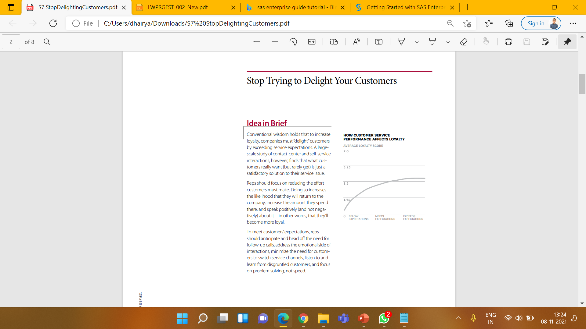
Alternative Strategies with Higher success potential
Team Profile: Sarthak Kumar Bal, Parag Agarwal, Shiwang Agarwal, Nishant Keswani, Harshita Khandelwal, Dhairya Manish Chawda
Service Failures not only drives existing customers to defect, they can also repel prospective ones.
Bad-Service Ripple Effect
Solving issues to be arrived in near future asap, get customers personalized services and mails along with coupons and vouchers, focus on customer effort score to measure their loyalty level, make effective medium to get different segments customers solve their issues.
Strategy to Impact Loyalty of Customers

