Slide 1
Project of CS7321
Towards Privacy Protection of On-screen Information
Jingnan Wang, Wanghua Shi

Slide 2

Potential risks of OSI leakage

Slide 3
Protect OSI privacy without additional equipment

Slide 4
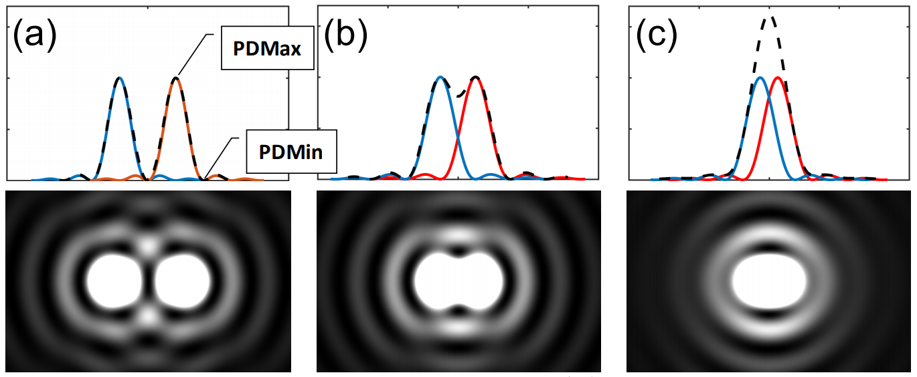
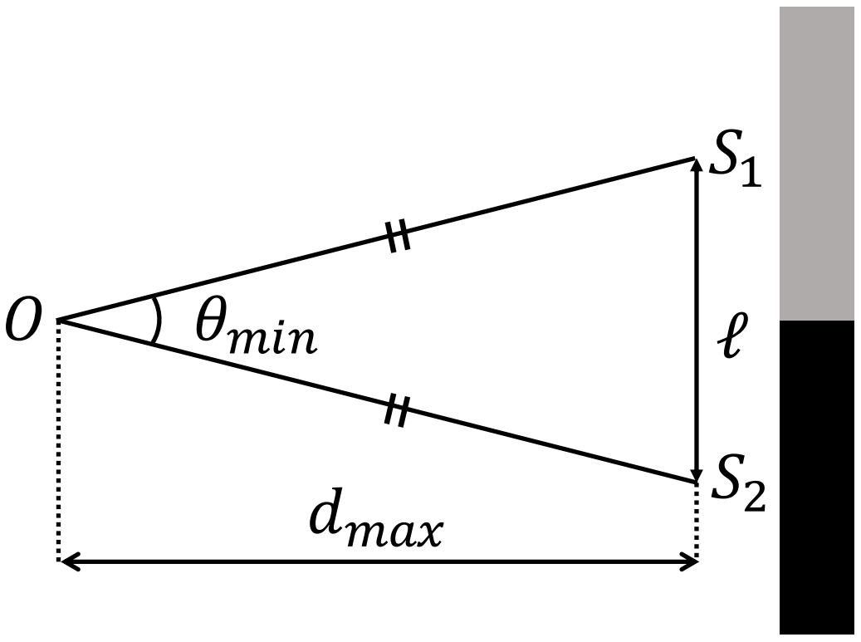
Resolving power of human vision
Human vision:

Slide 5
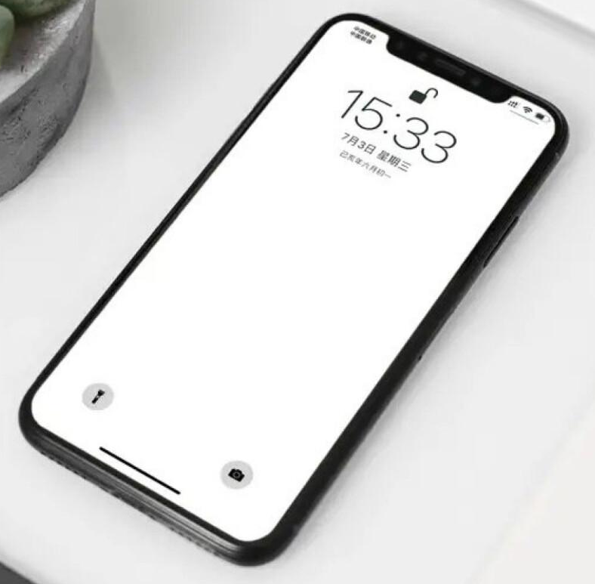

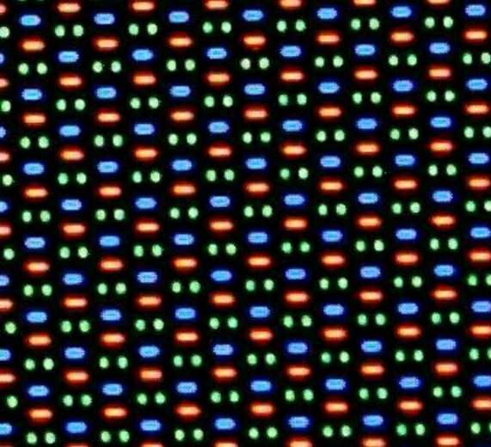
An example of resolving power
Notes:
子像素排列

Slide 6


Existing solution
MobiCom 2019

Slide 7
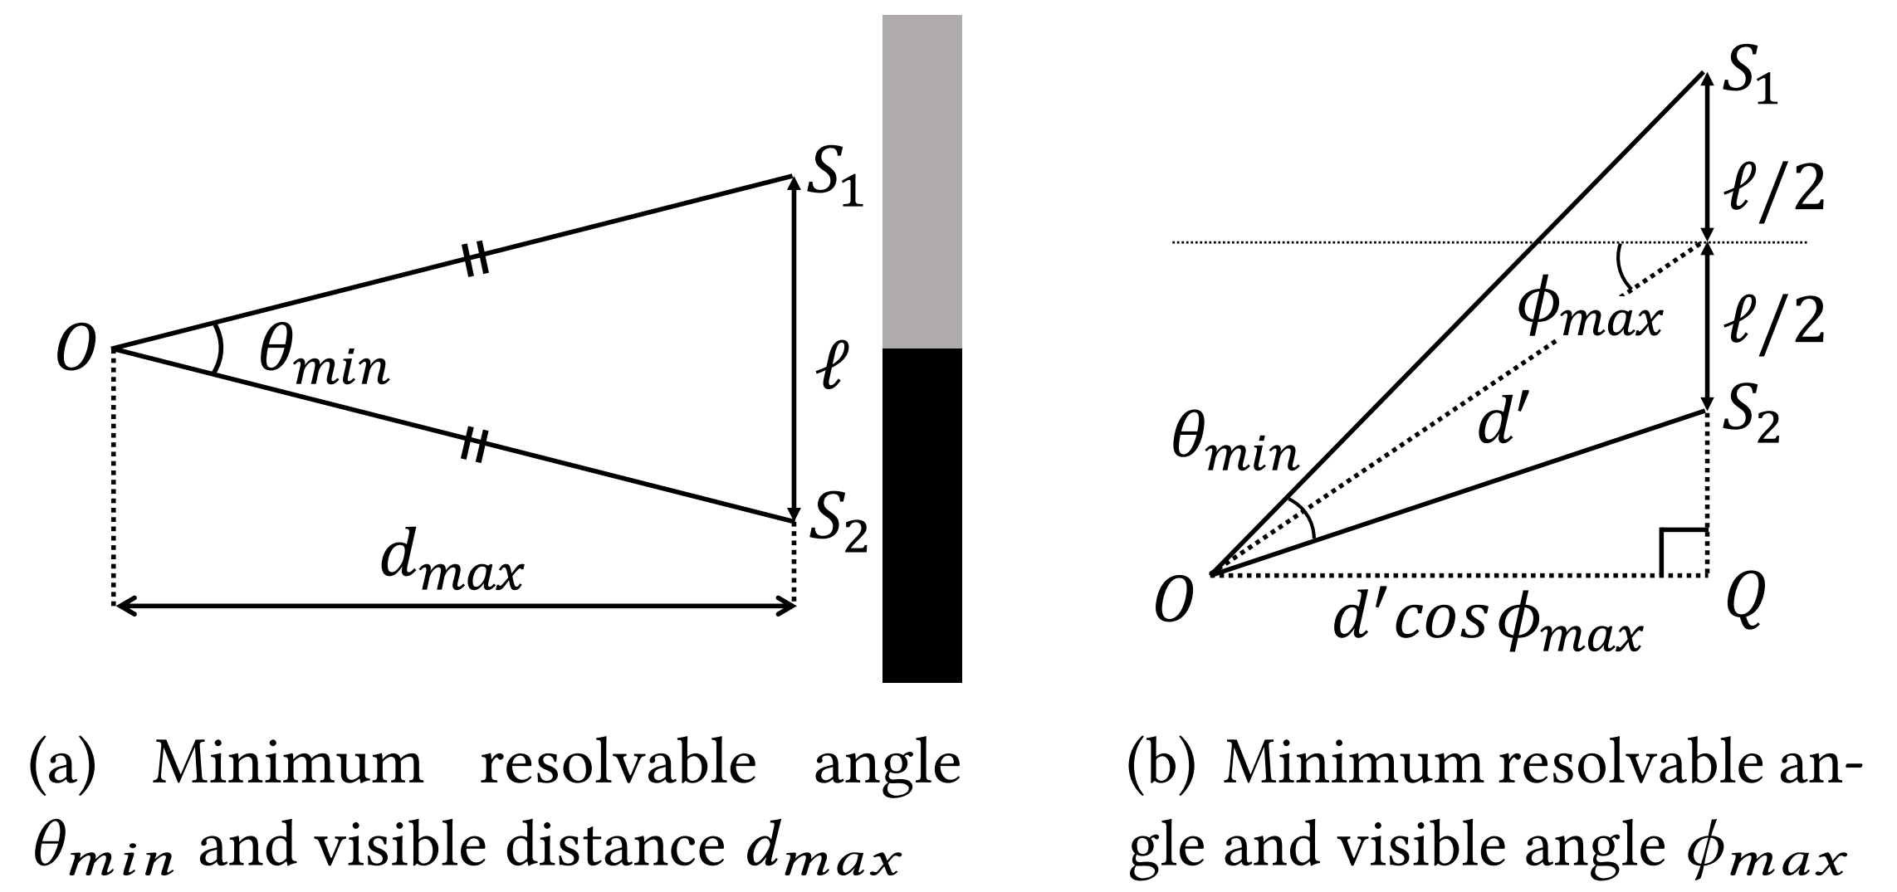
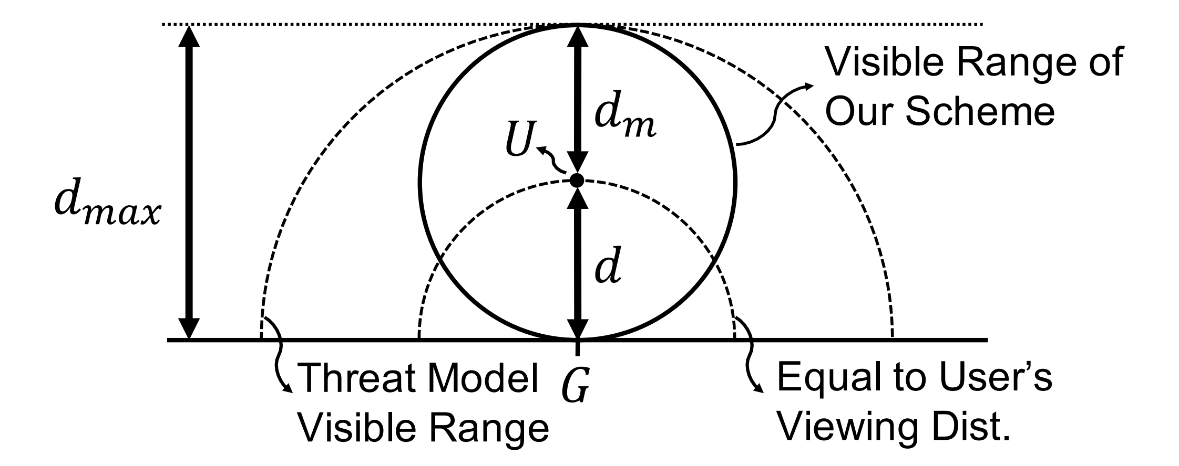
Existing solution

Slide 8
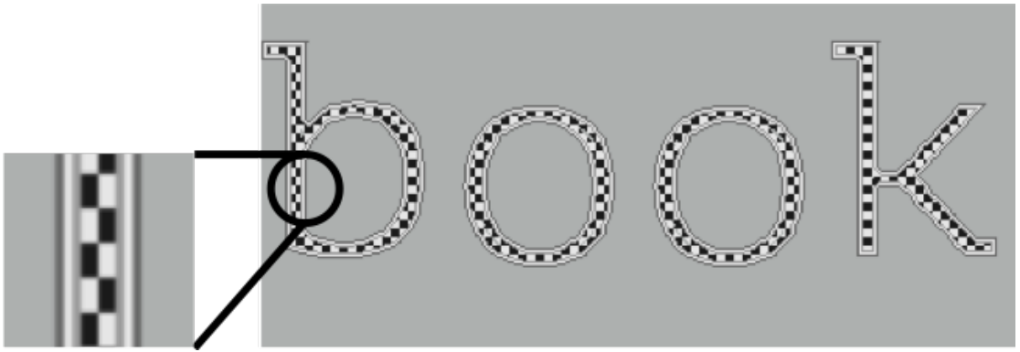
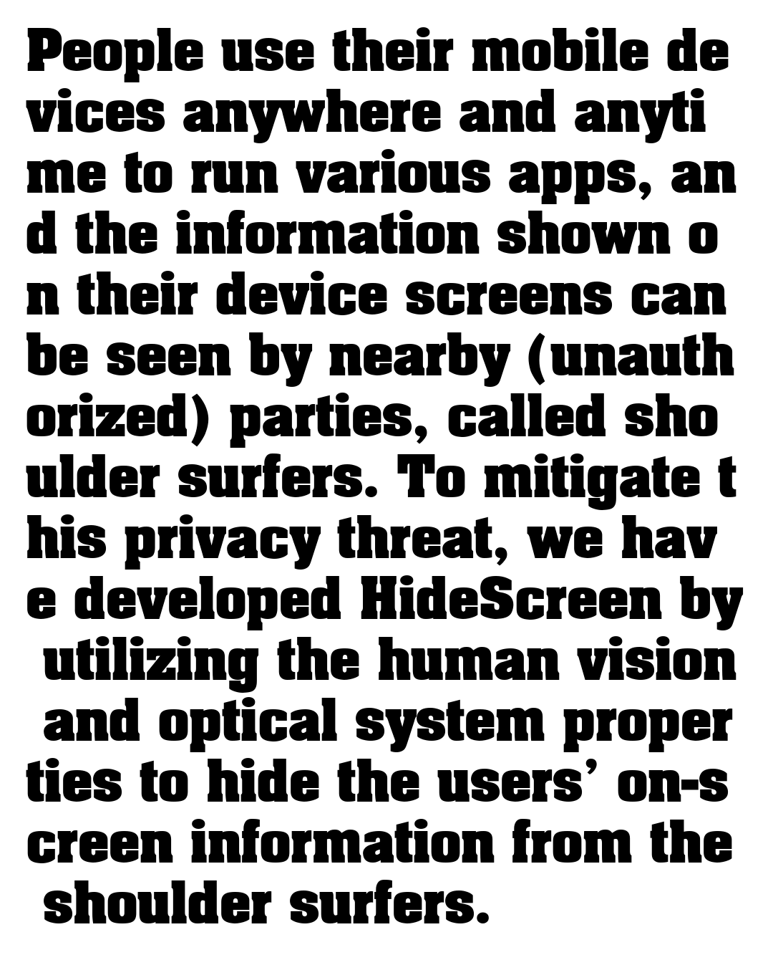
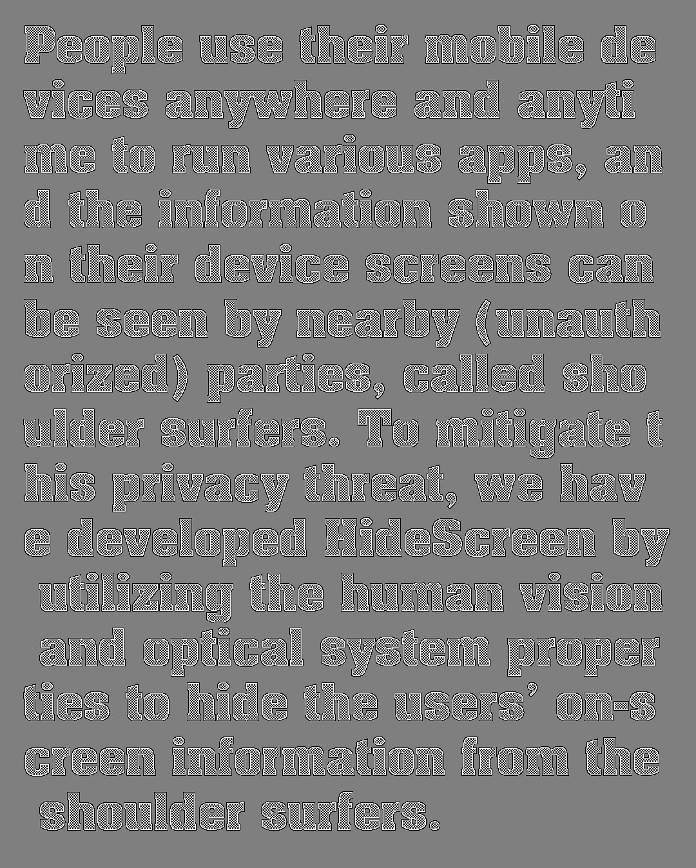
An example of text protection

Slide 9

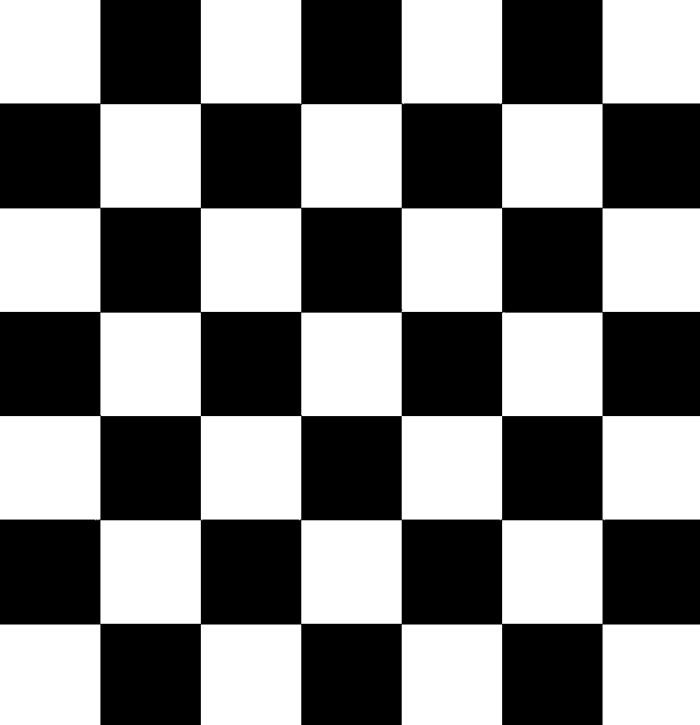
Too bright

Slide 10
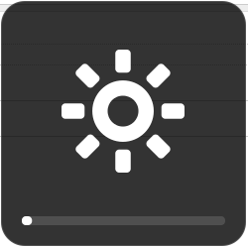
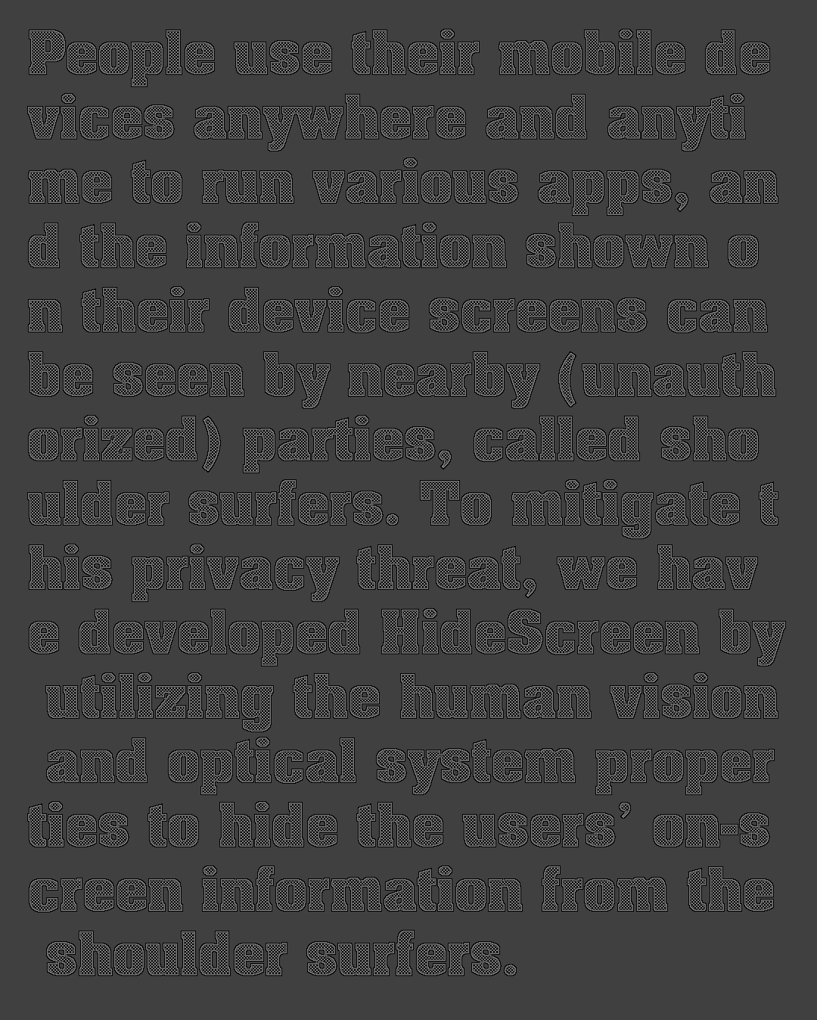
Still can been seen…

Slide 11

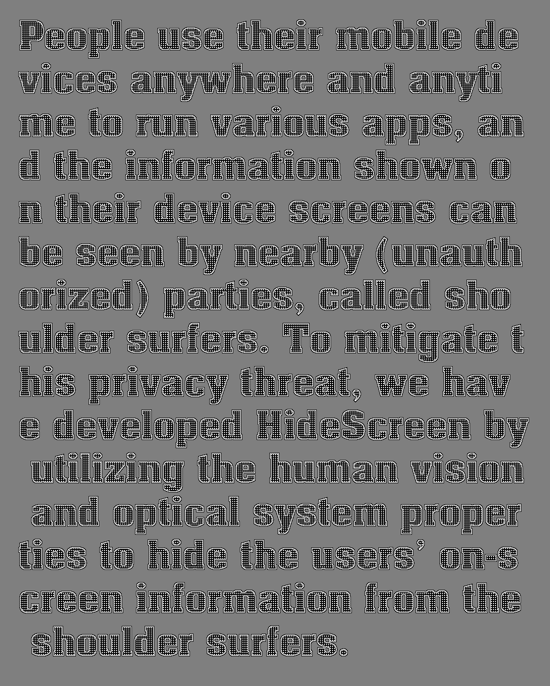
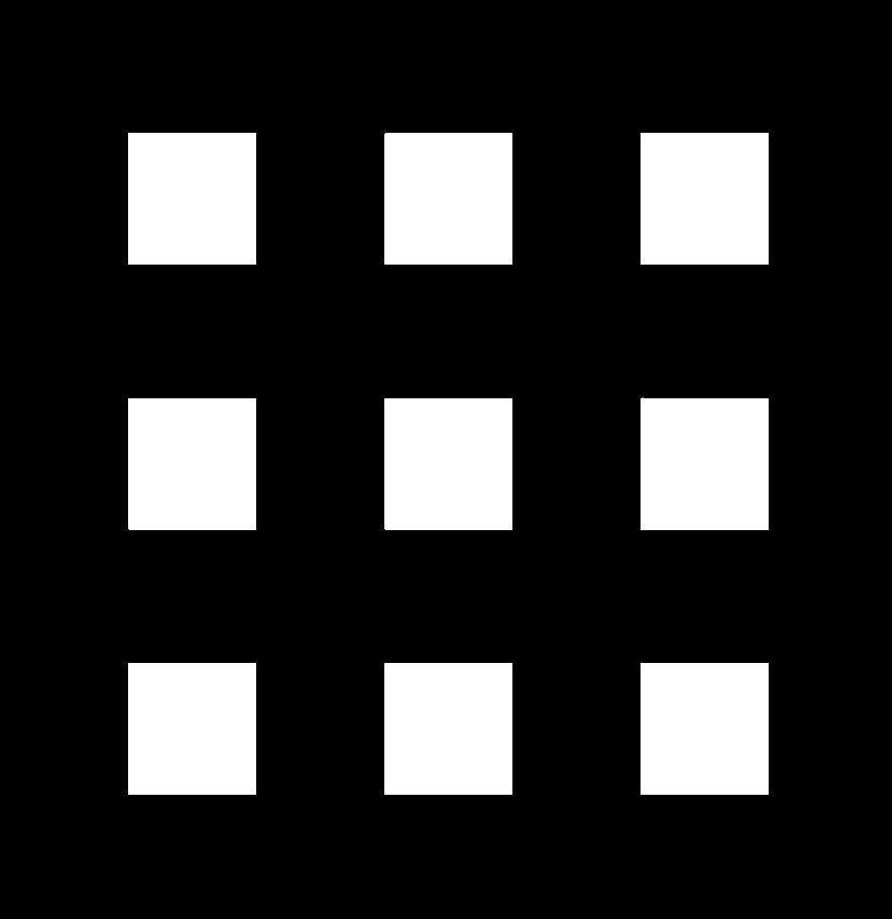
Better protection

Slide 12
Too bright border

Slide 13

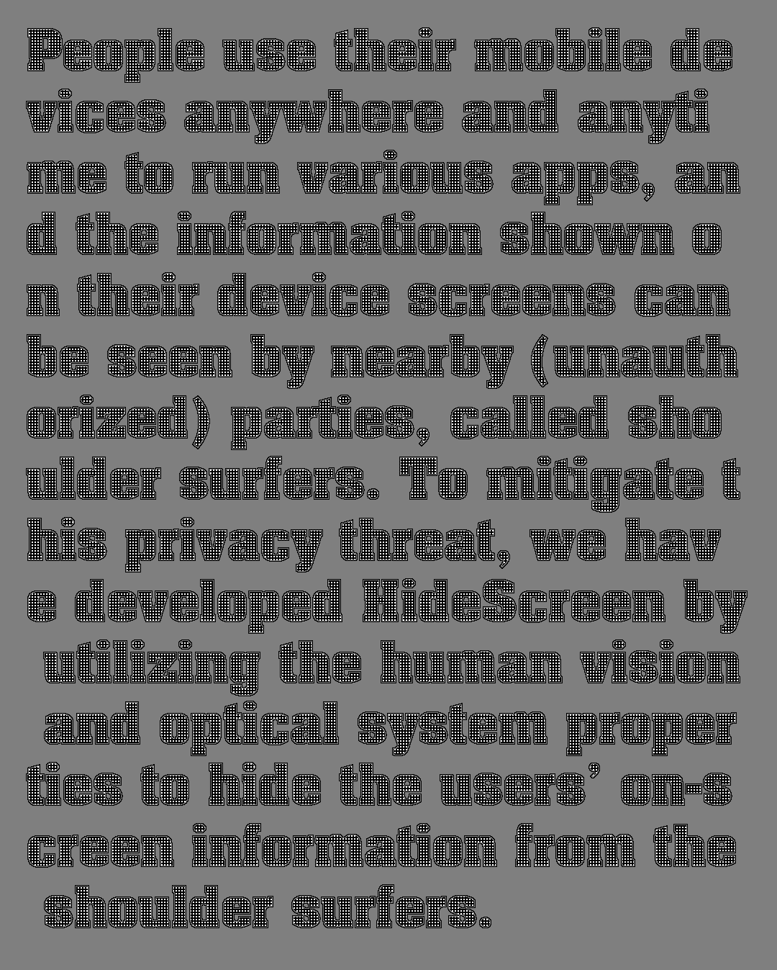
Further improvement

Slide 14


Image Protection
Original Partition grids in each level:
Reproductive Partition grids in each level:

Slide 15
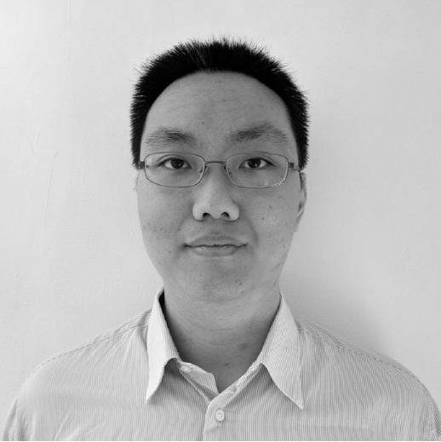


An example of image protection
Original photo
Original area in each level (white):
Reproductive area in each level (white):

Slide 16
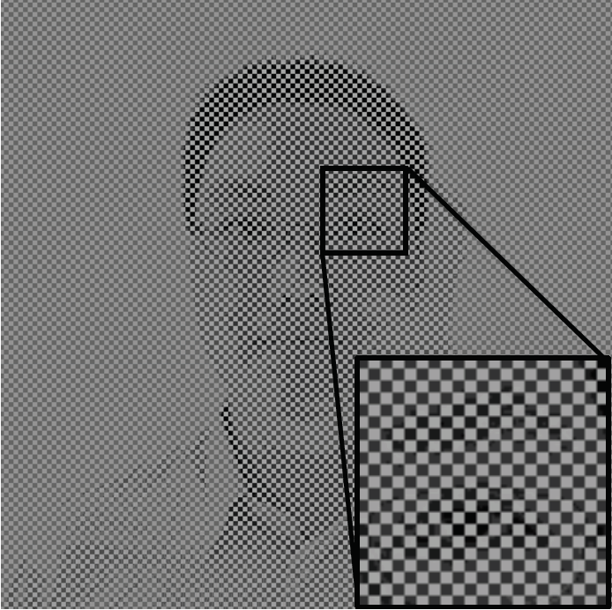
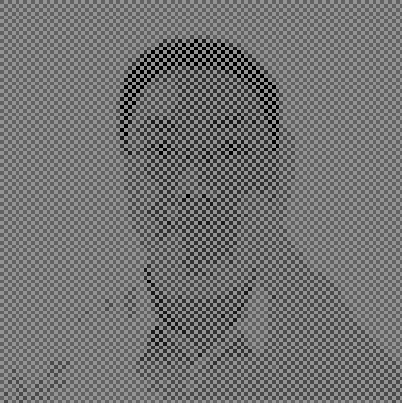
An example of image protection
Original protected image
Reproductive protected image

Slide 17
Thank you!

