Slide 1
HEM: A Hardware-aware Event Matching Algorithm for Content-based Pub/Sub Systems
Wanghua Shi, Shiyou Qian*
Notes:
Hi everyone. I’m shiwanghua from Shanghai Jiao Tong University. It’s my honor to share my paper HEM. It is a Hardware-aware Event Matching Algorithm for Content-based Pub/Sub Systems”.

Slide 2
Outline
1
Background
2
Problem
3
Motivation
4
Design
5
Evaluation
6
Future Work
Notes:
Next, I will introduce this paper from six parts.

Slide 3
1 Background
Content-based publish/subscribe system
composed of publishers, subscribers, and brokers.
on-demand data distribution.
realizes the decoupling of time, space and synchronization of communication parties.
Event Matching Algorithm
find all matching subscriptions for each event as soon as possible.
Notes:
The first part is background.
What's content-based publish/subscribe system?
For simplicity, It is composed of three parts:
publishers generate events, subscribers propose subscriptions,
and brokers are responsible for event matching and distributing.
The goal of Event Matching Algorithm is to find all matching subscriptions for each coming event as soon as possible.

Slide 4

2 Problem--Matching Semantics
Event: attribute-value pairs.
Subscription: predicates/constraints.
Predicate/Constraint: closed interval defined on an attribute.
E₁={(a₁, 3), (a₃, 7)}
S₁={(a₁, [1,5]), (a₂, [5,8])}
S₂={(a₁, [3,3]), (a₃, [1,10])}
E₁ matches S₂
$$\text{S}\text{ize} of a subscription≤\text{Size} \text{of} \text{an} \text{event}≤Dimension$$
Notes:
In this paper, we only consider the interval matching semantics in the form of logical conjunction.
An event contains a list of attribute-value pairs.
A subscription includes several predicates or constraints.
Each predicate is an closed interval defined in an attribute.
The right box gives an example.
The value in attribute one of the event E1 is three, three falls into the interval defined in attribute one of Subscription2,
and the seven falls into the interval one to ten. Thus, E1matches Subscription2.
E1 is null in attribute 2, subscription 1 has an interval in attribute 2, so subscription 2 is not a match.
In general, the size of a subscription is smaller or equal to the size of an event,
and the size of an event is smaller or equal to the dimension of the value domain.

Slide 5
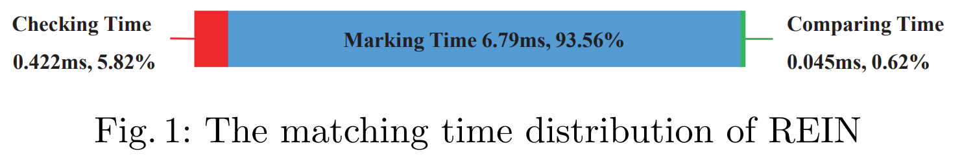
3 Motivation
The essence of backward marking based event matching algorithm
searches and marks all the unmatching subscriptions on each attribute
unmarked subscriptions are the matches of the event
The inherent defects of backward marking
tends to mark the same unmatching subscription for multiple times → redundant operations
heavily dependent on dimension
Notes:
In essence, the backward marking based event matching algorithm
searches and marks all the unmatching subscriptions in each attribute,
finally, the subscriptions never unmarked are the matches of the event.
This type of matching algorithm has two inherent defects:
first, it tends to mark the same unmatching subscription for multiple times,
this marking operations are redundant and repetitive,
for example, figure one displays the matching time distribution of REIN algorithm,
the marking time accounts for 93.56%, thus the performance bottleneck is marking or assignment statements.
Besides, backward marking is heavily dependent on dimension because it has to search every dimension.

Slide 6



3 Motivation
Discovery
efficient OR operation on bitset with millions of bits
large memory capacity → trade space for time
Breakthrough
inserting: pre-mark subscriptions in bitsets according to their predicates’ value distribution
matching: select bitsets to execute several OR operations instead of millions of assignment operations
SubID: 1 2 3 4 5
$$(00110)$$
OR op
$$(10011)$$
$$(10111)$$
S₂ is the unique match.
Notes:
From a hardware-aware perspective, bit OR operations on bitset with millions of bits are
more efficient than the operations performed repeatedly by most existing matching algorithms.
Moreover, nowadays the memory capacity is larger and price is cheaper.
Therefore, we design a cache mechansim to trade space for time.
When inserting, we pre-mark subscriptions in bitsets according to their predicates' value distribution
When matching, we select bitsets to execute several OR operations instead of millions of assignment operations
The example on the right shows a bitwise OR operation process.
Only the subscription 2 is never marked, so it is the unique matches.

Slide 7
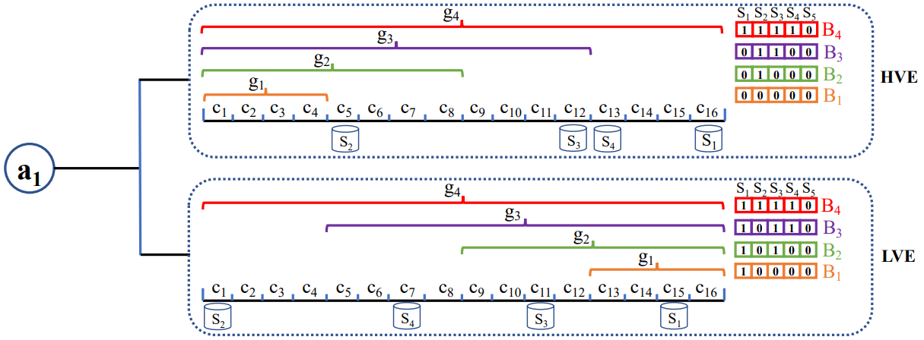
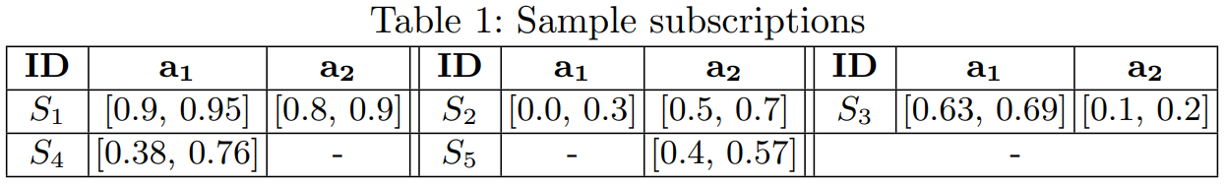
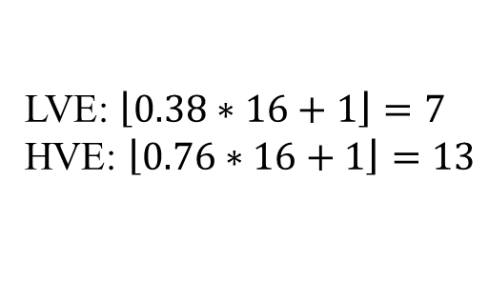
4 Design--Insertion
High Value End
Low Value End
Value Range: [0,1)
16 subspaces/cells
S₄ : (a₁,[0.38,0.76])
LVE: $\left\lfloor \left.0.38\right.\right.∗\left.16+1\right\rfloor =7$
HVE: $\left\lfloor \left.0.76\right.\right.∗\left.16+1\right\rfloor =13$
Notes:
This page explains how to insert subscriptions by an example.
The value range is divided into sixteen subspaces. Each subspace is bound to a cell.
The predicates' low values and high values are stored in two cell lists separately.
Let's take the first predicate of subscription 4 as an inserting example.
The low value 0.38 falls into cell number 7.
So we insert a pair <subId four, and the low value 0.38> into cell seven at the low value end of attribute one.
Similarly, we insert a pair <four, 0.76> into cell thirteen at HVE.
Because the cell seven belongs to group 3 and group 4,
the fourth bit is set to 1 in Bitset 3 and Bitset 4 at LVE of attribute one.
For the same reason, the fourth bit is set to 1 in B4 at HVE.
Since the Bitsets 4 at LVE and HVE are the same, only one bitset four is enough.

Slide 8

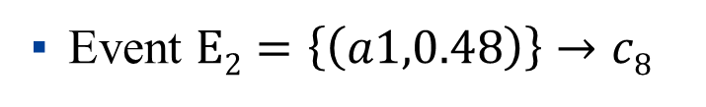
4 Design—Matching without bitsets
Event $E2=\left\{\left(a1,0.48\right)\right\}→c8$
High Value End
$$E2$$
Unmatching HVE cell list
Low Value End
Unmatching LVE cell list
Notes:
If we don't use bitsets to execute event matching, suppose there is an event falls into cell number 8,
the unmatching cell list at HVE is from c1 to c7,
because the high values of the predicates in these cells are smaller than the event value 0.48.
the unmatching cell list at LVE is from c9 to c16,
because the low values of the predicates in these cells are larger than 0.48.
In total, at least fifteen cells should be traversed in every attribute.

Slide 9





4 Design—Matching with bitsets
Event $E2=\left\{\left(a1,0.48\right)\right\}→c8$
SubID: 1 2 3 4 5
$$E2$$
$$HVE B1(00000)$$
OR op
$$LVE B2(10100)$$
$$(10100)$$
Mark op
$$(11100)$$
The number of marking cells is 3. (Cell Number/Group Number -1)
S₄ and S₅ are the matches.
Notes:
However, we can use bitsets to reduce the number of traversing cells.
For example, select B1 at HVE and B2 at LVE to execute bitwise OR operation,
then we only have to iterate cell number 5, 6, 7.
So subscription 2 will be marked.
Finally, Subscription 4 and 5 are two matches.
In this way, the number of marking cells is 3.
This is calculated by dividing the number of groups by the number of cells and minus one.
In addition, if the event is null on one attribute,
we can use one OR operation on bitset four instead of traversing sixteen cells.

Slide 10
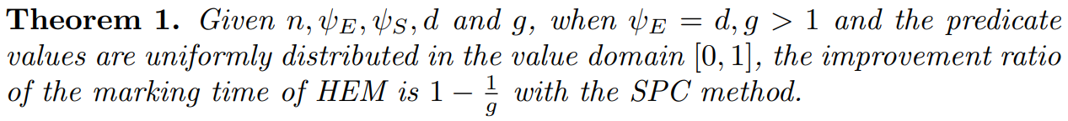
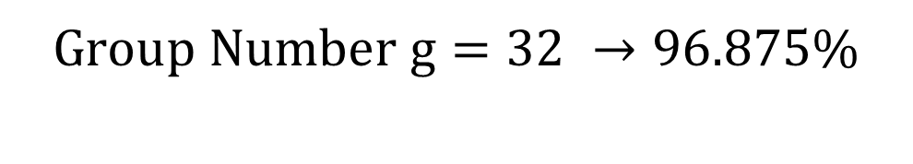
4 Design—Analysis
$$Group Number g=32 →96.875\%$$
Notes:
Theoretically, we find that if the group number is doubled, the marking time will be halved.
When g equals to 32, the improvement ratio is 96.875%, which will be proved in verification experiment.

Slide 11
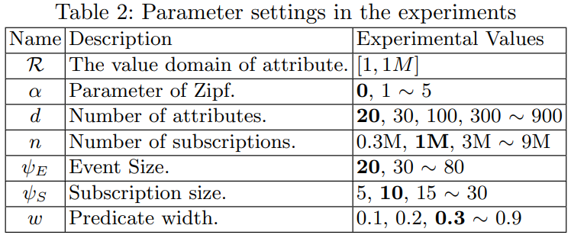
5 Evaluation--Setting
Language: C++ / g++9.3.0 -O3
Baseline: REIN, TAMA, Ada-REIN, OpIndex
Testbed:
Ubuntu 20.04
AMD 3.7 GHz
64GB RAM
Codes: https://github.com/shiwanghua/HEM
Notes:
This page gives the experiment settings.
All code is available on website https://github.com/shiwanghua/HEM.

Slide 12
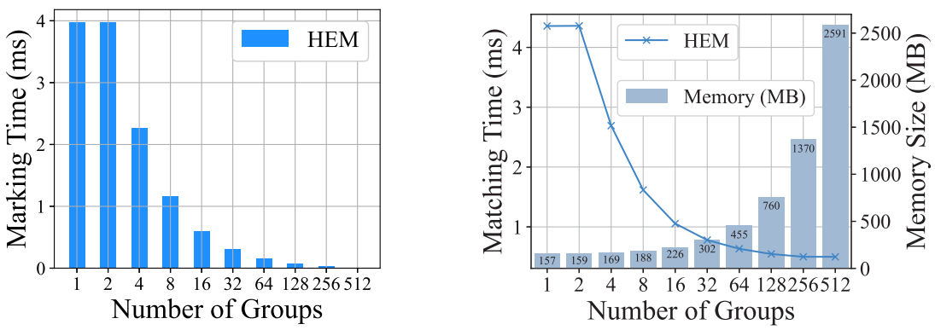
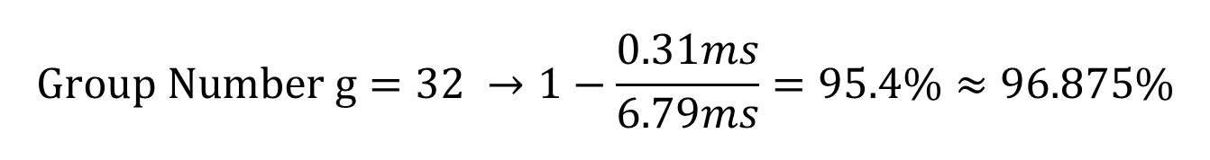
5 Evaluation-- Verification
$$Group Number g=32 →1−\frac{0.31ms}{6.79ms}=95.4\%≈96.875\%$$
Notes:
The verification experiment validates that the marking time is inversely proportional to the number of groups.
When g equals to 32, the improvement ratio is 95.4%, approximately equals to 96.875%, and the memory usage is low.

Slide 13
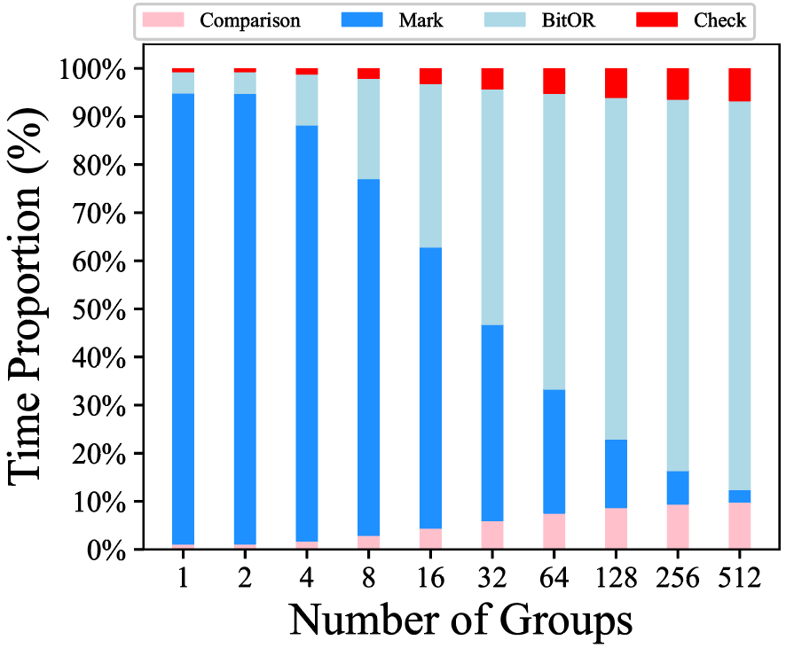
5 Evaluation-- Verification
Bottleneck is alleviated.
Choose g = 32.
Notes:
From this picture we can see the bottleneck -- marking time -- is alleviated.
We set group number to 32 to do the metric experments
since the marking time is firstly smaller than bitwise OR operation.

Slide 14
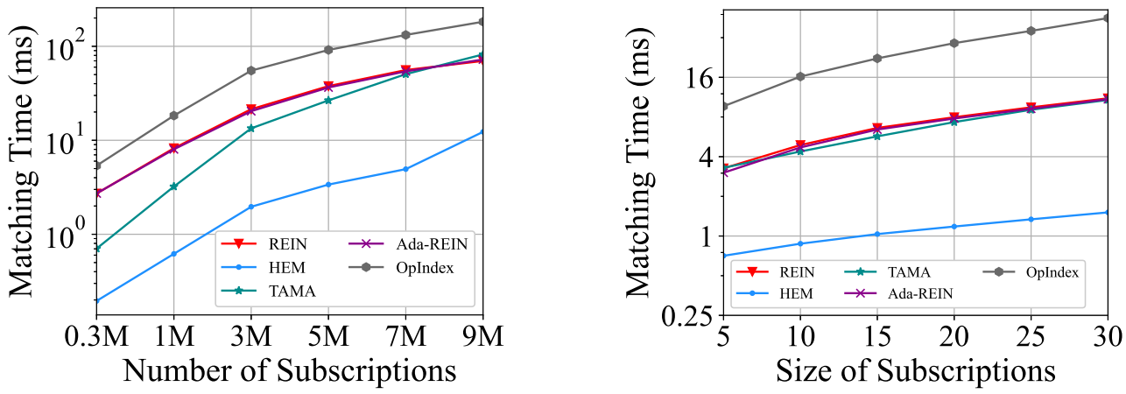
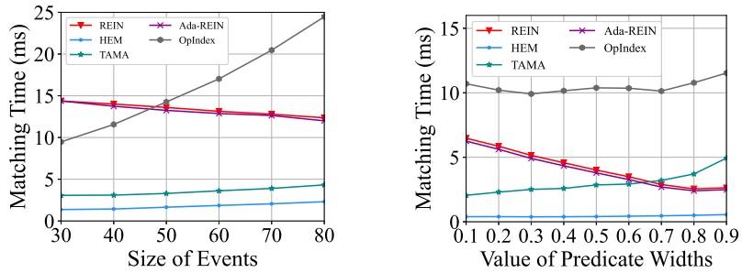
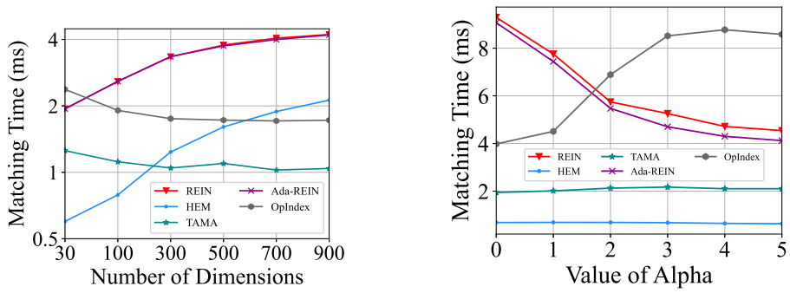
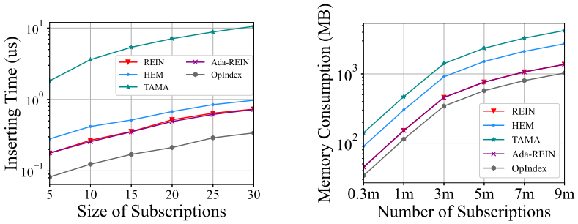
5 Evaluation--Metric
Notes:
We measure the matching time to test the performance affected by six parameters.
Basically, HEM shows excellent and stable performance under various conditions.
In terms of maintainability, the average insertion time of HEM increases by about 42.6%
compared to REIN because HEM needs to pre-mark a new subscription in one or more
bitsets for each attribute on which the predicate is defined.
The memory usage of HEM is about twice of REIN's and 64.3% of TAMA' s.

Slide 15
6 Future Work—series of optimizations
Double Reverse Optimization (Virtual Memory): how to select bitsets ?
Dynamic Group Optimization (Load Balancing): how to construct groups ?
Virtual Attribute Group Optimization
Real Attribute Group Optimization
OR Operation Optimization (avx2, avx512): 512-bits OR op
Other directions:
approximate matching / response time / thread pool parallelization
high dimensional space
Notes:
In future work, we can further improve HEM.
The DRO is an virtual memory technology, it relates to how to select bitsets.
The DGO is a load balancing technology, it deals with how to construct groups.
The Virtual/Real AGO copes with high dimensional space.
The O3 use SIMD to speed up OR operation of bitsets.
There are also some other directions: approximate matching / response time / thread pool parallelization.

Slide 16
Thanks for listening！
qshiyou@sjtu.edu.cn
Notes:
That's all. Thanks for listening.

