Slide 1
Customer Shopping Behavior Analysis
Data Analytics Project - Python | SQL | PostgreSQL | Power BI

Slide 2
1. Business Problem
The Problem
Retail businesses collect large amounts of customer transaction data but need to convert it into actionable insights.
Key Questions
Who are the major customer segments?
What products generate the most sales?
How do discounts affect purchasing?
Do subscribers behave differently?
Which products receive better ratings?
How can customer retention be improved?
Core Question:
How can customer shopping data be used to improve customer engagement and marketing strategy?

Slide 3
2. Project objectives
Objectives
Clean and prepare customer data
Understand purchasing behavior
Analyze customer segments
Study product performance
Analyze discounts
Compare subscribers and non-subscribers
Identify purchasing patterns
Build an interactive Power BI dashboard
Generate business recommendations

Slide 4
3. Dataset
Dataset Overview
Metric | Value
Records | 3,900
Attributes | 18
Products | 25
Categories | 4
Locations | 50
Missing Ratings | 37
Major Data Areas
Customer → Product → Transaction → Behavior

Slide 5
4. Technology Stack
1. Python
Data cleaning and exploratory analysis
2. Pandas
Data manipulation
3. PostgreSQL
Database storage
4. SQL
Business analysis
5. Power BI
Dashboard and visualization
6. Jupyter Notebook
Interactive analysis

Slide 6
5. Data Cleaning
Data Preparation Process
Raw CSV
↓
Data Inspection
↓
Missing Value Analysis
↓
Data Cleaning
↓
Column Standardization
↓
Feature Engineering
↓
Clean Dataset
Key Cleaning Activities
Checked data types
Checked missing values
Imputed missing review ratings
Standardized column names
Created age groups
Created purchase-frequency features
Removed redundant analytical fields

Slide 7
7. Exploratory Data Analysis
What Did We Analyze?
1. Customers
Age, gender, location
2. Products
Category, product, size, color
3. Transactions
Purchase amount, shipping, discounts
4. Behavior
Previous purchases, subscription, frequency
5. Feedback
Review ratings

Slide 8
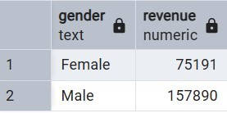
8. SQL Analysis
Business Questions Answered
1. Revenue by gender

Slide 9
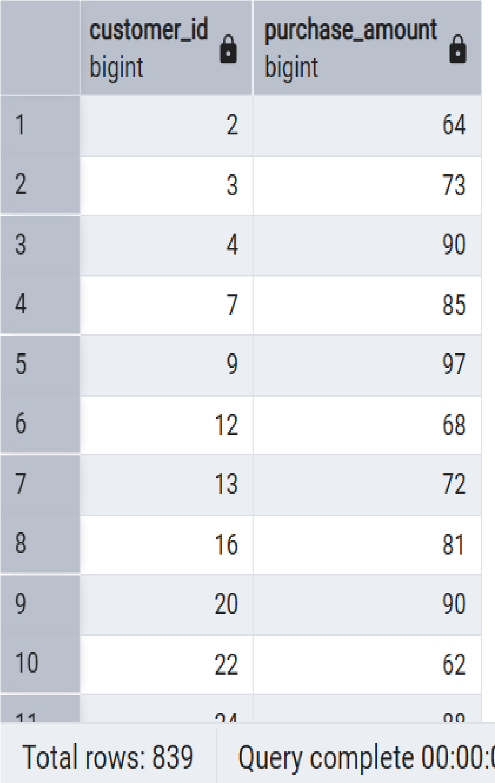
8. SQL Analysis
2. High-spending discount users

Slide 10
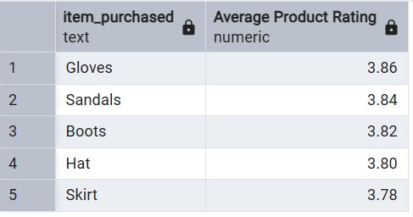
8. SQL Analysis
3. Top-rated products

Slide 11
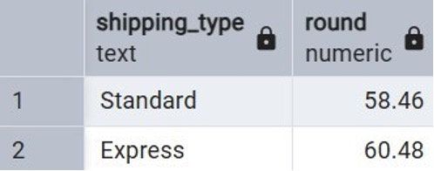
8. SQL Analysis
4. Shipping comparison

Slide 12
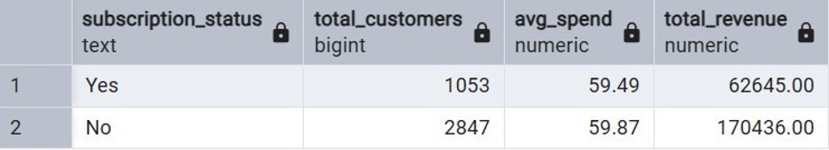
8. SQL Analysis
5. Subscriber vs non-subscriber behavior

Slide 13
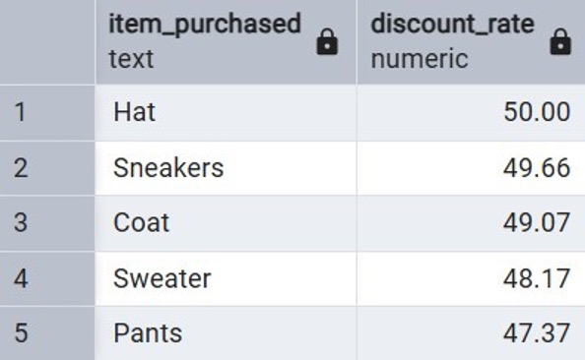
8. SQL Analysis
6. Discount-dependent products

Slide 14
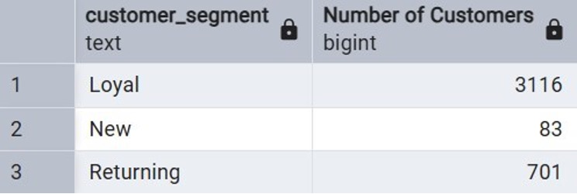
8. SQL Analysis
7. Customer segmentation

Slide 15
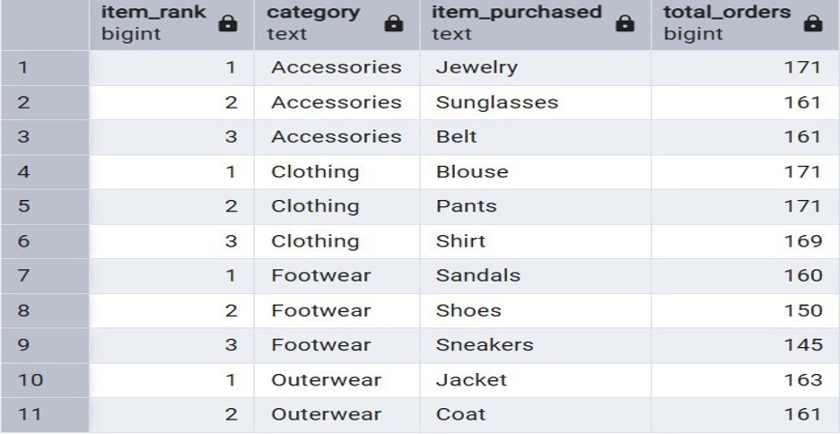
8. SQL Analysis
8. Top products by category

Slide 16
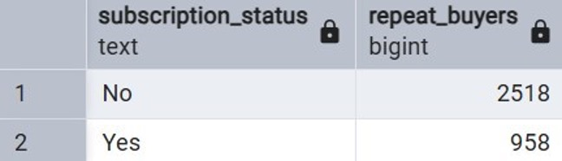
8. SQL Analysis
9. Repeat buyers and subscriptions

Slide 17
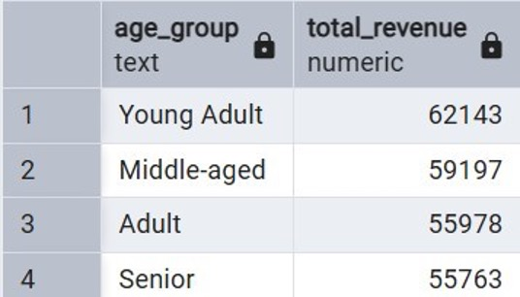
8. SQL Analysis
10. Revenue by age group

Slide 18
9. Customer Segmentation
Customer Segments
Segment | Customers
Loyal | 3,116
Returning | 701
New | 83
Insight
The dataset is dominated by customers with previous purchasing activity.
Business Opportunity
Focus on:
New → Returning → Loyal
as a customer-retention journey.

Slide 19
10. Product & Discount Insights
Highest-Rated Products
Gloves — 3.86
Sandals — 3.84
Boots — 3.82
Hat — 3.80
Skirt — 3.78
Highest Discount Rates
Hat — 50.00%
Sneakers — 49.66%
Coat — 49.07%
Sweater — 48.17%
Pants — 47.37%

Slide 20
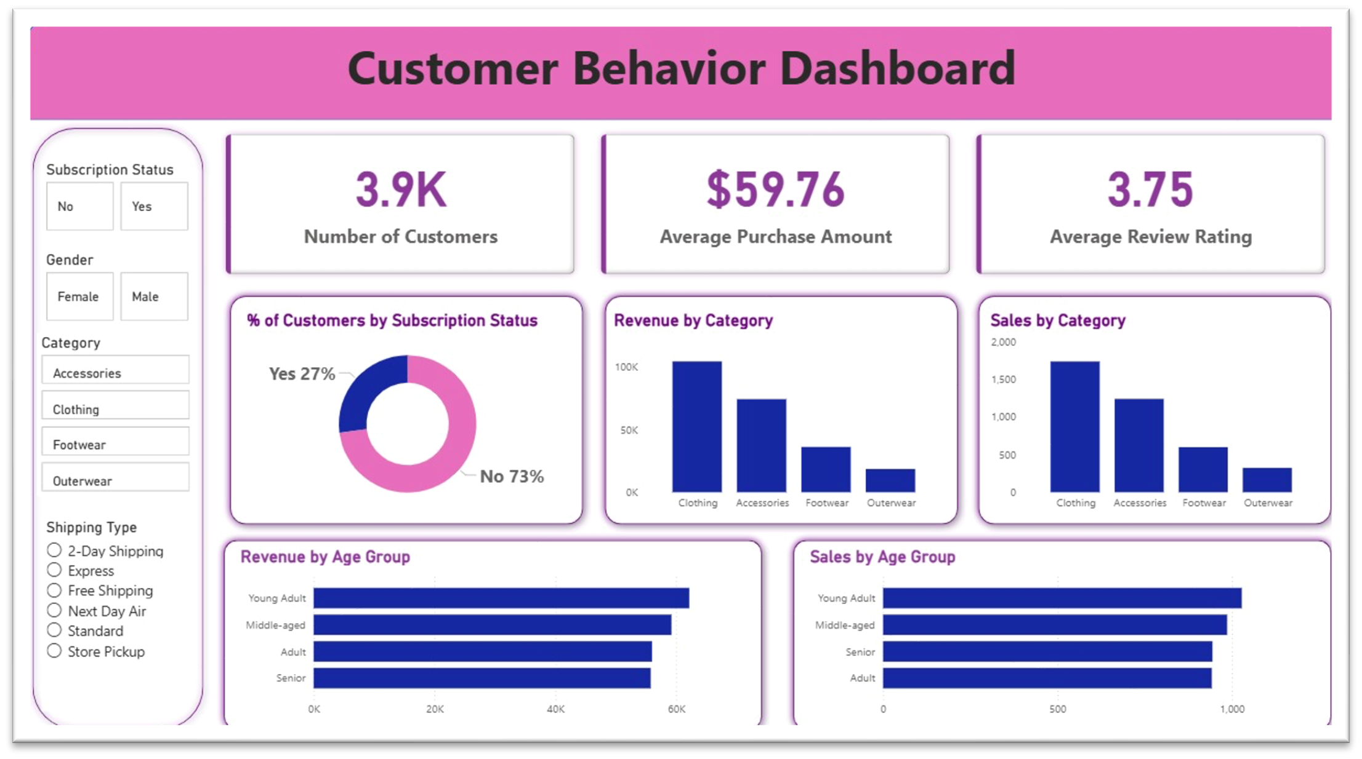
11. Power BI Dashboard

Slide 21
11. Power BI Dashboard
Key KPIs
3.9K Customers
$59.76 Average Purchase
3.75 Average Rating
Dashboard Features
Category analysis
Age-group analysis
Subscription analysis
Sales analysis
Interactive filters

Slide 22
12. Business Recommendations
01 — Strengthen Loyalty
Reward repeat customers.
02 — Improve Subscription Value
Create meaningful subscriber benefits.
03 — Optimize Discounts
Evaluate discounts alongside sales and profitability.
04 — Promote High-Rated Products
Use customer feedback in product marketing.
05 — Personalize Marketing
Use customer segments and purchasing behavior.

Slide 23
12. Conclusion
What Did We Learn?
Customer shopping data can reveal patterns in:
Spending
Loyalty
Product preferences
Discounts
Subscriptions
Customer demographics
Final Takeaway
The value of analytics is not simply finding patterns in data. It is converting those patterns into better business decisions.

